Slide 1
Microbiology First Course
Lec. 2
Microbial Interaction
Assist. Lec. Sherko M. Abdul-Rahman
MSc. in Microbiology
Email: sherko.abdulrahman@su.edu.krd

Slide 2
Microbial Interaction
Biological interactions are the effects that the organisms in a community have on one another.
There are completely different kinds of microbial interactions:
Plant-Germ interactions promoting plant growth,
Interaction with animals,
Interaction with humans, and
Interaction with water, etc.
The most common co-operative interactions seen in microbial systems are mutually beneficial.
The interactions between the two populations are classified according to whether both populations and one of them benefit from the associations, or one or both populations are negatively affected.

Slide 3
Microorganisms interacts with each other and can be physically associated with another organisms in a variety of ways. One organism can be located on the surface of another organism as an ectobiont or located within another organism as endobiont.
Microbial interaction may be:
Positive interaction: mutualism, proto-cooperation (syntrophism), commensalism,
Negative interaction: competition, parasitism, predation, and ammensalism (antagonism).

Slide 4
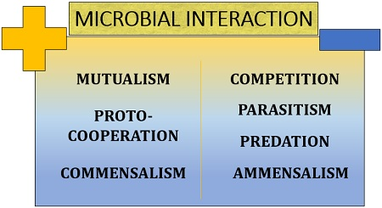
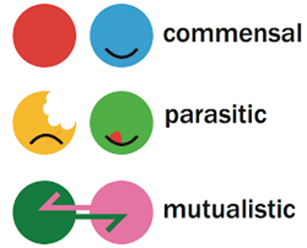

Slide 5
Types of microbial interaction:
Mutualism: positive interaction
It is defined as the relationship in which each organism in interaction gets benefits from association.
It is an obligatory relationship in which mutualist and host are metabolically dependent on each other.
Mutualistic relationship is very specific where one member of association cannot be replaced by another species.
Mutualism require close physical contact between interacting organisms.
Mutualistic relationship between organisms allows them to act as a single organism. This relationship enables each to tolerate harsh conditions where neither could survive.

Slide 6
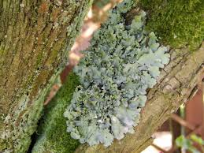
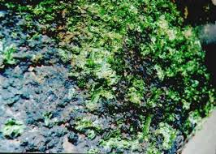
Examples of Mutualism:
Lichens are excellent example of mutualism, the association of specific (Fungi+Algae), in Lichen, fungal partner is called mycobiont and algal partner is called phycobiont is member of cyanobacteria green algae. Because phycobionts (Algae) are photoautotrophs, the fungus get its organic carbon directly from algal partner, in turn fungi protects the phycobiont from extreme conditions and also provide water and minerals to algae.

Slide 7
proto-cooperation (syntrophism): positive interaction
It is a special kind of symbiosis between two metabolically different types of microorganisms which cooperate by short-distance metabolite transfer. Thus, both organisms together can carry out a metabolic function that neither one can do alone.
Examples of syntrophism:
Lactobacillus arobinosus and Enterococcus faecalis are able to grow together but not alone. The synergistic relationship occurs in which Enterococcus faecalis require folic acid which is produced by Lactobacillus arobinosus and in turn Lactobacillus require phenylalanine which is produced by Enterococcus faecalis.

Slide 8
Commensalism: positive interaction
It is a relationship in which one organism (commensal) in the association is benefited while other organism (host) of the association is neither benefited nor harmed .
It is an unidirectional association and if the commensal is separated from the host, it can survive.
Examples of commensalism:
Association of Nitrosomonas (host) and Nitrobacter (commensal) in Nitrification: Nitrosomonas oxidize Ammonia into Nitrite and finally Nitrobacter uses nitrite to obtain energy and oxidize it into Nitrate.

Slide 9
Competition: negative interaction
The competition represents a negative relationship between two microbial population in which both the population are adversely affected with respect to their survival and growth.
Competition occurs when both population uses same resources such as same space or same nutrition.
Microbial population competes for any growth limiting resources such as carbon source, nitrogen source, phosphorus, vitamins, growth factors etc.
Competition inhibits both population from occupying exactly same ecological niche because one will win the competition and the other one is eliminated.
Examples of competition:
Competition between Paramecium cadatum and Paramecium aurelia: Both species of Paramecium feeds on same bacteria population when these protozoa are placed together.

Slide 10
Parasitism: negative interaction
It is a relationship in which one population (parasite) get benefited and derive its nutrition from other population (host) in the association which is harmed.
Some parasite lives outside host cell, known as Ectoparasite, while other parasite lives inside host cell, known as Endoparasite.
Examples of parasitism:
Viruses are obligate intracellular parasite that exhibit great host specificity. There are may viruses that are parasite to bacteria (bacteriophage), fungi, algae, protozoa etc.

Slide 11
Predation: negative interaction
It is a wide spread phenomenon when one organism (predator) engulf or attack other organism (prey).
The prey can be larger or smaller than predator and this normally results in death of prey.
Examples of predation involve carnivorous interactions, in which one animal consumes another. Think of wolves hunting moose, owls hunting mice, or shrews hunting worms and insects.

Slide 12
4. Amensalism (Antagonism): negative interaction
When one microbial population produces substances that is inhibitory to other microbial population. The first population which produces inhibitory substances are unaffected or may gain a competition and survive in the habitat, while other population get inhibited. This chemical inhibition is known as Antibiosis.
Examples of antagonism (Amensalism):
Lactic acid produced by many normal floras (lactic acid bacteria) in vaginal tract is inhibitory to many pathogenic organisms such as Candida albicans.
Fatty acid produced by skin flora inhibits many pathogenic bacteria in skin.

