Slide 1
Microbiology First Course
Lec. 3
Disease Transmission
Assist. Lec. Sherko M. Abdul-Rahman
MSc. in Microbiology
Email: sherko.abdulrahman@su.edu.krd

Slide 2
Why is it important to know how disease transmission?
Some germs ( microbes) are helpful and even help us to stay healthy, while others are harmful and cause infection. By understanding about how people can catch an infectious disease, you can then take effective action to prevent their spread.
Infectious diseases commonly spread through the direct transfer of bacteria, viruses or other germs from one person to another.
Each disease has transmission characteristics based on the nature of the microorganism that causes it, such as anthrax can be transmitted in more than one way.

Slide 3
Methods of Disease Transmission:
1. Transmission by direct contact
Direct contact transmission requires physical contact between an infected person and a susceptible person, and then physical transfer of microorganisms.
Examples:
Touching an infected individual,
Kissing,
Sexual contact,
Contact with oral secretions,
Contact with body lesions.
This type of transmission requires close contact with an infected individual, and will usually occur between members of the same household or close friends and family.

Slide 4
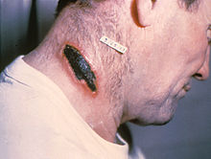
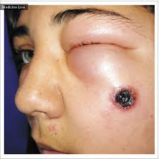
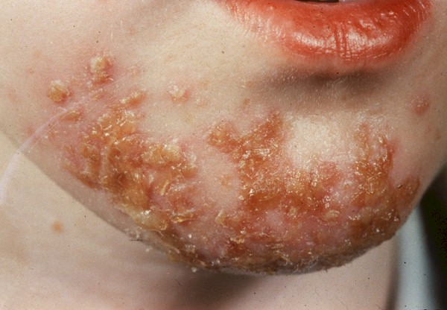
Anthrax can be spread through direct contact to a cut on the skin, producing cutaneous anthrax. It can also be spread through airborne spores which are inhaled, producing a more serious type of infection. Gastrointestinal anthrax can occur when anthrax spores are ingested.

Slide 5
2. Transmission by indirect contact
Indirect contact transmission refers to situations where a susceptible person is infected from contact with a contaminated surface.
To reduce transmission by indirect contact, frequent touch surfaces should be properly disinfected. Frequent touch surfaces (fomites) includes:
Door knobs, door handles, handrails, Tables, beds, chairs, Washroom surfaces cups, dishes, cutlery, trays, medical instruments, computer keyboards, mice, electronic devices with buttons, pens, pencils, phones, office supplies, children's toys, lift and lavatory.
Some diseases may be mainly spread via fomite transmission.
Examples:
Cold sores
Pink eye (conjunctivitis)

Slide 6
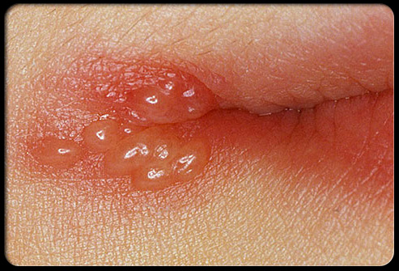
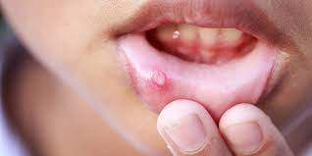
Cold sores: an inflamed blister in or near the mouth, caused by infection with the herpes simplex virus.

Slide 7
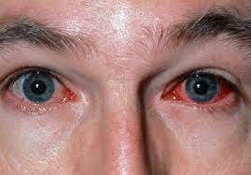
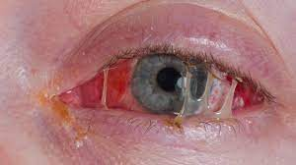
Pink eye (conjunctivitis): Is the inflammation or infection of the transparent membrane that lines your eyelid and eyeball. It's characterized by redness and a gritty sensation in your eye, along with itching. Often a discharge forms a crust on your eyelashes during the night.

Slide 8
3. Transmission by droplet contact
Some diseases can be transferred by infected droplets contacting surfaces of the eye, nose, or mouth. This is referred to as droplet contact transmission.
Droplets containing microorganisms can be generated when an infected person coughs, sneezes, or talks.
Droplets can also be generated during certain medical procedures, such as bronchoscopy. Droplets are too large to be airborne for long periods of time, and quickly settle out of air.
Droplet transmission can be reduced with the use of personal protective barriers, such as face masks and goggles.
Examples:
Measles
Severe Acute Respiratory Syndrome (SARS) associated coronavirus.

Slide 10
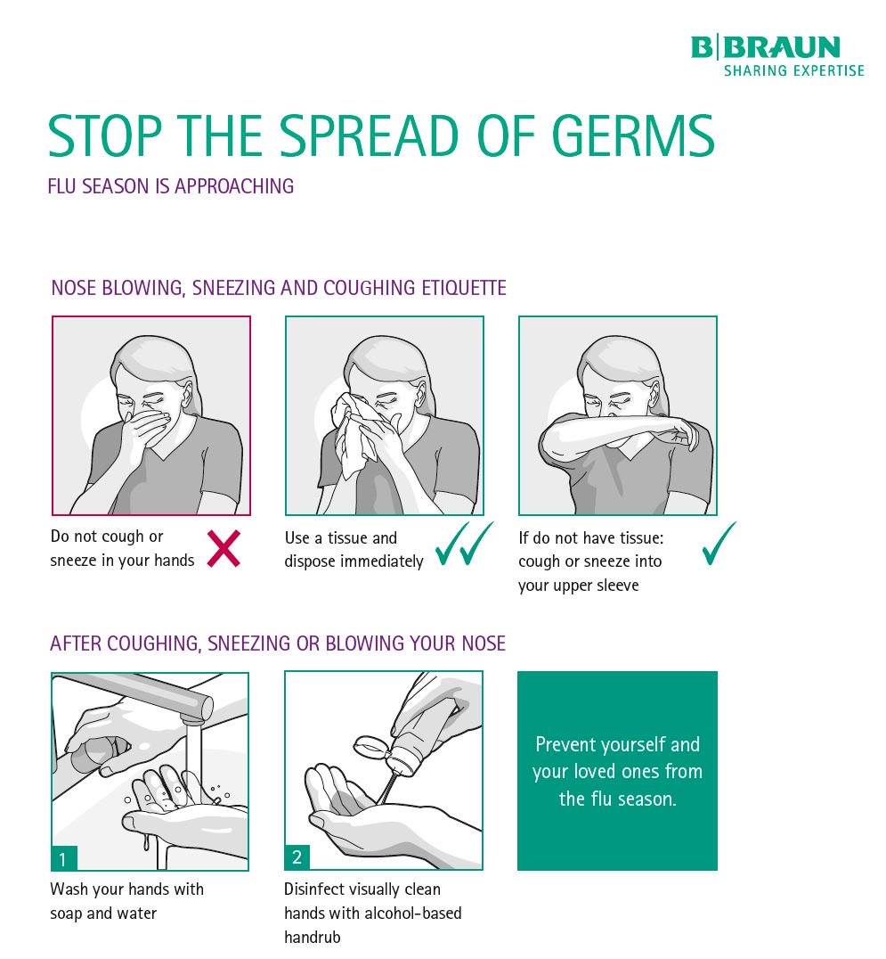

Slide 11
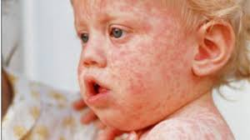
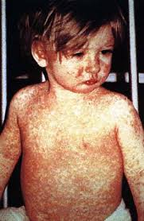
Measles: Is a highly contagious infectious disease caused by measles virus. Symptoms usually develop 10–12 days after exposure to an infected person and last 7–10 days. Initial symptoms typically include fever, often greater than 40°C, cough, runny nose, and inflamed eyes.

Slide 12
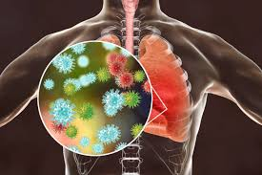
Severe Acute Respiratory Syndrome (SARS): Is a viral respiratory disease caused by a SARS, associated coronavirus. It was first identified at the end of February 2003 during an outbreak that emerged in China and spread to four other countries.

Slide 13
4. Transmission by airborne
Airborne transmission refers to situations where droplet nuclei (residue from evaporated droplets) or dust particles containing microorganisms can remain suspended in air for long periods of time. These organisms must be capable of surviving for long periods of time outside the body and must be resistant to drying.
Airborne transmission allows organisms to enter the upper and lower respiratory tracts. Fortunately, only a limited number of diseases are capable of airborne transmission.
Airborne diseases can be spread via respiratory droplets expelled from the mouth and nose.
Examples:
Chickenpox,
Common cold,
COVID-19,
Tuberculosis (TB).

Slide 14
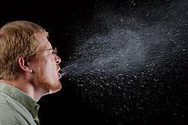

Slide 15
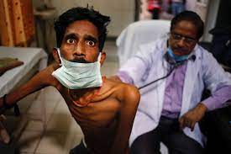
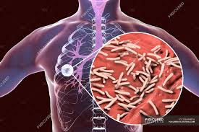
Tuberculosis (TB): Is a bacterial infection spread through inhaling tiny droplets from the coughs or sneezes of an infected person. It mainly affects the lungs, but it can affect any part of the body, including the tummy (abdomen), glands, bones and nervous system.

Slide 16
5. Transmission by fecal-oral
Fecal-oral transmission is usually associated with organisms that infect the digestive system. Microorganisms enter the body through ingestion of contaminated food and water. Inside the digestive system (usually within the intestines) these microorganisms multiply and are shed from the body in feces.
Fish and shellfish that swim in contaminated water may be used as food sources.
The germs that cause illness are found in the stool (feces) of an infected person, and are spread to another person.

Slide 17
Fecal-oral transmission can be reduced by:
Proper storage of food at proper temperatures.
Thorough cooking of food.
Frequent and thorough handwashing, especially after washroom use.
Adequate sewage treatment and water filtration/chlorination systems.
Disinfection of frequent touch surfaces to prevent indirect contact transmission
Increased public awareness of proper hygiene and food handling.

Slide 18
6. Transmission by vector-borne
Vectors are animals that are capable of transmitting diseases.
Examples of vectors are flies, mites, fleas, ticks, rats, and dogs. The most common vector for disease is the mosquito.
Mosquitoes transfer disease through the saliva which comes in contact with their hosts when they are withdrawing blood.
Examples:
Zoonotic Disease: a disease that can be transmitted from animals to people or, more specifically, a disease that normally exists in animals but that can infect humans, such as: Dengue fever, West Nile Virus, Lyme disease, malaria and yellow fever.

Slide 19
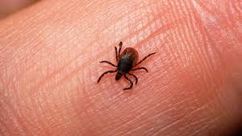
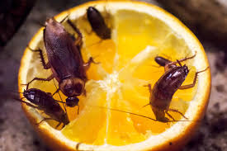

Slide 20
