Slide 1
Microbiology First Course
Lec. 5
Bacterial Cell Wall
Assist. Lec. Sherko M. Abdul-Rahman
MSc. in Microbiology
Email: sherko.abdulrahman@su.edu.krd

Slide 2
Bacterial Cell Wall
The cell wall is the layer that lies just outside the plasma membrane. It is strong and relatively rigid, with some elasticity, and openly porous, being freely permeable to solute molecules smaller than 1 nm in diameter.
Functions of the cell wall
1. To impart shape and rigidity to the cell.
2. It supports the weak cytoplasmic membrane against the high internal osmotic pressure of the protoplasm .
3. Maintains the characteristic shape of the bacterium.
4. It takes part in cell division.
5. To interactions (e.g. adhesion) with other bacteria and with mammalian cells.
6. Provide specific protein and carbohydrate receptors for the attachment of some bacterial viruses.

Slide 3
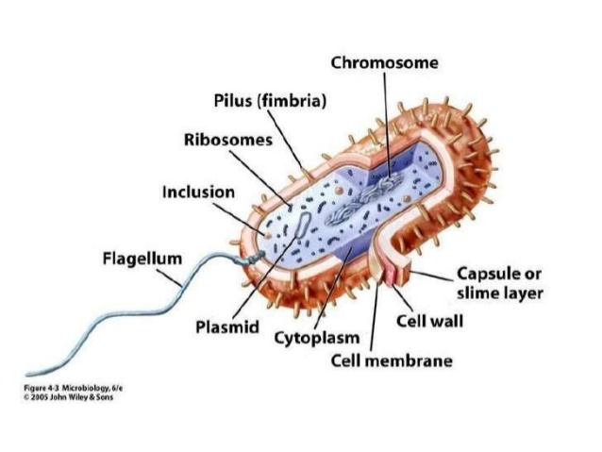
Structure of the bacterial cell

Slide 4
Chemical Structure of Bacterial Cell Wall
The cell wall consists mainly of peptidoglycan (PG), a mesh of polysaccharide strands (composed of a poly-[N-acetylglucosamine (NAG)-N-acetylmuramic acid (NAM)] backbone) cross-linked via short peptide bridges attached to the NAM residues.
In all bacterial species, the backbone is the same, however, tetrapeptide side chains and pentapeptide cross-bridges vary from species to species.

Slide 5
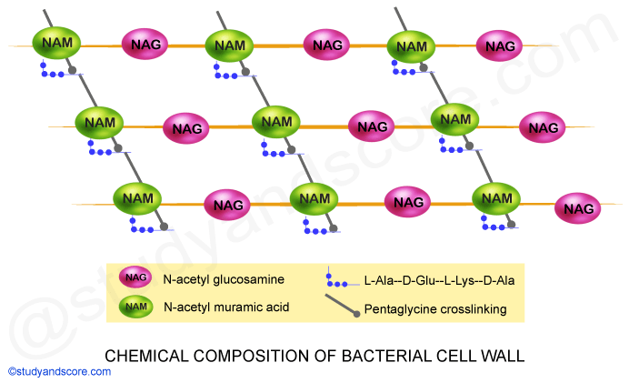

Slide 6
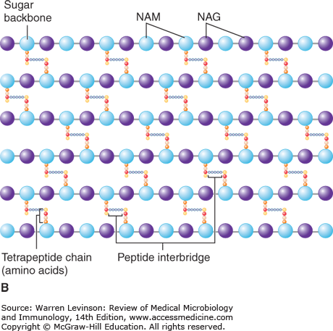

Slide 7
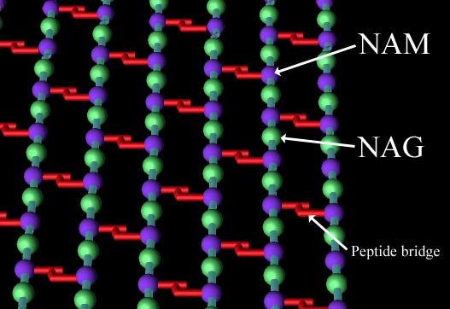
N-acetyl muramic acid (NAM) alternating with N-acetyl glucosamine (NAG), which are cross-linked by amino acids.

Slide 8
Gram-positive bacterial cell wall:
The cell wall of Gram-positive bacteria, consists mainly of:
Peptidoglycan, is about 80nm thick and is composed mostly of several layers of peptidoglycan which constitutes 60-80% of the dry weight of the wall and are thicker and stronger (more extensively cross-linked).
In addition, the cell walls of Gram-positive bacteria contain teichoic acids, which consist primarily of an alcohol (such as glycerol or ribitol) and phosphate. There are two types of teichoic acids:
Wall teichoic acid, covalently linked to peptidoglycan, and
Membrane teichoic acid (lipoteichoic acid), covalently linked to membrane glycolipid and concentrated in mesosomes.
Some Gram-positive species lack wall teichoic acids, but all appear to contain membrane teichoic acids.

Slide 9
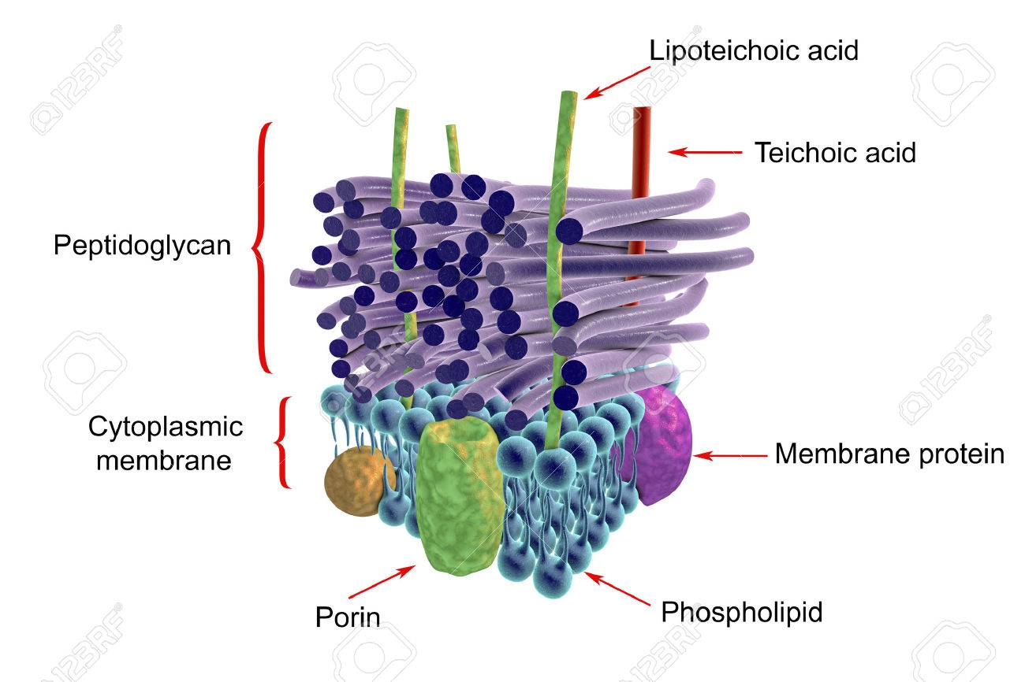
Cell wall of Gram-positive bacteria

Slide 10
Gram-negative bacterial cell wall:
Is structurally quite different from that of gram-positive cells. It consists of:
Peptidoglycan layer, is a single-unit thick and constitutes 10-20% of the dry weight of the wall of Gram-negative bacteria. It is bonded to lipoproteins covalently in the outer membrane and plasma membrane and is in the periplasmic, a gel like fluid between the outer membrane and plasma membrane. The periplasmic contains a high concentration of degrative enzymes and transport proteins.
Lipoprotein (murein lipoproteins), seemingly attach to the peptidoglycan by their protein portion, and to the outer membrane by their lipid component. Function: To stabilize the outer membrane and anchor it to the peptidoglycan layer.

Slide 11
iii. Outer membrane
External to the peptidoglycan, and attached to it by lipoproteins is the outer membrane. It is a bilayer structure. Its inner leaflet is composed of phospholipid while phospholipids of the outer leaflet are replaced by lipopolysaccharide (LPS) molecules. Functions:
A protective barrier: A most important function is to serve as a protective barrier. It prevents or slows the entry of the salts, antibiotics and other toxic substances that might kill or injure the bacterium.
Porins or transmembrane proteins: In addition to LPS, the outer membrane also contains several important proteins that function in the selective transport of the nutrients into the cell. Porins or transmembrane proteins, traverse the outer membrane and form trimeric channels that permit the passage of molecules such as nucleotides, disaccharides, peptides, amino acids, vitamin B12, and iron.

Slide 12
iv. Lipopolysaccharide (LPS)
A structural component that is unique to the gram-negative outer membrane is lipopolysaccharide(LPS). It is a large complex molecule that contains lipids and carbohydrates and consists of three components:
Lipid A: Is the lipid portion of LPS and is embedded in the top layer of the outer membrane. When gram negative bacteria die, they release Lipid A, which functions as an endotoxin. All the toxicity of the endotoxin is due to lipid A which is responsible for the endotoxic activities.
Core polysaccharide: Is attached to lipid A and a terminal series of repeat unit contains unusual sugars. Its role is to provide stability.
O polysaccharide: Extends outward from the core polysaccharide and is composed of sugar molecules.

Slide 13
O polysaccharides function as antigens and are useful for distinguishing species of gram negative bacteria. The role is comparable to that of teichoic acids in gram-positive cells. Polysaccharide represents a major surface antigen of the bacterial cell. It is known as O antigen. Bacteria carrying LPS containing O antigen form smooth colonies in bacteriological media in contrast to those lacking the O antigen, which form rough colonies.

Slide 14
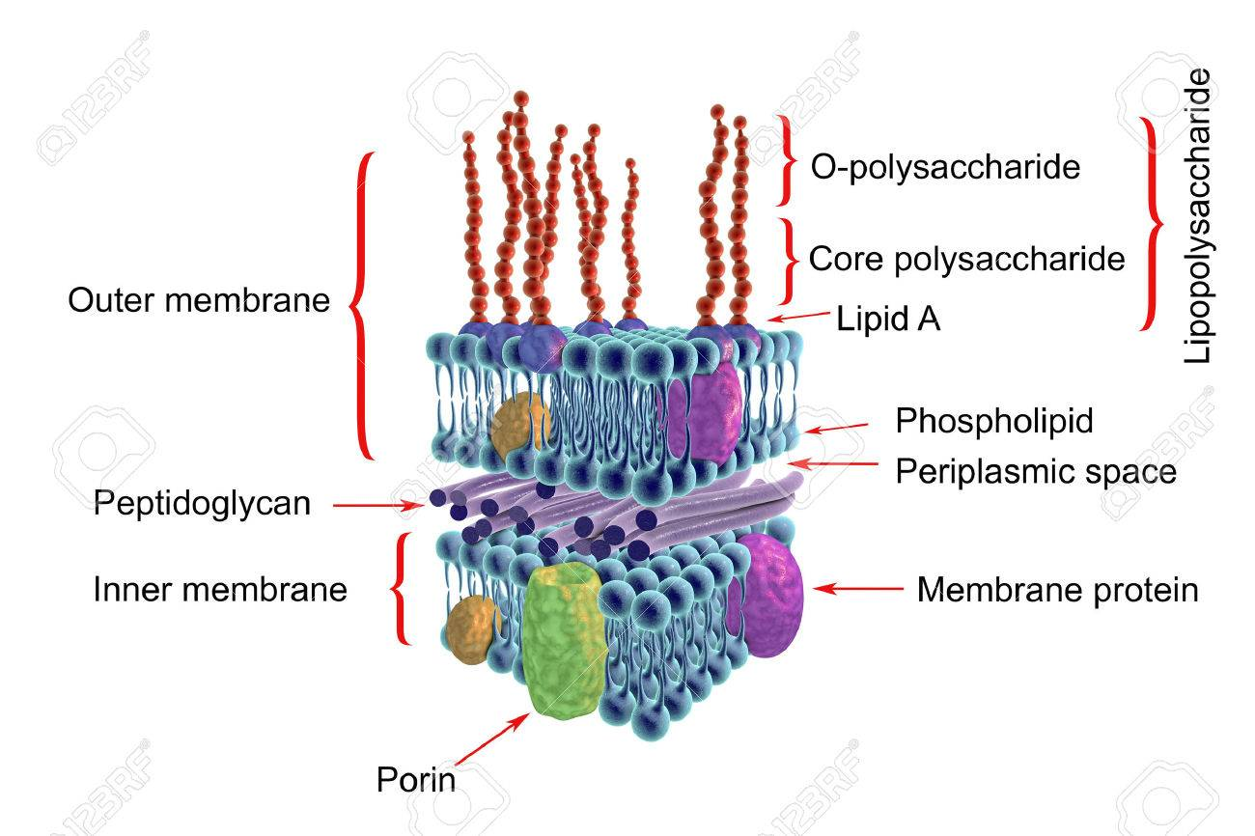
Cell wall of Gram-negative bacteria

Slide 15
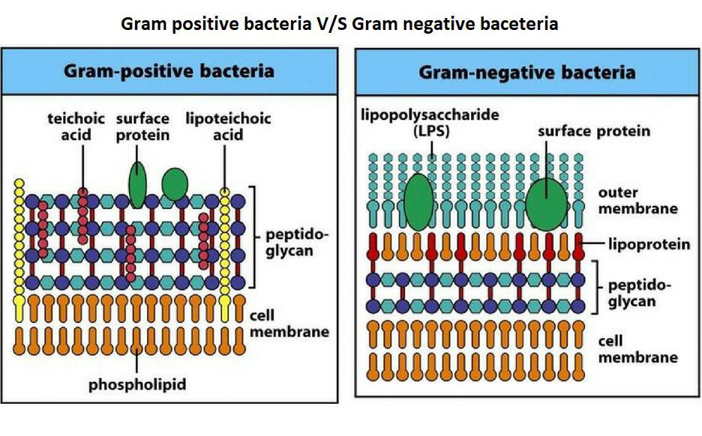

Slide 16
