Slide 1
Microbiology First Course
Lec. 6
Bacterial Growth
Assist. Lec.
Sherko Muhammed Abdul-Rahman
MSc. in Microbiology
Email: sherko.abdulrahman@su.edu.krd

Slide 2
To understanding competition for nutritional resources within a given microenvironment is essential to understanding the growth, survival, and death of bacterial species (also known as Bacterial physiology).
Much of our understanding of microbial physiology has come from the study of isolated cultures grown under optimal conditions in laboratories (nutrient excess).
However, most microorganisms compete in the natural environment under nutritional stress.
Furthermore, a vacant environmental microbial niche will soon be filled with a different microbiota composition.
In the end, appreciating the complex interactions that ensure the survival of a specific microbiome is a balance between availability of nutrients and physiologic efficiency.

Slide 3
What is the Growth?
Orderly increase of all of the chemical constituents of the cell. Bacterial growth involves both an increase in the size of individuals and increase in the number of individuals.
A. Bacterial Division
The cell division occurs by a constrictive or pinching process, or by the ingrowth of a transverse septum across the cell. Bacteria divide by binary fission, where individual cells enlarge and divide to yield two progeny of approximately equal size. Nuclear division precedes cell division and, therefore, in a growing population, many cells carrying two nuclear bodies can be seen. The daughter cells may remain partially attached after division in some species.

Slide 4
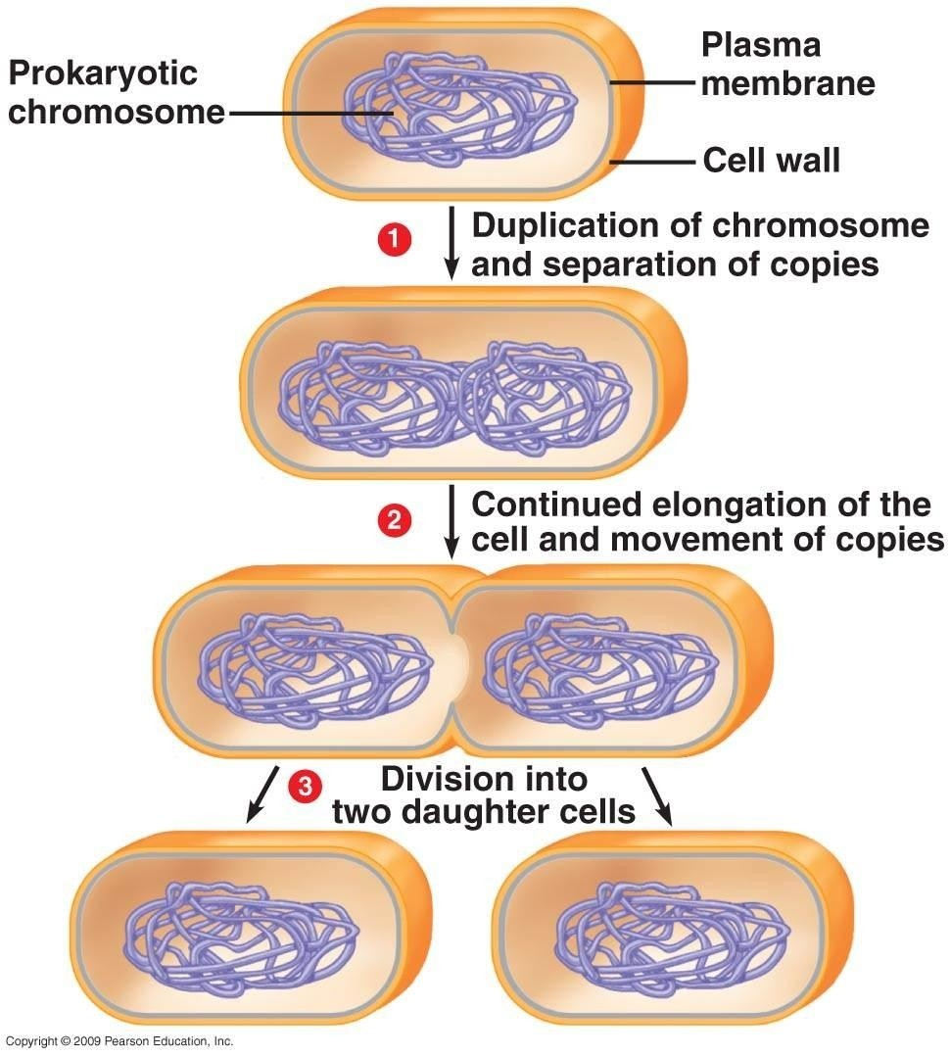
Bacterial Division

Slide 5
Bacterial Count:
Growth of bacteria is diffuse in liquid media and they form colonies on solid media. Each colony consists of a clone of cells derived from a single parent cell. Bacteria in a culture medium or clinical specimen can be counted by two methods:
Total count
A quantitative estimate of the number of microorganisms present in a sample, irrespective of whether they are living or dead. It is done by counting the bacteria under microscope using counting chamber.
2. Viable count
Measures only the number of living cells, which are capable of growing and producing a colony on a suitable medium, these cells capable of multiplication.

Slide 6
B. Bacterial Growth Curve
If a suitable liquid medium is inoculated with bacterium and incubated, its growth follows a definitive course.
The bacterial growth curve can be divided into four major phases:
Lag phase
Exponential or Log (Logarithmic) phase
Stationary phase, and
Decline or death phase.
These phases reflect the physiologic state of the organisms in the culture at that particular time.

Slide 7
Lag phase:
When microorganisms are introduced into fresh culture medium, usually no immediate increase in cell number occurs, and therefore this period is called the lag phase. After inoculation, there is an increase in cell size at a time, when little or no cell division is occurring. During this time, however, the cells are not dormant. This initial period is the time required for adaptation to the new environment, during which the necessary enzymes and metabolic intermediates are built up in adequate quantities for multiplication to proceed.
The lag phase varies considerably in:
Length with the species,
Nature of the medium,
Size of inoculum
Environmental factors such as temperature and nutrients present in the new medium.

Slide 8
2. Log (logarithmic) or exponential phase
Following the lag phase, the cells start dividing and their numbers increase exponentially or by geometric progression with time.
If the logarithm of the viable count is plotted against time, a straight line will be obtained.
The log phase is the time when cells are most active metabolically and is preferred for industrial purposes. However, during their log phase of growth, microorganisms are particularly sensitive to adverse conditions.
Exponential phase is of limited duration because of:
Exhaustion of nutrients; Accumulation of toxic metabolic end pro ducts;
Rise in cell density, Change in pH; and Decrease in oxygen tension (in case of aerobic organisms).

Slide 9
3. Stationary phase
After a varying period of exponential growth, cell division stops due to depletion of nutrients and accumulation of toxic products.
Eventually growth slows down, and the total bacterial cell number reaches a maximum and stabilizes.
The number of progeny cells formed is just enough to replace the number of cells that die. The growth curve becomes horizontal.
The viable count remains stationary as an equilibrium exists between the dying cells and the newly formed cells.

Slide 10
4. Decline or death phase
The death phase is the period when the population decreases due to cell death.
Eventually the rate of death exceeds the rate of reproduction, and the number of viable cells declines. Like bacterial growth, death is exponential cell death may also be caused by autolysis besides nutrient deprivation and buildup of toxic wastes.
Finally, after a variable period, all the cells die and culture becomes sterile.
2022-12-10
10

Slide 11

Generation Time(G) is the time it takes for a population of bacteria to double in number, for many common bacteria, the generation time is quite short, 20-60 minutes under optimum conditions. G is defined as the time (t) per generation (n=number of generations). Hence, G=t/n is the equation from which calculations of generation time (below) derive.
Example: What is the generation time of a bacterial population that increase 1000 to 1000000000cells /ml in two hours of growth.
Hence:
A (primary number of bacteria):${10}^{3}$ cell/ml or gm
T (time): 2hrs.
B (Secondary number of bacteria):${10}^{9}$cell/ml or gm
B= A+2n
log B= logA+nlog2
nlog2 = LogB$\text{−}$LogA
n= $\frac{\text{logB}\text{−}\text{logA}}{l\text{og}\text{2}}$
n= $\frac{{10}^{9}\text{−}{10}^{3}}{0.3}$ = $\frac{\text{9}\text{−}\text{3}}{0.3}$ = 20
G $\frac{\text{t}}{n}$= $\frac{\text{120}}{20}$ = 6 minutes

Slide 13
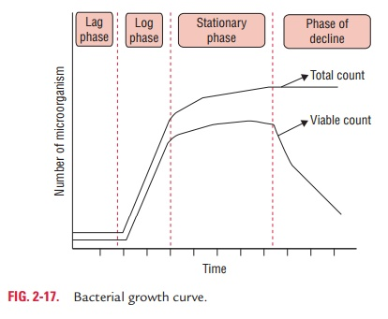
Phases of Bacterial Growth Curve

Slide 14
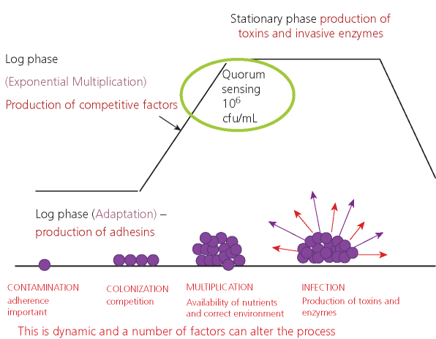

Slide 15
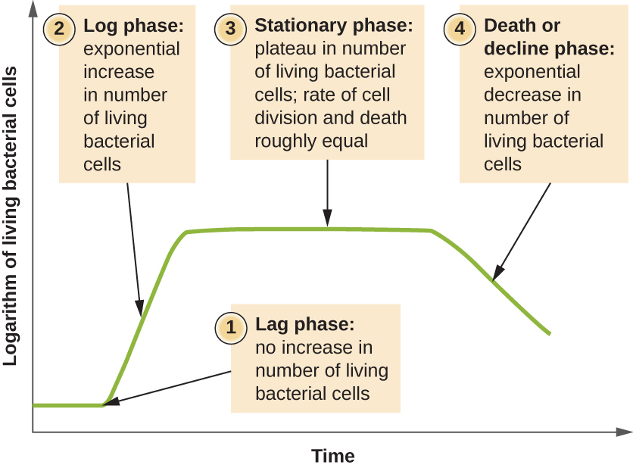
Microbial Growth Curve (Bacteria)

