Slide 1
Microbiology First Course
Lec.8
Microbial Virulence Factors
Assist. Lec.
Sherko Muhammed Abdul-Rahman
MSc. in Microbiology
Email: sherko.abdulrahman@su.edu.krd

Slide 2
Microbial Virulence Factors
Pathogenicity: The ability of a microbe to produce disease or tissue injury, an organism’s pathogenicity depends on its ability to
Invade a host, and
Multiply in the hosts
Microbial Virulence Factors: Organisms that infect these regions have ability to overcome the constant pressure of the host defenses at the surface. Or structural or physiological characteristics that help the microorganisms to cause infection and disease.

Slide 3
Sites of microbe entry in human hosts include:
Urogenital tract,
Digestive tract,
Respiratory tract and the conjunctiva, and
Cut skin
For example, Mycobacterium tuberculosis frequently causes disease upon entering the host whereas Staphylococcus epidermidis cause disease, rarely, when it enters into a host with poor defense.

Slide 4
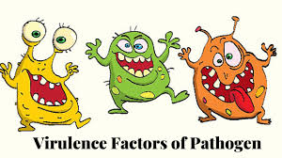
Bacterial virulence factors are as follows:
Adhesion
Invasiveness
Toxigenicity
Enzymes and other bacterial products
Inhibition of phagocytosis

Slide 5
Adhesion
Adhesions: Are cell-surface components or appendages of bacteria that facilitate adhesion or adherence to other cells or to surfaces, usually in the host they are infecting or living in.
Adherence: Is an essential step in bacterial pathogenesis or infection, required for colonizing a new host.
Once the bacteria enter the body of the host, the critical point in the production of bacteria disease is the organism’s adherence, or attachment. If the organism did not adhere, they would be swept away by the mucus and other fluids that bathe the tissue surface.

Slide 6
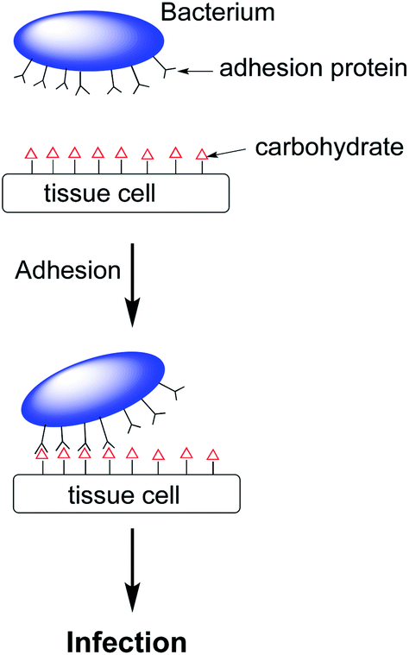
Adherence of bacteria to host cells or tissues

Slide 7
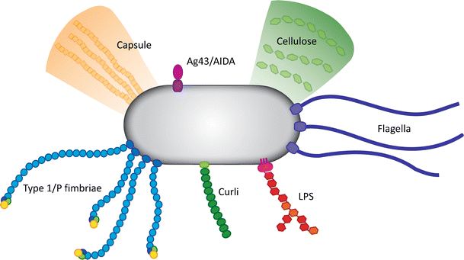
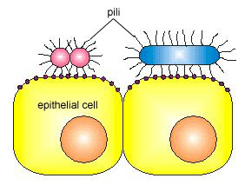
Bacterial adhesin

Slide 8
Adherence of bacteria to host cells or tissues depend on:
A. Tissue tropism: Is the cells and tissues of a host that support growth of a virus or bacterium. e.g. Streptococcus mutans is abundant in dental plaque but does not occur on epithelial surfaces of the tongue; Streptococcus salivarius which is attached in high numbers to epithelial cells of the tongue but is absent in dental plaque.
B. Species specificity: Certain pathogenic bacteria infect only certain species of animals, e.g. Neisseria gonorrhoeae infections are limited to humans not infected animals; Escherichia coli K-88 infections are limited to pigs; Escherichia coli CFAI and CFAII infect humans.
C. Genetic specificity: Certain strains or a species may be genetically immune to a pathogen, e.g. males are not susceptible to mastitis; females are not susceptible to orchitis.

Slide 9
2. Invasiveness: Is the ability of a pathogen to invade tissues. Invasiveness encompasses:
Ability to bypass or overcome host defense mechanisms which facilitate the actual invasive process.
Mechanisms for colonization (adherence to suitable cell and tissue and initial multiplication).
Production of extracellular substances (invasins), that promote the immediate invasion of tissues.

Slide 10
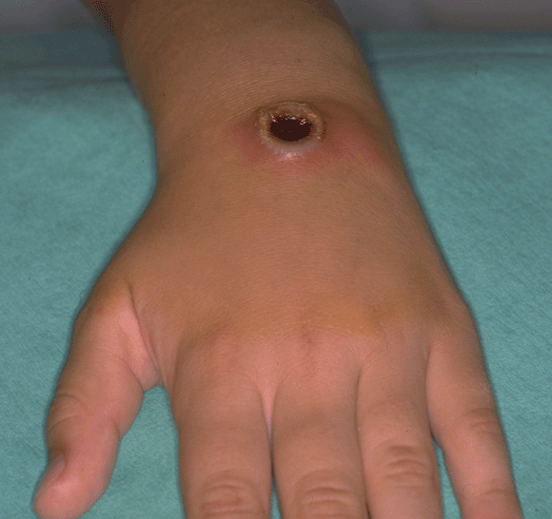
3. Toxigenicity
Toxins produce by bacteria are (Exotoxins and, Endotoxins which are lipopolysaccharide ).Toxins may be transported by blood and lymph and cause cytotoxic effects at tissue sites remote from the original point of invasion or growth.

Slide 11
4. Enzymes and other bacterial products: Staphylococci produced hemolysins, leukocidins, and Streptococci produced streptolysin, that destroy red blood cells and other cells (phagocytes) by lysis.
5. Inhibition of phagocytosis: There are several bacterial factors that have the potential to inhibit known mechanisms of phagocytosis:
A. Inhibition of chemotaxis.
Chemotaxis is the chemical process by which the phagocytes are led to the site of infection, so that they can begin their task. Some bacteria, such as Staphylococcus aureus, produce toxins which inhibit the movement of phagocytes.
B. Inhibition of attachment of phagocyte
To swallow and consume the bacteria, phagocytes must first grip onto the invader, and engulf them. Some bacteria evade phagocytosis by not presenting anything for the phagocytes to grip onto.

Slide 12
C. Phagosome lysosome fusion inhibition
The phagosome vacuole formed during phagocytosis requires a process of maturation that involves fusion with lysosomes, a decrease in luminal pH and the activation of the enzymes that eventually will destroy phagocytized micro-organisms. Some bacteria resist phagocytic destruction by escaping from the phagosome before the lysosome fuses. Some bacteria resist phagocytic destruction by preventing acidification of the phagosome. Tuberculosis is an infectious disease caused by Mycobacterium tuberculosis.

Slide 13
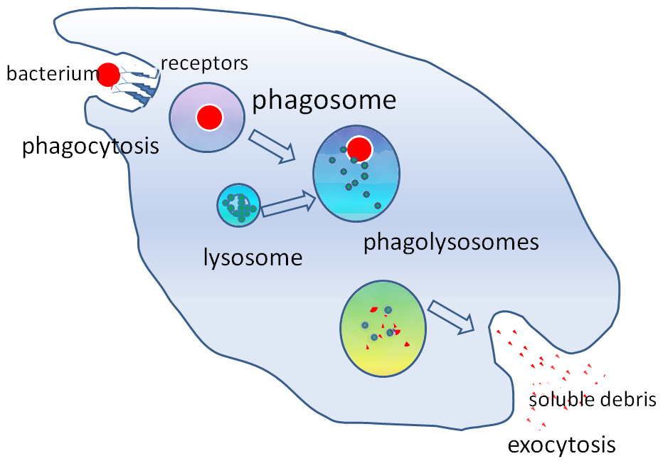
Phagocytosis

Slide 14
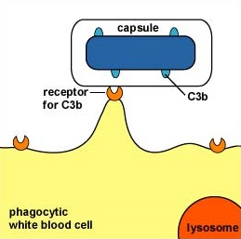
Inhibition of phagocytosis by capsule

Slide 16
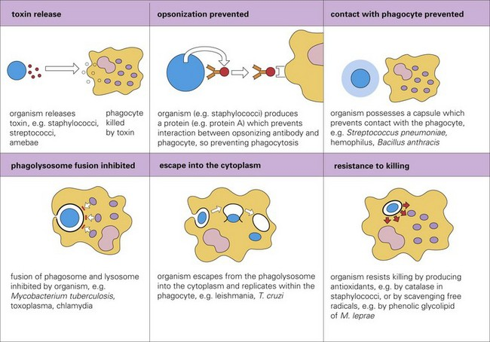
Many mechanism of inhibition phagocytosis

