Slide 1
Virology
Lec. 1
Introduction to Virology
Assist. Lec. Sherko M. Abdul-Rahman
MSc. in Microbiology
Email: sherko.abdulrahman@su.edu.krd

Slide 2
Virology: Is the science which deals with study of viruses as causative agents of very important diseases that occurs in human, animals, plants and other living organisms (insects, bacteria,…). Virology is often considered a part of microbiology or pathology.
Viruses: The smallest and simplest form of life on earth, which can replicate only in living susceptible cells.
Characteristics of Microbes:
Procaryotes: Microscopic, unicellular organisms. Lack nuclei and membrane-bound organelles
Eucaryotes: Unicellular and multicellular organisms. Have nuclei and membrane-bound organelles
Viruses: Acellular, parasitic particles composed of a nucleic acid and protein.
Microbial Dimensions
Procaryotes are measured in micrometers.
Viruses in nanometers
Helminths are measured in millimeters.

Slide 3
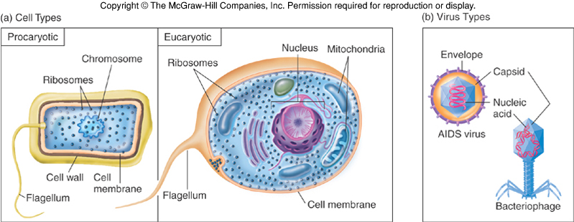

Slide 4
Definitions
Virion: The complete infective virus particle, which in some instances (adenoviruses, papovaviruses, picornaviruses) may be identical with the nucleocapsid. In more complex virions (herpesviruses, myxoviruses), this includes the nucleocapsid plus envelope.
Detective virus: A virus particle that is functionally deficient in some aspect of replication. Defective virus may interfere with the replication of normal virus.
Pseudovirus: During viral replication the capsid sometimes encloses host nucleic acid rather than viral nucleic acid. Such particles look like ordinary virus, particles when observed by electron microscopy, but they do not replicate. Pseudovirions contain the “wrong” nucleic acid.
Viroids: Single strand RNA genome and the smallest known pathogens affects plants much smaller than viruses ,no protein coat.
Prions: Infectious particles that are entirely protein no nucleic acid highly heat resistant in animal affects nervous tissue and results in Bovine spongiform encephalitis (BSE) “mad cow disease”, Scrapie in sheep and kuru & Creutzfeldt-Jakob Disease (CJD) in humans.

Slide 5
Viruses are infectious agents with both living and nonliving characteristics. They can infect animals, plants, and even other microorganisms. Viruses that infect only bacteria are called bacteriophages and those that infect only fungi are termed mycophages .
General characters of viruses:
1. Virus particles are very small in size; they are between 20-500 nm in diameter.
2. Viruses are obligate intracellular parasites. They replicate only inside living cells.
3. Multiply inside the cells by replicating their genomes which either DNA or RNA, but never both.
4- Viruses lack cellular organelles, such as mitochondria and ribosomes but they depend on infected cells to provide all their needed organelles.
5. Virus does not affect with antibiotics.
6. Most viruses sensitive to interferon.
7. Viruses cannot grow on artificial media, but only in living cells (specific host, Lab animals, chicken embryonated eggs & tissue culture).
8. Viruses cannot be seen by ordinary microscope, but only by Electron microscope (EM).

Slide 6
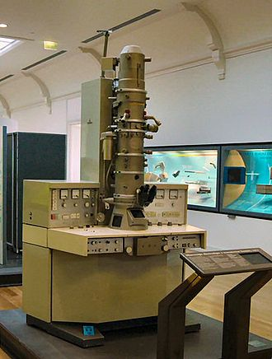
Size of Virus:
Smallest infectious agents, most are so small, they can only be seen with an electron microscope:
A small virus (Proviruses)- around 20 nm in diameter
A large virus (Mimi viruses)- up to 450 nm in diameter

Slide 7
