Slide 1
Virology
Lec. 2
Structure of Viruses
Assist. Lec. Sherko M. Abdul-Rahman
MSc. in Microbiology
Email: sherko.abdulrahman@su.edu.krd

Slide 2
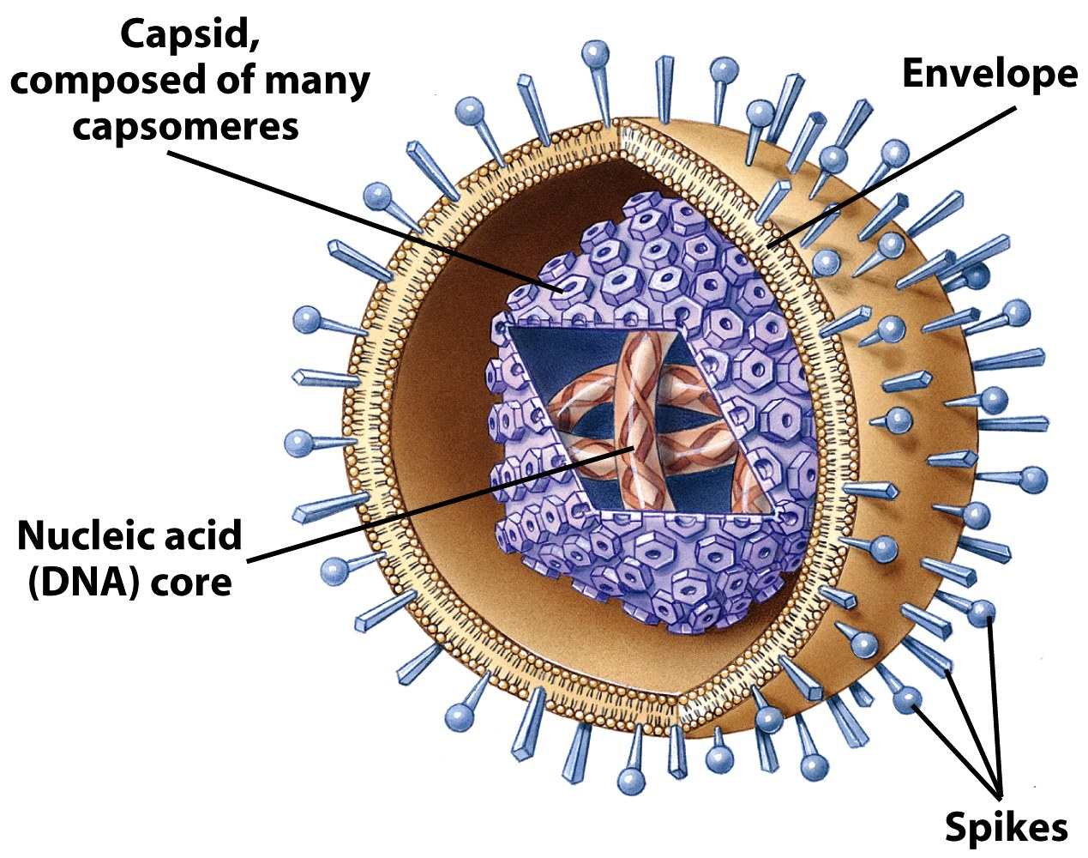
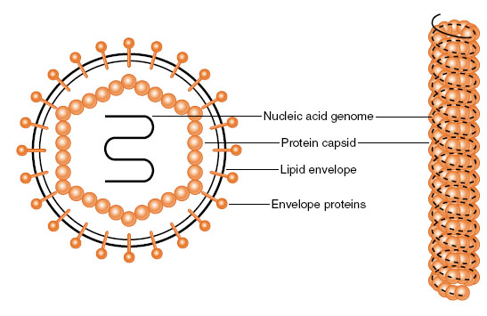
Generalized Structure of Viruses:
Viral components:
Nucleic acids
Capsid
Envelope
Glycoprotein

Slide 3
Basic virus structure
DNA
Capsid protein
Naked capsid virus
or
+
Nucleocapsid
=
RNA
Lipid membrane, glycoproteins
Nucleocapsid
+
Enveloped virus

Slide 4
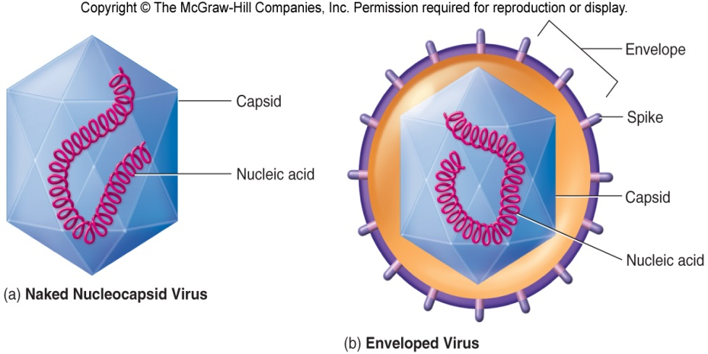
(a)virions lacking envelopes=Naked viruses (b)virions having envelopes=Enveloped viruses

Slide 5
Principles of virus structure:
Viruses come in many shapes and sizes, structural information is necessary for virus classification and for establishing structure-function relationships of viral proteins.
Types of symmetry of virus particles:
Electron microscopy, cryo-electron microscopy, and x-ray diffraction techniques have made it possible to resolve fine differences in the basic morphology of viruses. Viral architecture can be grouped into three types based on the arrangement of capsomeres and the morphology of the nucleocapsid subunits:
Helical symmetry, e.g. Orthomyxoviruses
Cubic symmetry (Icosahedral), e.g. Adenoviruses
Complex structures, e.g. Poxviruses and Bacteriophage.

Slide 6
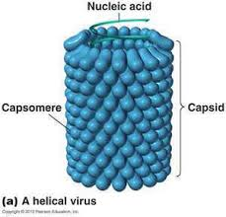
Helical symmetry
The helically symmetric nucleocapsid consists of a nucleoprotein and a multipartite genome of single-stranded antisense RNA in seven or eight segments.
The envelope carries a hemagglutinin attachment protein and a neuraminidase.
Influenza viruses are spherical or filamentous enveloped particles 80-120 nm in diameter.

Slide 7
2. Cubic symmetry (Icosahedral):
All cubic symmetry observed within animal viruses is of the icosahedral pattern.
The icosahedron has 20 faces (each an equilateral triangle), 12 vertices, and fivefold, threefold, and twofold axes of rotational symmetry.
The vertex units have five neighbors (pentavalent), and all others have six (hexavalent).

Slide 8
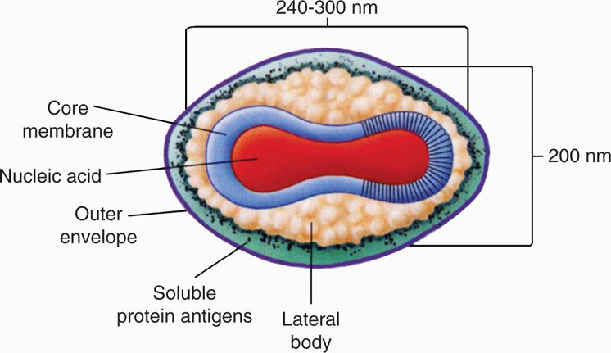
3. Complex Structures:
Some virus particles do not exhibit helical or cubic symmetry but are more complicated in structure.
For example, poxviruses are brick-shaped, with ridges on the external surface and a core and lateral bodies inside.

Slide 9
Chemical composition of viruses
Viral Protein
The structural proteins of viruses have several important functions:
Their major purpose is to facilitate transfer of the viral nucleic acid from one host cell to another.
They serve to protect the viral genome against inactivation by nucleases.
Participate in the attachment of the virus particle to a susceptible cell.
Provide the structural symmetry of the virus particle.
The proteins determine the antigenic characteristics of the virus.
Some surface proteins may also exhibit specific activities, e.g. Influenza virus hemagglutinin agglutinates red blood cells.

Slide 10
2. Viral Nucleic Acid
Viruses contain a single kind of nucleic acid, either DNA or RNA, that encodes the genetic information necessary for replication of the virus.
The genome may be single-stranded or double-stranded, circular or linear, and segmented or non-segmented.
The type of nucleic acid, its size are major characteristics used for classifying viruses into families.
The size of the viral DNA genome ranges from 3.2kbp (hepadnaviruses) to 375 kbp (poxviruses).
The size of the viral RNA genome ranges from about 7kb (some picornaviruses and astroviruses) to 30kb (coronaviruses).

Slide 11
3. Viral Lipid Envelopes
Envelopes vary in size, morphology, complexity, and composition.
A number of different viruses contain lipid envelopes as part of their structure.
The lipid is acquired when the viral nucleocapsid buds through a cellular membrane in the course of maturation.
The specific phospholipid composition of a virion envelope is determined by the specific type of cell membrane involved in the budding process.
For example, herpesviruses bud through the nuclear membrane of the host cell, and the phospholipid composition of the purified virus reflects the lipids of the nuclear membrane.

Slide 12
4. Viral Glycoproteins
Viral envelopes contain glycoproteins. In contrast to the lipids in viral membranes, which are derived from the host cell, the envelope glycoproteins are virus-encoded. However, the sugars added to viral glycoproteins often reflect the host cell in which the virus is grown:
It is the surface glycoproteins of an enveloped virus that attach the virus particle to a target cell by interacting with a cellular receptor.
They are also often involved in the membrane fusion step of infection.
The glycoproteins are also important viral antigens.

Slide 13
5. Viral Enzyme
Some viruses carry enzymes inside the virions. The enzymes are present in very small amounts and are probably not important in the structure of the virus particles. They are essential for the initiation of the viral replicative cycle, when the virion enters a host cell examples include an:
RNA polymerase
Carried by viruses with negative-sense RNA genomes (e.g, orthomyxoviruses, rhabdoviruses) that is needed to copy the first mRNAs,
2. Reverse transcriptase
An enzyme in retroviruses that makes a DNA copy of the viral RNA, an essential step in replication and transformation. At the extreme in this respect are the poxviruses, the cores of which contain a transcriptional system; many different enzymes are packaged in poxvirus particles.

