Slide 1
Virology
Lec. 3
Viral Replication
Assist. Lec. Sherko M. Abdul-Rahman
MSc. in Microbiology
Email: sherko.abdulrahman@su.edu.krd

Slide 2
Viruses multiply only in living cells (As viruses are obligate intracellular pathogens they cannot replicate without the machinery and metabolism of a host cell).
The host cell must provide the energy, synthetic machinery and the low-molecular-weight precursors for the synthesis of viral proteins and nucleic acids.
The viral nucleic acid carries the genetic specificity to code for all the virus-specific macromolecules in a highly organized fashion.
In order for a virus to replicate, viral proteins must be synthesized by the host cell protein-synthesizing machinery. Therefore, the virus genome must be able to produce a usable mRNA.
Various mechanisms have been identified which allow viral RNAs to compete successfully with cellular mRNAs to produce adequate amounts of viral proteins

Slide 3
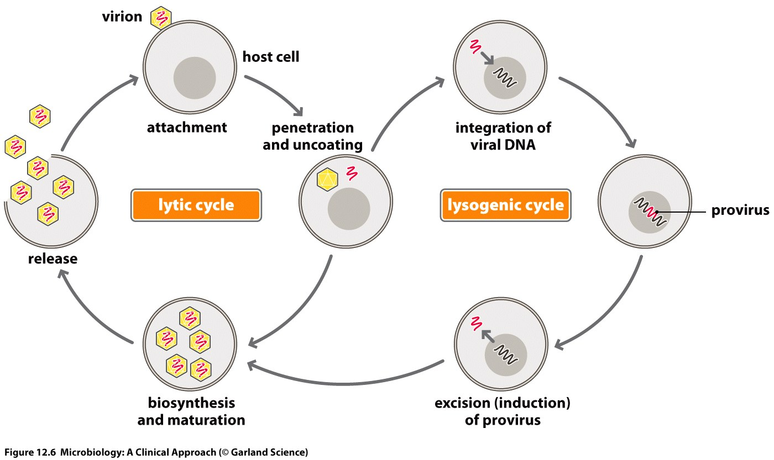
Two methods of replication:
Lytic cycle: The virus enters the cell, replicates itself hundreds of times, and then bursts out of the cell, destroying it (cell death).
Lysogenic cycle: The viral genome becomes incorporated into the host cell’s DNA. It can remain this way for an extended period. The host cell remain lives.

Slide 4
Virus Growth Phases:
1. Eclipse phase
Phase during which the virion has entered the cell and before progeny virus are made. No infectious virus is present during this phase. Period in which virus gains control of host synthetic machinery and produce components required to assemble into virus. Defined as the period between addition of virus and the appearance of assembled virus progeny inside the cell.
2. Latent phase
The period following the eclipse phase from the time of disappearance of the infecting virus to the appearance of infectious virus in the surroundings virus are internal and must be released.

Slide 5
Lytic cycles infection (Multiplication in animal viruses)
For animal viruses, there are six steps in lytic infection:
Attachment (Adsorption)
Penetration (Entry)
Genome Uncoating
Biosynthesis
Early viral mRNA synthesis
Early viral protein synthesis
Viral genome replication
Late viral mRNA synthesis
Late viral protein synthesis
Maturation (Assembly)
Release

Slide 6
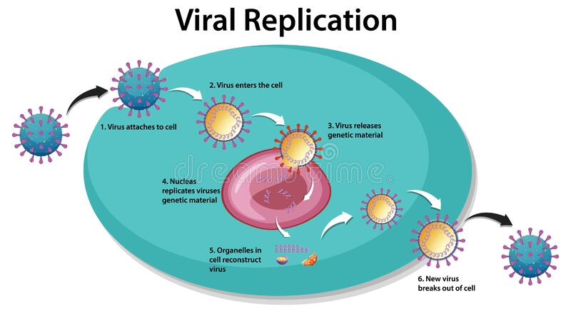
All of the six steps are not relevant to all viruses; the steps do not always occur in the same order and some viruses have an additional step.
In the later stages of replication several steps occur concurrently. For many viruses, transcription, translation, genome replication, virion assembly and exit can all be in progress at the same time.

Slide 7
1. Attachment (Adsorption)
Recognition & attachment to specific host receptor → Determines the host range of the virus.
Receptor sites:
Specific surface structures on host to which viruses attach.
Can be proteins, lipopolysaccharides, teichoic acids, etc.
Viruses typically can only infect a limited number of hosts (also known as host range), the "lock and key"
Does not require energy.
Examples on host range:
Human Immunodeficiency Virus (HIV): CD4 + T cells
Herpes Simplex Virus (HSV-1): fibroblast growth factor (FGF) receptor

Slide 8
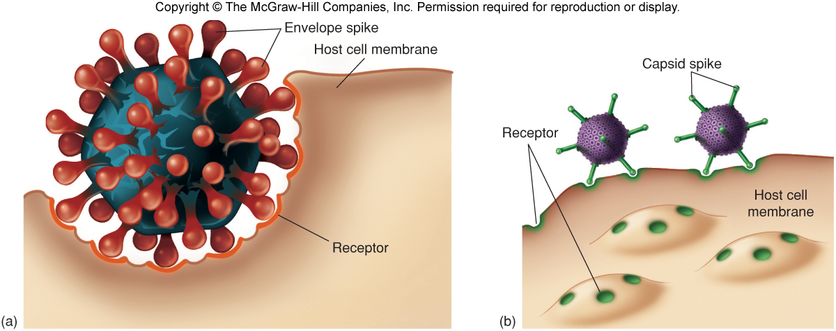

Slide 9
2.Penetration
Flexible cell membrane of the host is penetrated by the whole virus or its nucleic acid.
energy-dependent step.
Temperature-dependent step (37°C)
By three mechanisms:
Endocytosis; entire virus engulfed by the cell and enclosed in a vacuole or vesicle.
Fusion of virus envelope with cell membrane.
Direct Penetration (viropexis).

Slide 10
3. Genome Uncoating
Release of Genome= (uncoating)
Cell enzymes (lysosomes) in the vacuole dissolve the envelope and capsid.
Virion can no longer be detected; known as the ((eclipse period)).
4. Biosynthesis
Free viral nucleic acid exerts control over the host’s synthetic and metabolic machinery.
DNA viruses: enter host cell’s nucleus where they are replicated and assembled. DNA enters the nucleus and is transcribed into RNA. The RNA becomes a message for synthesizing viral proteins (translation). New DNA is synthesized using host nucleotides.
RNA viruses: replicated and assembled in the cytoplasm.
Components of capsid synthesis directed by late genes.
There are 2 types protein synthesis: Structural protein and Non-structural (enzyme for replication).

Slide 11
5. Assembly (Maturation)
Mature virus particles are constructed from the growing pool of parts, progeny particles assembled by packaging the viral nucleic acid within the capsid proteins.
Assembly of enveloped viruses needs interaction with plasma membrane which has been modified.
Naked viruses accumulate in cytoplasm and released during lysis.
6. Release
Non-enveloped (Naked viruses) and complex viruses are released when the cell membrane lyses or ruptures.
Enveloped viruses are liberated by budding through the outer membrane or exocytosis.
Anywhere from 3,000-100,000 virions may be released, depending on the virus.
Entire length of cycle anywhere from 8-36 hours.

