Slide 1
Virology
Lec. 4
Viral Activation of Immunity
Assist. Lec.
Sherko Muhammed Abdul-Rahman
MSc. in Microbiology
Email: sherko.abdulrahman@su.edu.krd

Slide 2
Immunity to viral infection is caused by a variety of specific and nonspecific mechanisms.
The activation of different immune functions and the duration and magnitude of the immune response depend on how the virus interacts with host cells (on whether it is a cytolytic, latent, and/or integrated infection) and on how the virus spreads (by local, primary hematogenous, secondary hematogenous, and/or nervous system spread).
Therefore, viral antigens may be present in different parts of the body depending on the route of spread and phase of infection. Local infections at surfaces such as the mucosa can stimulate local cell-mediated and humoral (IgA) immune responses, but not essentially systemic immunity.
The host has multiple immune defense functions that can eliminate virus and/or viral disease.

Slide 3
Humoral Immunity
Virus and/or virus-infected cells can stimulate B lymphocytes to produce antibody (specific for viral antigens) Antibody neutralization is most effective when virus is present in large fluid spaces (e.g., serum) or on moist surfaces (e.g., the gastrointestinal and respiratory tracts).
IgG, IgM, and IgA have all been shown to exert antiviral activity.
Antibody can neutralize virus by:
Blocking virus-host cell interactions or
Recognizing viral antigens on virus-infected cells which can lead to antibody-dependent cytotoxic cells (ADCC) or complement-mediated lysis.
IgG antibodies are responsible for most antiviral activity in serum, while IgA is the most important antibody when viruses infect mucosal surfaces.

Slide 4
Cell-Mediated Immunity
The term cell-mediated immunity refers to
The recognition and/or killing of virus and virus-infected cells by leukocytes (WBC).
The production of different soluble factors (cytokines) by these cells when stimulated by virus or virus-infected cells.
Cytotoxic T lymphocytes, natural killer (NK) cells and antiviral macrophages can recognize and kill virus-infected cells.
Helper T cells can recognize virus-infected cells and produce a number of important cytokines. Cytokines produced by monocytes (monokines), T cells, and NK cells (lymphokines) play important roles in regulating immune functions and developing antiviral immune functions.

Slide 5
Roles of immune functions during Viral Infections
The early, nonspecific responses:
Nonspecific inhibition,
Natural killer cell activity, and
Interferon, limit virus multiplication during the acute phase of virus infections.
The later specific immune:
Humoral and
Cell-mediated responses function to help eliminate virus at the end of the acute phase, and subsequently to maintain specific resistance to reinfection.

Slide 6
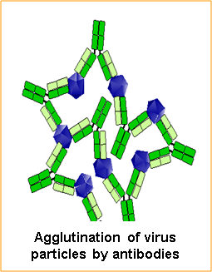

Slide 7
