Slide 1
Microbiology Second Course
Lec. 3 Fourth Stage
Gram positive cocci
2- Genus: Streptococci
Assist. Lec.
Sherko Muhammed Abdul-Rahman
MSc. in Microbiology
Email: sherko.abdulrahman@su.edu.krd

Slide 2
Gram positive
Cocci
Bacilli
Anaerobic:
1- Clostridium (SF)
2- Eubacterium (NSF)
Anaerobe: Peptostreptococci
capable of but not restricted to a particular function or mode of life
Aerobic/facultative anaerobe:
Cornybacterium (NSF)
Listeria Nocardia (NSF)
Latobacillus (NSF)
Bacillus Antheresis (SF)
Aerobic /facultative Anaerobe:
1- Staphylococci (cluster catalase +) 2- Streptococci (chains catalase -)
3- Enterococci

Slide 3
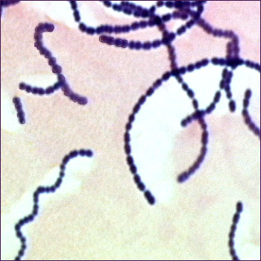
Streptococci
Characters of Streptococci
Gram positive cocci
Size 1µm
Chains or pairs
Non motile
Non spore forming
Facultative anaerobes
Fastidious
Catalase negative

Slide 4
Classification of Streptococci
According to:
Oxygen requirement
Anaerobic (Peptostreptococcus)
Aerobic or facultative anaerobic (Streptococcus)
Hemolysis on Blood Agar: α, β, and Ƴ
Lancefield classification for β hemolytic streptococci.
Lancefield grouping is a serological method for classifying streptococci into one of 20 groups (designated by a letter) based on the presence of polysaccharide and teichoic acid antigens in the bacterial cell wall.

Slide 5
Hemolysis on Blood Agar (BA)
Hemolysis on BA
α-hemolysis
Partial hemolysis
Green discoloration around colonies
e.g. S. pneumoniae & S. viridans
β-hemolysis
Complete hemolysis
Clear zone of hemolysis around colonies
e.g. Lancefield Group A & B (S. pyogenes & S. agalactiae)
γ-hemolysis
No hemolysis
e.g. Group D (Enterococcus sp.)

Slide 6
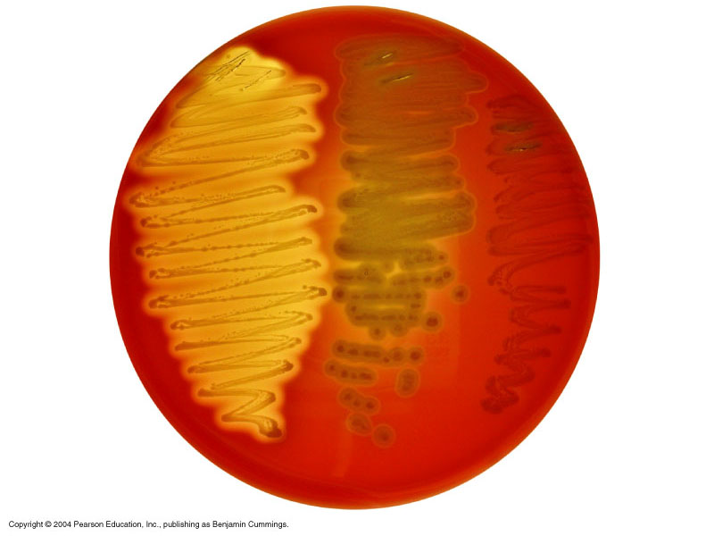
Hemolysis on Blood agar
β-hemolysis
α-hemolysis
γ-hemolysis

Slide 7
Lancefield Classification- β hemolytic
Streptococci
Lanciefield classification
Group A
S. pyogenes
Group B
S. agalactiae
Group C
S. equisimitis
Group D
Enterococcus
Other groups
(E-U)
Beta hemolysis
Alpha or Gamma hemolysis

Slide 8
Disease caused by S. pyogenes (Group A)
Suppurative is a term used to describe a disease or condition in which a purulent exudate (pus) is formed and discharged.
Non-Invasive
Pharyngitis (inflammation of the pharynx), tonsillitis, otitis media, mastoiditis, rarely meningitis.
Pyoderma- Impetigo: localised pus-producing lesions usually occur on face, arms, or legs.
Invasive
Erysipelas: diffuse infection of skin, involves superficial lymphatics. well demarcated borders
Cellulitis: infection of skin & subcutaneous tissue, spreading.

Slide 9
Toxin Mediated Diseases
Scarlet fever: Rash begins on chest & spreads across body.
Necrotizing fasciitis: Pyrogenic exotoxin produced by some strains of S. pyogenes, can lead to disseminated intravascular coagulation (DIC).
Streptococcal Toxic Shock Syndrome
Disseminated Intravascular Coagulation (DIC) is a rare and serious condition that disrupts your blood flow. It is a blood clotting disorder that can turn into uncontrollable bleeding. DIC can affect people who have cancer or sepsis.

Slide 10
Non suppurative complications or sequelae:
Rheumatic fever: following pharyngitis
carditis, poly arthritis, damage to heart valves, potentially fatal.
Acute Glomerulonephritits: following skin infection
Immune complex mediated disease, inflammation of glomeruli due to Ag-Ab complex deposit on basement membrane.
Clinically- Hematuria, Proteinuria, Hypertension
Good prognosis.

Slide 11
Pathogenesis & Virulence Factors
Structural components
M protein: inhibits phagocytosis of bacteria.
Lipoteichoic acid: helps in adhesion of bacteria.
Capsule: camouflages bacteria
Enzymes
Streptokinases- fibrinolysin
Deoxyribonucleases
Hyaluronidase
Pyrogenic / Erythrogenic exotoxin
Hemolysins
Streptolysin O: Oxygen labile, antigenic
Streptolysin S: serum soluble
Facilitate spread of streptococci in tissues

Slide 12
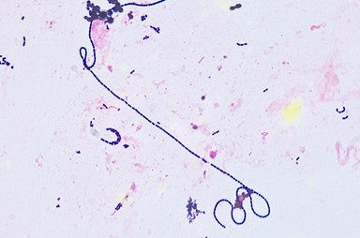
Lab Diagnosis
Sample: Throat swab, pus swab
Gram Stain: Gram positive cocci (GPC) in chains
Culture on Blood agar: beta hemolytic colonies, catalase negative

Slide 13
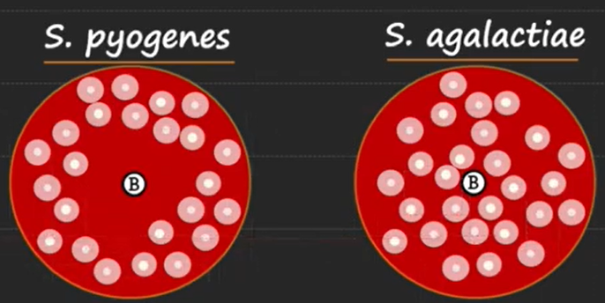
Bacitracin sensitivity
Principle: For presumptive identification of group A
Distinguish between S. pyogenes from other beta hemolytic streptococci. Strep. Py.ogenes sensitive to Bacitracin giving zone of inhibition around disk

Slide 14
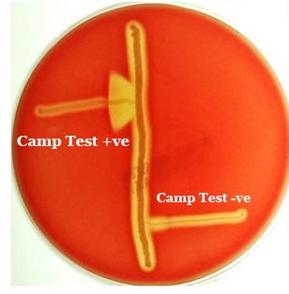
Differentiation of β-hemolytic streptococci
Lanciefield Classification
Bacitracin susceptibility Test
Specific for S. pyogenes (Group A)
The CAMP test (Christie–Atkins–Munch-Peterson) is a test to identify group B β-hemolytic streptococci
Specific for S. agalactiae (Group B)- normal flora of genital tract in women, can cause neonatal meningitis.

