Slide 1
Microbiology Second Course
Lec. 4&5 Fourth Stage
Gram-Positive Bacilli
Gram-Negative Cocci and Rods
Assist. Lec.
Sherko Muhammed Abdul-Rahman
MSc. in Microbiology
Email: sherko.abdulrahman@su.edu.krd

Slide 2
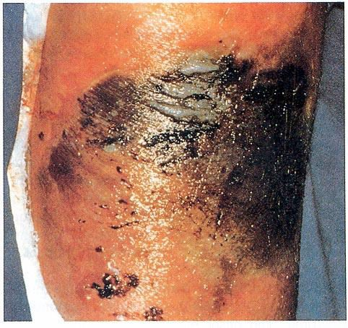
Gram-Positive Bacilli:
Non spore forming: eg. Lactobacillus
Spore forming which has the following:
Aerobic spore forming example: Bacillus anthracis, causes anthracis
Anaerobic forming example:
Clostridium tetani causes Tetanus
Clostridium perfringe causes Gas gangrene
Clostridium botulinum causes:
botulism
paralysis
respiratory failure
4. Clostridium diphtheriae causes:
Fever, pharyngitis, airway obstruction, myocarditis

Slide 3
Gram-Negative Cocci:
The Gonococcus, e.g. Neisseria gonorrhoeae
The Meningococcus, e.g. Neisseria meningitis, it is considered a potential pathogen in the orophyarynx.
Both looks identical kidney shaped and intracellular diplococci.

Slide 4
Gram-Negative Rods (GNR):
Enteric Bacteria they ferment sugars most important are: | Fastidious GNRs | Anaerobic GNRs
Escherichia coli (E. coli) (normal flora but can cause diseases) Salmonella (not-normal flora“exogenous”) Shigella Klebsiellosis pneumonia and Yersinia Proteus | 1. Bordetella pertussis 2. Haemophilus influenzae 3. Campylobacter jejuni 4. Helicobacter pylori 5. Legionella pneumophila | 1. Bacteroides fragilis 2. Fusobacterium

Slide 5
Gram-Negative Rods:
Oxidase negative, non-fermentative, they do not ferment sugars e.g: Acinobacter
Oxidase positive, fermentative, comma shaped. The most important are:
Vibrio cholerae that causes cholera, which is a disease characterized by severe diarrhea and dehydration.
Pseudomonas that causes infection in immunocompromised patients (resistance to antibiotics).

Slide 6
Non-Gram-stainable bacteria:
Spirochaetes: Cause syphilis (Sexual transmitted)
Chlamydia: Obligate intra-cellular bacteria
Mycoplasmas: Smallest free-living Organisms, No cell wall
Mycoplasmas pneumonia
Mycoplasmas genitalium

Slide 7
Salmonella
Causes infections in humans and vertebrates,
Enteric Fever( Typhoid Fever )
Gastroenteritis
Septicemias
Carrier state.
7

Slide 8
Enteric Fever (Typhoid Fever)
Salmonella typhi causes: Typhoid fevers
Salmonella paratyphi A,B,C causes: Paratyphoid fevers.
Food poison group causes: Gastroenteritis, Septicemias, Localized infection (Spread from animals to humans)
8

Slide 9
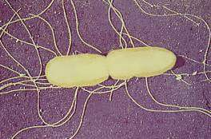
Morphology of Salmonella
Gram negative bacilli
Salmonella produces colonies of approximately 2–4 mm in diameter.
Motile by peritrichous flagella.
9

Slide 10
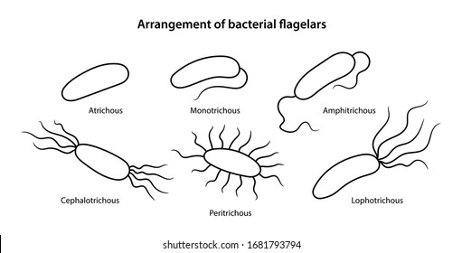

Slide 11
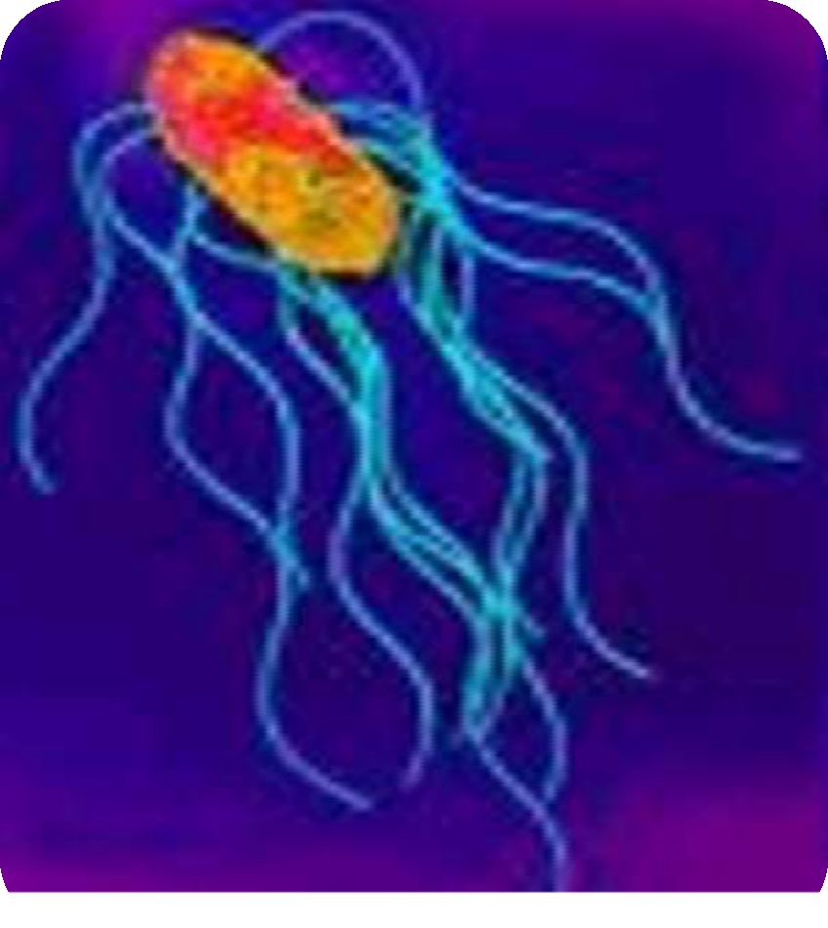
Bacteriology –Typhoid fever
The Genus Salmonella belong to Enterobacteriaceae family.
Facultative anaerobe
Gram negative bacilli
Distinguished from other bacteria by Biochemical and antigen structure
11

Slide 12
Cultural Characters
Aerobic / Facultatively anaerobic
Grows on simple media: Nutrient agar,
Temp. 15 – 41ºc / 37ºc
Colonies appear as large 2-4 mm, circular, low convex,
On MacConkey medium: appear colorless
On Selective medium: Wilson Blair, Bismuth sulphide medium. Produce Jet black colonies H2S produced by Salmonella typhi.
12

Slide 13
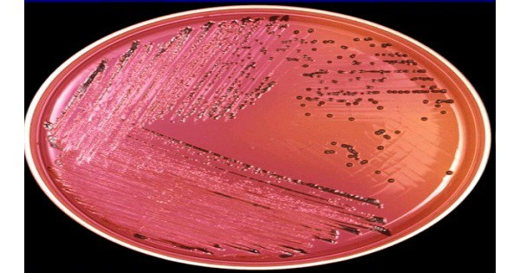
Produce Jet black colonies by Salmonella typhi.

Slide 14
Identifying Enteric Organisms
Isolates which are non lactose fermenting
Motile, Indole positive
Urease negative
Ferment Glucose,Mannitol,Maltose
Do not ferment Sucrose
Typhoid bacilli are anaerogenic
Some of the Paratyphoid form acid and gas
Further identification done by slide agglutination tests
14

Slide 15
Biochemical tests are used to identify bacterial species by differentiating them on the basis of biochemical activities. The difference in protein, fat metabolism, carbohydrate metabolism, enzyme production, compound utilization ability, etc. are some factors that aid in bacterial identification.
Salmonella typhi do not produce gas.
Indole -ve
Methyl Red +ve
Voges–Proskauer (VP) -ve
Citrate +ve
Urea -ve
H2S produced by Salmonella typhi
Paratyphi A do not produce H2S
11

Slide 16
Antigenic structure of Salmonella
Two sets of antigens
Detection by serotyping:
Somatic or 0 Antigens contain long chain polysaccharides(LPS).
Flagellar or H Antigens are strongly immunogenic and induces antibody formation rapidly.

Slide 17
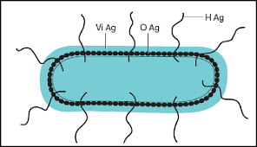
Antigenic structure of Salmonella

Slide 18
Clinical manifestation
Headache, malise,anorexia ,coated tongue
Abdominal discomfort,
Constipation / Diarrhea
Step ladder type fever,
Relative bradycardia,
Hepatomegaly
Rose spots appea
صداع ، توعك ، فقدان الشهية ، لسان مغلف
عدم ارتياح في البطن،
الإمساك / الإسهال
حمى نوع سلم الخطوة،
بطء القلب النسبي،
تضخم الكبد
تظهر بقع الورد
28

Slide 19
Complications of Enteric fever (Typhoid Fever)
Intestinal perforation,
Hemorrhage,
Circulatory collapse.
Bronchitis Bronchopneumonia,
Meningitis,
Cholecystitis,
Arthritis,Periostitis / Nephritis,
Osteomyletis,
انثقاب معوي
نزف،
انهيار الدورة الدموية.
التهاب الشعب الهوائية
التهاب السحايا ،
التهاب المرارة ،
التهاب المفاصل ، التهاب السمحاق / التهاب الكلية
التهاب العظم والنقي

Slide 20
How we diagnose Typhoid Fever
Diagnosis is made by any blood, bone marrow or stool cultures and with the Widal test (demonstration of salmonella antibodies against antigens O-somatic and H-flagellar).

Slide 21
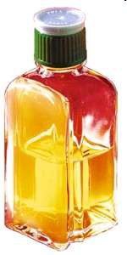
Blood cultures in Typhoid Fevers
Bacteremia occurs early in the disease
Blood cultures are positive in:
1st week in 90%
2nd week in 75%
3rd week in 60%
4th week and later in 25%

Slide 22
What are the latest serological tests for salmonellosis?
Serological tests used in the diagnosis of enteric fever yield limited sensitivity and specificity.
The Widal test is used to measure antibodies against O and H antigens of S typhi. Newer diagnostic tests (Typhidot, Tubex) allow direct detection of immunoglobulin M (IgM) antibodies against specific S typhi antigens.

