Slide 1
Microbiology Second Course
Lec. 6&7 Fourth Stage
Medically Important Gram-Positive Bacilli
Assist. Lec.
Sherko Muhammed Abdul-Rahman
MSc. in Microbiology
Email: sherko.abdulrahman@su.edu.krd

Slide 2
Medically Important Gram-Positive Bacilli
Three general groups:
Endospore-formers
Bacillus,
Clostridium
Non-endospore-formers
Listeria,
Erysipelothrix
Irregular shaped and staining properties
Corynebacterium,
Proprionibacterium,
Mycobacterium,
Actinomyces,
Nocardia

Slide 3
Spore-forming Bacilli
Genus Bacillus
Genus Clostridium
The genera Bacillus and Clostridium belong to the Bacillaceae family of sporing bacteria.
The organism in the group that is of veterinary and human medical interest is Bacillus anthracis.
There are numerous species e.g., B. cereus, B. subtilis, etc. that normally live in the soil.

Slide 4
The Genus Bacillus
Gram-positive, endospore-forming, motile rods
Aerobic and catalase positive
Source of antibiotics
Primary habitat is soil
Two species of medical importance:
Bacillus anthracis
Bacillus cereus

Slide 5
Bacillus anthracis
Large, black-shaped rods
Gram (+ve), non-motile, aerobic, spore forming rod
Streptobacilli with central spores
Livestock
Sheep, Cattle, Goats, and Humans
Virulence factors: polypeptide capsule and exotoxins
Three types of anthrax:
Cutaneous: spores enter through skin, black sore- eschar; least dangerous.
Gastrointestinal: ingested spores.
Pulmonary: inhalation of spores.

Slide 6
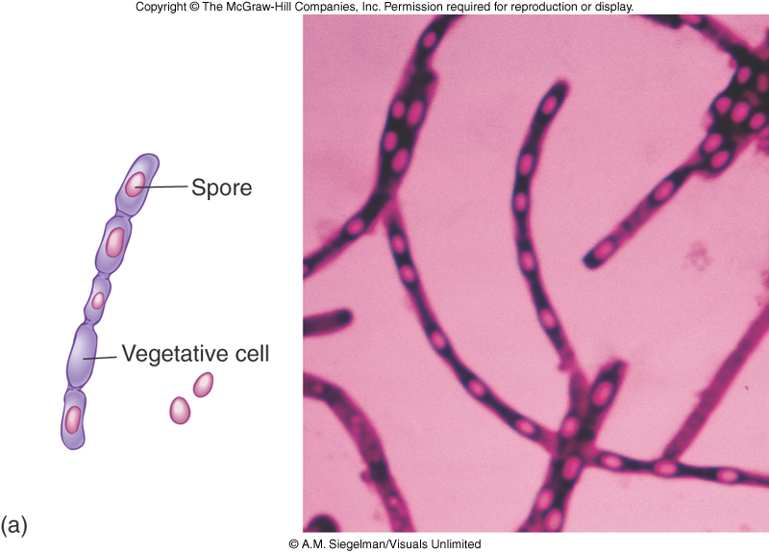

Slide 7
Three Forms of Human Anthrax
1. Cutaneous Anthrax
Enters thru cut or abrasion
Results in painless ulcer (1-3cm) with black (necrotic) center
About 20% mortality rate in untreated cases

Slide 8
2. Gastrointestinal Anthrax
Contaminated meat
Abdominal pain, fever, vomiting blood, severe diarrhea
25% to 60% mortality rate

Slide 9
3. Inhalation Anthrax
Initial symptoms resemble common cold.
Progress to severe breathing problems and shock.
Usually results in death 1-2 days after onset of acute symptoms.
Mortality rate 99% in untreated cases.
Treatment usually not effective after symptoms are present.
Notes:
Anthrax mid November 2001
5 killed - at least 13 infected

Slide 10
Anthrax as a Biological Weapon
Deadly if not treated early
Spores can be produced in large quantities using basic knowledge of biology
Spores may remain viable for years (60 at least)
Spores can be spread
Missiles, rockets, bombs, mail, crop dusters
No smell
No taste
No cloud or color
Antibiotics – only effective if administered early (within 24 –48 hours)

Slide 11
Control and Treatment of Bacillus anthracis
Treated with penicillin, tetracycline, or ciprofloxacin
Vaccines
live spores and toxoid to protect livestock
purified toxoid; for high risk occupations and military personnel;.
The diagnostic procedure involves detection of the pathogen in dermal lesions, sputum, and/or blood cultures using microscopic and culturing methods

Slide 12
Bacillus cereus
Common airborne and dust-borne; usual methods of disinfection and antisepsis are ineffective
Grows in foods, spores survive cooking and reheating
Ingestion of toxin-containing food causes nausea, vomiting, abdominal cramps and diarrhea; 24 hour duration
No treatment
Increasingly reported in immunosuppressed

Slide 13
The Genus Clostridium
Gram-positive, spore-forming rods
Anaerobic and catalase negative
120 species
Oval or spherical spores produced only under anaerobic conditions
Synthesize organic acids, alcohols, and exotoxins
Cause wound infections, tissue infections, and food intoxications

Slide 14
Clostridial Gastroenteritis
Clostridium perfringens
Spores contaminate food that has not been cooked thoroughly enough to destroy spores.
Spores germinate and multiply (especially if unrefrigerated).
When consumed, toxin is produced in the intestine; acts on epithelial cells, acute abdominal pain, diarrhea, and nausea
Rapid recovery

Slide 15
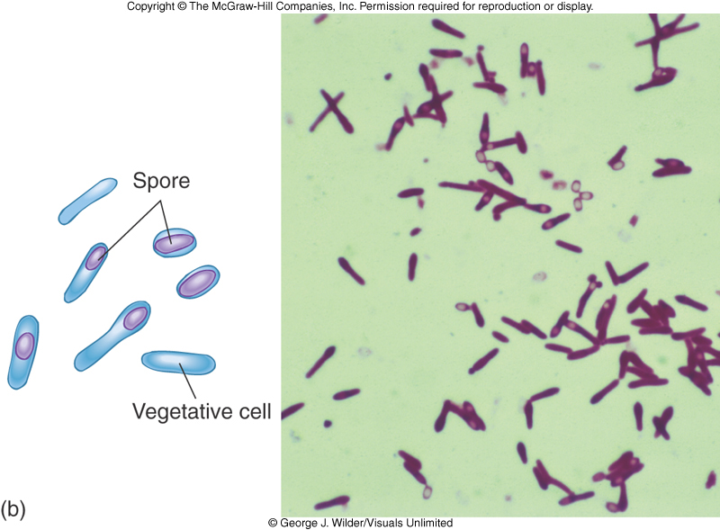
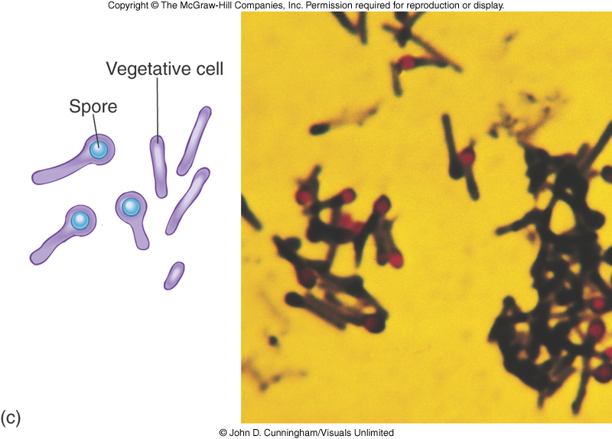

Slide 16
Gas Gangrene
Clostridium perfringens most frequent clostridia involved in soft tissue and wound infections-myonecrosis
Spores found in soil, human skin, intestine, and vagina
Predisposing factors (Gas Gangrene)
Surgical incisions, compound fractures, diabetic ulcers, septic abortions, puncture wounds, and gunshot wounds.

Slide 17
Virulence Factors of Clostridium perfringens
Toxins: alpha toxin: causes RBC rupture, edema and tissue destruction.
Collagenase
Hyaluronidase
DNase

Slide 18
Pathology of Clostridium perfringens
Not highly invasive; (requires damaged and dead tissue and anaerobic conditions).
Conditions stimulate spore germination, vegetative growth and release of exotoxins, and other virulence factors.
Fermentation of muscle carbohydrates results in the formation of gas and further destruction of tissue.

Slide 19
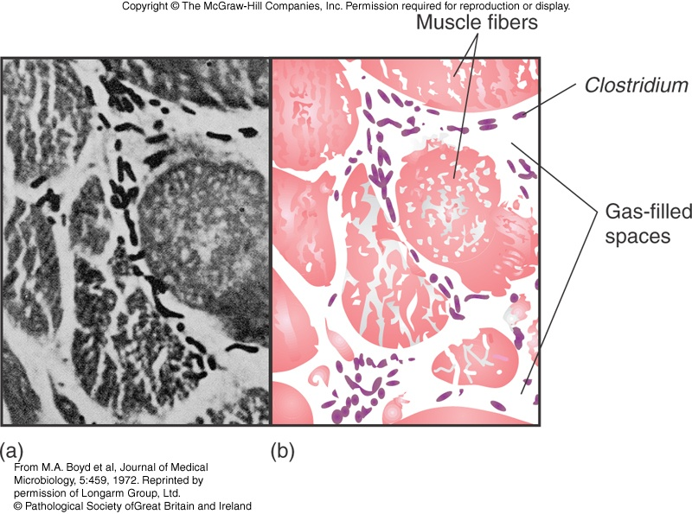

Slide 20
Clostridium difficile Associated Disease (CDAD)
Normal resident of colon, in low numbers
Causes antibiotic-associated colitis.
relatively non-invasive; treatment with broad-spectrum antibiotics kills the other bacteria, allowing C. difficile to overgrow.
Produces enterotoxins that damage intestines.
Major cause of diarrhea in hospitals.
Increasingly more common in community acquired diarrhea.

Slide 21
Tetanus
Clostridium tetani
Common resident of soil and Gastrointestinal (GI) tracts of animals
Causes tetanus or Lockjaw (It often causes a person's neck and jaw muscles to lock, making it hard to open the mouth or swallow.), a neuromuscular disease
Most commonly among geriatric patients and IV drug abusers; neonates in developing countries.
Diagnosis: The preferred method is toxin detection in wound material in an animal test (mouse) based either on neutralization or detection of the toxin gene with PCR. The pathogen is difficult to culture.

Slide 22
Lockjaw neuromuscular disease

Slide 23
Pathology of Clostridium tetani
Spores usually enter through accidental puncture wounds, burns, and crushed body parts.
Anaerobic environment is ideal for vegetative cells to grow and release toxin.
Tetanospasmin–neurotoxin causes paralysis by binding to motor nerve endings; blocking the release of neurotransmitter for muscular contraction inhibition; muscles contract uncontrollably
Death most often due to paralysis of respiratory muscles

Slide 25
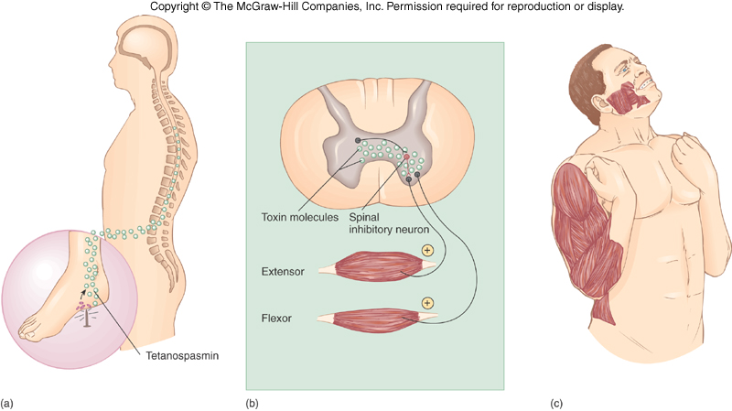

Slide 26
Clostridial Food Poisoning
Clostridium botulinum: rare but severe intoxication usually from home canned food.
Clostridium perfringens: mild intestinal illness; second most common form of food poisoning worldwide.

Slide 27
Pathogenesis of Clostridial Food Poisoning
Spores are present on food when gathered and processed.
If reliable temperature and pressure are not achieved air will be evacuated but spores will remain.
Anaerobic conditions favor spore germination and vegetative growth.
Potent toxin, botulin, is released.
Toxin is carried to neuromuscular junctions and blocks the release of acetylcholine, necessary for muscle contraction to occur.
Double or blurred vision, difficulty swallowing, neuromuscular symptoms.

Slide 28
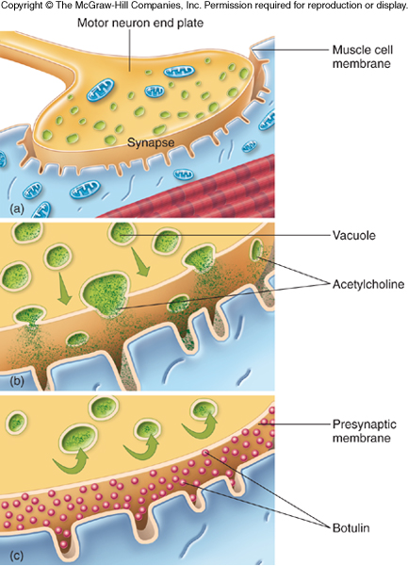

Slide 29
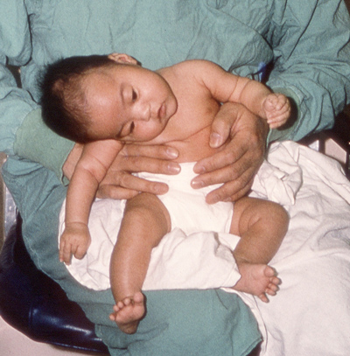
Infant and Wound Botulism Infant botulism: caused by ingested spores that germinate and release toxin; flaccid paralysis. Wound botulism: spores enter wound and cause food poisoning symptoms.

