Slide 1
Microbiology Second Course
Lec. 8 Fourth Stage
Gram-Positive Regular Non-Spore-Forming Bacilli
Assist. Lec.
Sherko Muhammed Abdul-Rahman
MSc. in Microbiology
Email: sherko.abdulrahman@su.edu.krd

Slide 2
Gram-Positive Regular Non-Spore-Forming Bacilli
Medically important:
Listeria monocytogenes
Erysipelothrix rhusiopathiae

Slide 3
Listeria monocytogenes
Non-spore-forming Gram-positive
Ranging from coccobacilli to long filaments
1-4 flagella
No capsules
Resistant to cold, heat, salt, pH extremes and bile.
Virulence attributed to ability to replicate in the cytoplasm of cells after inducing phagocytosis; avoids humoral immune system.

Slide 4
Epidemiology and Pathology
Primary reservoir are soil, water and animal intestines.
Can contaminate foods and grow during refrigeration.
Listeriosis: most cases associated with dairy products, poultry, and meat. Often mild or subclinical in normal adults. Immunocompromised patients, fetuses and neonates; affects brain and meninges, 20% death rate.

Slide 5
The pathogenesis of Listeria depends on the organism's ability to invade and survive within cells. Invasion of cells is mediated by protein internalin made by Listeria and E-cadherin on the surface of human cells. The ability of Listeria to pass the placenta, enter the meninges, and invade the gastrointestinal tract depends on the interaction of protein internalin and E-cadherin on those tissues. Upon entering the cell, the organism produces listeriolysin, which allows it to escape from the phagosome into the cytoplasm, thereby escaping destruction in the phagosome. Because Listeria preferentially grows intracellularly, cell-mediated immunity is a more important host defense than humoral immunity, then replication of the listeriae in the cytoplasm of infected cells. Suppression of cell-mediated immunity predisposes to Listeria infections.
L. monocytogenes can move from cell to cell by means of actin rockets filaments of actin polymerize and propel the bacteria through the membrane of one human cell and into another.

Slide 6
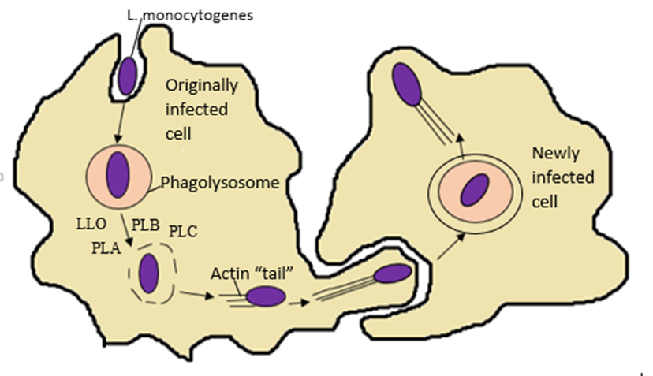
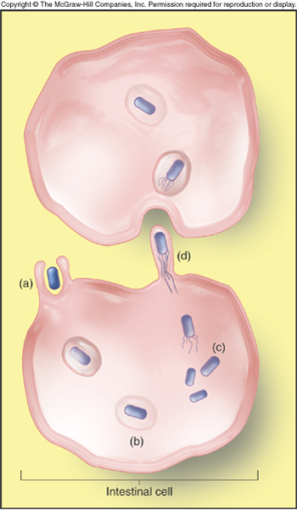

Slide 7
Diagnosis and Control
Culture requires lengthy cold enrichment process.
Rapid diagnostic tests using Enzyme-linked immunosorbent assay (ELISA) available.
Ampicillin and trimethoprim sulfamethoxazole
Prevention – pasteurization and cooking

Slide 8
Erysipelothrix rhusiopathiae
Gram-positive, catalase-negative, rod-shaped, non-spore-forming, nonmotile. widely distributed in animals and the environment.
Primary reservoir– tonsils of healthy pigs.
Enters through skin abrasion, multiples to produce erysipeloid, dark red lesions.
E. rhusiopathiae is primarily considered an animal pathogen, causing the disease known as erysipelas that may affect a wide range of animals. Pigs, turkeys and laying hens are most commonly affected, but cases have been reported in other mammals, birds, fish, and reptiles. In pigs, the disease is known as diamond skin disease.
The bacterium can also cause zoonotic infections in humans, called erysipeloid.

Slide 9
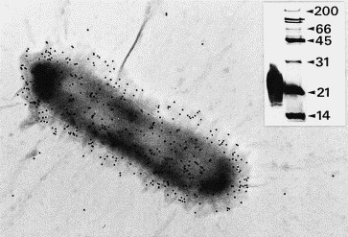

Slide 10
Various virulence factors have been suggested as being involved in the pathogenicity of Erysipelothrix rhusiopathiae. The presence of a hyaluronidase and neuraminidase has been recognized, and neuraminidase was shown to play a significant role in bacterial attachment and subsequent invasion into host cells.

Slide 11
Diagnosis and Control
Diagnostic procedures involve identification of the pathogen in wound.
Secretion using the methods of microscopy and culturing.
Penicillin or erythromycin
Vaccine for pigs

