Slide 1
Virology Fourth Stage
Lec. 2 Second Semester
Structure of Viruses
Lec. Sherko M. Abdul-Rahman
PhD. Student & MSc. in Microbiology
Email: sherko.abdulrahman@su.edu.krd

Slide 2
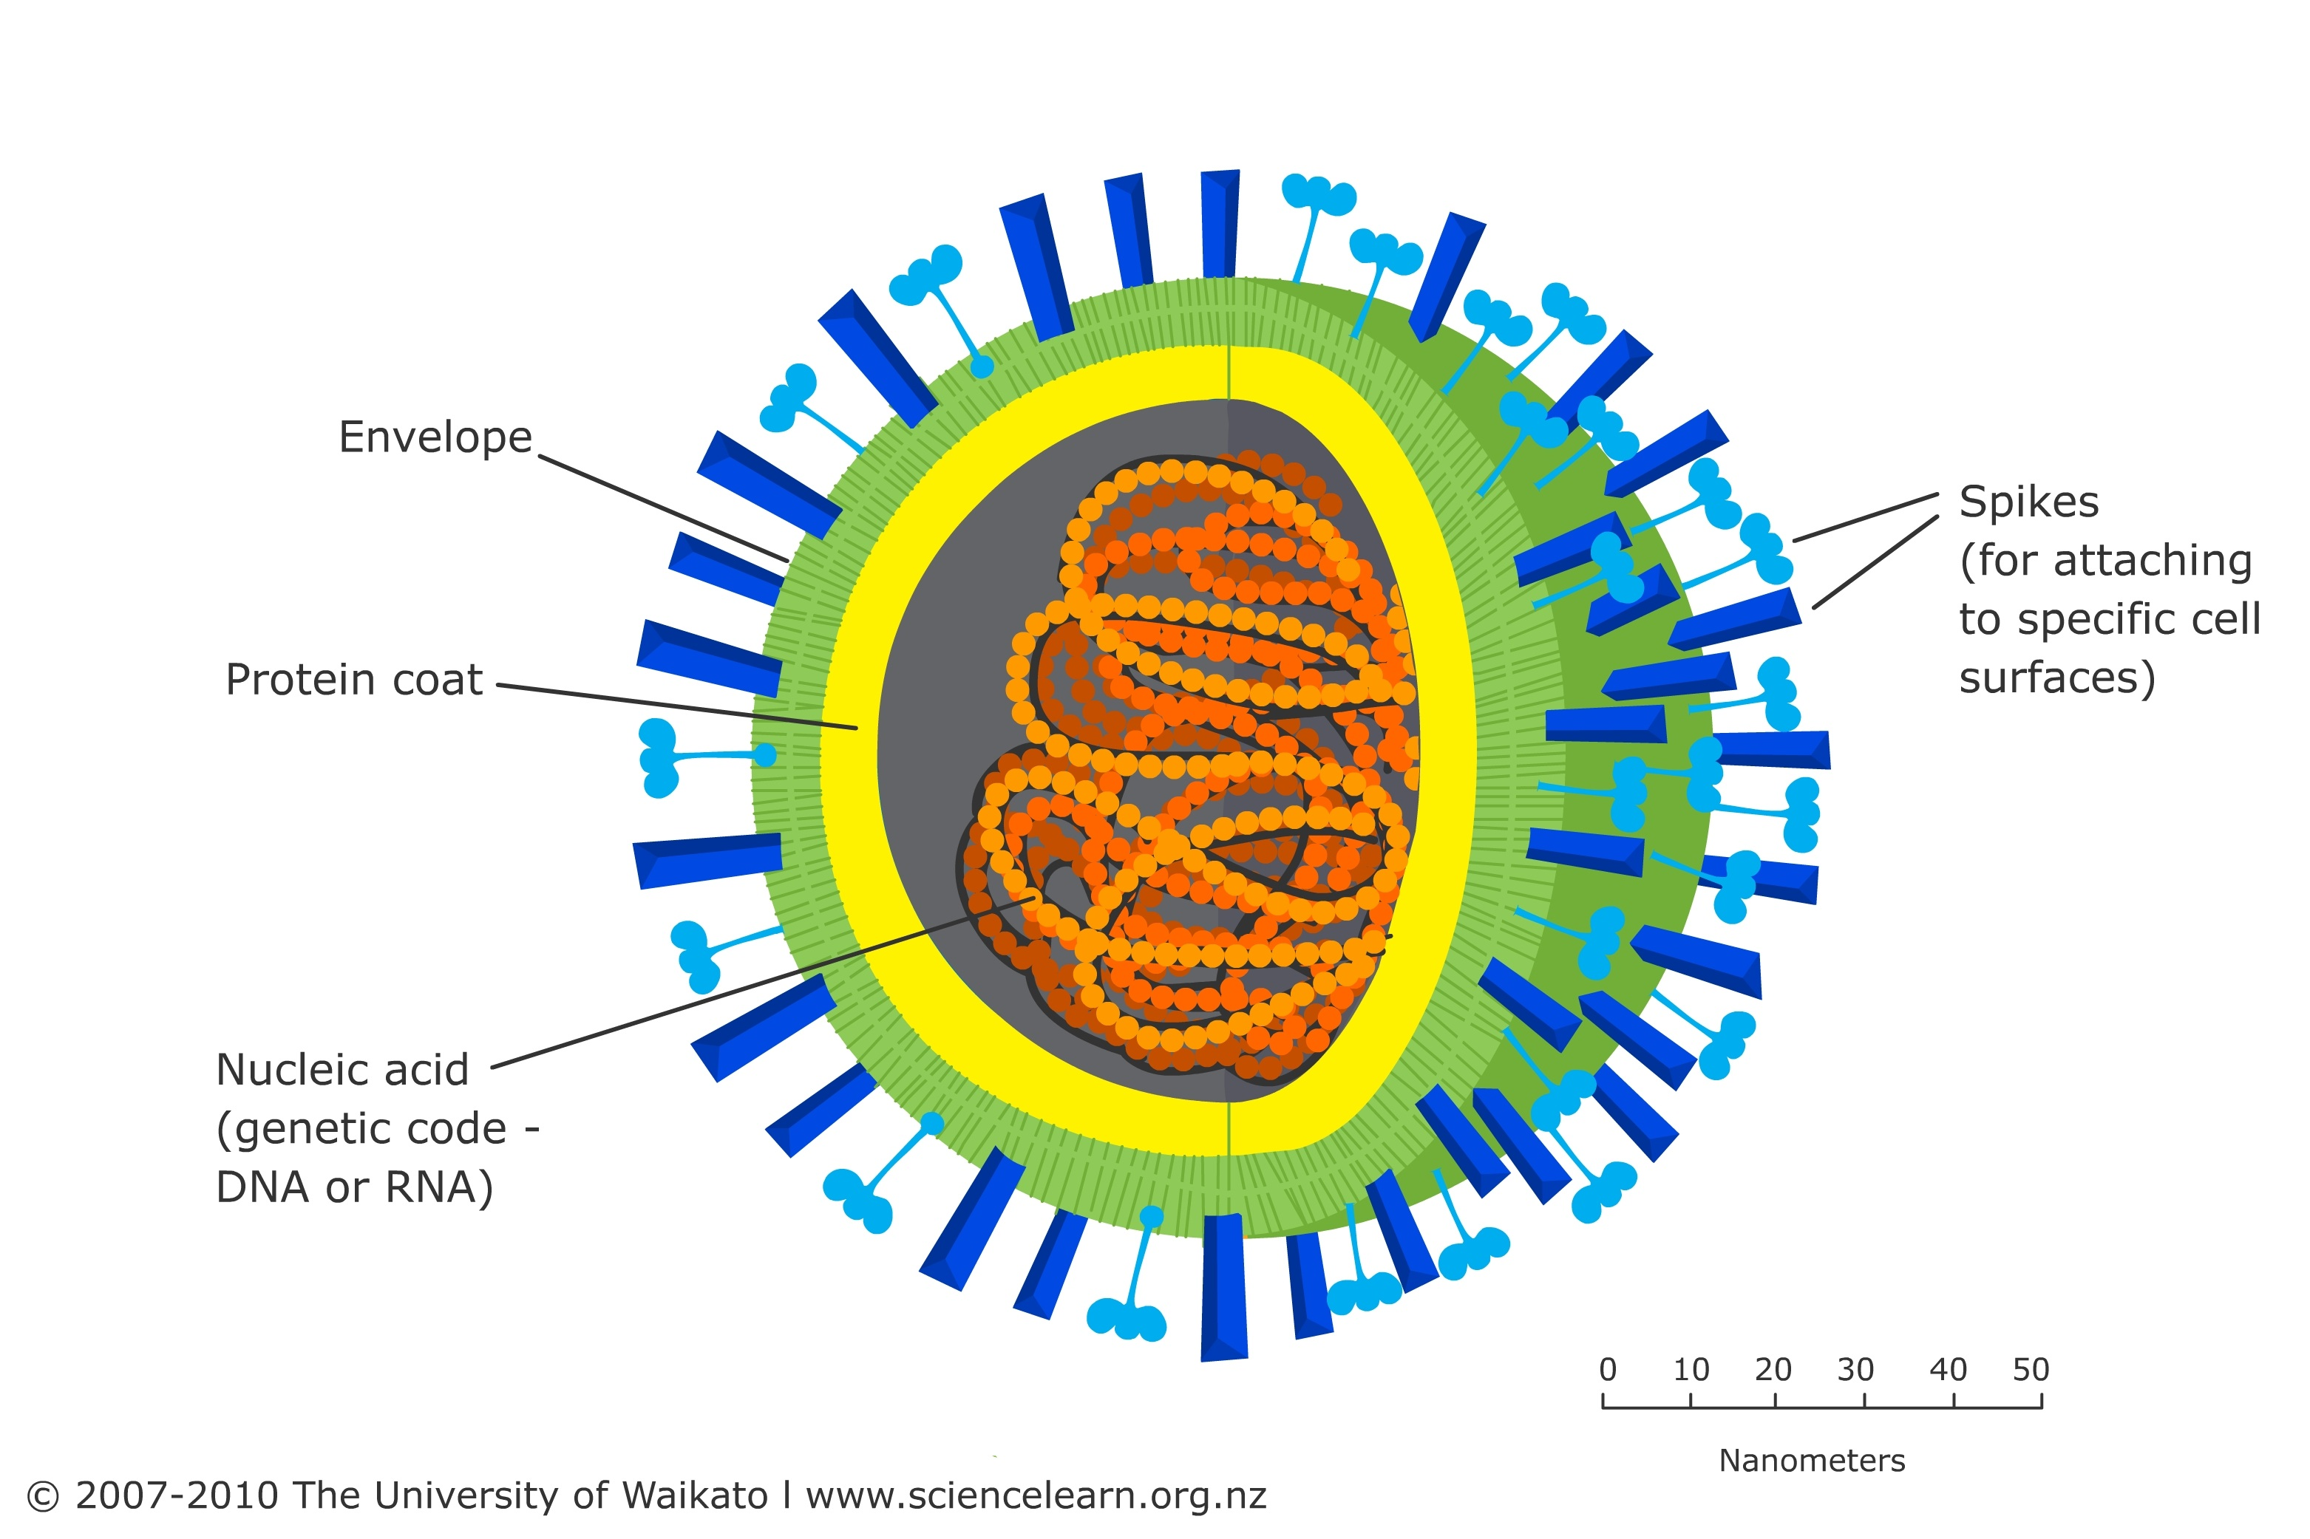
Generalized Structure of Viruses:

Slide 3
Viruses exhibit a wide range of structures, but they generally consist of the following components:
Genetic material (nucleic acid):
Viruses contain either DNA (deoxyribonucleic acid) or RNA (ribonucleic acid) as their genetic material. This nucleic acid carries the information for viral replication and can be single-stranded or double-stranded.
Capsid:
The capsid is the protein coat that surrounds and protects the viral genetic material. It is composed of protein subunits called capsomeres, which self-assemble to form the capsid structure. The capsid provides structural integrity to the virus and can vary in shape and symmetry.

Slide 4
3. Envelope (in some viruses):
Some viruses have an additional outer lipid envelope derived from the host cell membrane. The envelope may contain viral proteins and glycoproteins. Not all viruses have an envelope, and those that do are classified as enveloped viruses.
4. Surface Proteins and Glycoproteins
Viruses often have surface proteins and glycoproteins surrounded in their envelope or capsid. These proteins play essential roles in virus attachment to host cells, entry into host cells, and evasion of host immune responses.
5. Matrix Proteins (in enveloped viruses):
Enveloped viruses may also contain matrix proteins under the lipid envelope. Matrix proteins provide structural support and help maintain the shape of the virus particle.

Slide 5
6. Tail Fibers or Spikes (in some viruses):
Certain viruses, such as bacteriophages (viruses that infect bacteria), have tail fibers or spikes attached to their capsid or envelope. These structures facilitate attachment to host cell receptors and the injection of viral genetic material into host cells.
7. Nucleocapsid (capsid + nucleic acid):
The nucleocapsid refers to the combination of the viral capsid or envelope and the surrounded nucleic acid. It represents the core structure of the virus particle.
8. Genome Organization:
Viral genomes can vary in organization, with some viruses having linear genomes, while others have circular or segmented genomes. The genome may also encode additional proteins necessary for viral replication, assembly, and regulation of gene expression.

Slide 6
Basic virus structure
DNA
Capsid protein
or
+
Nucleocapsid
=
Naked capsid virus
RNA
Lipid membrane, glycoproteins
Nucleocapsid
+
Enveloped virus

Slide 7
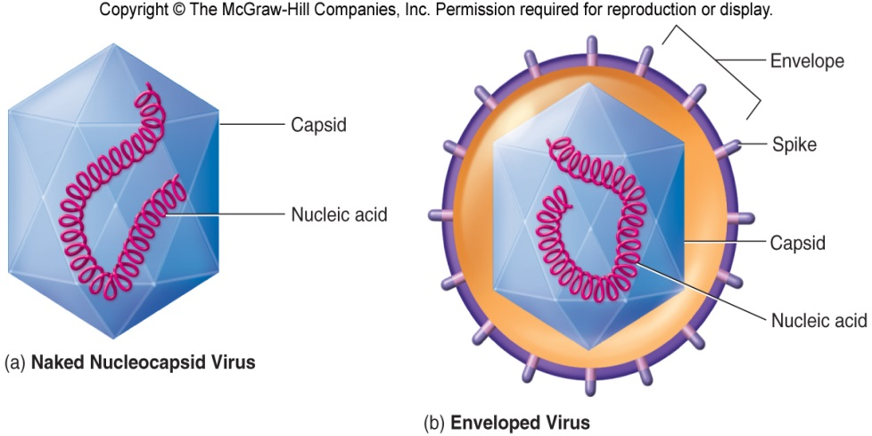
Virions lacking envelopes Virions having envelopes

Slide 8
Principles of virus structure:
The principles of virus structure include fundamental concepts that direct the organization and architecture of viruses. These principles are essential for understanding the variety of viral structures observed across different virus families and for explaining their biological functions.

Slide 9
Types of symmetry of virus particles:
Viruses exhibit different types of symmetry in their particle structure, which refers to the arrangement of protein subunits (capsomeres) in the viral capsid. The type of symmetry seen in a virus depends on its structure, size, and mode of assembly. The three main types of symmetry observed in virus particles are:
Helical symmetry
Icosahedral symmetry
Complex symmetry

Slide 10
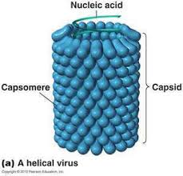
Helical Symmetry:
In viruses with helical symmetry, the capsomeres arrange themselves in a helical or spiral shape around the viral nucleic acid, forming a cylindrical or filamentous structure.
The length of the helical structure is determined by the length of the viral nucleic acid, and the diameter of the helix is determined by the size and arrangement of the capsomeres.
Examples of viruses with helical symmetry include tobacco mosaic virus (TMV), influenza virus, and Ebola virus.

Slide 11
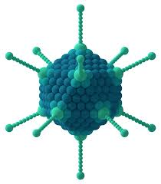
Icosahedral Symmetry:
Icosahedral symmetry is characterized by a symmetrical arrangement of capsomeres in a polyhedral structure with 20 equilateral triangular faces, 12 vertices, and 30 edges.
The icosahedral shape is the most effective way to packet identical subunits into a closed shell, maximizing the volume of the capsid while minimizing the surface area.
Many viruses, including adenoviruses, poliovirus, and herpesviruses.

Slide 12
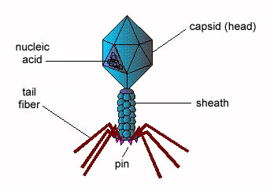
Complex Symmetry:
Some viruses exhibit complex symmetry that does not fit neatly into either helical or icosahedral categories. These viruses may have irregular shapes or additional structural features, such as tails or spikes.
Bacteriophages (viruses that infect bacteria) often have complex symmetry, with a polyhedral head and a tail structure that attaches to host cells.
Examples of viruses with complex symmetry include bacteriophages and some enveloped viruses such as poxviruses

Slide 13
Viruses typically do not possess the machinery necessary to carry out metabolic processes or produce enzymes on their own. Instead, they rely on host cell machinery to replicate and spread. However, some viruses encode certain enzymes or enzyme-like proteins that play critical roles in the viral life cycle. There are some examples of viral enzymes:
Viral RNA Polymerase:
Many RNA viruses encode an RNA-dependent RNA polymerase (RdRp) enzyme, which is responsible for replicating the viral RNA genome. RdRp catalyzes the synthesis of RNA from an RNA template and is essential for viral replication.

Slide 14
2. Viral DNA Polymerase:
DNA viruses typically encode a viral DNA polymerase enzyme, which catalyzes the synthesis of DNA from a DNA template during viral replication. Viral DNA polymerases can vary in structure and function depending on the virus family.
3. Reverse Transcriptase:
Retroviruses, encode a unique enzyme called reverse transcriptase. Reverse transcriptase catalyzes the synthesis of DNA from an RNA template, a process known as reverse transcription. This enzyme plays a central role in the replication of retroviral genomes.
4. Proteases:
Many viruses encode protease enzymes that cleave viral polyproteins into individual functional proteins during viral replication and assembly. These proteases are essential for processing viral proteins and maturing viral particles.

Slide 15
5. Helicases:
Helicases are enzymes that unwind double-stranded nucleic acids, facilitating processes such as replication, transcription, and recombination. Some viruses encode helicase enzymes that are involved in viral genome replication or RNA packaging.
6. Methyltransferases:
Methyltransferases are enzymes that catalyze the transfer of methyl groups to nucleic acids or proteins. Some viruses encode methyltransferase enzymes that modify viral RNA or DNA to evade host immune responses or regulate viral gene expression.
7. Neuraminidase:
Neuraminidase is an enzyme found in influenza viruses that cleaves sialic acid residues on the surface of infected cells and newly produced virions, facilitating the release of viral particles from host cells and promoting viral spread.

