Slide 1
Microbiology First Course
Lec. 1&2 Third Stage
Introduction
Assist. Lec. Sherko M. Abdul-Rahman
MSc. in Microbiology
Email: sherko.abdulrahman@su.edu.krd

Slide 2
What is Microbiology? Micro: too small to be seen with the naked eye Bio: life logy: study of
Microbiology: Is a branch of medical science concerned with the identification, diagnosis, prevention, and treatment of infectious diseases. In addition, this field of science studies various clinical applications of microbes for the improvement of health.
There are four kinds of microorganisms (mo.) that cause infectious disease such as bacteria, fungi, parasites and viruses

Slide 3
Organisms included in the study of microbiology:
Bacteria: Bacteriology
Protozoans: Protozoology
Algae: Phycology
Parasites: Parasitology
Yeasts and Molds (Fungi): Mycology
Viruses: Virology
Note: Microorganisms = Microbes = Germs

Slide 4
Characteristics of Life
Growth and development
Reproduction and heredity: genome composed of DNA packed in chromosomes; produce offspring sexually or asexually
Metabolism: chemical and physical life processes
Movement and/or irritability: respond to internal/external stimuli.
Cell support, protection, and storage mechanisms cell walls, vacuole and granules.
Transport of nutrients and waste.

Slide 5
Naming Microorganisms
Binomial (scientific) nomenclature, Carolus Linnaeus (1735)
Gives each microbe two names:
Genus: noun, always capitalized
species: adjective, never capitalized
Italicized for example: Staphylococcus aureus (S. aureus) or underline for example: Staphylococcus aureus (S. aureus)

Slide 6
Five Kingdoms of Living Organisms
Animalia
Plantae
Fungi
Protista
Monera - Bacteria and Cyanobacteria
Taxonomic Classification
Man
Animalia
Chordata
Mammalia
Primate
Hominidae
Homo
sapien
Cat
Animalia
Chordate
Mammalia
Carnivora
Felidae
Felis
domestica
Kingdom
Phylum
Class
Order
Family
Genus
species

Slide 7
Classification System
Three Domains Classification, Carl Woese (1978),
Bacteria: Unicellular prokaryotes with cell wall containing peptidoglycan
Archaea: Unicellular prokaryotes with no peptidoglycan in cell wall
Eukarya, Protista, Fungi, Plantae, and Animalia.

Slide 9
Characteristics of Microorganisms:
Procaryotes: Microscopic, unicellular organisms. Lack nuclei and membrane-bound organelles.
Eucaryotes: Unicellular and multicellular organisms. Have nuclei and membrane-bound organelles
Viruses: Acellular, parasitic particles composed of a nucleic acid and protein.
Microbial Dimensions:
Procaryotes and Eucaryotes are measured in micrometers.
Viruses in nanometers
Helminths are measured in millimeters.

Slide 10
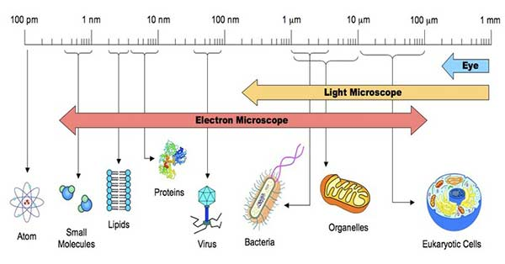

Slide 11
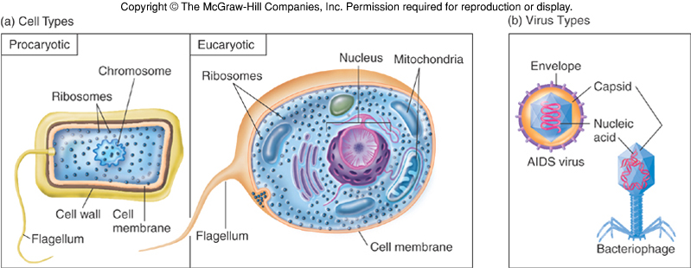

Slide 12
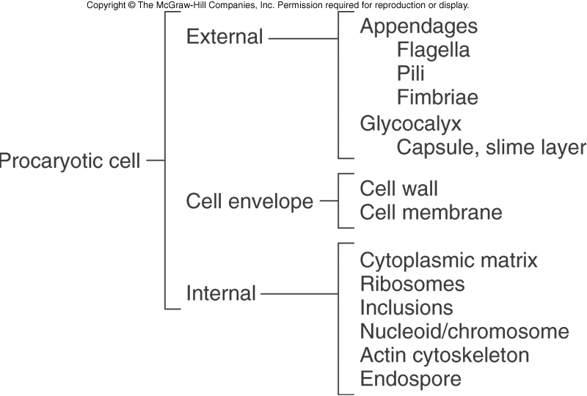

Slide 13
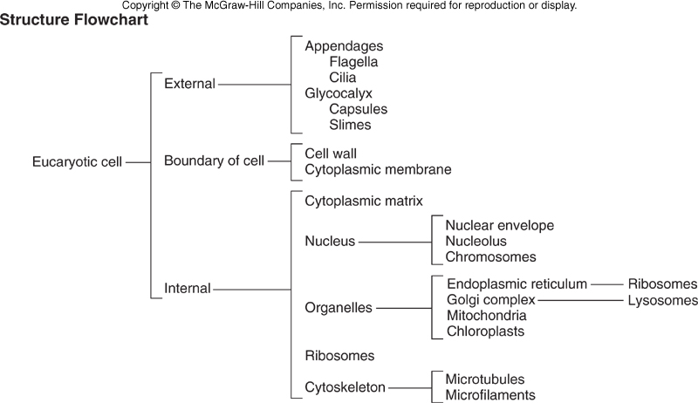

Slide 14
Microbes Benefit Humans:
Bacteria are primary decomposers - recycle nutrients back into the environment (sewage treatment plants)
Microbes produce various food products such as cheese, pickles, green olives, yogurt, vinegar, bread, Beer, Wine, and Alcohol.
Microbes are used to produce Antibiotics like Penicillin (Mold) by Penicillium notatum, it discovered by 1928 Alexander Fleming
Bacteria synthesize chemicals that our body needs, but cannot synthesize: Example Escherichia coli (E. coli)
B vitamins: for metabolism
Vitamin K: blood clotting

Slide 15
5. Microbial Antagonism: Our normal microbial flora prevents potential pathogens from gaining access to our body.
6. Insect Pest Control: Using bacteria to control the growth of insects: Bacillus thuringiensis
Caterpillars, bollworms and corn borers.
7. Recombinant DNA Technology (Gene Therapy or Genetic Engineering)
8. Bacteria can be manipulated to produce enzymes and proteins they normally would not produce: Insulin, Human Growth Hormone and Interferon.
9. Microbes form the basis of the food chain: Marine and fresh water microorganisms:
10. Bioremediation Using microbes to clean up pollutants and toxic wastes
as Exxon Valdez
11. Still other bacteria live on the roots of certain plants, converting nitrogen into a usable form.

Slide 16
Microbes do benefit us, but they are also capable of causing many diseases:
They are bacteria, protozoa, fungi, and viruses. The pathogenesis of microorganisms is efficient in causing infections upon the hosts themselves. Pathogens are capable of causing many harsh diseases. Few disease examples of bacteria are rabies, malaria, cholera, Pneumonia, Botulism, typhoid fever, syphilis etc.…….

Slide 17
Unusual forms of medically significant microorganisms:
Rickettsia
Very tiny, Gram-negative bacteria
Most are pathogens that alternate between mammals and fleas, lice or ticks.
Obligate intracellular pathogens
Cannot survive or multiply outside of a host cell
Cannot carry out metabolism on their own
Rickettsia rickettisii: Rocky Mountain spotted fever
Rickettsia prowazekii: epidemic typhus
Coxiella burnetti: Q fever

Slide 18
Chlamydia
Cell wall contains an outer lipopolysaccharide membrane but lacks peptidoglycan.
Contains cysteine-rich proteins that are assumed to be the functional equivalent of peptidoglycan
Stains Gram -
Tiny
Obligate intracellular parasites
Not transmitted by arthropods
Chlamydia trachomatis: severe eye infection and one of the most common sexually transmitted diseases
Chlamydia psittaci: ornithosis, parrot fever
Chlamydia pneumoniae: lung infections

Slide 19
Mycoplasma (Bacteria without cell walls)
Lack a rigid cell wall during their entire life cycle
The smallest known organisms – smallest genomes (other than viruses)
Diameter ranges from 0.15 - 0.30 µm
Do not stain with the gram stain
Pleomorphic
Tiny pleomorphic cocci, short rods, short spirals, and sometimes doughnut shape
Mycoplasma pneumoniae
Atypical pneumonia in humans

Slide 20
Archaea: The Other Procaryotes
Constitute third Domain Archaea
Seem more closely related to Domain Eukarya than to bacteria
Live in the most extreme habitats in nature, extremophiles
Adapted to heat, salt, acid pH, pressure and atmosphere, includes: Methane producers, hyperthermophiles, extreme halophiles, and sulfur reducers.

Slide 21
Cyanobacteria (blue-green algae): Free-living nonpathogenic bacteria
Oxygenic photosynthesis: use photosynthesis, can synthesize required nutrients from inorganic compounds:
12H2O + 6CO2 → C6H12O6 + 6H2O + 6O2
Gram-negative cell walls
Extensive thylakoids with photosynthetic chlorophyll pigments and gas inclusions unicellular, colonial & filamentous form.
Some species fix N2 in heterocyst.
Anoxygenic photosynthesis: Do not give off oxygen as a product of photosynthesis.
12H2S + 6CO2 → C6H12O6 + 12S°
Most species are found in fresh water: Marine, damp soil, moistened desert rocks and endosymbionts in lichens, plants, various protists or sponges.

