Slide 1
Microbiology First Course
Lec. 4
Bacteria
Assist. Lec. Sherko M. Abdul-Rahman
MSc. in Microbiology
Email: sherko.abdulrahman@su.edu.krd

Slide 2
Bacteria
Bacteria are small single-celled organisms. Bacteria are found almost everywhere on Earth and are vital to the planet's ecosystems. Some species can live under extreme conditions of temperature and pressure.
The human body is full of bacteria, and in fact is estimated to contain more bacterial cells than human cells.
Most bacteria in the body are harmless, and some are even helpful. A relatively small number of species cause disease.

Slide 3
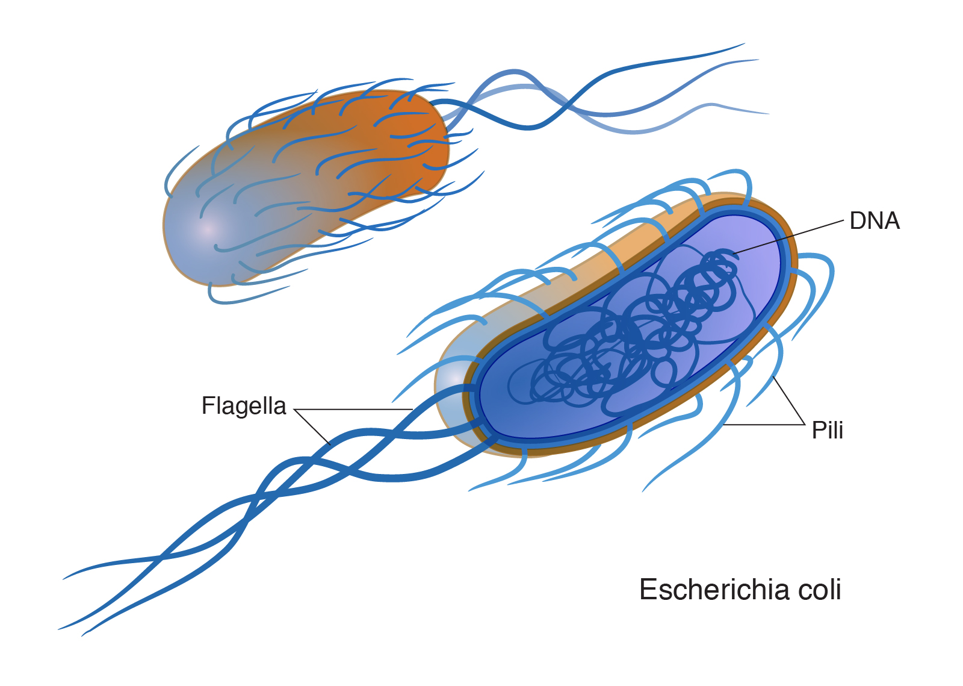

Slide 4
Size of Bacteria
Bacteria are very small in size. The unit of measurement in bacteriology is the micron (m) or micrometer (μm) .
One μm = a millionth part of a meter or a thousandth of a millimeter.
The diameter of the smallest body that can be resolved and seen clearly with naked eye is (200 μm).
Bacteria of medical importance generally measure (0.2-1.5 μm) in diameter.
To see bacteria, a light microscope must be used with oil immersion (is a technique used to increase the resolving power of a microscope).
The average diameter of spherical bacteria is 0.5-2.0 µm.
The average diameter of rod-shaped or filamentous bacteria, length is 1-10 µm and diameter is 0.25-1 .0 µm.

Slide 5
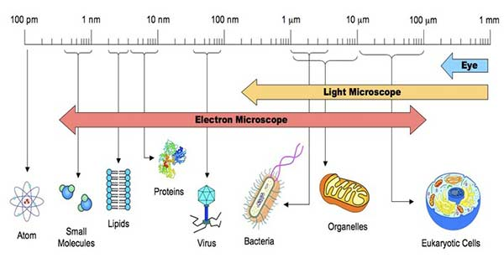
picometre (pm) micrometer (μm)
nanometer (nm) millimeter (mm)

Slide 6
Most microorganisms appear almost colorless do not show much structural detail under the light. Therefore, staining techniques used to produce color contrast.
Staining simply means coloring the microorganisms with a dye that showed certain structures.
Routine methods for staining of bacteria involve drying and fixing smears, fixing kills the microorganisms and attaches them to the slide. It also preserves various parts of microbes in their natural state with only minimal distortion.
Various staining techniques are commonly used in Bacteriology.

Slide 7
Shapes of Bacteria:
Cocci: Cocci are spherical, or nearly spherical.
Bacilli: Bacilli, rod shaped (cylindrical) cells. In some of the bacilli, the length of the cells may be equal to width, such bacillary forms are known as coccobacilli and have to be carefully differentiated from cocci.
Vibrios: Vibrios are curved or comma-shaped and derive the name from their characteristic vibratory motility.
Spirilla: Spirilla are rigid spiral or helical forms.
Spirochetes: Spirochetes (coil and chaite meaning hair) are flexuous spiral forms.
Mycoplasma: Mycoplasma are cell wall deficient bacteria and hence do not possess a stable morphology. They occur as round or oval bodies and interlacing filaments.

Slide 8
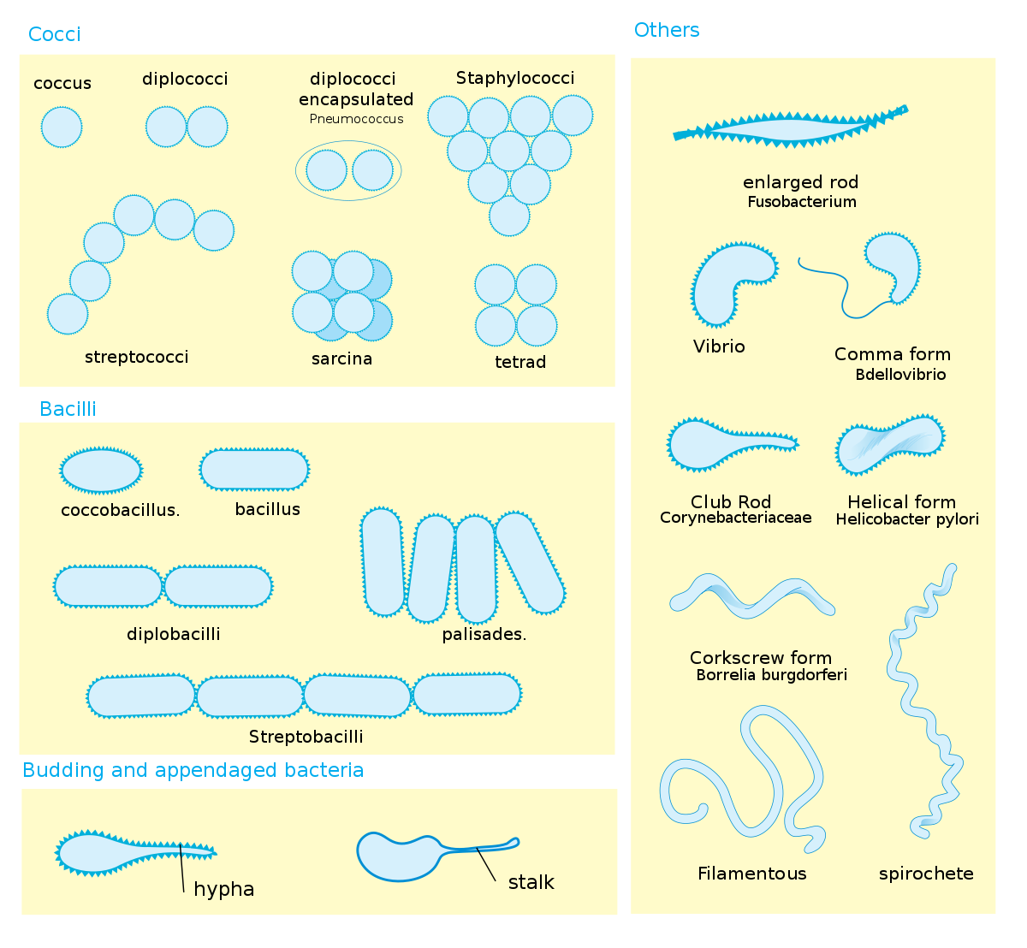
Shapes of Bacteria

Slide 9
Arrangement of Bacterial cells:
Cocci arrangement
Diplococci: Cocci may be arranged in pairs, when cocci divide and remain together. Ex:, Neisseria.
Long chains: when cells adhere after repeated divisions in one plane. Ex: Streptococcus, Enterococcus.
Grape like clusters: when cocci divide in random planes. Ex: Staphylococcus aureus
Tetrads: Square groups of four cells (tetrads).Ex: Micrococcus.
Cubical packets: Cubical packets of eight of cells. Ex: Sarcina.

Slide 10
2. Bacilli arrangement
Bacilli split only across their short axes, therefore, the patterns formed by them are limited. The shape of the rod’s end often varies between species and may be flat, rounded, cigar-shaped, or bifurcated.
Some bacilli too may be arranged in chains. Ex: Bacillus anthracis
Others are arranged at various angles to each other, resembling the letter V presenting a cuneiform or chinese letter arrangement and is characteristic of Corynebacterium diphtheria.

Slide 11
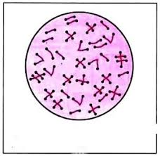
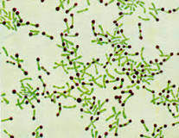
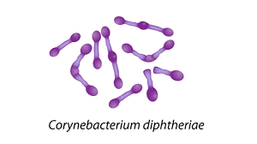

Slide 12
Structure of the bacterial cells
The principal structures of the bacterial cell can be divided into:
The outer layer or cell consists of:
Cell wall
Cytoplasmic or plasma membrane beneath cell wall.
B. Cellular appendages additional structures:
Capsule: Some bacteria produce a protective gelatinous covering layer called a capsule outside the cell wall. If the capsule is too thin to be seen with light microscope (<0.2 μm) it is called microcapsule.
Loose slime: Soluble, large-molecular, amorphous, viscid colloidal material may be dispersed by the bacterium into the environment as loose slime.
Flagella: Some bacteria carry external filamentous appendages protruding from the cell wall; flagella, which are organs of locomotion.
Fimbriae, which appear to be organs of adhesion; and
Pili: which are involved in the transfer of genetic material.

Slide 13
C. Cell Interior
Those structures that bounded by the cytoplasmic membrane, compose the cell interior and include cytoplasm, cytoplasmic inclusions (mesosomes, ribosomes, inclusion granules, vacuoles) and a single circular chromosome of deoxyribonucleic acid (DNA).

