Slide 1
Microbiology Third Stage
Lec. 4 Second Semester
Gram Positive Bacteria
Lec. Sherko M. Abdul-Rahman
PhD Student & MSc. in Microbiology
Email: sherko.abdulrahman@su.edu.krd

Slide 3
Staphylococci:
Staphylococci are a group of Gram-positive bacteria belonging to the family Staphylococcaceae.
They are spherical (cocci) in shape and typically occur in clusters resembling bunches of grapes when viewed under a microscope.
Staphylococci are facultative anaerobes, meaning they can grow in both the presence and absence of oxygen.
They are widely distributed in nature and can be found on the skin and mucous membranes of humans and animals, as well as in the environment.

Slide 4
Some key characteristics of staphylococci include:
Genus:
The genus Staphylococcus comprises various species, with Staphylococcus aureus, Staphylococcus epidermidis and Staphylococcus saprophyticus being the most clinically significant.
Colonial morphology:
Staphylococci typically form smooth white to golden-yellow colonies on solid culture media such as blood agar. The colonies are often circular, smooth, and convex in shape.
Cellular morphology:
Staphylococci are Gram-positive bacteria, meaning they retain the crystal violet stain in the Gram staining procedure. They appear purple-blue when stained and viewed under a microscope. The cells are spherical (cocci) and occur in irregular clusters or grape-like arrangements.

Slide 5
Cell wall composition:
Staphylococci have a thick peptidoglycan cell wall that provides structural support and protection. The cell wall also contains teichoic acids, which contribute to the overall negative charge of the bacterial cell surface.
Virulence Factors:
Staphylococci produce various virulence factors that contribute to their pathogenicity, including surface proteins (adhesins), exotoxins (e.g., hemolysins, enterotoxins), enzymes (e.g., coagulase, hyaluronidase), and biofilm-forming ability. These virulence factors enable staphylococci to adhere to host tissues, evade immune defenses, and cause tissue damage.

Slide 6
Antibiotic Resistance:
Staphylococci, particularly Staphylococcus aureus, have developed resistance to multiple antibiotics, posing challenges for treatment.
Methicillin-resistant Staphylococcus aureus (MRSA) is a notable example of antibiotic-resistant staphylococci that are difficult to treat and can cause serious infections in healthcare settings and communities.

Slide 7
Pathogenicity:
Staphylococci play a significant role in human health and disease, and their ability to cause infections underscores the importance of infection control measures and judicious antibiotic use in clinical practice.
Staphylococcus aureus is a highly pathogenic species known for causing a wide range of infections in humans, including skin and soft tissue infections, pneumonia, bloodstream infections (bacteremia), and bone and joint infections.
Staphylococcus epidermidis is considered a less virulent species but can still cause opportunistic infections, particularly in immunocompromised individuals or those with indwelling medical devices.
Pathogenicity of Staphylococci includes:
Cutaneous Infections
Deep Infections

Slide 8
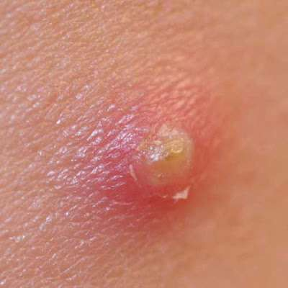
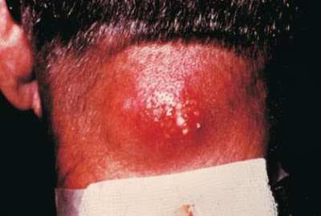
1. Cutaneous Infections
Furuncle/boils:
Furuncle is deep seated infection, originating from folliculitis,( if infection extends from follicle to neighbour tissue). Causes redness, swelling, severe pain. Commonly found on the neck, armpit and groin regions.
b) Carbuncle:
Is an aggregation of infected furuncles. Carbuncles may form large abscesses. It is a large area of redness, swelling and pain, punctuated by several sites of drainage pus.

Slide 9
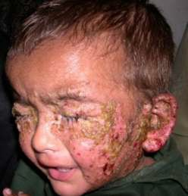
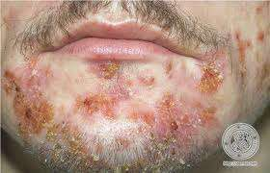
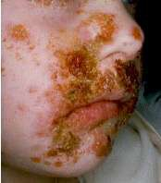
c) Impetigo:
A very superficial skin infection common in children, usually produces blisters or sores on the face, neck, hands, and diaper area. It is characterized by watery bristles, which become pustules and then honey colored crust.

Slide 10
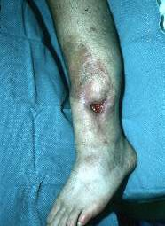
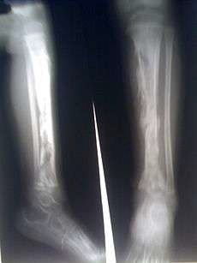
2. Deep Infections
Osteomyelitis:
Inflammation of bone. Bacteria can get to the bone via bloodstream and following an injury. Causes pain, swelling, deformity, defective healing, in some case pus flow.

Slide 11
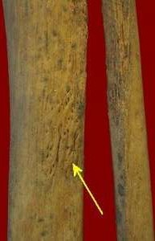
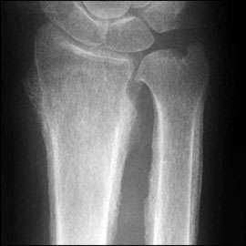
b) Periostitis:
Inflammation of periosteum. Cause fever, localised pain, leucocytosis

Slide 12
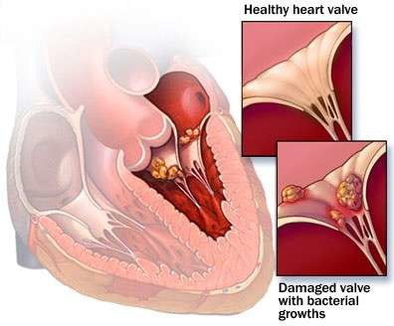
c) Endocarditis:
It is an inflammation of the inner layer of the heart, the endocardium. Endocarditis occurs when bacteria enter bloodstream, travel to heart, and lodge on abnormal heart valves or damaged heart tissue.

Slide 13
Mode of Transmission:
S. aureus is most often spread to others by contaminated hands. The skin and mucous membranes are usually an effective barrier against infection.

Slide 14
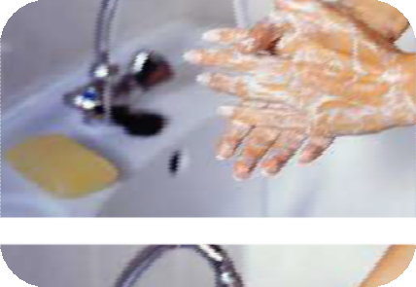
Prevention
Wash your hands
Keep wounds covered
Avoid sharing personal care items
Cooking and storing food properly

