Slide 1
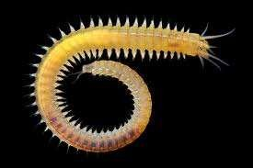
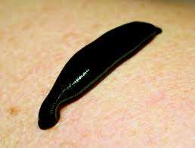
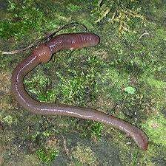
PHYLUM ANNELIDA

Slide 2
Phylum Annelida(Segmented worms)
(L. annelus, little ring, ida, pl. suffix) consists of the segmented worms
15,000 species
worms whose bodies are divided into similar segments, (metameres) arranged in linear series and externally marked by circular rings called annuli.
Sometimes called “bristle worms” because most annelids bear tiny chitinous bristles called setae.
Functions of Setae
  terrestrial annelids – for locomotion
  aquatic forms – for swimming

Slide 3
Body Plan:
The annelid body typically has a two-part head, composed of a prostomium and a peristomium followed by a segmented body and a terminal portion called the pygidium bearing an anus.
Peritoneum (a layer of mesodermal epithelium) lines the body wall of each compartment, forming dorsal and ventral mesenteries that cover
all organs
Hydrostatic skeleton
– coelom is filled with fluid.

Slide 4
Class Polychaeta
Polychaeta (Gr. polys, many, chaite¯, long hair) with more than 10,000 species
Polychaetes differ from other annelids in having a well differentiated head with specialized sense organs; paired appendages, called parapodia,
- They are paired appendages of polychaete that function in locomotion and breathing.
-Some spend much or all of their time in tubes or permanent burrow
Other - swim, crawl over the ocean bottom, or tunnel through
surface sediments.

Slide 5
Clitellata
Class Oligochaeta
3000 species of oligochaeta
include the familiar earthworms and many species that live in
freshwater.
Most are terrestrial or freshwater forms, but some are parasitic Ex. Chaetogaster limnaei
Forms and Body Function:
Earthworms use peristaltic movement: Contractions of circular muscles in the anterior end lengthen the body, pushing the anterior end forward where it anchors.
Differ from polychaetes, no parapodia

Slide 6
Nutrition:
Most are scavengers: feed mainly on decaying organic matter, bits of leaves and vegetation, and animal matter.
Circulation and Respiration :
- Have a double transport system: coelomic fluid and a closed circulatory system.
coelomic fluid – carries food, wastes, and respiratory gases.
closed circulatory system – which includes capillary systems in the tissues.

Slide 7
Excretion:
bears a pair of metanephridia.
- occupies parts of two successive segments :
ciliated funnel & Nephrostome

Slide 8
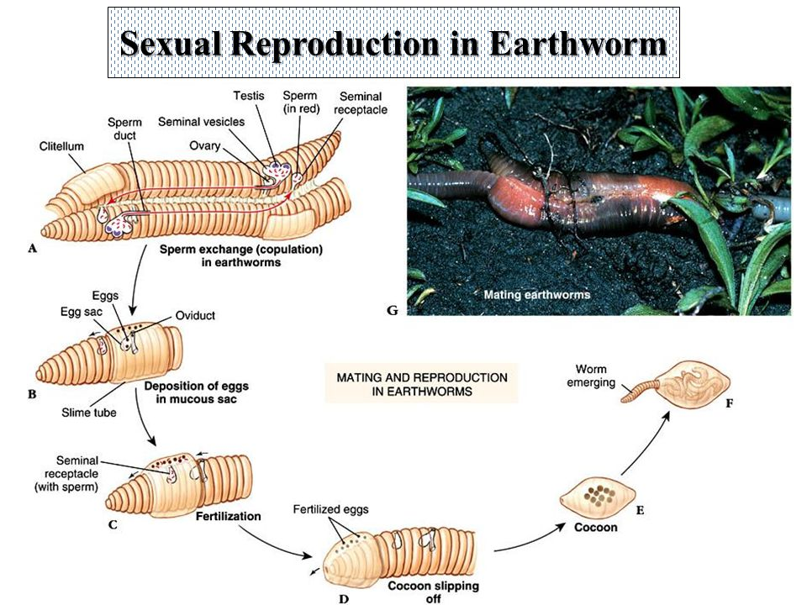
Reproduction and Development :
- Earthworms are monoecious (hermaphroditic).

