Slide 1
Salahaddin University- Erbil College of Agriculture Engineering Sciences Department of Forestry
Evolution of Humanity and Agriculture, industrialized agriculture, and organic farming
By:
Sherwan Yassin Assistant Lecturer
Email: Sherwa.hammad@su.edu.krd

Slide 2
Introduction
The production of food, fiber and fuel has been the major challenge for mankind throughout history and continues today.

Slide 3
History of Mankind and Agriculture
World was formed ca 4.6 billion years ago
First eukaryotic life forms 3.5 billion years ago
First hominid life forms ca 500 000 years ago (gatherers)
First farmers 12 000 years ago
Notes:
الحياة حقيقية النواة

Slide 4
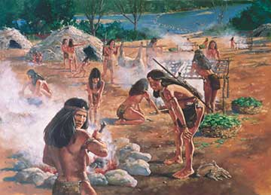
Gathering and hunting until domestication and cultivation starts

Slide 5
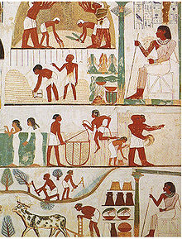
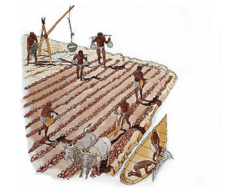
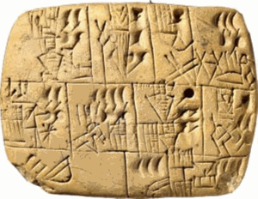
History of agriculture (1)
Cultivation around fertile valleys and thus benefiting from highly fertile soils in a restricted area around major river valleys

Slide 6
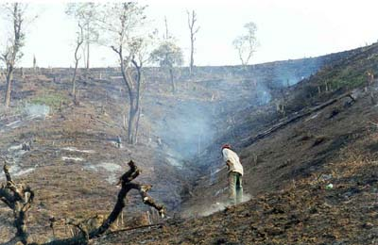
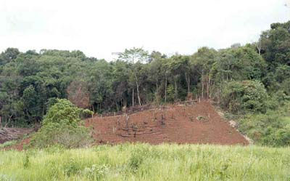
History of agriculture (2)
Shifting the cultivation to areas of burnt forests or natural vegetation and benefiting from nutrients supplied.

