Slide 1
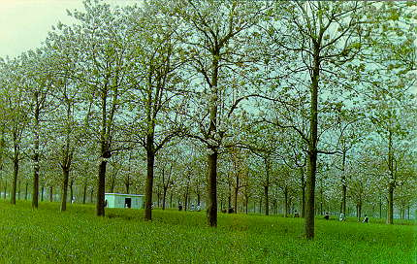
Classification of Agroforestry Systems
Home gardens
Boundary planting (Line Planting)
Biomass transfer
Entomoforestry
Aquaforestry
Block planting

Slide 2
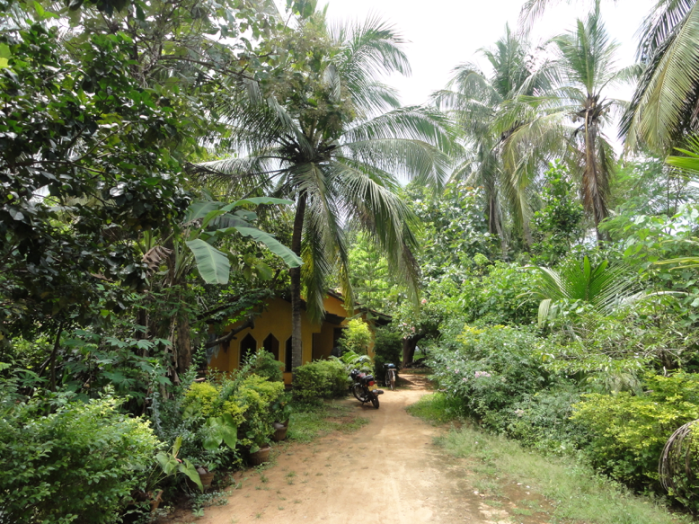
Home gardens
Home gardens are smaller, are located close to the homestead and provide a large number of different plant and animal products that are primarily for household consumption.

Slide 3
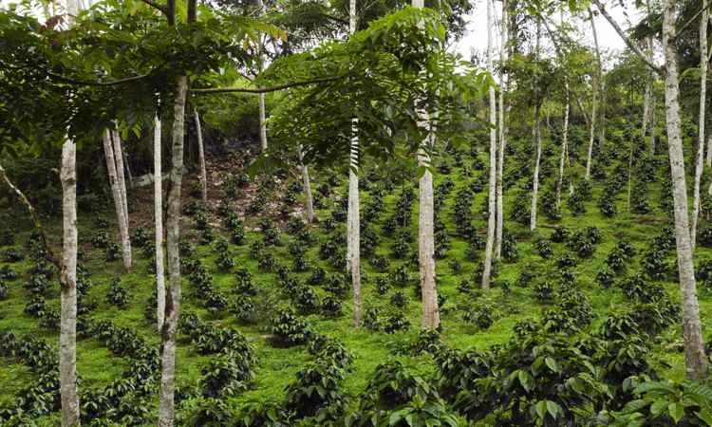
Forest gardens provide a narrower range of tree products, which are mainly marketed.

Slide 4
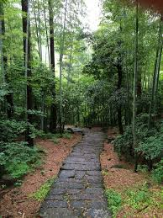
Boundary Planting (Line Planting)
This is planting of trees along field boundaries
or other borders, e.g. along footpaths or
irrigation channels.
Under this system, tree species are planted
in single or double rows, at an inter-tree
spacing of 1- 4 m, on the farm and field
boundaries, approach paths, water channels etc.

Slide 5
Trees Suitable for Line Planting
Eucalyptus (Eucalyptus hybrid)
Poplar (Populus deltoids)
Melia (Melia compacta)
Albizzia (Albizzia lebbeck, A. procera).

Slide 6
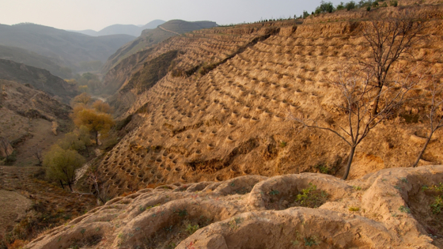
Biomass transfer
This is also called Cut-and-Carry mulching or Tree-Litter mulching.
The trees are grown as a separate block, possibly on less fertile parts of the farm.
Leaf matter is cut from the tree,
transported and added to the soil
of the cropland.

Slide 7
The trees may be natural forest or planted and may have other productive functions.
This system Minimizes Tree-Crop Competition, as there may be no tree-crop interface at all.

Slide 8
Entomoforestry
This consists of combinations of trees with insects. The main systems are:
Apiculture: the use of trees often (Acacia species) to raise bees for honey
Silkworm Culture: using mulberry trees(Morus spp.)
Production of Shellac: based on a parasitic insect-tree relationship. In that the trees remain permanently, there are likely to be favourable effects on soils.

Slide 9
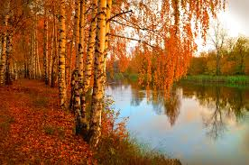
Aquaforestry
This is aquaculture which includes trees. The main subtypes are:
Marine Aquaforestry: management of mangroves to combine production of wood with fish or shellfish
Freshwater Aquaforestry: planting of trees around fishponds, so that the litter enriches the water.

Slide 10
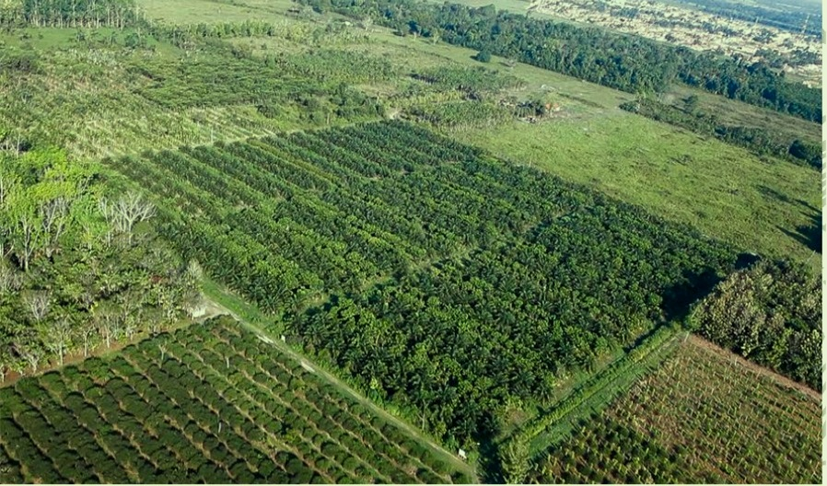
Block planting
Farmers with large holdings, small farmers with alternative source of income, absentee land-lords, and industrialists owning plots near cities have resorted to block planting of Eucalyptus, Poplar and other trees.

Slide 11
Here the preference is for closer planting of trees (1m x 1m to 2m x 2m) in case of Eucalyptus and (2m x 2m to 3m x 3m) in case of Poplars in the entire field / block.

Slide 12
Suitable Trees Species for Block Planting
Eucalyptus (Eucalyptus spp)
Poplar (Populus spp)
Melia (Melia azadirachta)
Acacia (Acacia nilotica var, indica)

