Slide 1
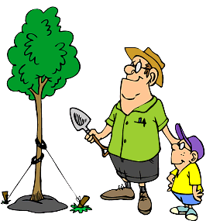
Types of Planting

Slide 2
Type of planting
1- Regular planting: In this type of planting the limited (constant) spacing were used either between planted stocks in the same row or between rows of planting.
This method is often for establishing irrigated stands by using mechanisms for soil preparation holes and opening the furrows.

Slide 3
This method can be carried out by the following shapes:
a: Square planting (quadrate)
b: Rectangular planting
c: Triangular planting

Slide 4
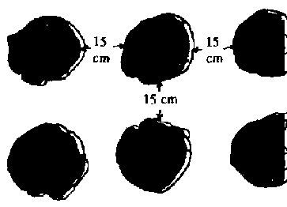
a: Square planting (quadrate):
In this shape of planting the spacing between both planted stocks and planted are rows are equal. This shape is considered as easy shape for application.

Slide 5
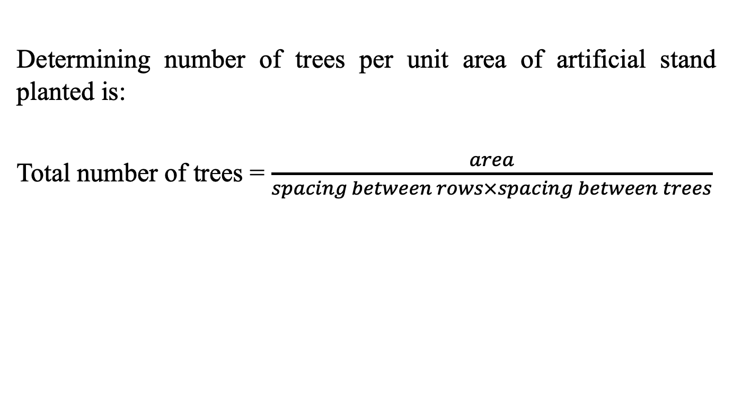
Determining number of trees per unit area of artificial stand planted is:
Total number of trees = $\frac{area}{spacing between rows×spacing between trees}$

Slide 6
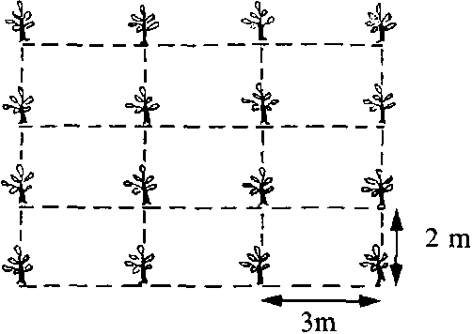

b: Rectangular planting:
In this shape of planting either the spacing between planted stocks is more than those between planted rows.
Total number of trees = $\frac{area}{spacing between rows×spacing between trees}$

Slide 7
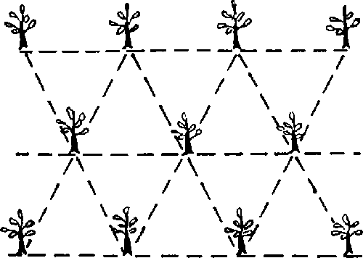
c: Triangular planting:
In this shape of planting the spacing between both planted stocks and planted are rows are equal but as alternatively shape.

Slide 8
This shape of planting is often used for:
Roadsides
Establishing windbreaks
Fixation of sandy dunes

Slide 9
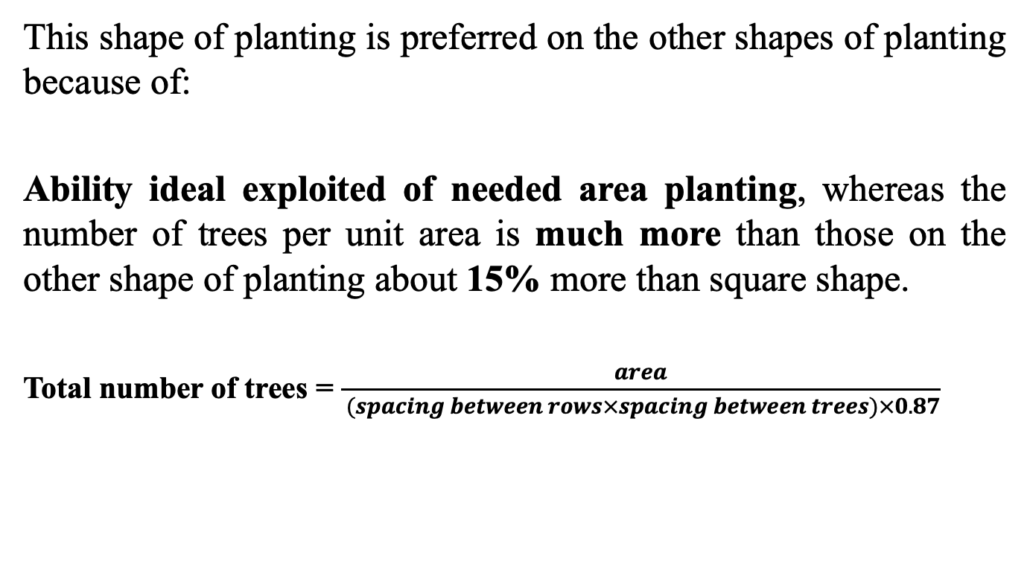
This shape of planting is preferred on the other shapes of planting because of:
Ability ideal exploited of needed area planting, whereas the number of trees per unit area is much more than those on the other shape of planting about 15% more than square shape.
Total number of trees = $\frac{area}{ (spacing between rows×spacing between trees)×0.87}$

Slide 10
2- Irregular planting:
In this shape of planting it’s not possible using constant distances between planted stocks or between planted rows due to topographic of land and existing of natural exposures in planting area as rocks or valley…etc.

Slide 11
This type of planting is often used in:
Mountain area
Mixing and replacing species
Establishing parks

Slide 12
According to the Deep of planting stocks
There are three levels of deeps for planting:-
Shallow planting:- When the connecting point of shoot with root to be above soil surface for 1–2cm, this type of planting must be avoided because a part of root system remain outside of soil surface.

Slide 13
Normal planting
When the connecting point of shoot with root system is at the level of soil surface for coniferous species, while for deciduous species the last bud existing on seedling stem must be above soil surface.

Slide 14
Deep planting
When the connecting point of shoot with root system is lower than soil surface for (1 – 2cm), this type of planting is usually used for:
Planting in Arid and Semi-arid areas
Planting in Sandy soil which is often exposed to erosion

Slide 15
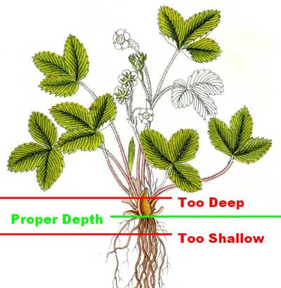
Deep of planting stocks
Shallow planting

Slide 16
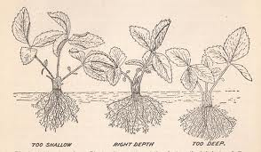
Normal planting

Slide 17
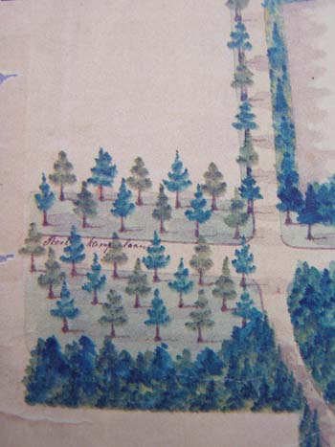
Forms of mixing species
1- Single tree mixing: Each species of tree is surrounded by another species of trees from all directions, such as Acer sp.

Slide 18
2- Row mixing
Each line with planting same species and alternative lines with another species, using two species of them are seciofite, such as different selected clones of Populus.

Slide 19
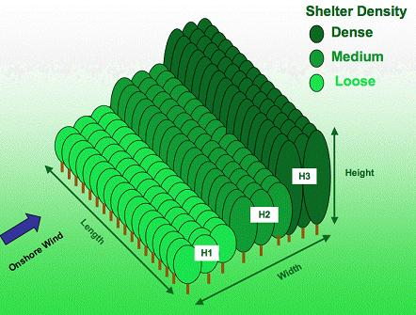
3- Strip mixing
Mixed plantations in belts composed of different species. Such as 4 rows of poplars with a spacing of 5 x 5 m are alternating with 4 rows of conifers (spacing 4 x 4m).

Slide 20
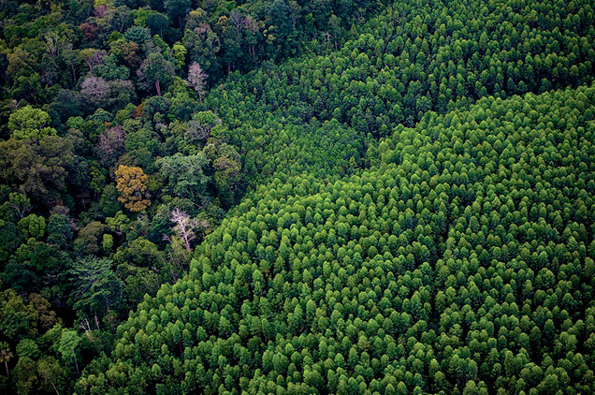
4- Patch (group) mixing
In this form of mixing the first species should be surrounded by another in the form of group. This form is often used in disturb and natural forest which cannot be regenerated naturally for any reason.

Slide 21
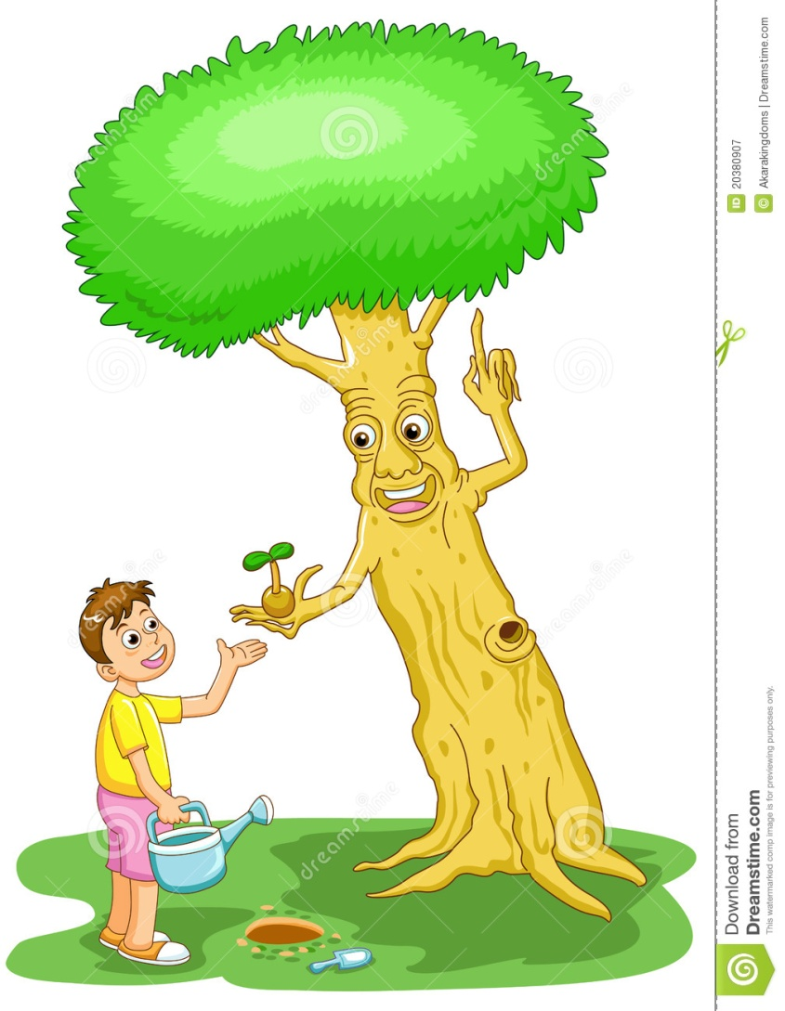
Lets be friend with trees

