Slide 1
Relationship between forests and other natural resources
How Do Trees Affect a Forest?
Trees and Shrubs
Tree Types
1- Coniferous trees
2- Broadleaved trees
Difference between Plants & Trees
Main parts of a tree
Tree Classification
Crown Classes

Slide 2
Relationship between forests and other natural resources
Forests play important roles in the water cycle, the forest filters the rain as it falls and serve as storage areas.
A forest regulates water flow, making it possible for fish and other animal and plant life to survive.
Forests filter rain and help reduce the erosion of soils. Trees and shrubs are responsible for removing much of the pollutant materials from the air and water run-off.

Slide 3
Forests and living organisms have many relationships, Algae, fungi, and other plants make their homes in the forest.
Forests also protection and nesting sites for many species of birds and fish.
Forests and wildlife relationships greatly vary depending on species; the wildlife in each forest region varies due to climate and harvesting times.

Slide 4
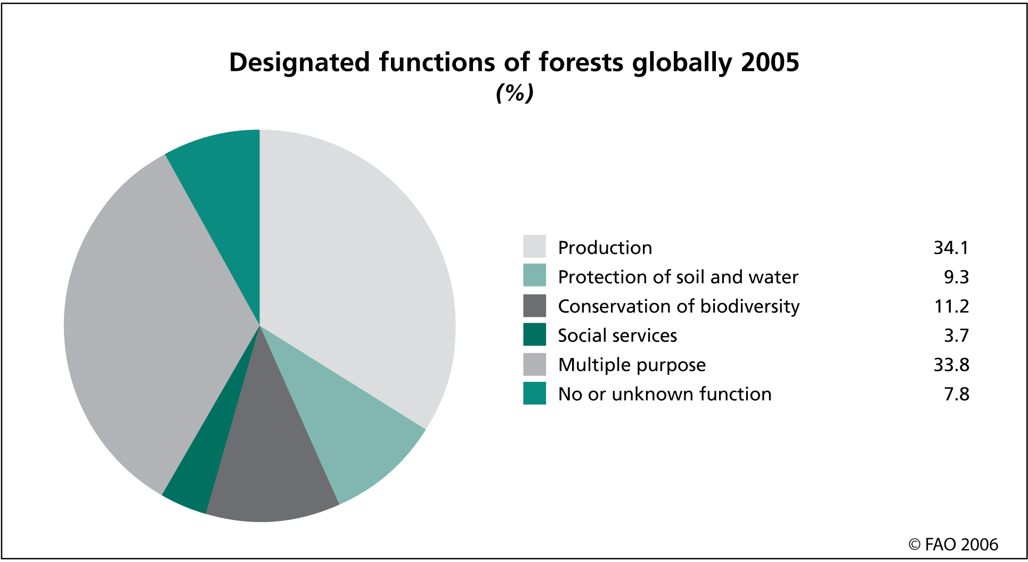

Slide 5
Importance of Trees & Forests
(Air)
Produce O₂
Absorb CO₂
(Soil)
Enrich the soil with decaying leaves etc.
(Soil)
Controls erosion
Importance of Trees & Forests
(Wildlife)
Homes
& shelter
(People)
Shade & wind protection
(Things we get from trees)
Food (nuts, fruit)
Oils
Wood
sap
(People)
recreation
Notes:
*Have the students STAR this chart as it will be on the test!!!

Slide 6
How Do Trees Affect a Forest?
They break the wind and with less air movement, there is less drying.
They shade the ground from the sun thereby lowering air temperature; forests tend to be cool, humid places and the soil is moist there.
Forest soil is also very rich in nutrient because of all the leaves, branches, and stems which decompose into humus.

Slide 7
What makes up forest?
In terms of woody plants, the two main types are trees and shrubs.
What are the main differences in a tree and a shrub?

Slide 8
Trees and Shrubs
A Tree is a woody plant, typically large with a well-defined stem and a more or less defined crown.
A Shrub is a woody plant, usually having several persistent woody stems branching from the ground.

Slide 9
What is a tree?
A tree is defined according to the following criteria:
It must have a self supporting trunk.
The trunk must be made of woody material.
A tree usually grows to a height of 5 to 7 metres.

Slide 10
Tree Types:
There are many thousands of different kinds of trees but all true trees are separated into two (2) basic classifications:
1- Coniferous trees which are also known as “evergreens” or “softwoods”
2- Broadleaved trees which are also known as “deciduous” or “hardwoods”.

Slide 11
Coniferous Trees
Includes the pines, firs and other evergreens that usually have narrow needles instead of broadleaves.
The term “evergreen” comes from the fact that the needles appear not to turn brown and fall to the ground at the approach of winter.
The evergreens do shed their needles however, they do it so slowly that there are always green needles on the trees.

Slide 12
Broadleaved Trees
This group of trees includes the oak, maple, poplar, birch and many others.
These trees have broad, flat leaves instead of needles.
Broadleaved trees produce flowers and after pollination these flowers develop seeds.

Slide 13
Difference between Plants & Trees
All other plants differ from trees in at least one of these ways.
1- No plant with a soft, juicy stem is a tree.
2- Most plants are much shorter than trees.
3- Shrubs, like trees, have woody stems; but most shrubs have more than one stem, none of the stems grow so thick as to be called a trunk.
4- Some jungle vines grow several hundred metres long and have a woody stem. However, the stems of vines cannot support themselves.

Slide 14
Four main parts of a tree
Crown: where the tree increases each year in height and spread of branches by adding on a new growth of twigs.
Leaves: make up the crown and produce food for the tree (photosynthesis).
Trunk: supports the crown and produces the majority of the tree’s useful wood.
Roots: anchors the tree, absorbs and stores water and nutrients.

Slide 15
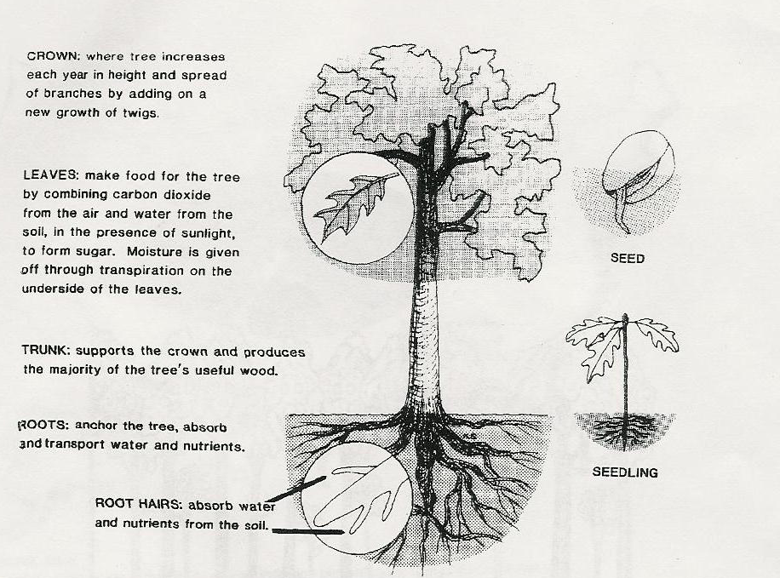

Slide 16
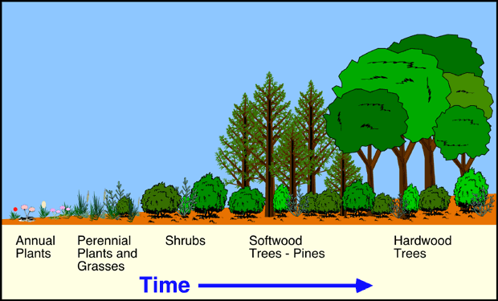

Slide 17
Tree Classification
Trees can be classified according to the position they occupy in the forest canopy or understory.
Such as system measures how well a tree has grown relative to its closet competitors. (Trees that get the most sunlight generally grow fastest).

Slide 18
Crown Classes
There are five crown classes:
Dominant: Have tops that rise above the general canopy level. They receive full sunlight from above and all sides.
Co-dominant: These trees make up the canopy level. Their crowns get full sunlight from above, but dominant and other co-dominate trees restrict some side sunlight.

Slide 19
Intermediate: These trees also occupy the average canopy level, but receive sunlight only from above.
Suppressed: These are trees that receive no direct overhead or side sunlight. They are usually are slow growing and are weak.
Dead trees (snags): These can be found in the canopy, understory or forest floor.

Slide 20
