Slide 1
Preparation of seedbeds
Seeding in the Nurseries
Broadcasted
In Lines
Drills
Depth of seed sowing
Time of seeding
Preparation of polythene bag
Transplanting
Goals and benefits of the transplanting
The points that must be taken into account during the transplanting

Slide 2
Preparation of seedbeds
Beds meant for germination of seeds are called as seed or germination or mother beds or seed flats.
They help to maintain the germinated seeds for certain period. As these germinated seedlings are to be transferred to another bed or containers for further growth, the rooting medium should facilitate easy lifting (without any damage to roots).
The desirable size of the nursery bed may be 1 X 10 m.

Slide 3
Seeding in the Nurseries
Usually there are three methods of seed sowing in nursery beds are adopted:
Broadcast
In Lines
Drills

Slide 4
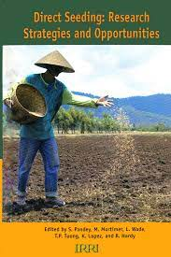
1. Broadcast seeding
In broadcast seeding, the small seeds such as Eucalyptus and Casuarina are sown.
The seeds should not be sown very dense because
it results in:
Poor germination
Greater mortality
Weak stock
Difficulty in weeding

Slide 5
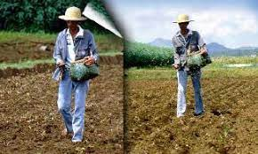
The small seeds are mixed with sand, ash or fine soil twice or three times of seeds size to facilitate the uniform distribution of the seeds.
After sowing, the area is leveled to cover the seeds.

Slide 6
Advantages of the method
The area is covered soon
Getting a lot of seedlings in small area
Requires preparation of whole area and large quantity of seed which is needed.

Slide 7
Disadvantages
Practiced only for small size seeds.
Not getting to good seedlings because the seedlings competing each other to get (sunlight, humidity, air, nutrients, etc.)

Slide 8
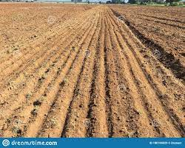
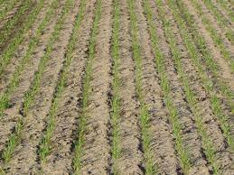
2. Line sowing: (Drill seeding)
Line sowing is generally considered good method of seeding and can be practiced for small and large size seeds.
Seeds should be sown in lines running across
the width of the bed.
The spacing of seeds in drills (Line) depends
upon species and size of the plants.
Spacing of drills varies from 8 cm to 25 cm.

Slide 9
Advantages
Can be practiced for small and large size seeds.
The cost of soil preparation and quantity of seed required in line sowing is comparatively less than broadcast sowing.
Getting good seedlings because the seedlings not competing each other.

Slide 10
Disadvantage
Getting of seedlings is little compared to broadcast sowing.

Slide 11
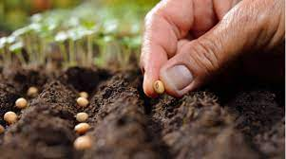
3. Dibbling
Large size seeds can easily be dibbled. Dibbling refers to sowing of seeds in shallow holes at definite intervals.
It is the good method as both spacing and
depth are controlled at the time of sowing.
Although; it is difficult to practice on large
scale.
Seeds of Acacia, Quercus and Juglans are sown by this method.

Slide 12
Depth of seed sowing
Sowing depth is generally twice the diameter of the seed. For example, Seed with a diameter of (3 cm) is sown at a depth of (6 cm).
If seed is sown too deep the food reserves in the seed may be depleted before the seedling has formed green leaves for its nourishment.
Similarly, the seeds should not be left on the surface of the bed because the seeds may be eating by birds and insects or drying by sun ray.

Slide 13
Time of seeding
The time of seeding depends on many factors such as:
Ripening of seed
Stage of dormancy
Rate of species growth
The size of plants required at the time of planting
Time of sowing in different tree species varies and most of them are coinciding with the period January to March.

Slide 14
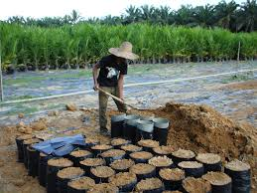
Preparation of polythene bag
Polythene bags are available in different size and thickness. Selection of polythene bag gauge and their size are depending upon:
The period for which the seedlings are to be grown
The size of seedling or seedling growth
The polythene bags should have two small holes to
allow drainage.
Bags filled are to be arranged in beds each having the capacity of 1000 numbers (10 X100 lines).

Slide 15
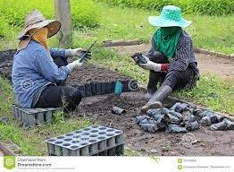
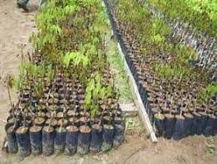
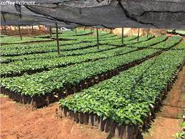

Slide 16
Transplanting
Transplanting is a transfer of seedlings from seedbeds places to wider places as seedbeds transplanting or pots of different kinds.
Preferable time varies from species to species and it generally starts after first week of germination and lasts up to one month.
At the time of transplanting the seedlings should be held with the thumb and forefinger below the first pair of leaves and pulled up from the germination beds.

Slide 17
The polythene bags should well be watered before picking the seedlings and transplanting should be done in holes made by inserting small wooden stick to a depth longer than the taproot of the seedling.
The seedlings should be planted without any bend.
Hole must be filled with soil and pressed firmly on all sides.

Slide 18
The most important goals and benefits of the transplanting
Reduction of overcrowding and competition between them in the seedbeds to get food and light and humidity
The production of good seedlings
Development of the root of the seedlings
Composition of the balance between stem and roots

Slide 19
The most important points that must be taken into account during the transplanting
Take care to not cut or injured roots of seedlings.
Do not leave seedlings especially the roots that exposed to air currents and the sun.
Seedlings are planted immediately after extraction in moist areas.
Do not leave roots of seedlings in dry and should be the roots moist during the process of transplanting.

Slide 20
5. Irrigate the container or plastic bags immediately after transplanting.
6. Transplanting in Deciduous should be before the conifers, because in deciduous; start the composition of branches in the spring before the conifers.
7. Do not do the process of transplanting in hot weather and should be left the process in the high temperatures and also when the wind picks up.

