Slide 1
Principle of Forestry
What is a Forest?
Types of Forests
Forest structure
Parts of a forest

Slide 2
What is a Forest?
A Forest is a community of trees, shrubs, herbs, and associated plants and organisms that cover a considerable area that use oxygen, water and soil nutrients as the community attains maturity and reproduces itself.
A Forest is a community of living and non-living things where the main species is trees.
Everything in a forest is connected. Everything affects everything else.

Slide 3
What is a Forest?
As a result, the forest is made up of small and large areas of different aged trees, often with a mixture of different species.
A forest with many trees of different ages and types supports a variety of wildlife.
Without a variety of trees in the forest the variety of animal life would be greatly decreased.

Slide 4
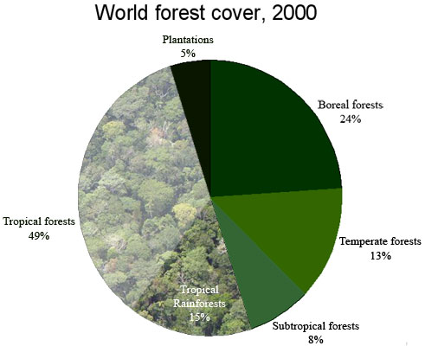

Slide 5
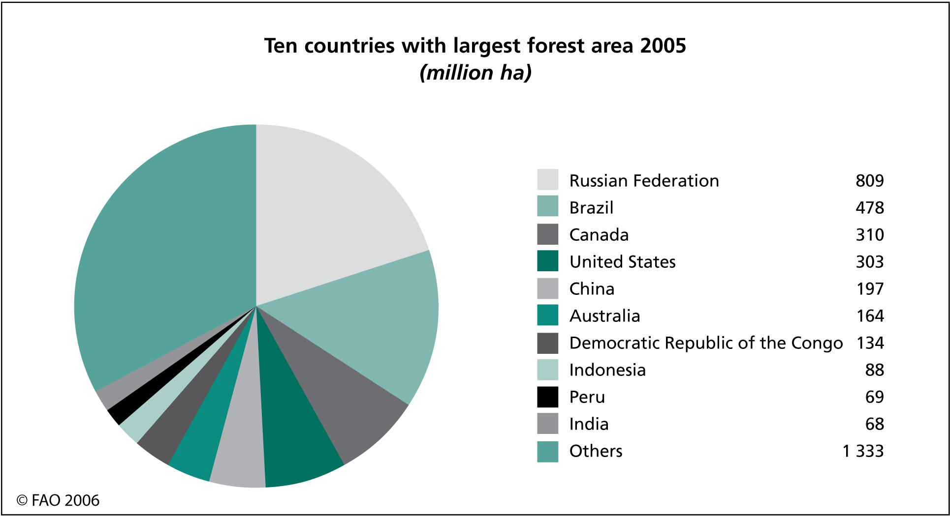

Slide 6
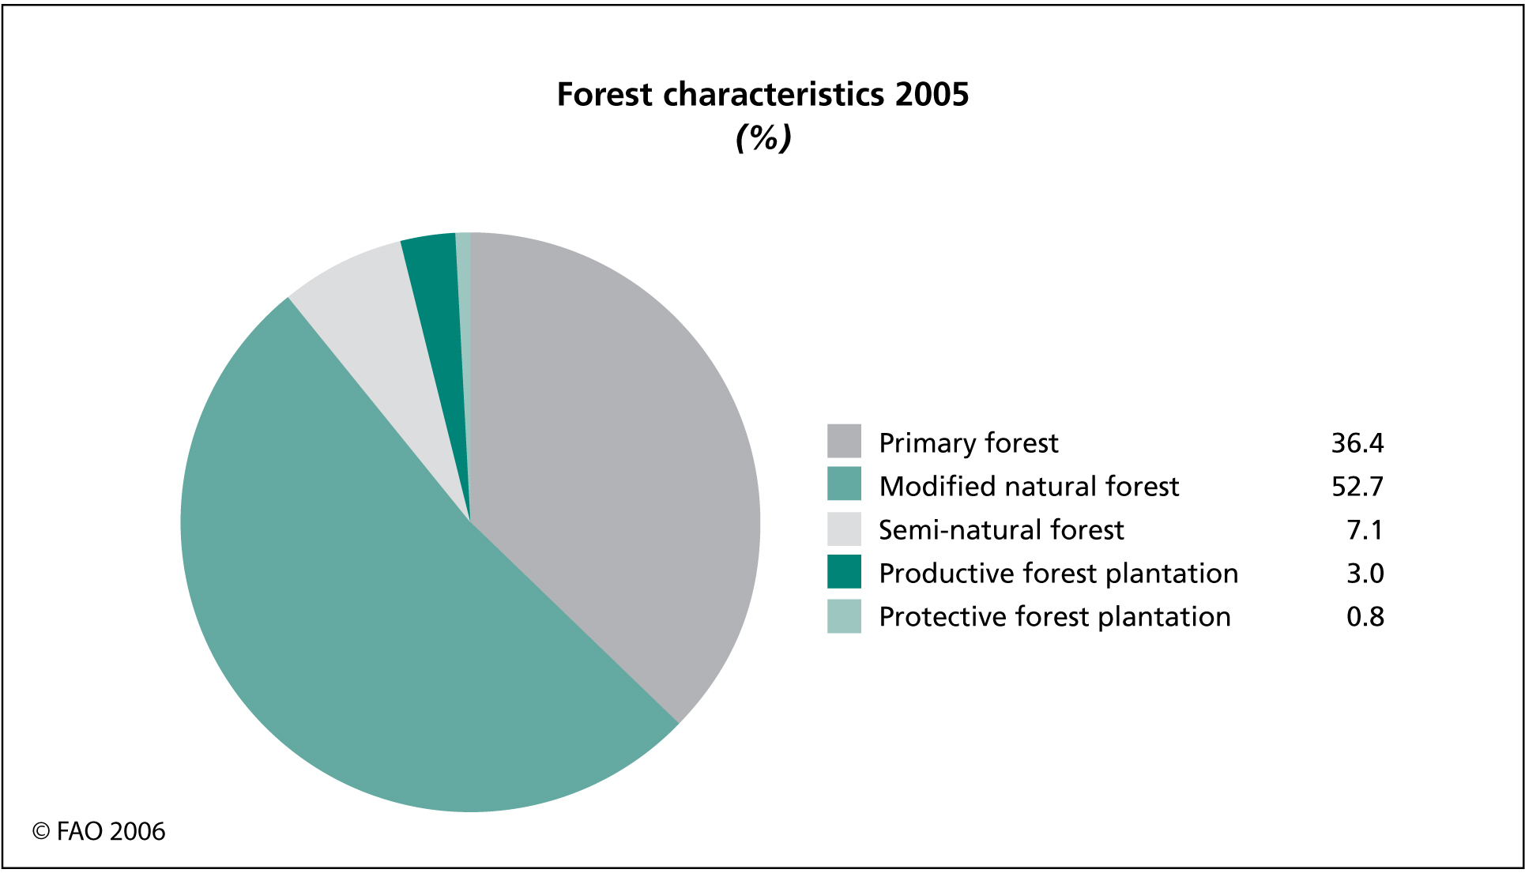

Slide 7
Types of Forests
Forests come in all Shapes and Sizes. The many different types of forest are generally classified according to Location and Climate.
Pure forest
Mixed forest

Slide 8
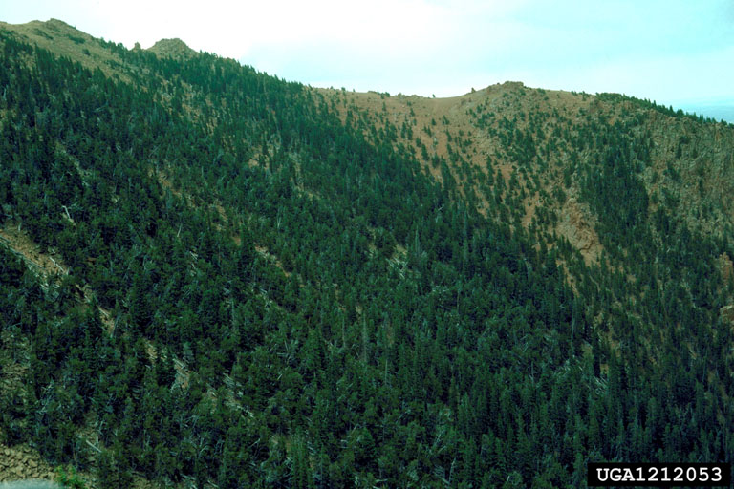
1- Pure forest
A forest in which one species makes up 80% or more of the total number of trees.

Slide 9
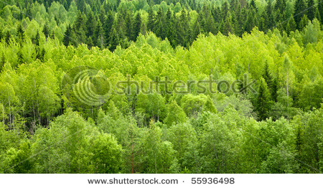
2- Mixed forest
A forest consists of two or more types of trees, with no more than 80% of the most common tree.

Slide 10
Forest structure
A forest has a distinct vertical structure. Within a healthy forest, there are recognizable layers of plants, from the soil to the treetops. Each of these layers is composed of one or more dominant types of plants.
Five layers that appear in most forests:
The canopy
Shrub
Herbaceous
Litter
Soil layers

Slide 11
Forest canopy: Formed by the branches and leaves from the tallest trees
Understory: The middle layer where shorter trees and shrubs grow.
Forest floor: Is the third layer where trees begin as seedlings. Tree roots also make up this layer that hold onto to soil and organic matter so that grasses, fungi, microorganisms and animals may flourish.

Slide 12
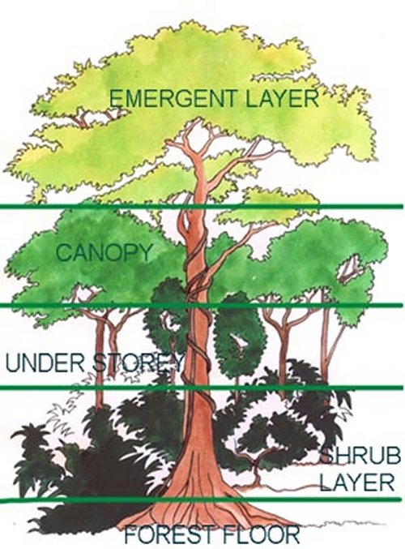

Slide 13
Parts of a forest
The living parts of a forest include trees, shrubs, grasses and other herbaceous (non-woody) plants, algae, fungi, insects, mammals, birds, and microorganisms living on the plants and animals and in the soil.
These interact with one another and with the non-living part of the environment - including the soil, water, and minerals, to make up what we know as a forest.

Slide 14
Levels of the Forest
Level:
Plant:
Animal:
Upper Canopy
top level of the forest formed by leaves & branches of tallest trees.
Different birds and insects
Level:
Plant:
Animal:
Middle Level or Understory
Smaller trees & shrubs
Insects, woodpeckers and many other birds
Level:
Plant:
Animal:
Herb, Underbrush or Shrubbery Layer
Ferns, wildflowers and other soft stem plants, tree seedlings.
Level:
Plant:
Animal:
Forest Floor
Ground cover and soil, leaf litter, mushroom, flowers.
bacteria, soil insects, spiders
Notes:
*Have students label the levels and names of plants and animals found in each level on Master #3 of EPSB
*Discuss reasons why plants and animals need to live at those levels.
*Divide students into 4 groups of 4 and 5. Each group will create a mural panel of one of the levels.

