Slide 1
Spectroscopy
Second Semester
Dr. Shireen Ibrahim

Slide 2
Spectroscopy and Spectroscopic Measurements
Chapter one

Slide 3
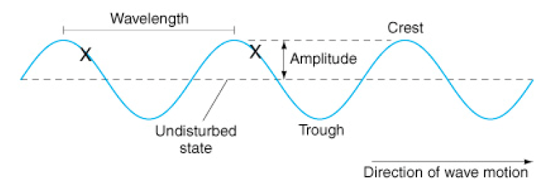
Properties of ElectroMagnetic Radiation (Light)
Introduction
A.) Spectroscopy: A method of analysis based on the interaction, absorption or production of light by matter. (also may include the interaction of electrons, ions with matter)
B.) Light: visible part of Electromagnetic radiation
Two different views of light:
1.) Wave Model: (Maxwell) wave properties of light

Slide 4
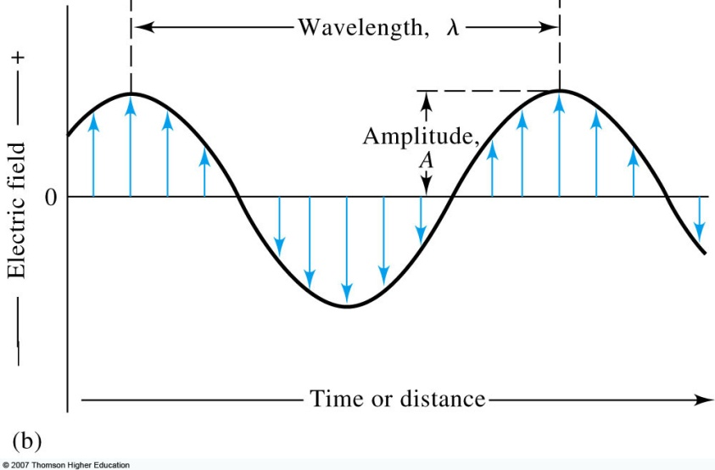
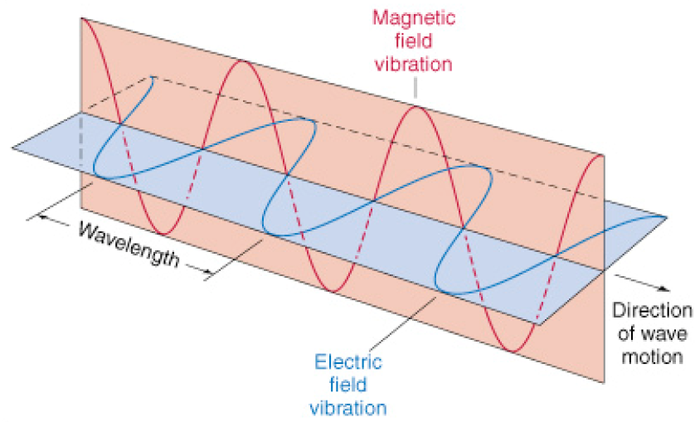
1. Wave Model
i.) represented by a sinusoidal wave traveling in space with an oscillating electric field and perpendicular magnetic field. (electric field is what is considered or used in most spectroscopic methods – except NMR)
ii.) description of wave model
1) amplitude (A) – height of wave’s electric vector
2) wavelength (λ) – distance (nm, cm, m) from peak to peak
a) wave number ( ) = 1/λ (cm⁻¹)

Slide 5
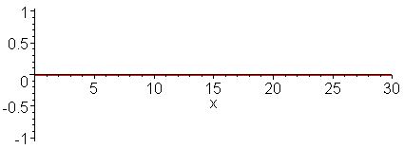
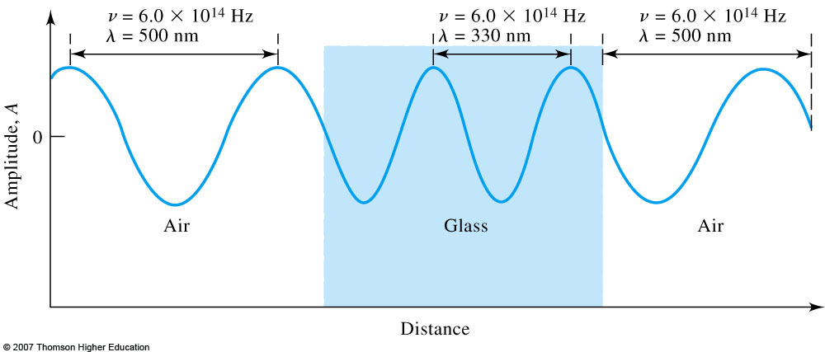
1. Wave Model
ii.) description of wave model
3) frequency (ν) – number of cycles or oscillations per second
a) hertz (Hz) or s⁻¹.
4) velocity of propagation (v_{i}) – rate of travel through space, dependent on composition of medium
a) v_{i} = νλ_{i}
b) maximum velocity (c) – speed of light in a vacuum (3.00 x10⁸ m/s)
c) slower in other media (~ 0.03% slower in air)

Slide 6
2. Particle Model (max plank):particle properties of light:
i.) light viewed as discrete particles of energy called photons
a) like other particles, light can be scattered, counted (quantized) , etc
ii. ) Energy of wave/particle:
E = hν = hc/λ = hc
h = Plank’s constant (6.63 x 10⁻³⁴ J.S)
ν = frequency, λ = wavelength, =wave number
note:
energy is proportional to frequency and wave number (áν óáE)
energy is inversely proportional to wavelength (áλ óâΕ)
Energy required of photon to give this transition:
ΔΕ = Ε₁ − Ε_{ο}

Slide 8
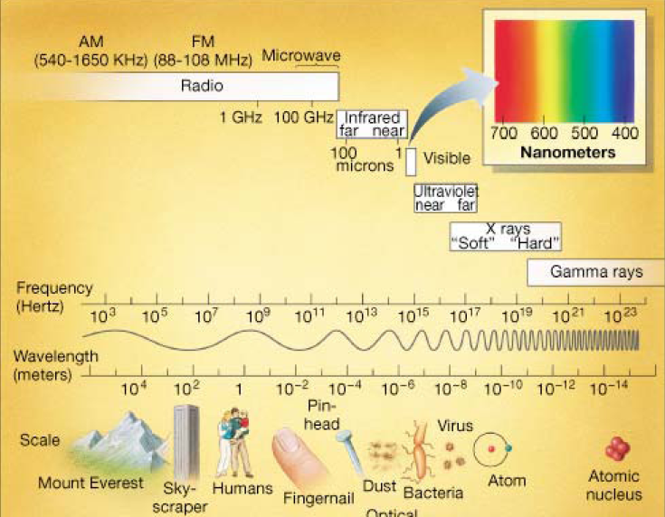
Wide Range of Types of Electromagnetic Radiation in nature.
Only a small fraction (350-780 nM is visible light).
The complete variety of electromagnetic radiation is used throughout spectroscopy.
Different energies allow monitoring of different types of interactions with matter.

Slide 9
Common Spectroscopic Methods Based on Electromagnetic Radiation
Type of Spectroscopy | Usual Wavelength Range | Usual Wave number Range, cm⁻¹ | Type of Quantum Transition
Gamma-ray emission | 0.005-1.4 Å | _ | Nuclear
X-ray absorption, emission, fluorescence, and diffraction | 0.1-100 Å | _ | Inner electron
Vacuum ultraviolet absorption | 10-180 nm | 1x10⁶ to 5x10⁴ | Bonding electrons
Ultraviolet visible absorption, emission, fluorescence | 180 -780 nm | 5x10⁴ to 1.3x10⁴ | Bonding electrons
Infrared absorption and Raman scattering | 0.78-300 μm | 1.3x10⁴ to 3.3x10¹ | Rotation/vibration of molecules
Microwave absorption | 0.75-3.75 mm | 13-27 | Rotation of molecules
Electron spin resonance | 3 cm | 0.33 | Spin of electrons in a magnetic field
Nuclear magnetic resonance | 0.6-10 m | 1.7x10⁻² to 1x10³ | Spin of nuclei in a magnetic field

Slide 10
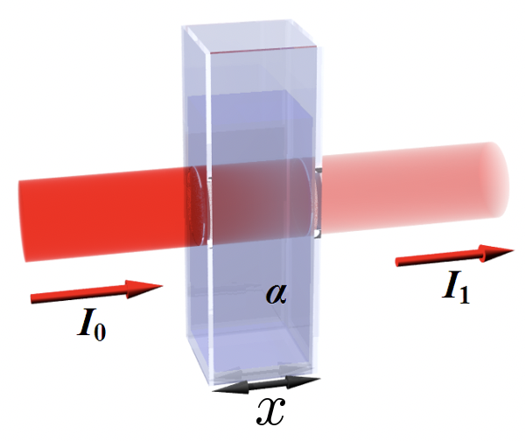
The Lambert-Beer Law:
The fact that transmittance of light varies exponentially as it passes through an absorbing medium was rediscovered by Johann Heinrich Lambert in 1760. Later, in 1852, August Beer defined absorbance:
A = -log₁₀(T)
When no light is absorbed, I_{E} = I_{O}, T = 1.00 and A = 0. When 90% of the light is absorbed, T = 0.1 and A = 1. Beer then showed that absorbance was linearly related to concentration.

Slide 11
These two men are given credit for the Lambert-Beer Law:
A = abc
Where a = a constant which takes into account the specific properties of the molecules which are absorbing photons, b = sample path length, usually given in centimeter units, and c = concentration of solution. Note that Absorbance is unitless, so the units of the constant a must be the inverse of the units of path length and concentration. For example, if b is in centimeter units and c is in mg/mL units, then a must be in mL*mg⁻¹*mL⁻¹ units.
When b has M⁻¹*cm⁻¹ units, we call it the molar absorption coefficient (formerly called the extinction coefficient) and designate it as ε. This means the concentration of the solution must be expressed in Molarity units. Also, some chemists will use l instead of b to denote path length.
A = εlc

