Slide 1
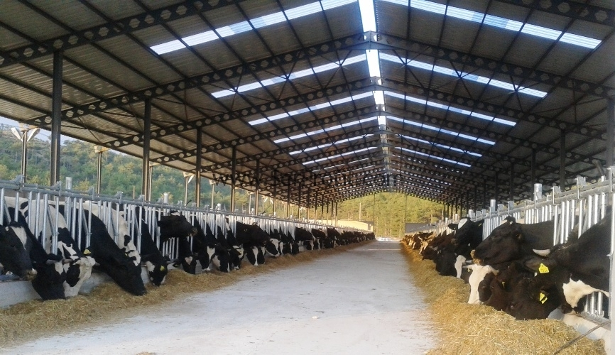
LEC. SHIREEN IHSAN
ANIMAL RESOURCE DEPARTMENT
STAGE 4
DAIRY CATTLE PRODUCTION – PRACTICAL
2022-2023
SECOND SEMESTER
Dairy Cattle Barns

Slide 2
Dairy Cattle Barns
It is known that environmental factors significantly affect animal productivity and ability to express its genetic capacity and its productive properties, as well as its impact on animal health and activity. Therefore, the provision of suitable pens should be necessary for animal husbandry. Therefore, when establishing a livestock breeding project, when constructing barns:

Slide 3
Daily Field Operations
1. Cleaning Barns :
These operations must be conducted daily using mechanization in cleaning barns, especially breeding calves barns because the accumulation of dung and increase moisture in barns can lead to animal injury various diseases, especially in the winter diseases such as respiratory and skin diseases and rotting hooves, because it becomes a suitable environment for the growth of microorganisms that cause these diseases.
Figure (1) Cleaning dung duct

