Slide 1
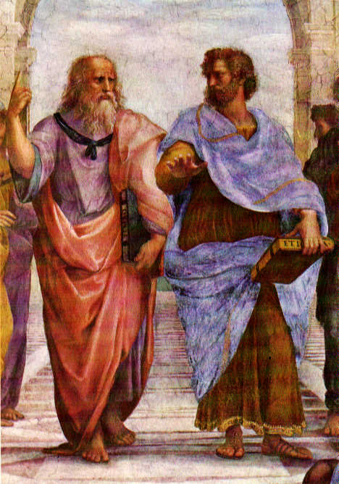
Plato: Republic
Dr. Shireen S. Rashid

Slide 2
Argument for Analysis:
Soujourner Truth, Women's Convention in Akron, Ohio, 1851:
“Well, children, where there is so much racket there must be something out of kilter. I think that 'twixt the negroes of the South and the women at the North, all talking about rights, the white men will be in a fix pretty soon. But what's all this here talking about?
That man over there says that women need to be helped into carriages, and lifted over ditches, and to have the best place everywhere. Nobody ever helps me into carriages, or over mud-puddles, or gives me any best place! And ain't I a woman? Look at me! Look at my arm! I have ploughed and planted, and gathered into barns, and no man could head me! And ain't I a woman? I could work as much and eat as much as a man - when I could get it - and bear the lash as well! And ain't I a woman? I have borne thirteen children, and seen most all sold off to slavery, and when I cried out with my mother's grief, none but Jesus heard me! And ain't I a woman?
Then they talk about this thing in the head; what's this they call it? [member of audience whispers, "intellect"] That's it, honey. What's that got to do with women's rights or negroes' rights? If my cup won't hold but a pint, and yours holds a quart, wouldn't you be mean not to let me have my little half measure full?
Then that little man in black there, he says women can't have as much rights as men, 'cause Christ wasn't a woman! Where did your Christ come from? Where did your Christ come from? From God and a woman! Man had nothing to do with Him.
If the first woman God ever made was strong enough to turn the world upside down all alone, these women together ought to be able to turn it back , and get it right side up again! And now they is asking to do it, the men better let them.
Obliged to you for hearing me, and now old Sojourner ain't got nothing more to say.”

Slide 3
Argument for Analysis
1) If women are equally capable, they deserve rights, same as men.
2) Women are equally capable.
(Look at me! I’m capable, and ain’t I a woman?)
3) Women deserve rights same as men.

Slide 4
Argument for Analysis
It’s wrong to say that people are always selfish just because our voluntary actions involve pursuit of our own ends. We can see unselfish actions all the time! Sometimes people even act in ways that are dramatically selfless, sacrificing their central interests and even their lives for the sake of others. To say that an action is selfish is not just to say that it’s done in pursuit of the actor’s own ends, it’s to say that it’s done for the sake of selfish or narrowly self-interested ends. If a person aims to benefit others around her, she’s not selfish even if her voluntary efforts to achieve this aim are efforts to achieve an aim that is her aim.

Slide 5
It’s wrong to say that people are always selfish just because our voluntary actions involve pursuit of our own ends. We can see unselfish actions all the time. Sometimes people even act in ways that are dramatically selfless, sacrificing their central interests and even their lives for the sake of others. To say that an action is selfish is not just to say that it’s done in pursuit of the actor’s own ends, it’s to say that it’s done for the sake of selfish or narrowly self-interested ends. If a person aims to benefit others around her, she’s not selfish even if her voluntary efforts to achieve this aim are efforts to achieve an aim that is her aim.
Alternative Conclusions:
C1) Psychological egoism (PE) is false.
C2) The fact that <people always pursue their own ends> does not imply that <people are always selfish.>
1) If PE were true, people would never act unselfishly.
2) People act unselfishly. (“We can see unselfish actions all the time.”)
C1) Therefore PE is false.
1) People are selfish when they narrowly pursue selfish ends.
2) The fact that people’s ends are their own ends does not imply that they are selfish ends.
C2) The fact that <people always pursue their own ends> does not imply that <people are always selfish>.

Slide 6
HIS CONCEPT ABOUT LAW
“Only stupid people obey the laws of “justice.” People who put these rules and laws in place do so for their own benefit, not for the benefit of the public. So when you do what “justice” requires, you’re just serving the selfish interests of someone else instead of serving your own interests. For example, the American legal system sets in stone values and rules that serve the big corporations who can hire lobbyists, while the interests of people who are poor or middle class can easily be ignored. The interests of ordinary middle-class citizens don’t even get on the table, because we can’t compete with the billions of dollars corporations pay to buy and influence politicians. Even worse, the politicians, corporations, and lobbyists convince people that they’re doing right by obeying the stupid, self-serving laws they enact. So people are not only enslaved because they’re forced to obey laws that serve the interests of others, their minds are enslaved too, since they are persuaded that “justice” or “morality” requires that they obey those rules!”

Slide 7
“Only stupid people obey the laws of “justice.” People who put these rules and laws in place do so for their own benefit, not for the benefit of the public. So when you do what “justice” requires, you’re just serving the selfish interests of someone else instead of serving your own interests. For example, the American legal system sets in stone values and rules that serve the big corporations who can hire lobbyists, while the interests of people who are poor or middle class can easily be ignored. The interests of ordinary middle-class citizens don’t even get on the table, because we can’t compete with the billions of dollars corporations pay to buy and influence politicians. Even worse, the politicians, corporations, and lobbyists convince people that they’re doing right by obeying the stupid, self-serving laws they enact. So people are not only enslaved because they’re forced to obey laws that serve the interests of others, their minds are enslaved too, since they are persuaded that “justice” or “morality” requires that they obey those rules!”
1) To be “Just” is to follow the laws and rules of justice. (Assumed not stated?)
2) Laws and rules only serve the interests of people who make them, not the interests of those who follow them.
3) It’s stupid to follow laws and rules that only serve other people’s interests.
Conclusion: It is stupid to be just. (to “obey the laws of justice.)
NOTE: This interpretation only captures part of the argument made here. It omits the argument about Platonic ignorance. Can you develop an interpretation that captures that part?

Slide 8
HIS IDEA ABOUT PRISON
“American prison doesn’t correct or reform convicted criminals who are incarcerated. Instead, American prisons brutalize people, and provide an excellent education for ambitious future criminals. Our politicians gain support by claiming that they will make prisons harsher and harder, as a disincentive to criminals. But this is just wrong and unjust: people are put in prison as punishment, not for punishment. And there is no evidence that criminals are deterred when prisons are harsh. When people leave our prisons, they are well equipped to be better criminals, but they are systematically excluded from the job market– our prisons make people worse, not better. Because of this, people who leave our prisons usually find that their most profitable option is to return to crime: . It may be understandable that we have organized our prisons around harsh treatment of criminals, because crime makes people angry, and anger makes people want to hurt those who have caused harm. But anger is not justice, and harsh treatment is not “correction,” it is brutalization. We should organize our prisons so that they reform criminals, so that they learn alternatives to crime, so that they are rehabilitated, not brutalized.”

Slide 9
Argument for Analysis
American prisons- our “department of corrections’- doesn’t correct or reform convicted criminals who are incarcerated. Instead, American prisons brutalize people, and provide an excellent education for ambitious future criminals. Our politicians gain support by claiming that they will make prisons harsher and harder, as a disincentive to criminals. But this is just wrong and unjust: people are put in prison as punishment, not for punishment. And there is no evidence that criminals are deterred when prisons are harsh. When people leave our prisons, they are well equipped to be better criminals, but they are systematically excluded from the job market– our prisons make people worse, not better. Because of this, people who leave our prisons usually find that their most profitable option is to return to crime: recidivism rates in the American “corrections” system are through the roof. It may be understandable that we have organized our prisons around harsh treatment of criminals, because crime makes people angry, and anger makes people want to hurt those who have caused harm. But anger is not justice, and harsh treatment is not “correction,” it is brutalization. We should organize our prisons so that they reform criminals, so that they learn alternatives to crime, so that they are rehabilitated, not brutalized.
1) It is wrong and unjust to punish people in ways that make them worse instead of making them better.
2) The American prison system makes people worse.
Conclusion: The American prison system is wrong and unjust.
Plato: “Justice never harms those who are subject to it.”

Slide 10
Argument for Analysis:
The more real something is, the more permanent and unchanging it will be. Things that are really permanent, forever unchangeable, must therefore be the most real things of all. Physical objects like tables and chairs change regularly, so they must be less real. Fundamental ideas are permanent and unchanging– for example, you can’t change the number two by erasing its symbol from the board. So ideas must be more real than physical objects.
True knowledge can only be knowledge of things that are permanent and unchanging. Since ideas are the only things that are permanent and unchanging, the only true knowledge we can have must be knowledge of ideas. There can be no real knowledge of changeable physical objects.

Slide 11
Argument 1:
The more real something is, the more permanent and unchanging it will be. Things that are really permanent, forever unchangeable, must therefore be the most real things of all. Physical objects like tables and chairs change regularly, so they must be less real. Fundamental ideas are permanent and unchanging– for example, you can’t change the number two by erasing its symbol from the board. So ideas must be more real than physical objects.
Argument 2:
True knowledge can only be knowledge of things that are permanent and unchanging. Since ideas are the only things that are permanent and unchanging, the only true knowledge we can have must be knowledge of ideas. There can be no real knowledge of changeable physical objects.
1) Things are more real when they are more permanent.
2) Physical objects are less permanent than fundamental ideas.
3) Fundamental ideas are more real than physical objects.
1) We can only have knowledge about things that are permanent and unchanging.
2) Ideas are the only things that are permanent and unchanging.
3) Ideas are the only things we can know.
1) We can only have knowledge of things that are permanent and unchanging.
2) Physical objects are not permanent and unchanging.
3) We can never have knowledge of physical objects.

Slide 12
Argument for Analysis
People aren’t responsible for things we do from ignorance. For example, we don’t hold people legally responsible who act under delusions, or who didn’t understand that their actions would harm others. This is even clearer in the case of moral responsibility: if someone had no reason to believe that her action would be harmful to others, then we should not hold her blameworthy for harms she would not have perpetrated if she had only understood what she was doing. But as Plato shows us, people who do wrong or unjust actions are always ignorant in one way or another: all wrong, unjust, or immoral actions are things people wouldn’t do if they properly understood that they were behaving badly. To recognize an action as bad is to recognize that it’s not choiceworthy. People who act wrongly are mistaken about the choiceworthiness of the actions they consider. So people never act voluntarily when they do what is wrong or unjust. For this reason, they’re not properly responsible for what they’ve done.

Slide 13
People aren’t responsible for things we do from ignorance. For example, we don’t hold people legally responsible who act under delusions, or who didn’t understand that their actions would harm others. This is even clearer in the case of moral responsibility: if someone had no reason to believe that her action would be harmful to others, then we should not hold her blameworthy for harms she would not have perpetrated if she had only understood what she was doing. But as Plato shows us, people who do wrong or unjust actions are always ignorant in one way or another: all wrong, unjust, or immoral actions are things people wouldn’t do if they properly understood that they were behaving badly. To recognize an action as bad is to recognize that it’s not choiceworthy. So people never act voluntarily when they do what is wrong or unjust. For this reason, they’re not properly responsible for what they’ve done.
1) Wrong, bad, and unjust actions are not choiceworthy.
2) If one recognizes an action as bad is then one knows it’s not choiceworthy.
3) No one voluntarily chooses to perform an action if he recognizes it as not-choiceworthy.
4) So people who perform such actions are acting from ignorance.
5) Actions that arise from ignorance are not voluntary.
Conclusion: Wrong, bad, and unjust actions are not voluntary.

Slide 15
Some Background on Plato:
Plato: 427-347 BCE
Athens in 400-300 BCE: a place of high culture and intellect, in which philosophic dialogue could flourish (this may have been possible only because Athenians held slaves.)
Plato lived during a time of turmoil in Athens: by the time this dialogue became available, many of the people named in it had died, executed or in political struggle.

Slide 16
Reading Plato:
Dialogue form: Plato's writings are in the form of dialogues- careful philosophical conversations, in which one character (usually Socrates) propounds Plato's own views. Other characters in the dialogues usually have lots of lines like "Yes Socrates." "Oh of course Socrates" "Why of course, you've made that perfectly clear Socrates, you're so clever and wise..."
Others, like Thrasymachus in Republic Book I, are usually passionate and bullying, and are driven to mouth frothing fury by the inexorable reason of Socrates.
Sophists: ['sophistry'] Traveling teachers who took money for teaching. Plato looked down on them, and his contempt is usually reflected in the writings of contemporary philosophers, who nevertheless accept their paychecks. [Plato was independently wealthy, and apparently despised those who weren't.] Thrasymachus was a real person– a sophist who taught public speaking and reasoning skills.

Slide 17
Reading Plato:
Socrates (469-399 BC) -neglected his work and family to wander streets and talk -Oracle at Delphi claimed that he was the wisest man alive. But Socrates believed that he knew nothing. Reasoned that if the Oracle was right, it must be because he at least knew that he was ignorant, while others falsely believed that they had knowledge.
Socratic Method- asking questions and offering counterexamples in a manner which ultimately leads the other person to reach the right (or at least a better) conclusion.
Philosopher as “gadfly” (to prick at complacently held prejudice, and ill founded opinion) or MIDWIFE (to help others to give birth to truth, by asking the right questions to help them to figure out what the answer might be).
Meiutic method: Philosophical dialogue aims to help people to give birth to their own ideas, not simply to persuade others or provide them with information.
Socrates was condemned to death for being "an evil doer and a curious person, searching into things under the earth and above the heaven; and making the worse appear the better cause, and teaching all this to others” and for “corrupting the youth of the city” by teaching them philosophy.

Slide 18
Reading Plato:
Plato
-Socrates most celebrated student
Two older brothers (Glaucon and Adiamantus) who figure in the Republic. All were fortunate to come from a wealthy and important family. Related on fathers side to last king of Athens, on mothers to Solon, founder of Athenian Law.
Plato originally named Aristocles after his father Ariston, but was nicknamed Plato by his wrestling coach, since Plato is the Greek word for 'broad.' (Probably referred to the width of his forehead or shoulders.)

Slide 19
Some Influences on Plato:
Influence of Parmenides: Parmenides argued that reality must be timeless and changeless.
Plato: True knowledge is knowledge of the timeless and unchanging.
Influence of Heraclitus: Nothing is permanent in the sensible world.
Plato: We cannot get knowledge of the timeless and unchanging truths by using our senses alone.
Consequence for Plato: Knowledge is not derived from the senses but from the intellect.

Slide 20
Plato’s Works:
Three Periods:
1) Early "aporetic" dialogues: (Laches, Apologia, Crito, Euthyphro) Socrates doesn't advance new views, just knocks down those of other people. Form: “What is x?”
2) Middle- offers positive theories of his own. For example, in The Republic, a paradigmatic middle dialogue, Socrates presents his theory of justice for the state, of justice for the individual, and his theory of forms.
3) Late- Finally, in his later dialogues, (Laws, Theatetus, Timias, Sophist) Plato shies away from positive exposition. In his later years, he conceived of philosophy as a never-ending process, since he concludes that we love only what we do not have. As lovers of knowledge, then, we must be without knowledge. Socrates is often not even portrayed in the later dialogues, and there is considerable controversy as to how much of the various dialogues should be attributed to Socrates and how much to Plato. Clearly there is more of Plato (and less of Socrates) in the later dialogues.

Slide 21
Aporea:
State of suspended judgment.
The ‘aporetic’ dialogues leave us with a suspension of our false beliefs, but don’t replace them with The Truth.

Slide 22
How to Read Plato:
1) First, read the story line, catching the main subjects discussed and the main divisions marking change of subject or direction.
2) Then Go Back and read for more specific content of the arguments. Tease out the structure of the dialogue and the patterns of reasoning, the claims being made, the arguments being offered.
3) Reconstruct the argument in your own terms, including consideration of possible objections or alternatives.
4) Go back and see whether Plato has actually addressed your objections or worries.

Slide 23
Can we learn philosophy from a book?
PLATO, in fact, had a serious mistrust of books
See Phaedrus ([274b-277a].

Slide 24
From Pheadrus:
Socrates: [Socrates tells of the response of Thamis, King of Egypt, to Theuth, the inventor of letters.] O most ingenious Theuth, the parent or inventor of an art is not always the best judge of the utility or inutility of his own inventions to the users of them. And in this instance, you who are the father of letters, from a paternal love of your own children have been led to attribute to them a quality which they cannot have; for this discovery of yours will create forgetfulness in the learners' souls, because they will not use their memories; they will trust to the external written characters and not remember of themselves. The specific which you have discovered is an aid not to memory, but to reminiscence, and you give your disciples not truth, but only the semblance of truth; they will be hearers of many things and will have learned nothing; they will appear to be omniscient and will generally know nothing; they will be tiresome company, having the show of wisdom without the reality.

Slide 25
"Books cannot answer back and respond to the objections they provoke; there is no real dialogue of minds between writer and reader, only between two people actually engaged in philosophical discussion. Plato is deeply influenced by the idea that true knowledge is something that can only be gained by each individual in his or her own case, by thinking things through and questioning everything accepted. There is no short cut to understanding by passively reading a book. ...Plato would be less disturbed by an articulately hostile objection than by a passively uncritical acceptance. He is giving us the truth as he sees it; but it is a truth that each of us must rediscover for ourselves before we can properly be said to possess it."
Julia Annas, Introduction to Plato’s Republic, [OUP] pp. 2-3)

Slide 26
Plato on the Value of philosophy?
Plato: Most people are effectively in chains, because they do not understand the nature of the world they live in, and do not understand what is valuable in life. They spend their lives pursuing worthless, useless goals instead of pursuing what matters. Philosophy makes us free by removing the chains of ignorance. Through careful philosophical enquiry, we can discover what truly matters, what makes good lives good and meaningful. Then we’ll know how to pursue those things instead of worthless illusions.

Slide 27
How do people organize their lives?
Plato: For the most part, people follow whatever desires they happen to have at the time.
People “hand over the rule of themselves to each appetite as it comes along until it is replenished, as if it had chosen the lot for that office, and then turn to another dishonoring none but fostering all appetites equally.” (516b)

Slide 28
How should people organize their lives?
Plato: Since we’re usually confused about what is valuable, we should begin by discovering which things have true value so that we can organize our lives around those things.
The Myth of the Cave: Republic VII
(514A) Cahn p. 160

Slide 29
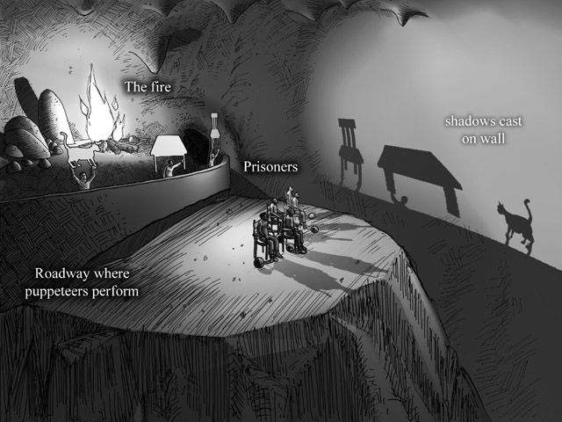

Slide 30
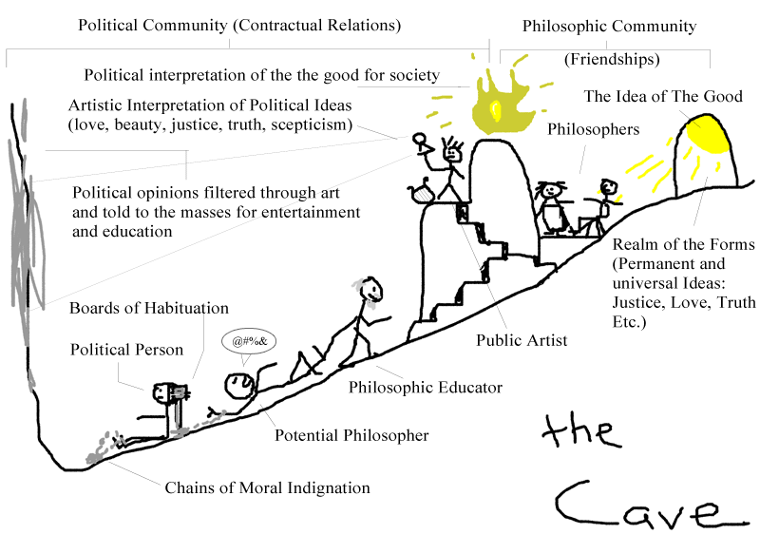

Slide 31
What does philosophy have to offer?
Plato: Enlightenment, Knowledge, Meaning, and Freedom
“None are more truly enslaved than those who falsely believe themselves to be free.”
-Goethe

Slide 32
Questions for Plato:
What is justice?
What are the values I should pursue in life? (How should we live?)
What does it mean to be a good person?
What is real, and what illusion among the things I perceive around me?
What is the knowledge that can free us from the chains of illusion?

Slide 33
Reading Plato:
Plato died almost 2400 years ago. Socrates died almost exactly that long ago.
Claim: Reading Plato is not just an exercise in intellectual archaeology. Plato’s project is a continuing project, a continuous conversation that has been taking place for more than 2000 years.

Slide 34
Reading Plato:
“When evening has come, I return to my house and go into my study. At the door I take off my clothes of the day, covered with mud and mire, and I put on my regal and courtly garments; and decently reclothed, I enter the an­cient courts of ancient men, where, received by them lovingly, I feed on the food that alone is mine and that I was born for. There I am not ashamed to speak with them and to ask them the reason for their actions; and they in their humanity reply to me. And for the space of four hours I feel no boredom, I forget every pain, I do not fear poverty, death does not frighten me. I deliver myself entirely to them.”
-Niccolo Machiavelli, Letter to Vettori 1531

Slide 35
REPUBLIC I:
Dialogue in Book I:
Discussion with Cephalus & Polemarchus
Justice is “paying ones debts and telling the truth” (331c)
Justice is “giving to each what he is due” (331e)
Justice is “doing good to friends, harm to enemies.” (332a-b)
Discussion of this idea (332c-336a)
Entrance of Thrasymachus: (336b)
Justice as “the advantage of the stronger” (338c)
Socrates’s maundering response… (338d-343b)
Justice as “another’s good” (343c)
Just people will do worse, so it’s stupid to be just. (343c-344d)
Socrates’s (unsatisfactory?) responses. (344d-end of book I)

Slide 36
Justice in Republic I:
Cephalus: “Justice is telling the truth and paying one’s debts.” (331c)
Polemarchus: “Justice is giving to each person what he is due.” (331e)
Polemarchus: “Justice is doing good to our friends and harm to our enemies.” (332a-b)
Thrasymachus: Justice is the “advantage of the stronger”(338c)
Thrasymachus: Justice is ‘another’s good.” It is disadvantageous to those who practice it. (343c-344d)

Slide 37
Justice in Republic I:
ANALYSIS ONE: Cephalus) Justice is telling the truth, returning what has been borrowed, paying one's debts. [331c]
TEXTUAL CLUES: Should we consider whether Cephalus represents compacency and apathy? (Note his discussion of sexual desire-- he's glad to be relieved of it, "as from a cruel master.“) Perhaps not, since he is also presented as a ‘wise old man’ who has conquered appetites and done well.
1) Socrates objects that there must be more to justice than merely always telling the truth and returning what's borrowed, since it would surely prohibit one from returning a weapon to an enraged, murderous friend, or telling potentially dangerous truths to a madman.
2) This gives only EXAMPLES of justice, not the characteristic that makes just acts JUST.
At this point Cephalus leaves the dialogue, and Polymarchus takes over, claiming that justice is giving to each person what she is due.

Slide 38
ANALYSIS TWO: Polemarchus– (from Simonides) Two Parts: 1) Justice is Giving each person what is due. 2) This means giving good to one's friends and evil to one's enemies.
SOCRATES RESPONSE TO POLEMARCHUS: Four Objections
1) If Justice is giving everyone what is due, then it is trivial, because there is no special field for it to be concerned with. (Medicine is the skill concerned with cures for the body, cookery with palatable food... What skill is the field of Justice concerned with?)
Polymarchus' Response: The scope of justice is to do Good to your friends and harm to your enemies. [332d]
The Objection Carried Further: What's the just person good for? To be good to your friends, you must help them in some specific way. But the best person to help you when you are ill is the doctor, when you are at sea, the navigator. On Polymarchus' account, the Just person still has no expertise of her own.
2) This Df. is cut off from the AIMS of the just person. The person with the ability to keep a thing safe also has the ability to steal it. It is not essential to Polymarchus' Df of Justice that it must have a good aim: it is simply MEANS/END reasoning.
3) We may be wrong in our judgment of who our friends are... What is meant by 'Friend' and 'Enemy?'

Slide 39
Who are my Friends?
Polemarchus: A persons friends are those he thinks are Good, enemies those he thinks are Bad.
Socrates: But we may be wrong in such judgments, so by this account, just actions may harm those who are 'On our side,' and who are REALLY Good, though we don't recognize their goodness.

Slide 40
Justice and Harm
Can justice harm people on whom it is practiced?
Are people who are justly punished harmed by their punishment?
Argument: 335b-e

Slide 41
4) Justice cannot HARM anyone, even one's enemies [335b-e]
Is it the role of the just man to harm anyone?
Certainly, he must harm those who are both bad and enemies.
Do horses become better or worse when they are harmed?
Worse.
With respect to the virtue that makes dogs good, or the one that makes horses good?
The one that makes horses good.
And when dogs are harmed, they become worse in the virtue that makes dogs good, not horses?
Necessarily.
Then won’t we say the same about human beings too, that when they are harmed they become worse in human virtue?
Indeed.
But isn’t justice the human virtue?
Yes certainly.
Then people who are harmed become more unjust?
So it seems.
Can musicians make people unmusical through music?
They cannot.
Or horsemen make people more horsemanlike through horsemanship?
No.
Well then can those who are just make people unjust through justice? In a word, can those who are good make people bad through virtue?
They cannot.

Slide 42
Fourth Objection: Justice and Harm
4) Justice cannot HARM anyone, even one's enemies [335b-e]
An Interpretation of Socrates Counterargument:
Justice cannot cause harm.
1) A horse, when harmed, is a worse horse; a dog a worse dog: In general, they become worse specimens of their kind. 2) SO: When a person is harmed, she or he becomes a worse person: worse in respect to human excellence. 3) Justice is the peculiar human excellence. (from where?) 4) So those who are harmed become worse with respect to justice (more unjust). 5) But it is implausible to think that Justice would produce its opposite. (Musicians, by their skill, don't make people deficient in music; heat makes other things hot, not cold... Just so, excellence makes things more excellent.) 6) So those who are just cannot make people deficient in Justice. 7) So justice cannot involve harming anyone.

Slide 43
Justice and Harm:
What does Plato’s view imply about punishment?

Slide 44
Thrasymachus’s Challenge:
Thrasymachus' Challenge: Winners make the rules, and 'nice' (just) people finish last.
Subject Questions:
1) What is justice?
2) Is justice beneficial to those who practice it?
Thrasymachus's First Claim: Justice is the advantage of the stronger. [Conventionalism & Power makes conventions]
Thrasymachus's Second Claim: The Just will be Worse Off than the Unjust.
Question: Are these claims consistent? It is sometimes argued that they are not.

Slide 45
SOCRATES INITIAL RESPONSE:
1) The rulers may not always be right about their advantage. We can distinguish between the commands of the ruler and the advantage of the ruler. [339c]
2) Crafts seek the perfection of some weaker thing, subject to the excellence of the craft. Thus Justice in rulers must seek the perfection of (thus the interest of) the weaker, not the stronger. [342d]
THRASYMACHUS: This is just naïve and foolish!

Slide 46
THRASYMACHUS' SOLILOQUY [343b]
1) Shepherd Metaphor: [343b] 2) Unjust person will GET MORE. [343d-e] a) contracts: When the just contract with the unjust, the unjust will do better. b) taxes: those who avoid 'em do better by being unjust. 3) "Those who give injustice a bad name do so because they are afraid, not of practicing, but of suffering, injustice. [344c]
We must recognize that a strong case has been made. Plato arms his opponent with the strongest argument he can, but still, Socrates is unconvinced. [“Am I to take my argument and pour it into your mind?!?” [345b]]
THRASYMACHUS: Position is a kind of "Immoralism"- says that Justice may not merely be conventional, it may be (as he puts it) “another’s good." But on this understanding, conforming to Justice is not in one's interest. The unjust, he claims, are better off. Who, after all, will look out for your good if you don't? The person who looks after herself first will simply do better than the person who spends energy looking out for others.

Slide 47
Thrasymachus’s Challenge:
QUESTION: Is this second of Thrasymachus' definitions of justice consistent with his former claim that "justice is the advantage of the stronger?" Perhaps not...
The former assumes conventionalism: Justice is whatever the conventions happen to be.
The latter assumes that justice is the 'another's good.' But this won’t be true for the stronger, will it?
It's not entirely consistent, perhaps, in the usage of the term 'justice.' But there may well be a consistent position behind this view: If conventionalism is true, and if the conventions work to the advantage of the strong, then all but the strong might be better off avoiding doing what's just. Justice, on this view, is relative to individuals– different for those who set the rules, and for those who are supposed to follow them.

Slide 48
Socrates Responses to Thrasymachus:
1) We define a craft separately from the payment one receives for practicing it. So crafts have internal goods, unrelated to the profit we pay. [346c] A good shepherd is one who cares well for her flock; and a good ruler is one who cares well for those in her charge. This is shown from the fact that crafts persons require payment for what they do.

Slide 49
Socrates Responses to Thrasymachus:
2) Good people must be forced to rule. They will not Rule for money or honor, for the benefits of ruling well go to the ruled, not the ruler.
[Plato in fact thought that the only people competent to rule would be those who don't want to do so.]

Slide 50
Socrates Responses to Thrasymachus:
3) [349a-350e] Thrasymachus characterizes the happy, well-off person as one who will always want more, and as the person who uses his brains. But, says Socrates, such a person is just a fool: Unlike such a person, the just person won't "overshoot the mark" by always trying for more. [Lyre example, 349d-e]. An expert lyre tuner will tune the lyre to the RIGHT pitch, not beyond. A wise person will not strive to out do such a person, but only to similarly hit the right mark.
NOTE: This argument presents justice as a “balance point” between too much and too little. Foreshadows Aristotle?

Slide 51
Socrates Responses to Thrasymachus:
4) [351a-352c] Thrasymachus associates Injustice with strength, and justice with weakness. The unjust person is powerful, and achieves great things, becoming a ruler of cities. Socrates argues that injustice causes fractions and hatreds, which preclude cooperation. Without cooperation, nothing will get done, and we will be weaker. On the individual level, the unjust person is supposed always to be at odds with herself: she can't achieve anything, because there are 'fractions' within her.
Question: Do individuals function in the same way as groups, as Plato suggests?

Slide 52
Socrates Responses to Thrasymachus:
5) AN IMPORTANT ARGUMENT: THE FUNCTION ARGUMENT, (foreshadowing Aristotle…?) [352d-354b]
Socrates begins by getting Thrasymachus to agree that a variety of things have functions, and that for every function, there is a corresponding virtue, or excellence. (The function of a knife is to cut, and an excellent knife is one which cuts well). The function of the soul is to guide and direct the body-- to direct a person’s life.
Thrasymachus Agrees that the excellence of the soul is Justice, therefore the just person lives well, which is to be happy. Thus justice pays: The Just Person is Happy!

Slide 53
Socrates Responses to Thrasymachus:
Function Argument: A Standard Form Interpretation
(1) Justice is the excellence of the soul. (From nowhere?) (2) The person who is just must have a soul that is functioning properly. (3) To have a properly functioning soul is to live well. (4) To live well is to be happy. (5) Therefore the just person is happy.
PROBLEM: The argument really depends on the contentious premise that 'the excellence of the soul is justice'. Thrasymachus says that he has agreed to this (where?) This characterization of justice is quite different from others considered, which all have to do with interpersonal morality. So this is an important premise, yet there has been, it seems, no argument for it or explanation of just what Socrates means by it! (In fact, the rest of the book can be understood as an extended argument for this premise.)
But Thrasymachus is silenced, and goes off with a jibe at Socrates.

Slide 54
Republic I:
QUESTION: Why isn't Thrasymachus convinced, if Socrates argument is a good one? Meiutic arguments aren't supposed to silence opponents, but to convince them. Does the answer lie in Thrasymachus character and not in the argument? Sometimes people are not convinced by arguments, even when they ought to be convinced.

Slide 55
Republic II: Glaucon’s Challenge
Glaucon and Adiamantus' (Plato's Brothers) Take up Thrasymachus' position, and make it stronger, to see Socrates rebutting argument.

Slide 56
Republic II: Glaucon’s Challenge
Three kinds of goods [357b-d] (Glaucon)
Intrinsic- Good things that are desired 'for their own sake,' including pleasure and enjoyment. Activities like eating delicious food that isn’t good for us are desired in this way.
Merely Extrinsic- Painful but beneficial" activities, corresponding to this category include working and uninspiring job, and getting painful medical treatment.
Intrinsic and Extrinsic- We desire both for itself and its consequences, including health, sight, and knowledge. Activities corresponding to this category might include playing sports, eating a good tasting and healthy meal, and doing philosophy.
Glaucon suggests that Justice corresponds to the third category, where Socrates insists that it belongs in the second.

Slide 57
Republic II: Glaucon’s Challenge
Question: How can we form an ARGUMENT that something is an INTRINSIC GOOD?
1) Can't give reasons in terms of other goods, since this would make the basis extrinsic.
2) Can't base Good on God's will somehow: If we do what is right only because God will punish us if we don't, our commitment to Justice is external, not internal. This is not enough. Socrates has a difficult task here...

Slide 58
Republic II: Glaucon’s Challenge
Glaucon’s Case Against Platonic Justice:
1) Common opinions concerning the origin and nature of justice. (Justice as a contract.) (358e)
2) People are just only because they are coerced, not because they thing it is intrinsically in their interest. (Ring of Gyges) (359d-360d)
3) People ought to act unjustly, because they are most benefited by acting so. (Comparison: Perfect Justice and Perfect Injustice) (360e-362a)

Slide 59
Republic II: Glaucon’s Challenge
Common Opinions: Contractarian Justice [358e-359b]
Glaucon's explanation of the nature and origin of justice is a crude contractarian one in which people make a compact. They willingly make this agreement because they gain more from others respecting the rules than they loose by not being able to break them.

Slide 60
Republic II: Glaucon’s Challenge
The Ring of Gyges 359d
That all people act justly only from compulsion can be seen by imagining how they would act if the threat of punishment were lifted. Glaucon claims that all would break the rules if only they had a ring of Gyges.

Slide 61
Republic II: Glaucon’s Challenge
In order to show that one ought to act unjustly, Glaucon compares the 'perfectly unjust person' with the 'perfectly just person.'
The perfectly unjust person appears just, but is in fact unjust. The perfectly just person appears unjust, but is in fact just.
Perfectly unjust person would be: -rich, since she'd steal from others. -well respected since others respected her wealth, and took her to be just. -Need not worry about the afterlife, since she could use wealth to make considerable sacrifices to the Gods. (The poets portrayed the gods as moved by such things.)
Perfectly Just person would be: -poor, since she toiled for a living and was stolen from. -scorned- since others look down on poverty, and believe her to be unjust. -must worry about the afterlife, since in no position to make sacrifices to the Gods.

Slide 62
Republic II: Glaucon’s Challenge
A Common confusion about Glaucon’s Challenge:
Glaucon describes the perfectly just person as appearing unjust not because he thinks that this is the norm, but because such a description is necessary to be sure of her motives. If the just person were respected as just, then we would be unsure whether she acted justly for its own sake (intrinsic good), or merely for coveted good reputation (extrinsic goods). If all acts of justice bring a bad reputation, then we can be sure that continued virtue stems from a desire to do justice for the sake of justice.
NOTE: Glaucon has made a three part argument for a specific claim.
What is that claim?
Justice is not good for its own sake, only for what comes from it.
How do the considerations he has raised count as evidence?
If he is right, then people will (if they’re smart) behave justly only when they can’t get away with injustice.

Slide 63
Republic II: Glaucon’s Challenge
Modern Example: It's often said that "Cheaters only hurt themselves..." But is this true? What about cheaters who don't get caught, and who get an A? Are they really worse off than they would have been if they'd done their own work and gotten an F?
SO: Why do the right thing?
Socrates faces a challenge: he must counter each of Glaucon's three main points to show that acting justly is not only extrinsically valuable, but has intrinsic value as well.

Slide 64
Socrates Response:
To consider ‘justice’ in an individual is too difficult. Better to begin by considering what justice is in a state or a city. Then we can use what we discover about just states to understand justice in an individual person.

Slide 65
Platonic Justice
A) To find what justice is in a state, we need to consider the different functions that must be accomplished within the state: (i) Some jobs require only strength, some require craft-intelligence [The kind of intelligence that is displayed by craftspeople who shoe horses or make pots], (ii) Some jobs require valor and bravery, and (iii) Some jobs require guiding intelligence and reason.

Slide 66
Platonic Justice
According to Plato, a State is just when each ‘kind of citizen’ performs the role appropriate to his or her capabilities:
Ordinary citizens pursue crafts and trade.
Valorous citizens act as a soldier class, protecting the city.
The wise citizens– those who are not only valorous, but who also have knowledge and truth– should organize everyone and see that each person fills his or her proper function.

Slide 67
Plato's Tripartite Theory of the Soul:
Our 'souls' have three aspects.
Knowledge- wisdom, knowledge (Philosopher) (Just State)
Spirit- energy, enthusiasm, valor (impetuous fool)(Timarchy)
Desire- appetite (Glutton) (Democracy)
Faults of character as well as faults of political systems can be traced to unbalance: the wrong part of the (state/soul) is ruling!

Slide 68
When States go Wrong:
Democracy– public desires take control over the political process.
(Correlate: Glutton)
Timarchy– Military class takes control. Excessive focus on conquest and war.
(Correlate: Courageous but vainglorious fool)

Slide 69
Relation between Justice and Happiness
Connection to Happiness and Well-Being: A person whose "soul" is out of harmony will be: internally divided (see 351a-c: This passage, and the analogy between individual and social divisions becomes clear now) subject to inappropriate and unpleasant emotions motivated to do what she should not.
Virtues and Vices:
Courage- reason supports spirit Cowardice- desire (to escape harm) and foresight (to see it coming) overcome spirit, because reason doesn’t keep them in check. Vainglory- spirit overcomes wisdom Temperance- desire is mediated by wisdom Gluttony- desire takes over Insensibility- insufficient (desire and spirit) to care properly for virtue

Slide 70
Socratic Paradox:
Thus the Socratic Paradox: No one knowingly (willingly, voluntarily) does wrong... All wrongdoing arises from ignorance.
This follows from Plato's view that morality involves a kind of knowledge or wisdom. Those who do wrong must lack this wisdom. But if we act as we do because we lack knowledge, our actions cannot be said to be truly voluntary.
Ex: Poisoning myself with arsenic laced coffee: Involuntary if I don't know the arsenick is there.
Ex: Cheating on an exam: I'm greedy for a higher grade and for the benefits it will afford. If reason were in command of my actions, I'd recognize that I'm trading my honor (a higher good) for a mere grade. Plato would urge that this is a bad bargain, and if I truly recognized that this is the exchange I'm making, I wouldn't sacrifice the greater good for the lesser.

Slide 71
Platonic Ideas:
Platonic Forms: The forms are fundamental, perfect ideas. For every physical object, there is a perfect idea of that object. All our knowledge is properly knowledge of the forms, and only secondarily knowledge of the objects that ‘participate’ in these forms.
Plato has Semantic, Epistemic, and Metaphysical arguments that support his theory of forms. We will only look, for now, at the semantic argument.
The general question: What is the relationship between ideas, and concrete objects, and creations of our imagination? Are 'ideas' of the imagination like ideas of mathematics and geometry, or like our ideas of concrete objects like cups?

Slide 72
Example:
1) This is a philosophy class. 2) This is a philosophy class.
Question: Is there one sentence above, or are there two?

Slide 73
Problem of Universals and Properties:
Example: Cups and Ideas of Cups. Question: What is the relationship between the thing we drink from and the idea?
Example 2: Triangles and Ideas of Triangles: Question: What is the relationship between actual triangles and the ideas we work with when we do geometry?
Triangles First: Idea is more perfect, since actual triangles inherit the errors of those who draw them. Our true understanding of triangles is understanding of the idea, not the concrete. In this sense, the idea is "more real" than the instantiation. (What can this mean?)
Cups Second: Idea is more perfect (?) since actual cups leak... Understanding of cups is not about particular indivuals Idea (Plato thinks) is 'more real' than the instantiation. Actual cups are identifiable as cups only by virtue of their participation in the idea.

Slide 74
Plato's Theory of Ideas:
Ideas are real things. They are, in fact, more real than the visible things they describe. Wise people understand the ideas, not just the concrete individuals. We can “see” ideas only with the eye of the intellect.
In fact, Plato believed that all our knowledge of particular things is really knowledge of their ideas or forms. Knowledge of particular things isn't true knowledge, since these things change all the time. Ideas, on the other hand, are timeless and enduring. The same geometry that Plato knew is studied in High School classrooms worldwide.

Slide 75
Some Influences on Plato:
Influence of Parmenides: Parmenides argued that reality must be timeless and changeless.
Plato: True knowledge is knowledge of the timeless and unchanging.
Influence of Heraclitus: Nothing is permanent in the sensible world.
Plato: We cannot get knowledge of the timeless and unchanging truths by using our senses alone.
Consequence for Plato: Knowledge is not derived from the senses but from the intellect.

Slide 76
Relating Plato’s Theory of Forms to Heraclitus and Parmenides:
Heraclitus claimed that knowledge is impossible, since things are always changing. Parmenides claimed that change is illusion, and that true reality, which can be perceived only by the intellect, is enduring, perfect, and unchanging. We will see that Plato's view represents a kind of synthesis of these two.
THE FORMS: What is the knowledge that guides the intelligent and wise person?
It is knowledge of the ideas that lie behind the world of appearances presented to us by the eye. This kind of knowledge is knowledge of a higher, unchanging reality, and without it we will have a confused sense of priorities.

Slide 77
Platonic Forms:
1) The forms are separate from (prior to) the empirical world, since in order to understand the names of empirical objects, we need to have (implicitly) the concept of the form that gives meaning to these names.
2) The forms are more real than empirical objects, because it is only through participation in the forms that empirical things have the properties they have.
3) The forms can be perceived only by the intellect. The philosopher is in contact with a different reality because of this connection to the heaven in which these abstract entities exist.
On the Reality of the Forms, and on Degrees of Reality: Which is more real, ideas, or the things ideas represent?" (What can the second question mean? Can some things be 'more real' than others? Is reality like pregnancy and death, or like wisdom and height?)

Slide 78
PARABLE OF THE LINE: 510a-511e in the text.
THE LINE:
The Intelligible: Higher Forms: [Noesis = understanding] Illumine" and make intelligible the lower forms. The form of the good is highest, and like the sun it illumines other forms and makes them intelligible. Other exalted forms like the true and the just lie at this highest level.
Lower forms: [Dianoia = Reasoning] Those "illuminated" by the higher forms. Forms of 'mere things' like horses and cups are illumined, by the form of the good.
The Visible [pstis = opinion] Things that are visible get their qualities, their identity and their reality from participation in the forms, which are more general and pure. Just as actual geometric figures are less perfect than those we understand with reason, the forms in which things participate are more perfect (and more real-- here we have an origin of the notion that "reality" is a form of perfection-- a confusion that gave rise to the Ontological Argument, which we will see later.)
The Imaginary: [eikasia = image making] Shadows, Images, Imaginary ideas, and Art.

Slide 79
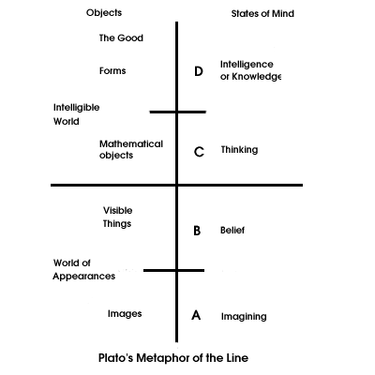

Slide 80
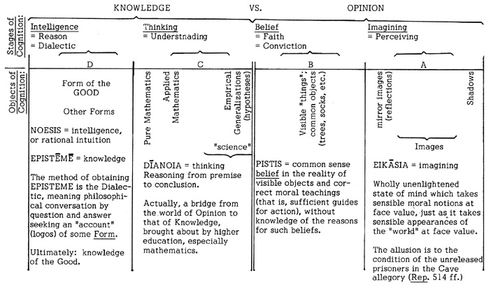

Slide 81
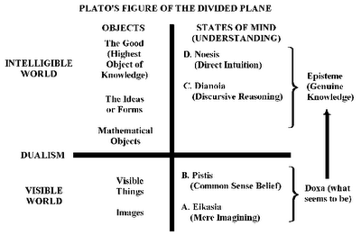

Slide 82
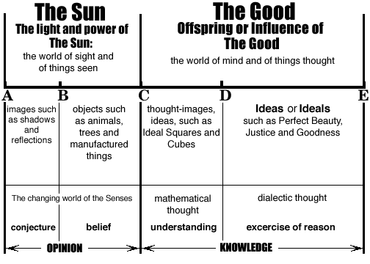

Slide 83
The Form of the Good?
The Form of the Good: The knowledge guiding the just person is knowledge of the good, which is a kind of super-form which gives meaning to all the others. Knowledge of the good is the highest and most important knowledge. Nothing has any value at all unless it participates in the form of the good, so the form of the Good is prior to and more important than any other thing that has importance or value.
As light shines on things we see with our eyes, the Good 'shines' on things which we perceive with our minds. It 'illuminates' truth and value in all cases. It lies behind beauty, and science, and truth, and strength, and pleasure, and virtue, and justice.
Only by contemplating this form with our intellect can we know how to guide our lives. The just person is the person who can do this, she is a person who is guided by Good in all its guises, and who is not misled by passion, or by desire, or by falsehood. Such a person does not need worldly or empirical success in order to be happy. A truly just person needs none of these external goods, because she can appreciate the form of the Good with her intellect.

Slide 84
MYTH OF THE CAVE REVISITED:
[517b] p. 169. Allegory explained.
HYPOTHESES AS STEPPING STONES: [511b] p. 167.

Slide 85
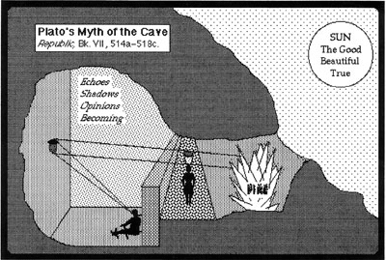

Slide 86
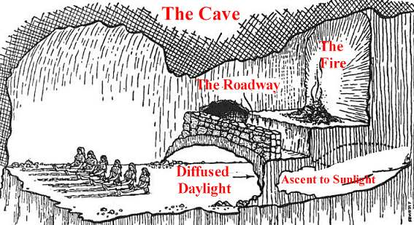

Slide 89
Platonic Justice:
Plato's Response to Thrasymachus/Glaucon's challenge:
Now Plato is in a position to answer the initial question: Is justice merely extrinsically valuable, or is it both intrinsically and extrinsically valuable? According to Plato, justice is a state of harmony in the soul. Persons who lack this harmony are either ruled by desire or passion. But it is bad to be ruled by either of these things, and people who are ruled by passion or desire are unhappy and unfortunate. It is much better, claims Plato, to be ruled by reason, that is to be in a state of justice. A person who is ruled in this way will have no reason (no motivation) to behave unjustly, no matter what the prospective EXTERNAL prospects.

Slide 90
“And justice was in truth, it appears, something like this. It does not lie in a man’s external actions, but in the way he acts within himself, really concerned with himself and his inner parts. He does not allow each part of himself to perform the work of another, or the sections of his soul to meddle with one another. He orders well what are in the true sense of the word his own affairs; he is master of himself, puts things in order, is his own friend, harmonizes the three parts like the limiting notes of a musical scale, the high, the low, the middle, and any others there may be in between. He binds them all together, and himself from a plurality becomes a unity. Being thus moderate and harmonious, he now performs some public actions or private contract. In all these fields he thinks the just and beautiful action, which he names as such, to be that which preserves this inner harmony, and indeed helps to achieve it, wisdom to be the knowledge which oversees this action, an unjust action to be that which always destroys it, and ignorance the belief which oversees that.” (Bk IV 443d)

Slide 91
PLATO ON JUSTICE
Connection to Happiness and Well-Being: A person whose "soul" is out of harmony will be: internally divided (see 351a-c: This passage, and the analogy between individual and social divisions becomes clear now.) subject to inappropriate and unpleasant emotions motivated to do what she should not.

Slide 93
Plato on Love:
One function of Philosophy: Philosophy should enable us, by the use of reason, to organize our lives well. It should free us of unnecessary fears (like the fear of death), and from being captured or ‘overcome’ by irrational emotions and attitudes.

Slide 94
Plato on Love:
Love is a hugely powerful force in human lives, one that has the potential to go astray and make people absolutely miserable. Philosophy, as a study designed to help us to organize our lives, has a role to play here, to help us to understand this force, to plan for its effects, and to insure that it plays the right role, rather than the wrong one, in our lives.

Slide 95
On the feeling of crazy passionate love:
Dan (Jude Law): I fell in love with her, Alice. Alice (Natalie Portman): Oh, as if you had no choice? There's a moment, there's always a moment, I can do this, I can give in to this, or I can resist it, and I don't know when your moment was, but I bet there was one.
-Closer

Slide 96
On the feeling of crazy passionate love:
Well, love is insanity . The ancient Greeks knew that. It is the taking over of a rational and lucid mind by delusion and self-destruction. You lose yourself, you have no power over yourself, you can't even think straight. - Marilyn French

Slide 97
On the feeling of crazy passionate love:
Who wants that? I'd rather choose to fall in love and be hurt. Sometimes I can't even sleep because I love someone so much. And there's always sadness in our lives. It's that sad feeling that keeps us going. Because if we can overcome that sadness, we can hope for happiness in the future –House

Slide 98
On the feeling of crazy passionate love:
“You're in a car with a beautiful boy, and he won't tell you that he loves you, but he loves you. And you feel like you've done something terrible, like robbed a liquor store, or swallowed pills, or shoveled yourself a grave in the dirt, and you're tired. You're in a car with a beautiful boy, and you're trying not to tell him that you love him, and you're trying to choke down the feeling, and you're trembling, but he reaches over and he touches you, like a prayer for which no words exist, and you feel your heart taking root in your body, like you've discovered something you didn't even have a name for. (…) …he touches you with his fingers and burns holes in your skin with his mouth and it hurts when you look at him and it hurts when you don't, it feels like someone's cut you open with a jagged piece of glass.” –R. Siken

Slide 99
On the feeling of crazy passionate love:
Remember that the best relationship is one in which your love for each other exceeds your need for each other.
-Dalai Lama XIV

Slide 100
On the feeling of crazy passionate love:
SAPPHO, Fragment 31: “He seems to me equal to gods, that man whoever he is who opposite you sits close and listens to your sweet speaking and lovely laughing. Oh, it puts the heart in my chest on wings. For when I look at you, even a moment, no speaking is left in me. No! My tongue breaks and thin fire races under my skin, in my eyes there is no sight, drumming fills my ears, cold sweat holds me, and shaking grips me all. I am paler than dried grass, and seem in my madness to be little better than dead! But I am compelled to dare everything…”

Slide 101
Also from Sappho:
“Eros shakes my soul, a wind on the mountain overwhelming the oaks.”
"If you're squeamish, don't prod the beach rubble."

Slide 102
Plato: Love is a Serious Mental Disease
REPUBLIC: Republic 329b-d, Character of Cephalus:
“I was once present when someone asked the poet Sophocles: “How are you as far as sex goes, Sophocles? Can you still make love with a woman?” “Quiet man,” the poet replied, “I am very glad to have escaped from all that, like a slave who has escaped from a savage and tyrannical master.” I thought at the time that he was right, and I still do, for old age brings peace and freedom from such things. When the appetites relax and cease to importune us, everything Sophocles said comes to pass, and we escape from many mad masters.”

Slide 103
Plato: Love is a Serious Mental Disease
Two Philosophical Perspectives from Pheadrus:
View from the rim of heaven”
(Pheadrus 247b)
View from the Chariot: (Pheadrus246b)

Slide 104
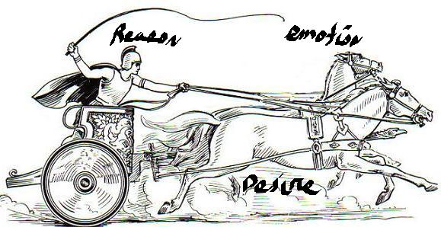

Slide 105
Plato: Love is a Serious Mental Disease
Symposium (189d-193d), Speech of Aristophanes: A myth about the origin of sex—once human beings were completely round, with back and sides in a circle and with four legs and arms. We were separated by Zeus who, as a punishment, divided each into two separate individuals. Sundered from our “other half,” we run about trying to reconnect and so to become whole again.

Slide 106
Plato: Love is a Serious Mental Disease
Symposium (190e-191a) Zeus “cut those human beings in two, the way people cut sorb-apples before they dry them or the way they cut eggs with a hair. As he cut each one, he commanded Apollo to turn its face and half its neck toward the wound, so that each person could see that he’d been cut and keep better order. [Then Apollo] …drew skin from all sides over what is now called the stomach, and there he made one mouth, as in a pouch, with a drawstring and fastened it at the center of the stomach. [Then he shaped people] using some such tool as shoemakers have for smoothing wrinkles out of leather on the form. But he left a few wrinkles around the stomach and navel…”

Slide 107
Plato: Love as a serious mental disease
Symposium (191a-c), Aristophanes: “Now since their natural form had been cut in two, each one longed for its own other half, and so they would throw their arms about each other, weaving themselves together, wanting to grow together. In that condition they would die from hunger and general idleness, because they would not do anything apart from each other.”

Slide 108
Nussbaum on the silliness of this story & the absurdity of sex:
“From the point of view of desire,… the penetration of a part of one’s own body into some opening in the loved one’s body is an event of excitement and beauty. From the outside it just looks peculiar, or even grotesque; (…) As we hear Aristophanes’ distant myth of this passionate groping and grasping, we are invited to think how odd, after all, it is that bodies should have these holes and projections in them, odd that the insertion of a projection into an opening should be though, by ambitious and intelligent beings, a matter of the deepest concern. (…) From the outside, we cannot help laughing. They want to be gods—and here they are running around anxiously trying to thrust a piece of themselves inside a hole; or perhaps more comical still, waitin in the hope that some hole of theirs will have something thrust into it.”
Martha Nussbaum, 1986.The Fragility of Goodness, 172-3

Slide 109
Symposium (211c-d) “Ladder of Love”: Speech of Socrates/Diotima:
“This is what is is to go aright, or to be led by another, into the mystery of love: one goes always upwards for the sake of this Beauty, starting out from beautiful things and using them like rising stairs: from one body to two and from two to all beautiful bodies, then from beautiful bodies to beautiful customs, and from customs to learning beautiful things, and from these lessons he arrives in the end at this lesson, which is learning of this very beauty so that in the end he comes to know just what it is to be beautiful.”

Slide 110
To be continued…

