Slide 1
Social Background
England was the “workshop of the world.”
Widespread poverty and wretchedness among the working class.
People were trying to live up to a national spirit of earnestness, respectability, modesty and domesticity.
Common sense and moral propriety, which were ignored by the Romanticists, again became the predominant preoccupation in literary works.

Slide 2
Victorian Literature
Literature produced during this period reflects the “spirit of the times”:
Expansion of newspapers and periodicals led to ongoing debates about current political and social issues.
Victorian literature (especially novels) offered a realistic, day-to-day portrayal of social life and represented these issues in the stories of the characters.
Suddenly, the once-silent female segment of society raised their voices. They could even appear onstage, acting in dramas (a privilege denied to them prior to this time).

Slide 3
Victorian Literature
Chronologically the Victorian period roughly coincides with the reign of Queen Victoria over England from 1836 to 1901.
In literature, the early Victorian age can be said to be the age of critical realism. The critical realism of the 19th century flourished in the forties and in the early fifties.
Puritan morality of the early and mid Victorian period was reflected in the novels. In Victorian novels the society’s effects on individual are analyzed.

Slide 4
The Victorian Poetry
Victorian poetry developed in the context of the novel. Poets sought new ways of telling stories in verse.
All poets show the strong influence of the Romantics, but cannot sustain the confidence the Romantics felt in the power of the imagination.
Victorian poets often rewrite Romantic poems with a sense of belatedness.
Dramatic monologue – the idea of creating a lyric poem in the voice of a speaker ironically distinct from the poet is the great achievement of Victorian poetry.

Slide 5
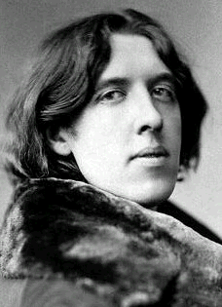
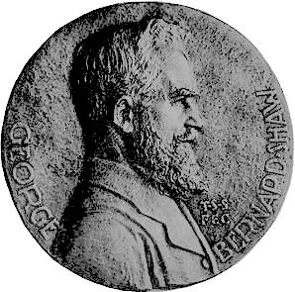
The Victorian Drama
The theater was a flourishing and popular institution during the Victorian period.
The popularity of theater influenced other genres.
Bernard Shaw and Oscar Wilde transformed British theater with their comic masterpieces.

Slide 6
Victorian Literature
The novel became the dominant form of literature
Novels were commonly read aloud in family gatherings. This led to novelists avoiding some topics which would be inappropriate for the entire family.
Readers wanted to be guided and enlightened by authors.
Much of Victorian literature has a positive, eager or earnest response to the innovations of life in the 19th century

Slide 7
The Victorian Novel
Victorian novels seek to represent a large and comprehensive social world, with a variety of classes.
Victorian novels are realistic, their major theme is the place of the individual in society, the aspiration of the hero or heroine for love or social position.
The protagonist’s search for fulfillment is emblematic of the human condition.
For the first time, women were major writers: the Brontës, Elizabeth Gaskell, George Eliot.
The Victorian novel was a principal form of entertainment.

Slide 8
Victorian Novels
Most were concerned with people in society and with manners, morals and money.
Typically a protagonist struggles to find him or herself in relation with other men and women, in love or marriage, with family or neighbors, or with work associates.
Most novels were set in 19th century England, a world that would be recognizable to the reader.
Many novels were published in installments. This challenged the writer to sustain the interest of the readers. In every single installment they had to entertain.

Slide 9
Aspects of Victorian Novels
Realism – capturing everyday life as it really is lived; identified social problems: Charles Dickens,Charlotte Brontë, & Emily Brontë.
Psychological realism – focused on inner realities of the mind: George Eliot’s.
Naturalism – views nature and society as forces indifferent to human suffering. E.g. Thomas Hardy.

Slide 10
Novel of Realism
Renders reality closely and in comprehensive detail.
Characters appear in their real complexity of temperament and motive; They are in explicable relation to nature, to each other, to their social class, to their own past.
Character is more important than action and plot; Complex ethical choices are often the subject.
Events will usually be plausible. Realistic novels avoid the sensational, dramatic elements of naturalistic novels and romances.
Notes:
From Richard Chase, The American Novel and Its Tradition

Slide 11
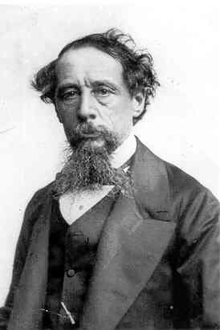
Charles Dickens (1812-1870)
Without doubt the most popular of Victorian writers was Charles Dickens.
His combination of sentimentality and his attacks on the social evils of the day made him highly successful.
He is concerned with the problems of crime and poverty and the life of the lower class.

Slide 12
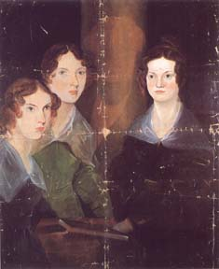
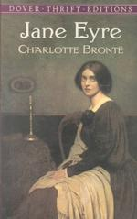
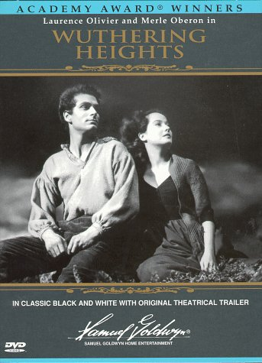
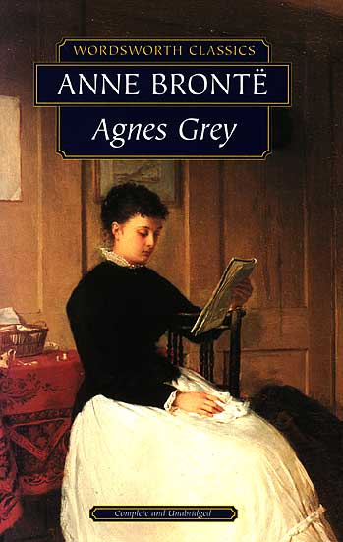
The Brontë sisters
Charlotte (1816-1855): Jane Eyre
Emily (1818-1848): Wuthering Heights
Anne: Agnes Grey

Slide 13
The Sisters & their Identities
Wutheirng Heights and Agnes Grey were accepted for publication before Charlotte had finished writing Jane Eyre.
However, their publisher delayed bringing their novels out so that Jane Eyre was published first. It became a best seller.
In an effort to cash in on the success of Jane Eyre, he implied that Wuthering Heights and Agnes Grey were written by "the author of Jane Eyre–to the distress of all three sisters. The pseudonyms they had adopted unintentionally contributed to his deception.

Slide 14
The Sisters & their Identities
Wanting their works to be judged for their literary merit and not on their sex, Anne, Charlotte, and Emily published their novels under names which were not obviously masculine, Acton, Currer, and Ellis Bell.
Preserving their male identities was so important to the Brontë sisters that Charlotte maintained that identity even in writing to her publishers.
In order to prove to Charlotte's publishers that Acton, Currer, and Ellis Bell were not one person, Charlotte and Anne met with them in London; during the interview, Charlotte inadvertently revealed that they were three sisters.

Slide 15
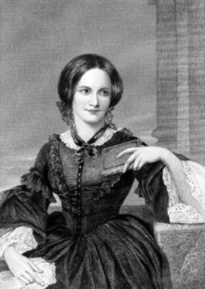
Charlotte Brontë
Charlotte wrote three other books, Shirley, Villette,and The Professor.In 1854 Charlotte married.But she died in the following year after a lengthily painful illness.
Charlotte Bronte published Jane Eyre under the pen name Currer Bell, in London in 1847.

Slide 16
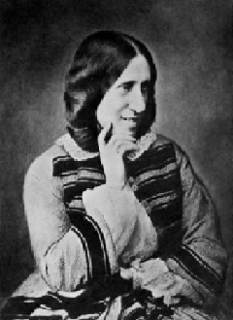
George Eliot (1819-1880)
The pseudonym of Mary Ann Evans, born in Warwickshire, England in 1819
Called “the embodiment of philosophy in fiction” by Oscar Wilde
Adam Bede (1859)
The Mill on the Floss (1860)
Silas Marner (1861)
Middlemarch ()
Daniel Deronda (1876).
Notes:
Mary Ann Evans, better known by the pen name George Eliot (22 November 1819 - 22 December 1880), was an English novelist. She was one of the leading writers of the Victorian era. Her novels, largely set in provincial England, are well known for their realism and psychological perspicacity.
She used a male pen name, she said, to ensure that her works were taken seriously. Female authors published freely under their own names, but Eliot wanted to ensure that she was not seen as merely a writer of romances. An additional factor may have been a desire to shield her private life from public scrutiny and to prevent scandals attending her relationship with the married George Henry Lewes.
http://en.wikipedia.org/wiki/George_Eliot

Slide 17
Naturalism
Characters’ lives are governed by scientific determinism, i.e., heredity and environment.
To show this determinism, naturalists often create weak and passive characters.
Sex and violence are bed partners; sex is brutish, without tenderness. Violence dominates the lives of the naturalistic character.

Slide 18
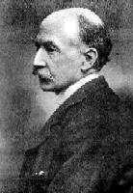
Thomas Hardy (1840-1928)
The last and one of the greatest of Victorian novelists
His best local-colored works:
The Return of the Native
The Mayor of Casterbridge
Tess of the D’Urbervilles
Jude the Obscure

Slide 19
According to traditional writing techniques developed before the 20th century, a piece of narrative works should tell a vivid, interesting story and portray one or more characters who have distinct traits and who are often involved in certain kind of psychological or social conflicts which, with the development of the plots, will in the end come to certain solution.
This kind of notion, however, was fiercely attacked since the end of 19th century. Since then the concept of narrative literature and its writing techniques have undergone profound changes.

