Slide 1
Practical Zoology
1st class Biology students
Classification
By: Shna I. Ismail
Msc. In Medical Mycology
2022-2023

Slide 2
Living organisms are classified in to five kingdoms:
Monera: Include prokaryotic, unicellular organisms, e.g. bacteria and cyanobacteria.
Protista: Include eukaryotic, unicellular organisms, e.g. Euglena, Amoeba and Paramecium.
Fungi: Include eukaryotic, unicellular organisms, e.g. yeasts and multicellular, e.g. mushrooms.
Plantae: Include eukaryotic, multicellular organisms, e.g. gymnosperms and angiosperms (photosynthetic organisms).
Animalia: Include eukaryotic, multicellular organisms, e.g. invertebrate (95%) and vertebrate (5%) animals.

Slide 3
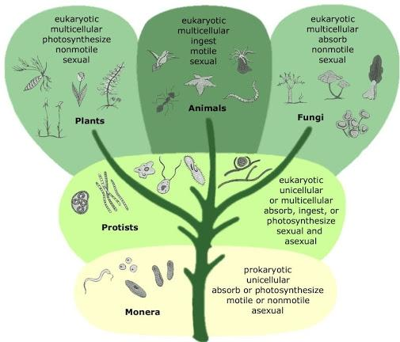

Slide 4
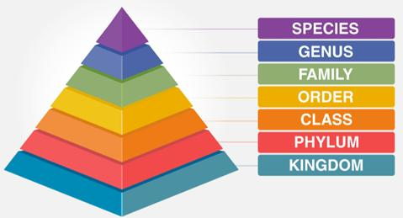
Each kingdom is divided into its own Phyla, Classes, Orders, Families, Genera and Species.
Genus name is always capitalized and either underlined or italicized. Species names are always lower case and either underlined or italicized.

Slide 5
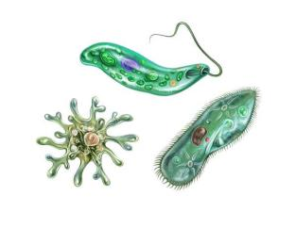
Kingdom: Protista
Sub-kingdom: Protozoa
General characteristics:
They are eukaryotic cells, unicellular organisms and simple multicellular.
They are free-living and some of them are parasitic organisms.
Reproduce asexually (simple binary fission and budding), some of them reproduce sexually (gametes or conjugation)
They are both autotrophic such as Euglena and heterotrophic such as Amoeba.
Most of them are microscopic and some of them are large enough to be seen with the naked eye.

Slide 6
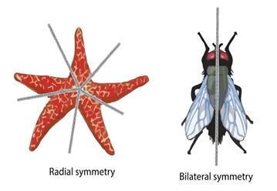
They are occurring in the sea, in all types of freshwater and in the soil where moisture is present.
Feed by pinocytosis or phagocytosis and some by photosynthesis.
Some of them are asymmetrical, but others are symmetrical (bilateral and radial symmetry).
The locomotor organelles of the protozoans may be flagella, cilia, or pseudopodia.
Characteristic of many protozoans is an organelle called the contractile vacuoles or water expulsion vesicle.
Gas exchanges occur by the diffusion of oxygen across the cell membrane.

Slide 7
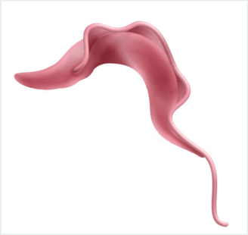
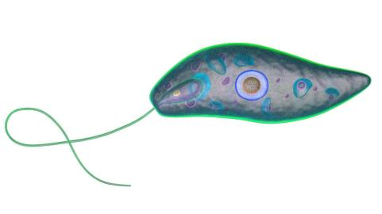
Phylum: Mastigophora (Flagellata)
1. Class: Phytomastigophora (Plant- like flagellata): e.g. Euglena sp. (now it is algae)
2. Class: Zoomastigophora (Animal- like flagellata): e.g. Trypanosoma sp.

Slide 8
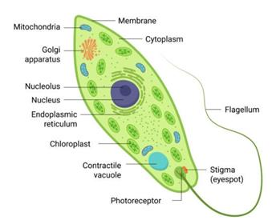
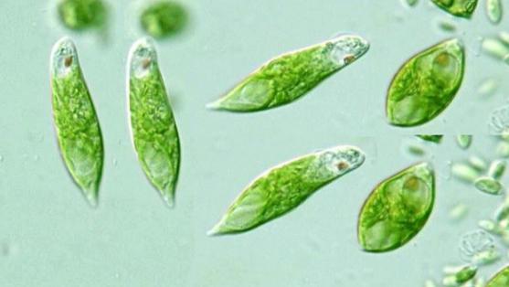
Euglena sp.
Lives in ponds and stagnant water, producing the green coloration of the water.
Moves by whip-like process called flagellum.
The body is fusiform pointed at posterior.
The body is differentiated into ectoplasm and endoplasm.
The endoplasm with chloroplast.

Slide 9
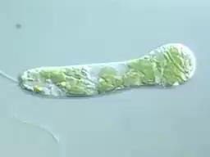

Slide 10
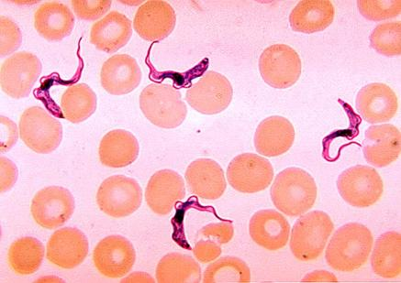
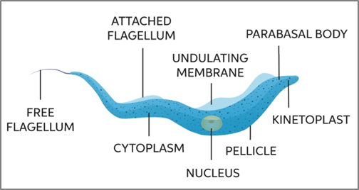
Trypanosoma sp.
They require 2 hosts, an invertebrate (in alimentary canal) and a vertebrate (in the blood).
To transport from host to another need insect vector (Tsetse flies), which caused "African sleeping sickness".
The body is long slender, in the anterior of the body there is a flagellum.
The ectoplasm is thin, endoplasm with spherical nucleus, near the center of body.

Slide 11
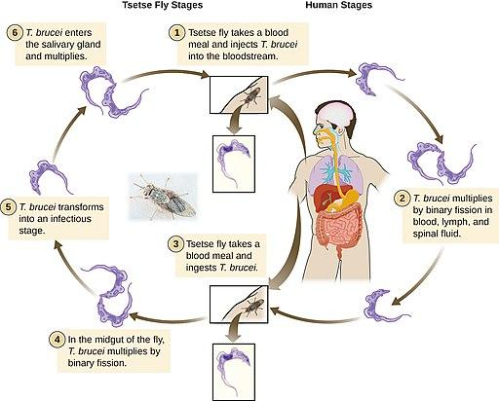

Slide 12
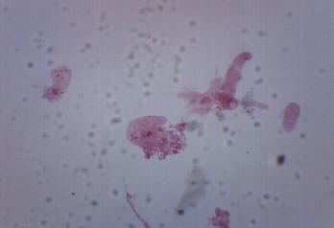
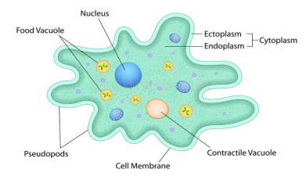
2. Phylum: Sarcodina
Class: Rhizopoda
Amoeba proteus
Live in fresh water ponds and backwater of rivers.
Some species live in marine and others in soil.
Feeding on bacteria and other microscopic organisms.
Moves by pseudopodia.
Reproduces a sexually by binary fission.
Endoplasm contains nucleus, contractile vacuole and food vacuoles.

Slide 13
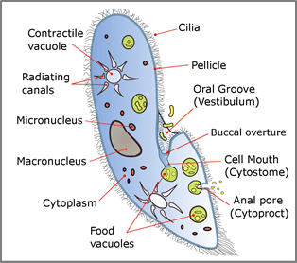
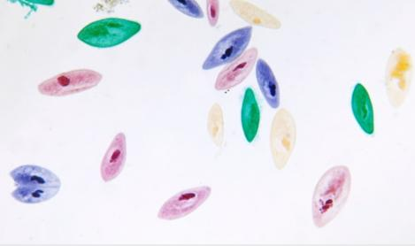
3. Phylum: Ciliophora (Ciliata)
Class: Holotricha
Paramecium sp.
The most well known example of a ciliate is Paramecium sp., with two nuclei, the large and oval is known macronucleus (concerned with vegetative functions) and small known micronucleus (concerned with reproductive function). They reproduce sexually by conjugation (exchanging genetic information). They can also reproduce asexually by binary fission.

Slide 14
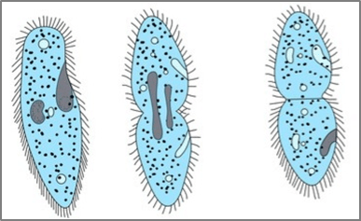
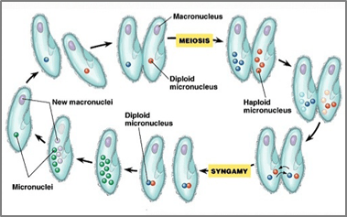
Binary fission
Conjugation

Slide 15
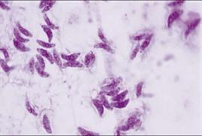
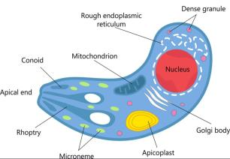
4. Phylum: Sporozoa
Members of this group are nonmotile, heterotrophic, parasitic organisms. They produce spores during the phase of asexual reproduction of their life cycle.
Toxoplasma gondii
Toxoplasma is an obligate intracellular parasite.
Its crescent shape.
Its life cycle includes two phases called; the intestinal (Cat) and extra-intestinal (All infected animals).
Animals are infected by eating infected meat, by contact with cat feces, or by transmission from mother to fetus.

Slide 16
