Slide 1
PHYLUM Chordata
Lab one
Shukur Wasman Smail Medical Virology Lab 1 4th class

Slide 2
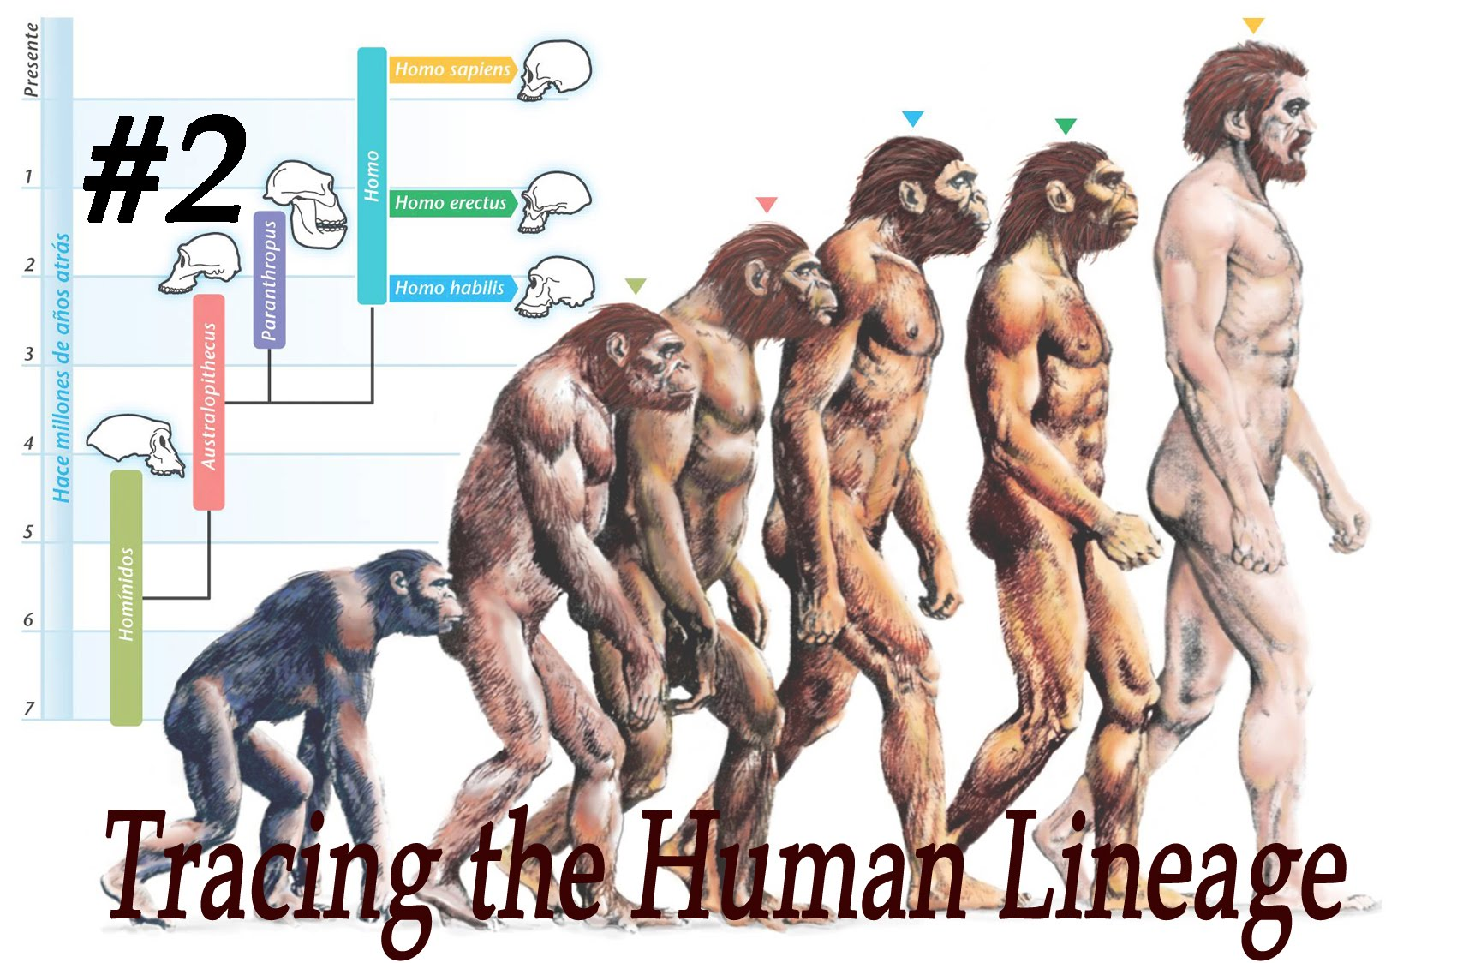
Evolution: is defined as a genetic change in a population over time.
Comparative anatomy involves comparing the body structures of two species. Comparative means to look at the similarities between two things, and anatomy has to do with the structure of the body.

Slide 3
Homologous structures are structures that are similar in two organisms because they have a common ancestor but differ in function. For example, birds, humans, bats and even whales all have a similar arm bone structure.
Analogous structures are anatomical features of two species that look similar, or serve the same purpose, but the species are not closely related.

Slide 4
PHYLUM CHORDATA

Slide 5
PHYLUM CHORDATA
PROTOCHORDATA
VERTEBRATA
AGNATHA
GNATHOSTOMATA
HEMICHORDATA
UROCHORDATA
CEPHALOCHORDATA

Slide 7
Characters of phylum Chordata:
Animals in the phylum Chordata share four key features:
1-Notochord,
2-Dorsal hollow nerve cord
3-Pharyngeal slits
4-Post-anal tail

Slide 8
These characteristics are only present during embryonic development in some chordates.
The notochord provides skeletal support, gives the phylum its name, and develops into the vertebral column in vertebrates.
The dorsal hollow nerve cord develops into the central nervous system: the brain and spine.
Pharyngeal slits are openings in the pharynx that develop into gill arches in bony fish and into the jaw and inner ear in terrestrial animals.
The post-anal tail is a skeletal extension of the posterior end of the body, being absent in humans and apes, although present during embryonic development.

Slide 9
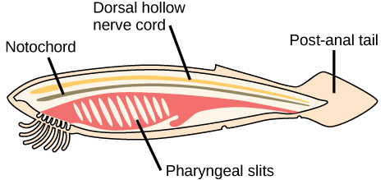
Notochord is a flexible rod like structure that forms the main support of the body in the lowest chordates.
Nerve cord is a dorsal tubular cord of nervous tissue above the notochord of a chordate
Pharyngeal slit is filter-feeding organs found in non-vertebrate chordates (lancelets and tunicates) and hemichordates living in aquatic environments

Slide 10
Group ACRANIA (=PROTOCHORDATA) (Primitive chordates without head and vertebral column)
Subphylum HEMICHORDATA, Balanoglossus, primitive and doubtful chordates, now classified under non-chordates after echinoderms.
Subphylum UROCHORDATA, Molgula ,and Ciona Sp.
sedentary or planktonic tunicates in which chordate characters’ manifest in the larval stage.
Subphylum CEPHALOCHORDATA, Amphioxus, typical chordates having chordate characters in the larval as well as adult stage.

Slide 11
Sub phylum Cephalochordates: (e.g Amphioxus lanceolatus) Commonly called amphioxus or lancelets, are marine invertebrate chordates.
Cephalochordates have a notochord and a nerve cord and a very simple circulatory system.
The segmental arrangement of the mooneyes facilitates the lateral movements used during swimming.
A characteristics "wheel organ" is present to direct microscopic food particles.
Sexes separate

Slide 12
Sub phylum Cephalochordates: (e.g Amphioxus lanceolatus)

Slide 13
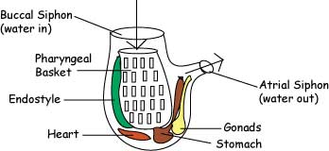
Subphylum urochordate: (e.g Ciona and Molgula)
The characteristics of tunicates are a bag-like body with two siphons, the branchial siphon and the atrial siphon. The animal takes in food and water through the mouth, or branchial siphon. It is then circulated through the pharynx, then the water passes out through the atrial siphon.

Slide 14
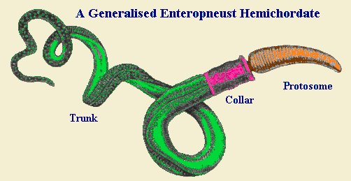
Subphylum Hemichordata: (e.g Balanoglosus).
The Hemichordates, or Acorn Worms are a small phylum of generally small animals that were once considered to be a part of the Chordata. However modern science has proven that none of them possess a post anal tail or a notochord and they have been allocated to a phylum of their own.

Slide 15
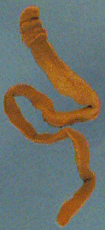
Characteristics of Hemichordata
Bilaterally symmetrical.
Body cavity a true coelom.
Nervous system normally diffuse, but variable
Has a partially open circulatory system.
Feeds on fine particles in the water.
All live marine environments

Slide 16
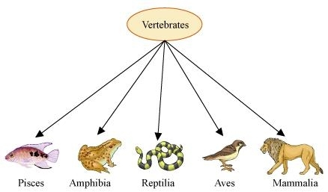
Group CRANIATA (=EUCHORDATA) (Chordates with skull, with 54,000 species of true chordates)
Subphylum VERTEBRATA, chordates with head, brain and vertebral column.
This subphylum includes mammals, fishes, reptile, amphibians and birds.

Slide 17
Subphylum: Vertebrata (Craniata)
Organism having cartilaginous or bony skull (cranium), which encloses the brain and sensory capsules
Sense organs include one pair eyes, olfactory organs and inner ears.
Notochord is replaced by vertebral column. The vertebral column allows the body to flex and provides attachment sites for muscles. In addition, it surrounds and protects the nerve cord
Excretory system achieved by a pair of kidneys.
The sexes are usually separate and reproduction usually sexual, achieved by pair of gonads.

Slide 18
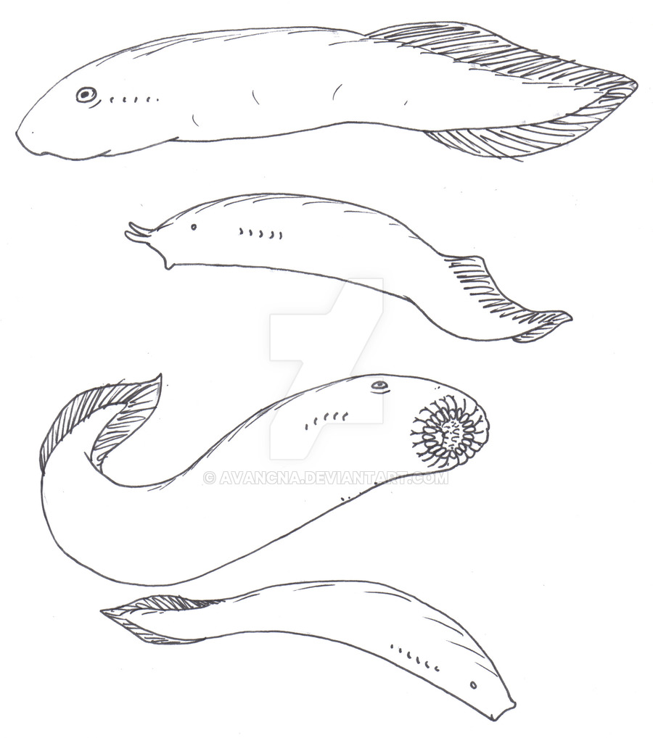
Agnatha - Lamprey, Hagfish (Jawless Fishes)
Agnatha are jawless fish. Lampreys and hagfish are in this class, Members of the agnatha class are probably the earliest vertebrates. And they don't have paired fins or a stomach. Both adults and larvae have a notochord.

Slide 19
Kingdom Animalia
Phylum Chordata
Subphylum Vertebrata
Class Cephalaspidomorphi
Order Petromyzontiformes
Family Petromyzontidae
Genus Petromyzon (Lamprey)

Slide 20
Lamprey (Petromyzon Sp.)
1-The lamprey looks like an eel, but it has a jawless sucking mouth that it attaches to a fish.
2-It is a parasite and sucks tissue and fluids out of the fish it is attached to.
3-The lamprey's mouth has a ring of cartilage that supports it and rows of horny teeth that it uses to latch on to a fish.
4-The 7 pair's gill slits, gill pouches are lined with gill filaments that serve as a surface for the exchange of respiratory gases.

Slide 23
hagfish (Myxini Sp.)
Phylum Chordata
Subphylum Vertebrata
Superclass Cyclostoma
Class Myxini
Order Myxiniformes
Family Myxinidae
Genus Myxini Sp.
Kingdom Animalia

Slide 24
The hagfish is also known as the slime fish.
The hagfish is also known as the slime fish.
It is eel-like and pinkish in color.
It has glands along its sides that produce a thick, sticky slime that it uses as a defense mechanism.
The hagfish is almost completely blind, but it has a good sense of touch and smell.
It has a ring of tentacles around its mouth that it uses to feel for food. It has a tongue-like projection that comes out of its jawless mouth. At the end of the projection are tooth-like rasps that close when the "tongue" is pulled back into the hagfish's mouth.
No vertebrae.
Has twelve pair's gill slits

Slide 25
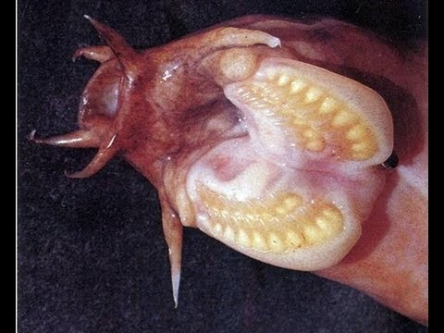
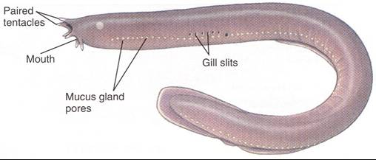
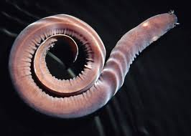

Slide 26
