Slide 1
Department of Civil Engineering
College of Engineering
Salahaddin University-Erbil
Coagulation and Flocculation
Lecture No. 2
Stage: 4th year
Prof. Dr. Shuokr Qarani Aziz and Mr. Khasro Kail (M.sc.)
Emails: shuokr.aziz@su.edu.krd, shoker71@yahoo.com, kasro.dizayee@su.edu.krd
February 13, 2023

Slide 2
Outline:
Coagulation process
Coagulants and coagulant aids
Mixing process
Jar test
Flocculation
Examples

Slide 3
Outcome:
To learn:
Coagulation process
Coagulants and coagulant aids
Mixing process
Jar test
Flocculation process

Slide 4
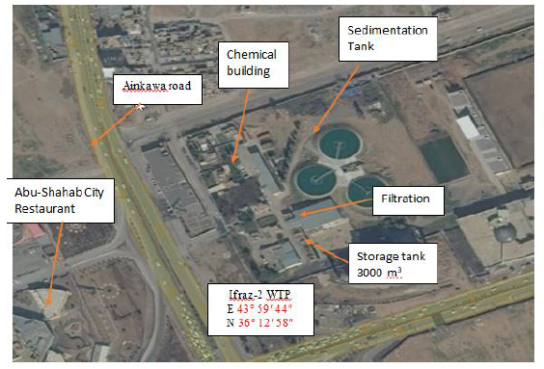
Ifraz 2 Water Treatment Plant
Figure: Ifraz 2 Water Treatment Plant (Omar and Aziz, 2020)

Slide 5
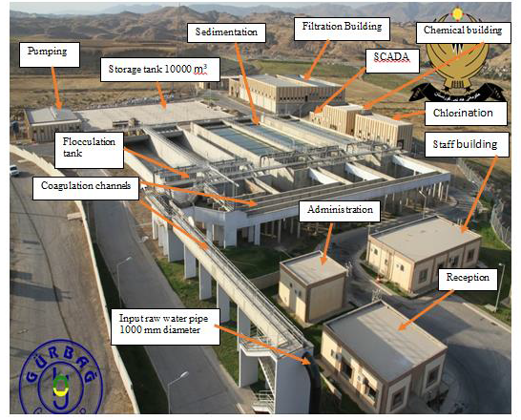
Qandil Water Treatment Plant
Figure: Qandil Water Treatment Plant (Omar and Aziz, 2020)

Slide 6
COAGULATION AND FLOCCULATION
Removal of very fine and light particles and colloidal matter in water by normal sedimentation process is not possible.
These type of SS (from about 0.1µm up to about 100 µm in diameter) and colloids (less than 0.001 mm in size) called non-settleable solids.
The colloids have a large surface area to volume ratio, remain in dispersed state without the tendency to combine, and hence do not settle down quickly, Figure 8-1.

Slide 7
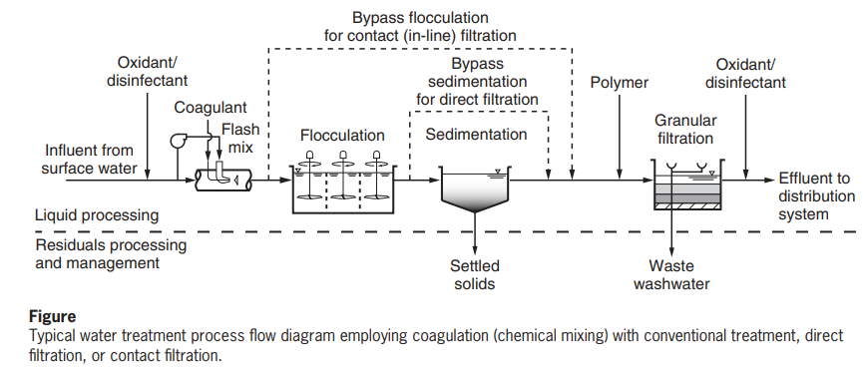
COAGULATION AND FLOCCULATION
The importance of the coagulation and flocculation in water treatment shown in the Figure below.
Coagulation is the addition of a chemical coagulant for the purpose of conditioning the suspended, colloidal, and dissolved matter for subsequent processing by flocculation or to create conditions that will allow for the subsequent removal of particulate and dissolved matter.

Slide 8
COAGULATION AND FLOCCULATION (Cont.)
Flocculation is the aggregation of destabilized particles (particles from which the electrical surface charge has been reduced) and precipitation products formed by the addition of coagulants into larger particles known as flocculant particles or, more commonly, ‘‘floc.’’
The aggregated floc can then be removed by gravity sedimentation and/or filtration. Coagulation and flocculation can also be differentiated on the basis of the time required for each of the processes.
Coagulation typically occurs in less than 10 s, whereas flocculation occurs over a period of 20 to 45 min.

Slide 9
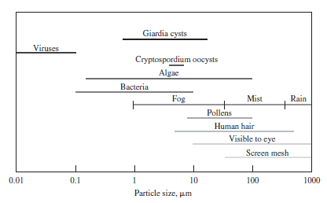
COAGULATION AND FLOCCULATION
Figure 8-1: Particulates in water and miscellaneous other reference sizes

Slide 10
TYPES OF COLLOIDS:
Hydrophilic (water-loving) → readily dispersed in water (very stable) - difficult to coagulate and remove from suspension
Hydrophobic (water-hating ) → no attraction - easily coagulated and destabilized
Settling velocity depends on specific gravity (SG) and the size of particles.
Commonly, SSs have SG of greater than 1.2 and they defined as settleable solids. While, SSs with SG of less than 1.2 are defined as non-settleable solids.
For example, it has been observed that silt particle with diameter of 0.05 mm needs 11 hours to travel 3 m depth. Clay particles with diameters of 0.002 mm requires 4 days to travel 3m depth. Colloids with diameter of ≤ 0.0001 mm does not settle.
Coagulation and flocculation processes are essential for SS > 50 mg/L.

Slide 11
COAGULATION
Coagulation defined as the addition of a chemical coagulant or coagulants for the purpose of conditioning the suspended, colloidal, and dissolved matter for subsequent processing by ﬂocculation or to create conditions that will allow for the subsequent removal of particulate and dissolved matter.
In a treatment plant, coagulation is achieved through rapid and intensive mixing of coagulants with water in a tank (like flash mixer), Figure 8-2a.

Slide 12
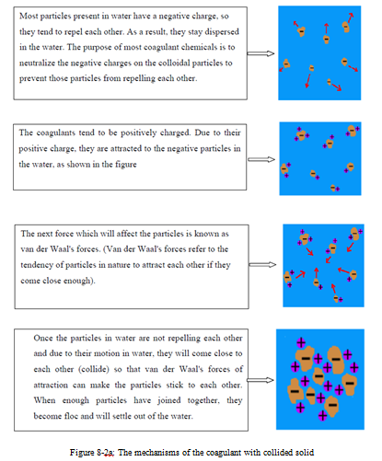

Slide 13
References:
Brandt M.J., Johnson K.M., Elphanston A.J., and Ratnayaka D.D. (2017) Twort’s Water Supply, 7th Edition, Published by Elsevier Ltd.
Davis, M. L. (2010) Water and Wastewater Engineering- Design Principles and Practice, The McGraw Hill Companies.
Steel, E.W. and McGhee, T.J. (1991).Water Supply and Sewerage. 6th edition. International student edition.
Aziz, S. Q. and Mustafa, J. S. (2019) Step-by-step design and calculations for water treatment plant units, Advances in Environmental Biology, Vol. 13, No. 8, pp. 1-16.
Omar, I. A. and Aziz, S. Q. (2020) Comparison and Assessment of Ifraz-2 and Qandil Drinking Water Treatment Plant Units. 6th International Engineering Conference “Sustainable Technology and Development" (IEC). , 26-27 February 2020, Erbil-Iraq. IEEE Publisher, DOI: 10.1109/IEC49899.2020.9122922.
Omar, I. A., and Aziz, S. Q. (2021) Optimization of ACH Coagulant, Settling Time and Powdered Activated Carbon as Coagulant Aid with Economic Analysis, Global NEST Journal, In Press.

Slide 14
Thank You

