Slide 1
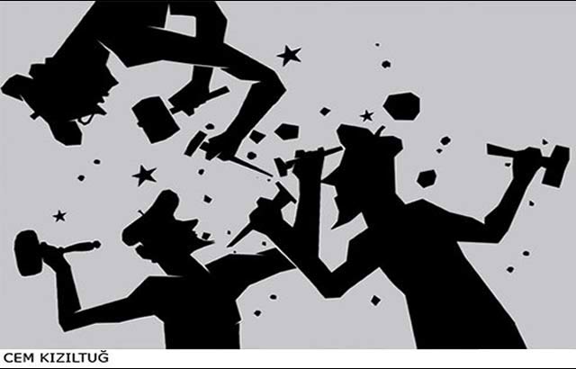
Constructivism
The world is social, not purely material

Slide 2
Introduction
In international relations: constructivism is a theory that concentrates that significant elements of international relations are shaped by ideational factors (which are historically and socially constructed), not simply material factors.
In contrast to some other prominent IR approaches and theories (such as Realism), constructivists do not make specific predictions about international relations, they see identities and interests of actors as socially constructed and something changeable.

Slide 3
Definition of Constructivism
Social constructivism definition:
Constructivism believes in the importance of ideas, identity, and interaction in the international system, arguing the human world is not simply given or natural but it is constructed through the actions of the actors themselves.
Constructivism puts into context the actions, beliefs, and interests of actors and understands that the world they inhabit has been created by them and impacts on them.

Slide 4
Key Concepts of Constructivism
Identity:
It is a central element of constructivism because identity tells us who actors are, what their interests are, and how those interests might inform their actions.
Interests cannot be pursued without particular identity, Identities, interests, political behavior of political agents are socially constructed by collective meaning, interpretations, and assumptions about the world.

Slide 5
Key Concepts of Constructivism
Beliefs, collective ideas and culture:
Beliefs are shared understandings of the world, share knowledge is important to identity formation. This sets up shared understanding between communities and states. Collective meaning constitute how we understand the world and respond to it.
Culture: It is a set of practices that give some sort of meaning to shared experiences and actions.

Slide 6
Alexander Wendt
Anarchy is what states make of it
Alexander Wendt’s piece ‘Anarchy is what states make of it : The social construction of power politics examines the dynamic and changing nature of the international system, he states that ‘today if there is a self-help world, it is due to process and not the structure.’ He argues that ‘ Anarchy is what states make of it’. Simply put, self-help system and power politics are facets of the international system and not it’s fixed characteristics. He also states that people act in a certain ways to things based on the meanings or identities associated with it, we base our own identities on our interests, and these identities are defined by certain roles accordingly.

Slide 7
Wendt’s Clear Example
Alexander Wendt (1995) offers an excellent example that illustrates the social construction of reality when he explains that 500 British nuclear weapons are less threatening to the United States than five North Korean nuclear weapons.
These identifications are not caused by the nuclear weapons (the material structure) but rather by the meaning given to the material structure (the ideational structure).

Slide 8
The Nature of Conflicts are Socially Constructed.
The example also shows that nuclear weapons by themselves do not have any meaning unless we understand the social context. It further demonstrates that constructivists go beyond the material reality by including the effect of ideas and beliefs on world politics.
Constructivists argue that agency and structure are mutually constituted, which implies that structures influence agency and that agency influences structures. Agency can be understood as the ability of someone to act, whereas structure refers to the international system that consists of material and ideational elements.
The social relation of enmity between the United States and Iran is related to the beliefs among both states, if the ideas and identity of these two actors change, the relationship between them would ultimately change.

Slide 9
Identities Determines Interests
Another central point for Constructivists is that identities determine interests and the nature of relationships among states in the international environment. Constructivists argue that states can have multiple identities that are socially constructed through interaction with other actors. Identities are representations of an actor’s understanding of who they are, which in turn signals their interests. They are important to constructivists as they argue that identities constitute interests and actions.
For example, the identity of a small state implies a set of interests that are different from those implied by the identity of a large state. The small state is arguably more focused on its survival, whereas the large state is concerned with dominating global political, economic and military affairs.

Slide 10
The Importance of Social norms For Constructivists
Social norms are generally defined as a standard of appropriate behavior for actors with a given identity. States that conform to a certain identity are expected to comply with the norms that are associated with that identity.
For example, constructivists argue that those state who have commitments towards the issue of climate change, they always come together to develop climate change mitigation policies because it is the right thing to do for the survival of humanity. This has, over decades of diplomacy and advocacy, become an appropriate behavior that the most of citizens expect their leaders to adhere to.
Liberals, on the other hand, might reject the notion of climate change politics in favor of continued economic growth and pursuing innovative scientific solutions, while realists might reject it due to the damage that climate policies may do to shorter-term national interests.

Slide 11
Three Basic Ontological Positions of Constructivism
1-normative or ideational structures are important and matter as much as, if not more than material structure. This means that ideas are center stage and are privileged.
2-identities are matter. Identities give us interests and those interests tell us something about how actors act/behave and the goals they pursue.
3-agents and structures are mutually constituted. This attention to how actors shape the world and how the world shapes actors means that human relations are inherently social and we create the world that we live in and it influences us as well.

Slide 12
What Are the Key Points of Constructivism
1-Constructivism has become a major approach in IR and security studies, drawing attention to the importance of ideas, identity and interaction.
2- it offers alternative ways of thinking about security, such as how anarchy itself is socially constructed.
3- it gives attention to the ideational factors, in contrast to rationalist approaches such as neorealism and neoliberalism which they rely on material factors in their analysis.
4- Constructivism also takes states as part of a social international framework, which is all too true, as we cannot possibly operate alone in the world. Our interactions with other people influence our own subjective opinions and shape bits of our interests and in turn our identity as people and states.
5-Consturctivism believes that political actors or states are not merely motivated by self-interest but rather that actions can be the by-product of social norms and ideas.

Slide 13
What Are the Key Points of Constructivism
6- Another key aspect of constructivism is that it states that agents of the international structure shape and the international system as time changes, the international system is not fixed but rather dynamic with changing times and normative ideas. These international structures are also created by the actions of political actors.

