Slide 1
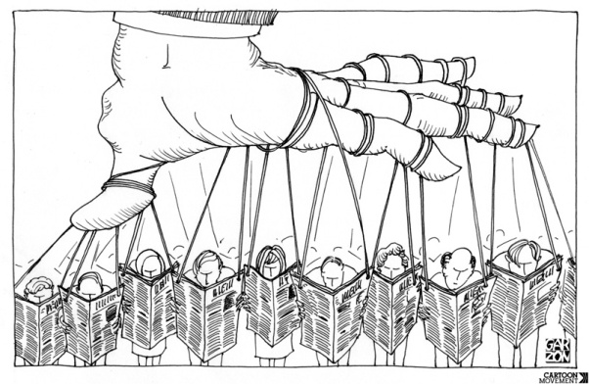
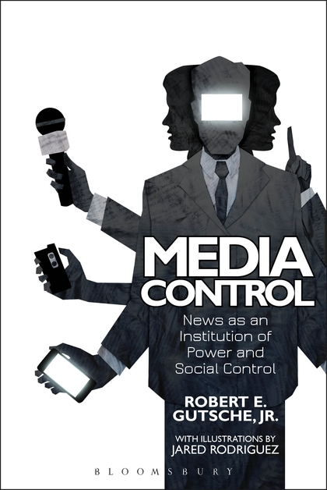
Media and Politics

Slide 2
The Relationship Between Media and Politics
There is a deep connection between media and political process in those countries that press is not banned. Due to the effectiveness of media on today's political life, political parties are very sensitive on how the media cover their characters because it directly influences their career.
If media is used against politicians, their career can easily be destroyed. On contrary, if the media cover positive elements of political parties and politician, their career can goes up to new heights.
What is media politics?
Ideally, media is supposed to fulfill its main role that is to inform the public disseminating a balanced political opinion to enable the public to make their choices. Media should objectivity (unbiased) cover political activities without having specific political ideology.

Slide 3
Relationships Between Governments and Media
To better understand media, considering political environment in which they operate is necessary. Governments in all nations serve as the structure that can constrain or promote free activity or agency of the media. This tension between structure and agency applies to media precisely. State regulation of media includes:
1-policies aimed at influencing the ownership structure of media.
2-the content it produced by media.
3-the technological infrastructure used to access and distribute the content.
In totalitarian systems, the structural constraint of the state largely dominates the potential agency of media:
In what ways tyrannical governments can dominate the press agency?
1- When the state-owned news agencies act as propaganda arms of the state.
2- When promotes a narrow set of government sanctioned images and messages.
3- When media used as indirect mechanism to support state interests.
4- When media used as surveillance mechanism to monitor potential political threats.

Slide 4
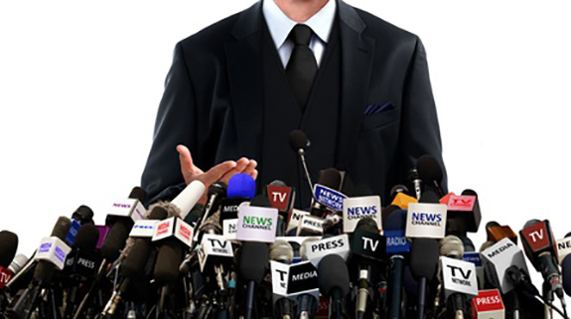
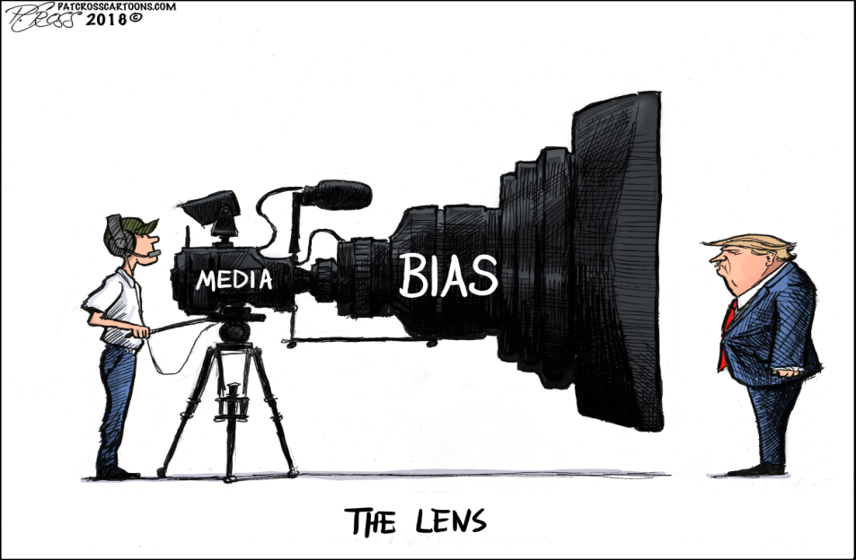
How political media can be recognized?
The main characteristics of political media.
1- Media station is owned by wealthy individuals who support specific political ideology.
2- Its coverage is biased due to its political connection to a specific political party.
3- Hiding the truth from the public.
4- Manufacturing stories to promote specific political agenda.
5- It becomes a tool for politicians to gain power.

Slide 5
Political Media and society
The politico-media complex:
The politico-media complex refers to the close, symbiotic relationship between a state's political, interest group and ruling classes and its media industry. The PMC is often used to describe collusion between governments or individual politicians and the media industry in an attempt to manipulate rather than inform the people.
The evidence of this influential relationship of the politico-media complex is in the form of propaganda, which can be observed in many areas of media industry, including print, radio, film, television, and the internet. Newsprint has served as a source of political news and platform for political propaganda for the long time.

Slide 6
The Nature of Relationship Between Media and Politics
The sordid relationship between politics and the media can be manifested as follows:
1- it manipulates the public to comport themselves in ways that enable governments to implement agenda with the consent of the electorate which they otherwise would find challenging to introduce.
2- Most of the materials in political media contains political content that exchanges between politicians and individuals.
3-The influence of government officials and politicians to share their agendas is massively vast and unprecedented.
4- it has watchdog role to monitor individuals and their opponents both in government and society.
5- Not wanted public officials are subject to greater scrutiny.
6- it has boundless access to information, and can reach even every single members of society through personalized, peer-to-peer channels.

Slide 7
The Role of Political Media in Democratic Society
Media play some essential roles in politics or a democratic society.
1-The media's main purpose is to inform the public, providing citizens with the information needed to make thoughtful decisions about leadership and policy.
2- Media act as watchdogs checking government actions.
3- Media set the agenda for public discussion of issues, and provide a forum for political expression.
4- Media also facilitate community building by helping people to find common causes, identify civic groups, and work toward solutions to societal problems.
What are the benefits of media-politics for politicians and individuals?
It easily creates channels of communication that play a key role in circulating news, it is powerful to change not just the message, but the dynamics of political corruption, values, and the dynamics of conflict in politics.

Slide 8
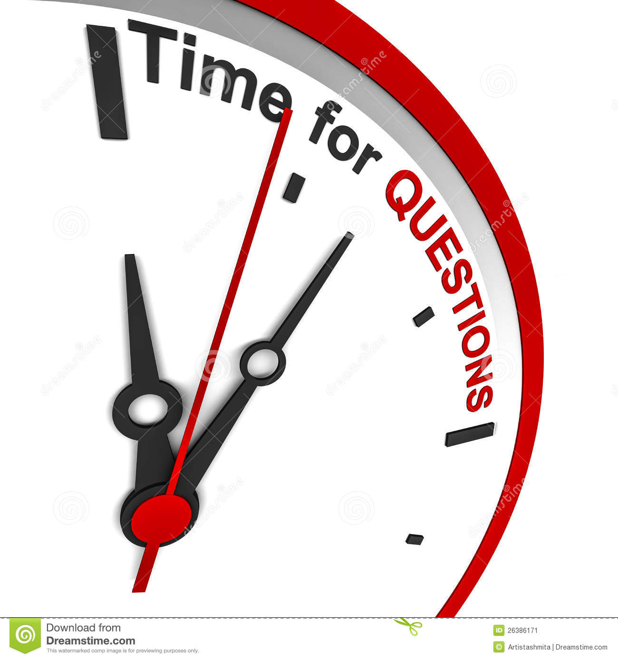
Questioning Time

