Slide 1
Wall Systems
By
Assist.Prof.Dr.Sinan Abdulkhaleq Yaseen
Civil Engineering Department
sinan.yaseen@su.edu.krd
Lecture 12

Slide 2
Wall Systems
Reference:
Building Construction, Principles, Materials, and Systems Madan Mehta, Walter Scarborough, Diane Armpriest, 2nd Edition
Construction Building Envelope and Interior Finishes Databook, 2004
Fundamentals of Building Construction, Edward Allen and Joseph Iano, FIFTH EDITION, 2009

Slide 3
Wall
Walls are built to partition living area into different parts. They impart privacy and protection against temperature, rain and theft. Walls may be classified as:
Load bearing walls:
Load-bearing walls carry and support the structural weight of a house, They are to be designed to transfer the load safely
The critical portion of the walls are near the openings of doors and windows and the positions where concrete beams rest. Minimum wall thickness used is 200 mm

Slide 4
Wall
Partition walls (non load bearing walls)
Non-load-bearing walls are found in the interior of a house
They are non-load-bearing in that they do not have to support the weight of the house, and primarily serve as partitions
For example, a wall that separates two bedrooms that are next to each other would be a non-load-bearing wall

Slide 5
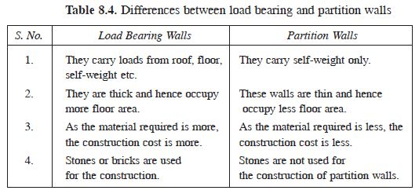
Wall
Table shows the differences between load bearing and partition walls

Slide 6
Materials Used In Wall Construction
With regard to history
The first recorded brick masonry units were made by the Egyptians in 10,000 B.C.
The Romans used brick in many of their structures 2000 years go.
The Great Pyramid of Giza in Egypt is the first recorded use of mortar

Slide 7
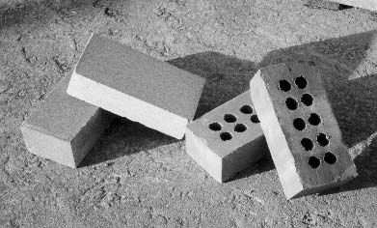
Masonry Brick Walls
Bricks are one of the major construction materials instantly associated with building construction, but more importantly because the sizes chosen for the manufacture of bricks affect practically everything in a building
Bricks are entirely ‘man-made’ masonry units. A variety of materials are quarried, mined or salvaged from manufacturing processes and
made into bricks or blocks
Solid and perforated bricks.

Slide 8
Brick materials
The primary raw materials for making bricks are clay and shale. The two main constituents of clay and shale are the oxides of silicon and aluminum
Some minor components are iron and other metal oxides, which are particularly responsible for giving brick its red-brown color
White or light-colored bricks are made by using clay that is naturally lacking of metal oxides and removing whatever metal oxides are present in it
White bricks are generally more expensive than the normal (red-brown) bricks.

Slide 9
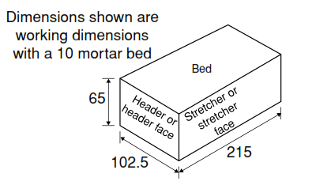
Bricks Terminology
The surfaces of a brick have names:
Top and bottom surfaces are beds
Ends are headers or header faces
Sides are stretchers or stretcher faces

Slide 10
Properties of Good Bricks
The following are the required properties of good bricks:
Color: Color should be uniform and bright
Shape: Bricks should have plane faces. They should have sharp and true right angled corners
Size: Bricks should be of standard sizes as prescribed by codes and specifications
Texture: They should possess fine, dense and uniform texture. They should not possess fissures, cavities, loose grit and un-burnt lime.
Soundness: When struck with hammer or with another brick, it should produce metallic sound

Slide 11
Properties of Good Bricks
Hardness: Finger scratching should not produce any impression on the brick
Strength: Crushing strength of brick should not be less than 3.5 N/mm2. A field test for strength is that when dropped from a height of 0.9 m to 1.0 m on a hard ground, the brick should not break into pieces
Water Absorption: After immersing the brick in water for 24 hours, water absorption should not be more than 20 per cent by weight
Efflorescence: Bricks should not show white patches when soaked in water for 24 hours and then allowed to dry in shade. White patches are due to the presence of sulphate of calcium, magnesium and potassium. They keep the masonry permanently in damp and wet conditions

Slide 12
Properties of Good Bricks
Thermal Conductivity: Bricks should have low thermal conductivity, so that buildings built with them are cool in summer and warm in winter
Sound Insulation: Heavier bricks are poor insulators of sound while light weight and hollow bricks provide good sound insulation
Fire Resistance: Fire resistance of bricks is usually good. In fact bricks are used to encase steel columns to protect them from fire

Slide 13
Bonding of Bricks wall
The purposes of bricks wall bonding are:
Obtain maximum strength whilst distributing the loads to be carried throughout the wall
Ensure lateral stability and resistance to side loads
Create an acceptable appearance

Slide 14
Mortar
Mortar is the bonding agent that holds all of the masonry units together. Mortar serves four functions:
It bonds the masonry units together and seals the space between them, also keep water and wind from penetrating
It allows for dimensional variations in the masonry units while maintaining a high degree of levelness
It bonds to the reinforcing steel in the wall
It provides an added decorative effect to the wall inasmuch as various colors or tooled joints can be introduced

Slide 15
Mortar
The most characteristic type of mortar is cement–lime mortar, made of Portland cement, hydrated lime, an inert aggregate, and water.
The sand must be clean and must be screened to eliminate particles that are too coarse
Lime is added to impart smoothness and workability. Lime is produced by burning limestone or seashells (calcium carbonate) in a kiln to drive off carbon dioxide and leave quicklime (calcium oxide)

