Slide 1
Building Construction
By
Assist.Prof.Dr.Sinan Abdulkhaleq Yaseen
Civil Engineering Department
sinan.yaseen@su.edu.krd
Lecture 13

Slide 2
Wall Systems
Reference:
Building Construction, Principles, Materials, and Systems Madan Mehta, Walter Scarborough, Diane Armpriest, 2nd Edition
Construction Building Envelope and Interior Finishes Databook, 2004
Fundamentals of Building Construction, Edward Allen and Joseph Iano, FIFTH EDITION, 2009

Slide 3
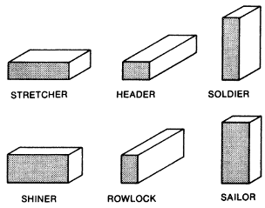
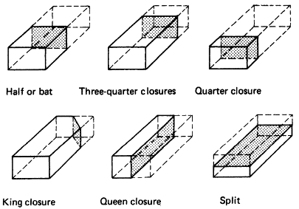
Types of Brick Wall Bonding
Names of cut bricks
Bricks Terminology

Slide 4
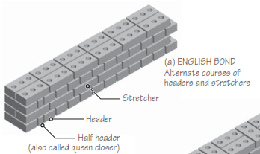
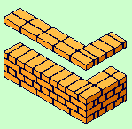
Types of Brick Wall Bonding
English bond
One course in stretcher bond, and one course in header bond. One header placed centrally above each stretcher

Slide 5
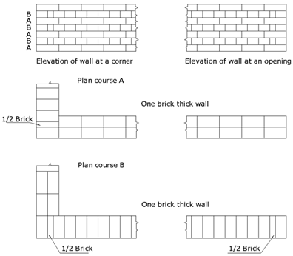
English bond

Slide 6
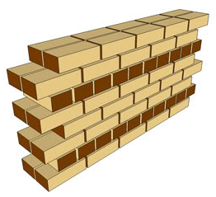
Types of Brick Wall Bonding
1.1 English Garden bond
Three courses of stretchers to one of headers

Slide 7
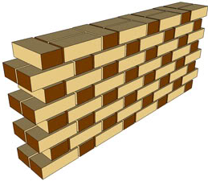
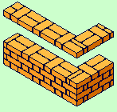
Types of Brick Wall Bonding
Flemish bond
Alternate bricks are placed as header and stretcher in every course. Each header is placed centrally between the stretcher immediately above and below

Slide 8
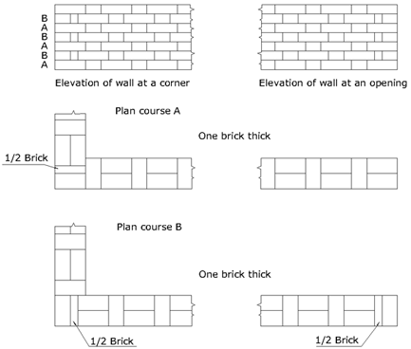
Flemish bond

Slide 9
Types of Brick Wall Bonding
2.1 Flemish Garden bond
In each course, one header to every three stretchers

Slide 10
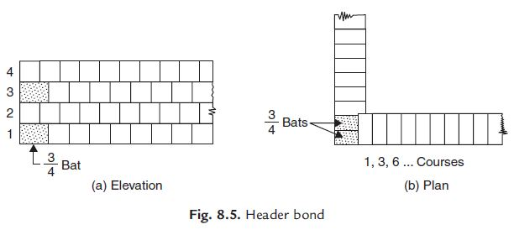
Types of Brick Wall Bonding
Header bond
Header bond is created by rows of headers, only displaced by half a brick on each row. This bond is often use to create curved brickwork

Slide 11
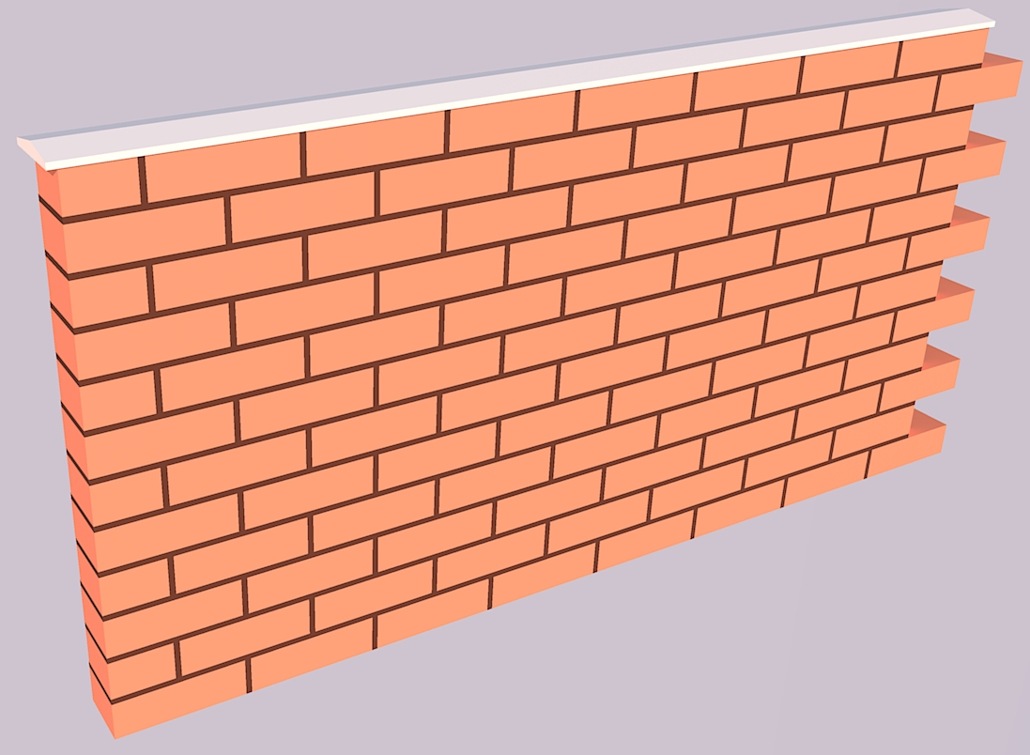
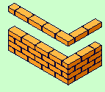
Types of Brick Wall Bonding
Stretcher bond
It is easy to lay with little waste and composed entirely of stretchers set in rows, offset by half a brick

Slide 12
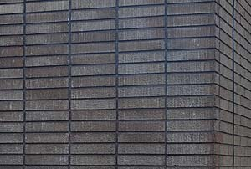
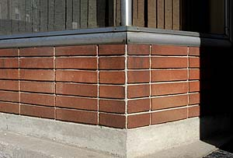
Types of Brick Wall Bonding
Stack bond
A pattern made up of rows of stretchers with each stretcher centered on the stretcher below it. All joints run vertically down the entire wall.

Slide 13
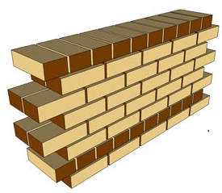
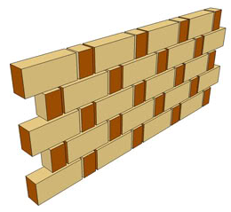
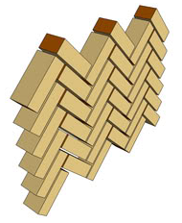
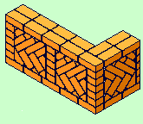
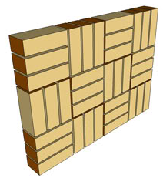
Types of Brick Wall Bonding
Other types of brick wall bonding
Scottish bond
Rat-trap bond
Herringbone bond
Raking Bonds
Basket bond

