Slide 1
Wall Systems
Reference:
Building Construction, Principles, Materials, and Systems Madan Mehta, Walter Scarborough, Diane Armpriest, 2nd Edition
Construction Building Envelope and Interior Finishes Databook, 2004
Fundamentals of Building Construction, Edward Allen and Joseph Iano, FIFTH EDITION, 2009

Slide 2
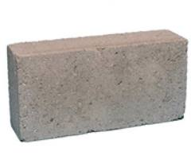
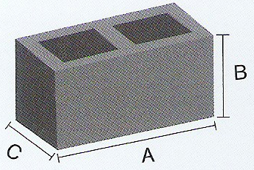
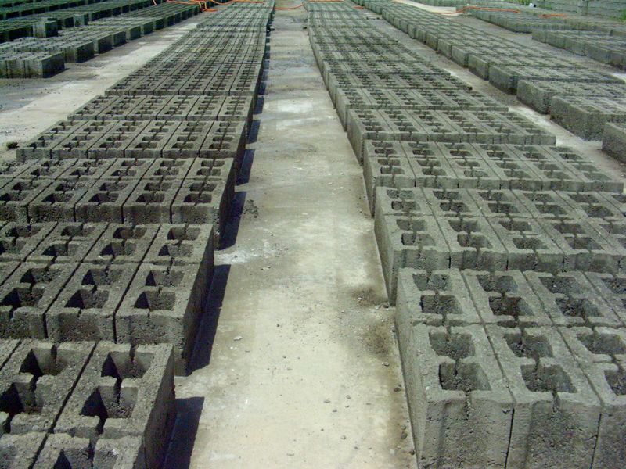
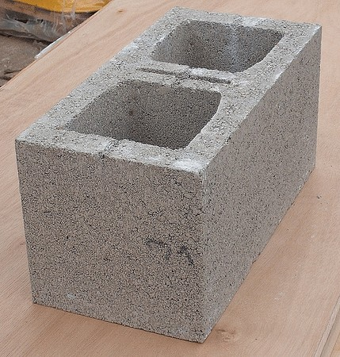
Masonry Concrete Blocks Wall
Concrete blocks are made from cast concrete, i.e. Portland cement and aggregate, usually sand and fine gravel for high-density blocks
Solid Block
Hollow Block

Slide 3
Concrete Blocks
Concrete blocks generally manufactured in two basic forms: solid block, and hollow block
The hollow load bearing concrete blocks of the standard size 400 x 200 x 200 mm will weight between 17 and 26 kg (1063 to 1625 kg/m3) when made with normal weight aggregates
The compressive strength of concrete blocks should be ranged between 5 N/mm² to 11 N/mm². It depends on the grade of the concrete which typically depends on cement strength and aggregate

Slide 4
Concrete Blocks
These are used extensively for both load bearing and non-load bearing walls, externally and internally
A concrete block wall can be laid in less time and may cost up to half as much as a similar brick wall
Light weight aggregate concrete blocks have good insulating properties against transfer of heat

Slide 5
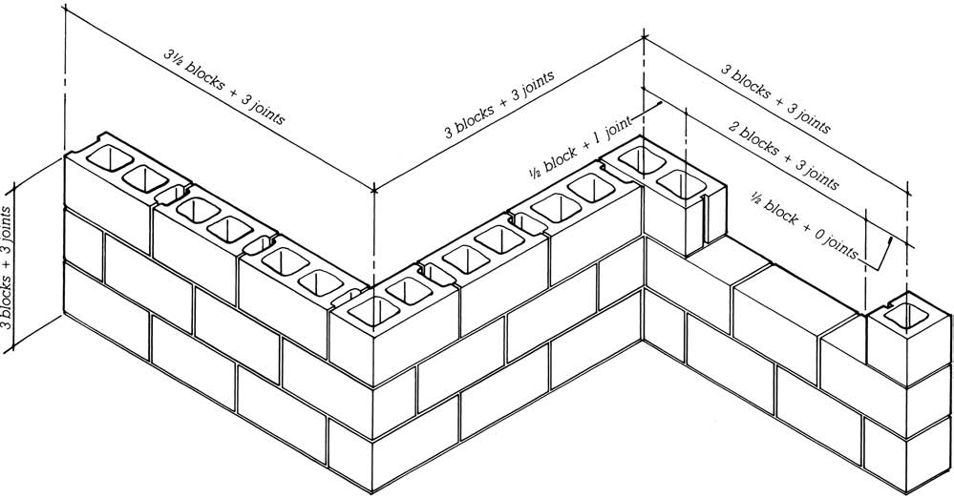
Concrete Blocks
It is more economical and produces better results if the designer lays out buildings of concrete masonry in dimensional units that correspond to the module of the block

Slide 6
Natural Stone
Natural stone was the predominant material used in major building construction. It was not only the structural material, but also the exterior and interior finish, and often the flooring and roofing as well
The strength of a stone depends on its structure, the hardness of its particles, and the manner in which those particles are interlocked or cemented together
A minimum compressive strength of 5000 Psi (35 MPa) is considered adequate for building purposes

Slide 7
Natural Stone
Hardness of stone is critically important only in horizontal planes such as flooring and paving. It effects on workability
Workability in this instance refers to the ease with which a stone may be sawed, shaped, dressed, or carved, and will directly affect the cost of production
Workability decreases as the percentage of siliceous materials increases
Porosity, the percentage of void content, affects the stone’s absorption of moisture, thus influencing its ability to withstand frost action and repeated freeze-thaw cycles
Durability of stone, or its resistance to wear and weathering, is also considered roughly analogous to silica content.

Slide 8
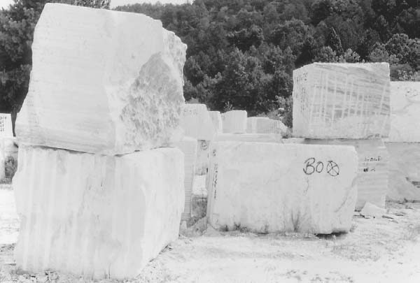
Use of Stone in Buildings
Load-bearing and self supporting masonry
Masonry facade to buildings
Cladding and linings
Roofing
Flooring

Slide 9
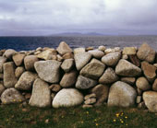
Civil Engineering Use
Structural uses
Facing and cladding
Hard landscaping

Slide 10
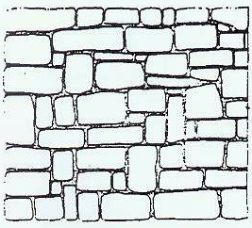
Application

Slide 11
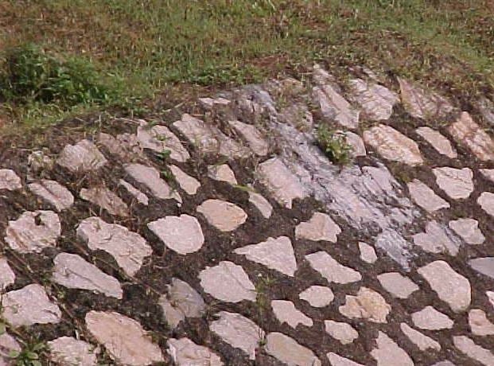
Application

Slide 12
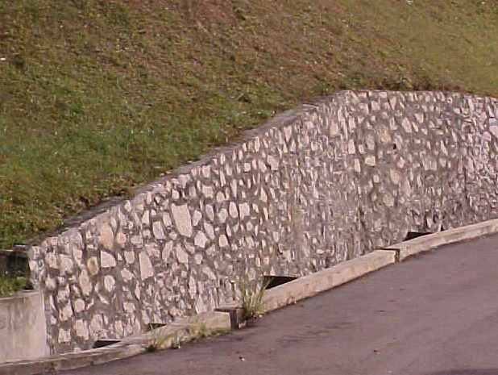
Application

Slide 13
Applications

