Slide 1
Wall Systems
Reference:
Building Construction, Principles, Materials, and Systems Madan Mehta, Walter Scarborough, Diane Armpriest, 2nd Edition
Construction Building Envelope and Interior Finishes Databook, 2004
Fundamentals of Building Construction, Edward Allen and Joseph Iano, FIFTH EDITION, 2009

Slide 2
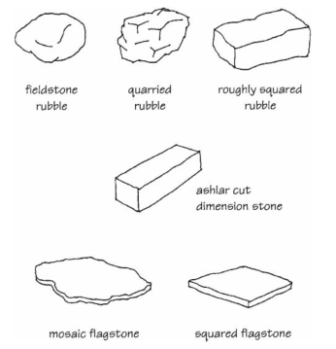
Natural Stone
Stone is used for masonry construction in many forms and is available commercially as:
Rubble stone,
Flagstone,
Dimension stone,
Tile

Slide 3
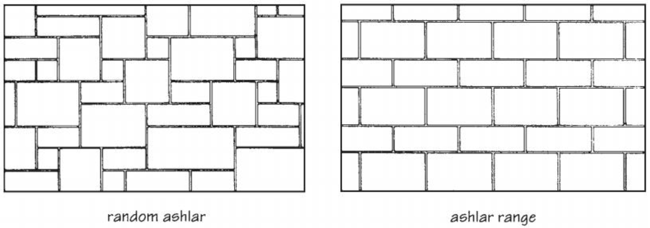
Natural Stone
Stone bonding patterns

Slide 4
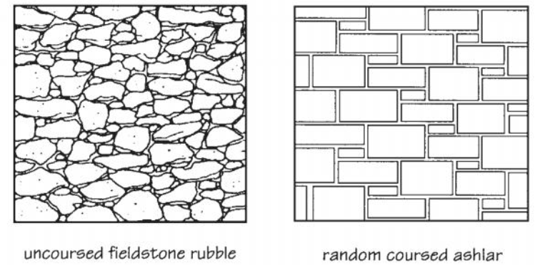
Natural Stone
Stone bonding patterns

Slide 5
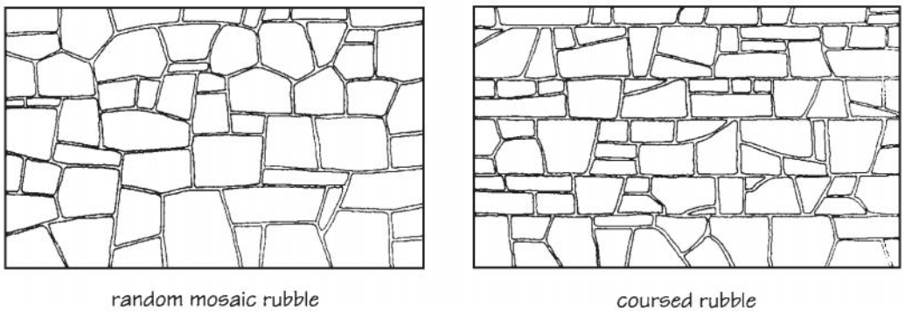
Natural Stone

Slide 6
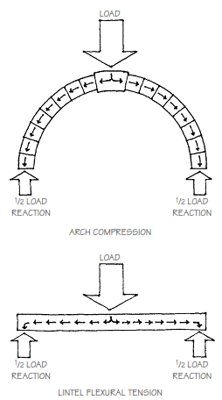
Lintels and Arches
lintels of steel, reinforced masonry,
stone, concrete, precast concrete, and
cast stone are typically used to span
openings in masonry walls
Arches carry loads in compression,
but lintels act as flexural members
spanning horizontally from one
support to the other

Slide 7
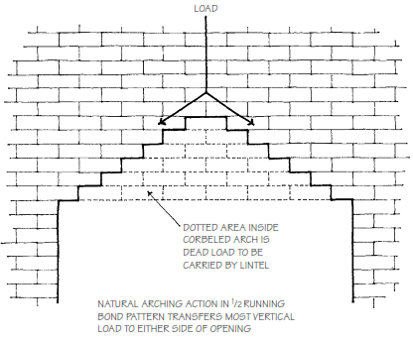
Lintels and Arches
When masonry is laid in running bond (stretcher bond), it creates a natural arch
Lintels must be designed to carry the weight of the masonry inside the triangle formed by the line of such arching action
This triangular area has sides
at 45° angles to the lintel, and
its height is therefore one-
half the span length

Slide 8
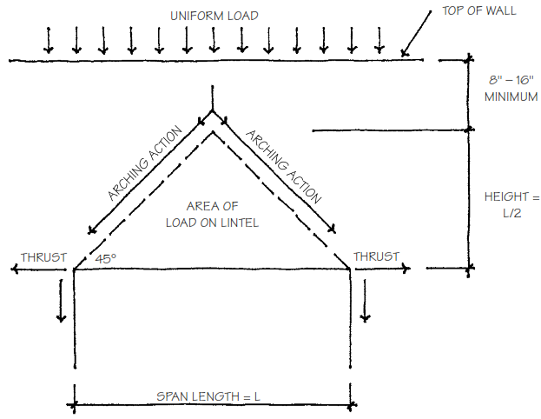
Lintels and Arches
Outside this area, the weight of the masonry is assumed to be carried to the supporting abutments by natural arching. For this assumption to be true, however, the arching action must be stabilized by minimum of 40 cm of masonry above the top of the triangle
If arching action cannot
be assumed to occur
because of inadequate
height above the load
triangle, or because the
masonry is not laid in
running bond, the lintel
must be sized to carry
the full weight of the wall above its entire length

Slide 9
Lintels and Arches
Arching action produces an outward horizontal thrust at each support or abutment. The abutments, therefore, must have sufficient mass to resist this force
If the opening is near a corner or close to another opening, or if an expansion or control joint occurs at the side of the opening, it may again be necessary to size the lintel large enough to carry all of the loads above its entire length, without assuming any arching action in the masonry
Lintels may be construct by using steel angels, precast concrete, reinforced masonry

Slide 10
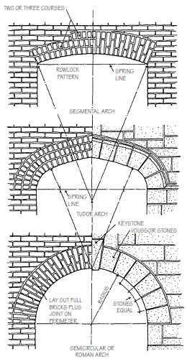
Lintels and Arches
Arches may be constructed in
various forms such as segmental,
elliptical, Tudor, Gothic, semicircular,
parabolic, flat or jack arches
The primary structural advantage of an
arch is that under uniform loading
conditions, the stress is principally
compression rather than tension
This is very efficient structurally since
masonry’s resistance to compression
is greater than its resistance to tension

Slide 11
Lintels and Arches
Arches whose spans do not exceed 6 ft. are called minor arches, and they are most often used in building walls over door and window openings
Major arches whose spans are wider than 6 ft. require engineering design
The terminology used to describe the various parts of an arch are illustrated in next 3 slides

Slide 12
Lintels and Arches
Arch terminology

Slide 13
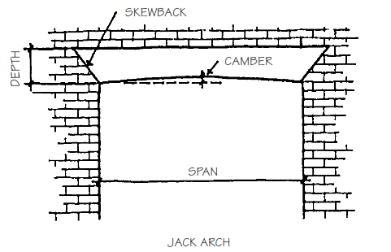
Lintels and Arches
Arch terminology

Slide 14
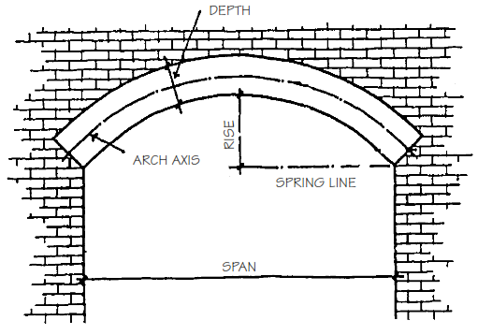
Lintels and Arches
Arch terminology

Slide 15
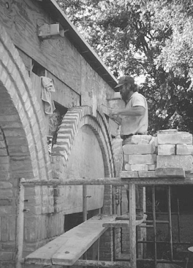
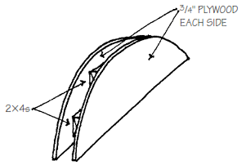
Lintels and Arches
The steps in building a masonry arch are simple, but good workmanship is essential. Arches are constructed over temporary shoring or centering to
carry the dead load of the material
and other applied loads until the
arch itself is completed and the
mortar has cured to sufficient
strength

Slide 16
Lintels and Arches
There should always be an odd number of units so that the center unit or key falls exactly at the center of the arch
All units should be full size and the joints should be spaced evenly
Although the shape and placement of each unit are most important in the structural stability of an arch, mortar keeps the units from sliding, and it is especially important that the mortar joints be completely filled
It can be difficult to achieve full joints in soldier courses because the mortar tends to slump toward the bottom of the joint as the unit is placed. Full mortar joints are easier to achieve with rowlock courses

Slide 17
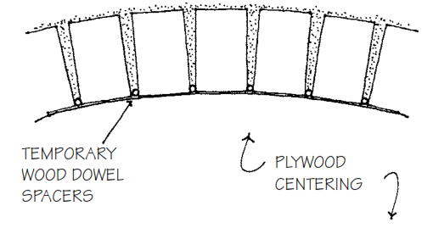
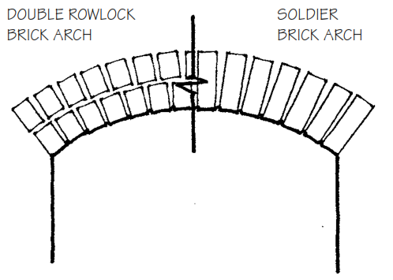
Lintels and Arches
A wooden dowel of the appropriate size placed at the bottom of the joint will maintain the correct joint width and unit spacing

