Slide 1
STRAINS

Slide 5
Example
Force P is applied to the arm ABC, the arm rotates about pin A through an angle of 0.05ᵒ
Determine the normal strain in wire BD.
Solution

Slide 6
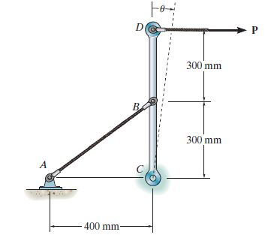
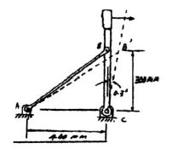
Example
If Force P is applied to the end D and cause rotate member CBD by ϴ= 0.3ᵒ
Determine the normal strain in the cable AB.
Solution

