Slide 3
Start from the left side load is positive when it is upward counter counterclockwise moment is positive

Slide 7
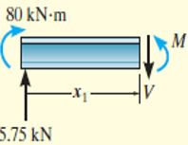
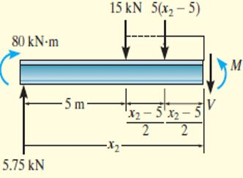
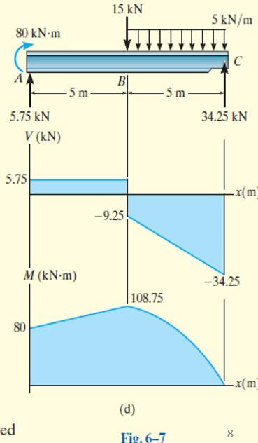
Checking

