Slide 1
FOOD CHAINS AND FOOD WEBS

Slide 2
Food Chains
a series of organisms each dependent on the next as a source of food.
the series of processes by which food is grown or produced, sold, and eventually consumed.

Slide 3
The energy flow from one trophic level to the other is know as a food chain
A food chain is simple and direct
It involves at least one group oforganism at each trophic level
Primary Consumers – eat autotrophs (producers)
Secondary Consumers – eat the primary consumers
Tertiary Consumers – eat the secondary consumers
Decomposers – bacteria and fungi that break down dead organisms and recycle the material back into the environment

Slide 4
Food Web
Most organisms eat more than JUST one organism
When more organisms are involved it is known as a FOOD WEB
Food webs are more complex and involve lots of organisms

Slide 5
Food Web
Notice that the direction the arrow points → the arrow points in the direction of the energy transfer, NOT “what ate what”

Slide 6
Words to Know
Producer – an organism that makes it’s own
food
*Plants are
Consumers – an organism that has to eat to get energy

Slide 7
Types of Consumers
herbivore – an organism that only
eats plants
carnivore - an organism that only
eats meat
omnivore – an organism that eats
meat and plants

Slide 8
What is Ecological Pyramid?
An ecological pyramid is a graphical representation of the relationship between the different living organisms at different trophic levels. It was given by G. Evylen Hutchinson and Raymond Lindeman.
It can be observed that these pyramids are in the shape of actual pyramids with the base being the broadest, which is covered by the lowest trophic level, i.e., producers. The next level is occupied by the next trophic level, i.e., the primary consumers and so on.

Slide 9
Pyramid of Number
Pyramid of numbers is divided into two different forms depending on the number of organisms: upright and inverted.
In the Upright pyramid of numbers, the numbers of organisms mostly reduce from bottom to top. It usually occurs in pond and grassland ecosystems where plants occupy the base of the pyramid. The next levels of the pyramid include the consumers.

Slide 10
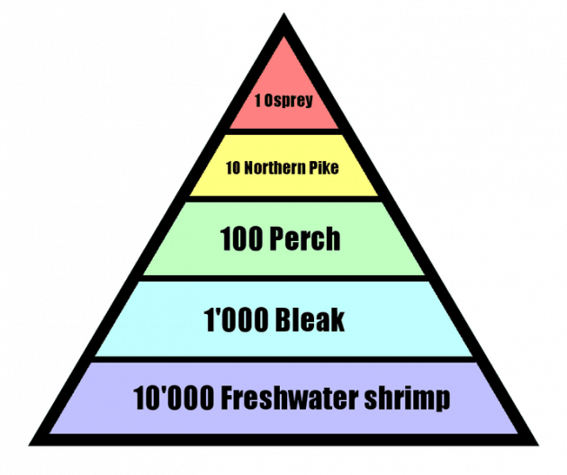
Upright

Slide 11
Inverted pyramid of Number

Slide 12
An inverted pyramid is actually the opposite of the upright pyramid. It can closely be observed in tree ecosystem, where trees are the producers and insects are the consumers.
The population of higher tropic individuals usually become continuously lower because of food wastage during eating, wastage of food during digestion and finally use of food in the process of respiration and physical activities.

Slide 13
Pyramid of Energy
Pyramid of energy is the only type of ecological pyramid, which is always upright as the energy flow in a food chain is always uni-directional. Also, with every increasing trophic level, some energy is lost into the environment.

Slide 14
Energy Pyramid
Shows the amounts of energy available at each trophic level of an ecosystem
The higher in the pyramid, the less energy available

Slide 15
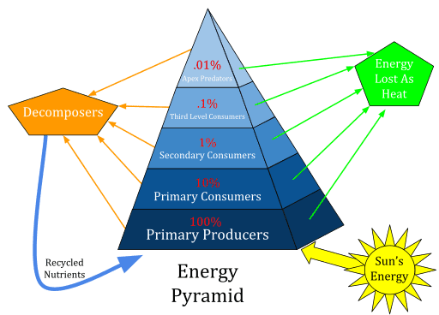

Slide 16
3- Pyramid of Biomass
This ecological pyramid shows different amounts of biomass produced by each trophic level. The pyramid of biomass is always upright except in oceans because large numbers of zooplankton depend on phytoplankton. The producers have the highest biomass in this pyramid and then primary consumers have less biomass than producers. Similarly, secondary consumers have less biomass than primary consumers and at least biomass is present at the top of the pyramid. The pyramid of biomass in a sea is also inverted because the biomass of fish exceeds phytoplankton.

