Slide 1
Environmental Impact Assessment
Prepared by
Dr. Siraj M.A. Goran

Slide 2
EIA (Environmental Impact Assessment)
EIA is a systematic process to identify, predict and evaluate the environmental effects of proposed actions and projects on the environment.
A broad definition of environment is adopted. Whenever appropriate social, cultural and health effects are also considered as an integral part of EIA.
Finally, particular attention is given in EIA for preventing, mitigating and offsetting the significant adverse effects of proposed undertakings

Slide 3
Definition
It is a planning and management tool for sustainable development that seeks to identify the type, magnitude and probability of environmental and social changes likely to occur as direct or indirect result of a project or policy and to design the possible mitigation procedure.

Slide 4
EIA acts as a Practical Solutions for Problems) as:
∗ Determining and managing (identifying, describing, measuring, predicting, interpreting, integrating, communicating, involving and controlling),

Slide 5
∗ Potential (or real) impacts (direct and indirect, cumulative, likelihood)
∗ Proposed (or existing) human actions (projects, plans, programs, legislation, activities) and their alternatives on the environment,
Environment (Physical, Chemical, biological, human health, cultural, social, economic, built and interactions)”

Slide 6
EIA is a tool that is applied…
before major decisions are taken and when all alternatives are still open;
to inform all stages of decision making, including final approval and the establishment of conditions for project implementation;
public participation and consultation; and
to integrate environmental considerations and safeguards into all phases of project design, construction and operation

Slide 7
Environment will cover, the existing condition in or/and around the area is as much as:
(i) Physical environment to include:
(a) Land and Climate: Weather conditions to include temperature (ambient), humidity, wind velocity, precipitation, land use, topography, geology and seismic considerations.
(b) Atmospheric conditions: Ambient air quality at the site and around specially in down wind direction
(c) Water bodies: Laks, rivers, ponds and canals. Hydrology and existing quality. Ground water availability and flow regime
(d) Noise level

Slide 8
(ii) Chemical Environment to include:
(a) Industrial activities, types of industries at the site and around (10 km radius), types of wastes produced and methods of treatment and disposal of effluents.
(b) City dumping sites, land fill sites

Slide 9
(iii) Infrastructure: Public Services, Water Supply, Waste Treatment Plants, Energy resources, distribution system, Transport system, communication, important buildings, heritage, sites etc.
(iv) Biological environment: Vegetation, forests, flora, fauna. Natural vegetation, parks, cultivated land, crops, threatened and endangered species.

Slide 10
Before 1960, seldom environmental factors considered in economic equation.

Slide 11
Environment is a comprehensive term meaning surroundings. It includes the gaseous envelope surrounding earth, the Atmosphere, the mass of water above and below the earth, the Hydrosphere, the land masses that support life, the Lithosphere, and the whole microbes, plants, and animals, collectively referred as, Biosphere.

Slide 12
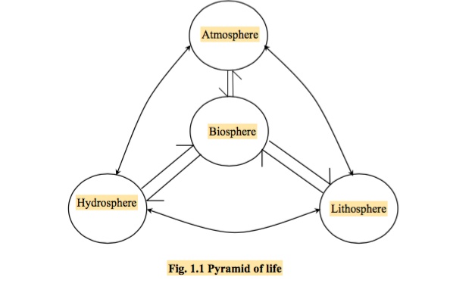

Slide 13
Man is often said to be his own enemy. This is perhaps true in the consequence of human activities to provide food, shelter, amenities (characters) and transport. While products of industry and agriculture make human existence more bearable and pleasant, they give rise to waste effluents and emissions.

Slide 14
Some of the interactions of human existence relate to:
- utilization of a resource without impairing its use,
- disposal of wastes without creating problems,
- degradation of forest wealth and exploitation of biota

Slide 15
The rapid growth of population, improvements in standards of living and concomitant growth of infrastructure have altered the environment, sometimes beyond its power of resilience. These changes have resulted in ecological crisis and have become a matter of grave concern to managers and decision makers throughout the world. The issues both at national and global levels are focussing concern of nodal agencies (to support sustainable development and tend to produce adverse impacts on living conditions of human, animals, plants and geographical environment.

Slide 16
History
The National Environmental Policy Act 1969 of USA is the legislative basis for EIA. The policy was the result of wide spread recognition in the 1960s that some major environmental problems were created by the government’s projects (power stations, dams and reservoirs, industrial complexes).
The legislation made mandatory to assess the environmental consequences of all projects by federal agencies.
In 1990s, many developed and some developing countries designed their EIA legislation. e.g. New Zealand (1991), Canada (1995), Australia (1999), Vietnam (1993), Uganda (1994), Ecuador (1997).
Today, EIA is firmly established in planning process in many of these countries.

Slide 17
Purposes/Aims and Objectives
Environmental impact assessment is an important management tool for improving the long-term viability of projects. Its use can help to avoid mistakes that can be expensive and damaging in environmental, social and economic terms. Human activities are altering natural cycles and systems on an unprecedented scale, and the cumulative effects of these activities are estimated to be on part with bio-physical processes as an agent of ecological change.

Slide 18
Usually, the cost of undertaking an EIA accounts for only a small proportion of total project costs (usually less than 0.1% of overall project costs), but savings to the project from an impact assessment can often considerably more.

Slide 19
More broadly, EIA is used for early warning planning of a wide range of resource use, development, and conservation initiatives in order to make the most of options for achieving sustainability.
We live in a greenhouse world of ozone holes and vanishing (disappear) species. It is now considered that the impact of human activities on the biosphere is reaching critical thresholds, with the consequent threat of ecological breakdown and social conflict.

Slide 20
The immediate aim of EIA is to inform the process of decision-making by identifying the potentially significant environmental effects and risks of development proposals.

Slide 21
Objectives related to this aim are to:
improve the environmental design of the proposal;
ensure that resources are used appropriately and efficiently;
identify appropriate measures for mitigating the potential impacts of the proposal; and
facilitate informed decision making, including setting the environmental terms and conditions for implementing the proposal.

Slide 22
The ultimate (long term) aim of EIA is to promote sustainable development by ensuring that development proposals do not undermine (destroy) critical resource and ecological functions or the well being, lifestyle and livelihood of the communities and peoples who depend on them.
Objectives related to this aim are to:
protect human health and safety;
avoid irreversible changes and serious damage to the environment;
safeguard valued resources, natural areas and ecosystem components; and
enhance the social aspects of the proposal.

Slide 23
Thanks

