Slide 1
Kurdistan Region- Iraq
Ministry of Higher Education
& Scientific Research
Salahaddin University- Erbil
Gravity Method
Course Book
Muhammad Ali
Sirwa Qadir
3rd Stage Students
Earth Sciences and Petroleum Department
1st Semester - Academic Year: 2023/2024

Slide 2
Practical Course Program:
This includes about 12-14 labs on different topics
covered in the theory as follows:
Lab. 1: Newton’s law of gravitation
Lab. 2: Drift correction (Homework: looping process)
Lab. 3: Free Air correction and Bouguer correction
Lab. 4: Latitude correction and Bouguer anomaly
(Homework: Theoretical gravity value and absolute Bouguer anomaly)
Lab. 5: Regional and Residual (profile & map hand smoothing)
(Homework: Calculation of density: (Nettleton’s method & Borehole gravity survey)
Monthly exam

Slide 3
Practical Course Program:
Lab. 6: Griffin’s method and Second Vertical Derivative (SVD)
Lab. 7: Interpretation of gravity (sphere and cylinder bodies),
(depth determination)
Lab. 8: Interpretation of gravity (sphere and cylinder bodies),
(volume determination)
Lab. 9: Interpretation of gravity (Fault structure)
Monthly exam
Lab. 10: Magnetic Corrections
Lab. 11: Interpretation of Magnetic Data (part One)
Lab. 12: Interpretation of Magnetic Data (part two)
Monthly exam

Slide 4
Grading of Practical:
Mid-term practical exam: 35% Exam: 15%
Reports: 8% Quiz: 6%
Activity: 6%

Slide 5
References
Dobrin M. B. and Savit C. H. (1988): Introduction to Geophysical Prospecting. 4th edition. New York: McGraw-Hill.
Griffin, W.R. (1949): Residual gravity in theory and practice. Geophysics, Vol. 14, P. 39-56.
Reynolds J. M. (1997): An Introduction to Applied and Environmental Geophysics. John Wiley and Sons. England. 798p
Lectures notes and internet preview.

Slide 6
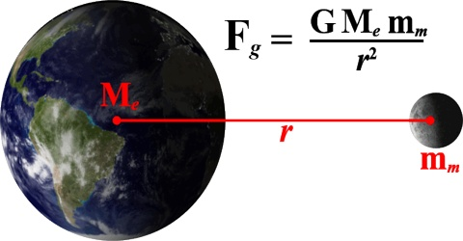
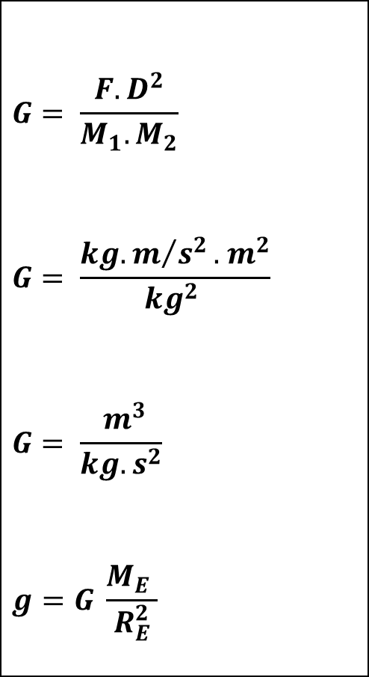
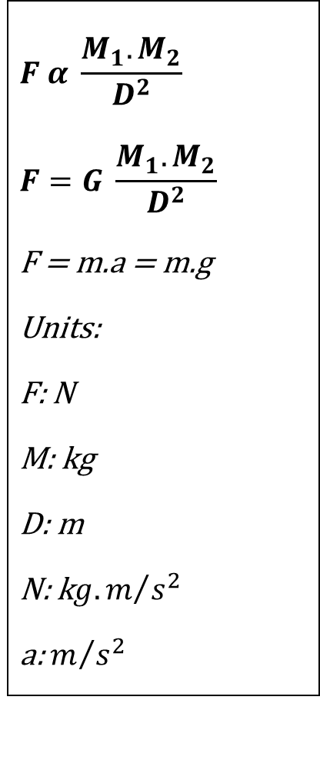
Lab. 1
Newton’s law of gravitation
$$F α \frac{M_{1}.M_{2}}{D^{2}}$$
$$F=G \frac{M_{1}.M_{2}}{D^{2}}$$
F = m.a = m.g
Units:
F: N
M: kg
D: m
N: k${g.m}/{s^{2}}$
a: $m/{s^{2}}$
$$G= \frac{{F. D}^{2}}{M_{1}.M_{2}}$$
$$G= \frac{{kg.m}/{s^{2}}.{ m}^{2}}{kg^{2} }$$
$$G= \frac{{ m}^{3}}{kg{.s}^{2}}$$
$$g=G \frac{M_{E} }{R_{E}^{2}}$$
Distance
Force
Mass 1
Mass 2

Slide 7

$g=G \frac{M_{E} }{R_{E}^{2}}$ = 9.8 N
$$g=G \frac{M_{E} }{{(2R)}_{E}^{2}}$$
$$g=G \frac{M_{E} }{{4 R}_{E}^{2}}$$
$g= \frac{9.8 }{4}$ = 2.45 N
Body
Mass = 1 Kg
weight = 2.45 N
R
Body
Mass = 1 Kg
weight = 9.8 N
9.8
R

