Slide 1
Practical clay minerals
Msc. Sirwa Saeed

Slide 2
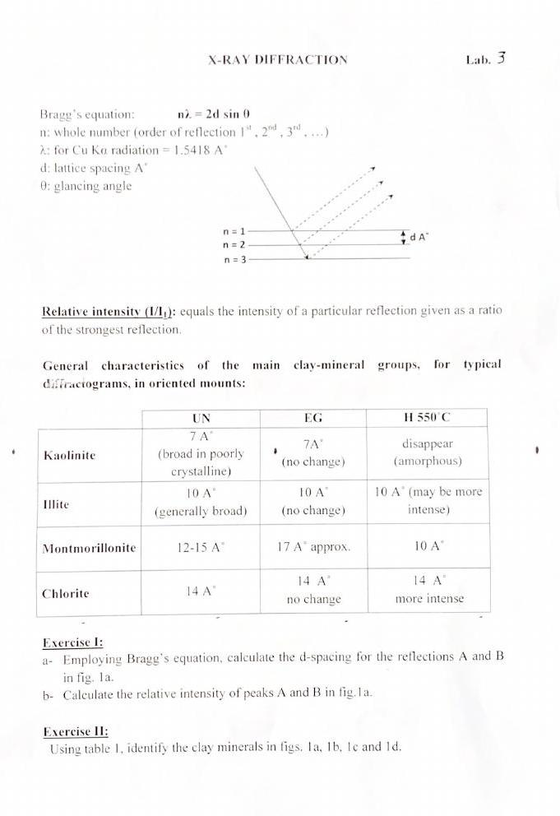

Slide 4
Exercise: Identify clay minerals in in fig 1b, 1c
Sample number | Untreated 2Ө d(A°) | EG 2Ө d(A°) | Heating 550C° 2Ө d(A°) | Mineral name

