Slide 1
Metal are used extensively in construction of building. Engineers should aware of the different products and treatments that are available for the materials.
They exist in nature as compound like oxides, carbonates, sulfate and phosphates and are known as ores.
Metals are derived from ores by removing impurities.
METALS

Slide 2
They are alloys of iron and carbon, other elements like copper, manganese, nickel, tungsten, etc…, may be added to iron to make special steel.
Steel is iron containing less than 1.5% carbon.
Cast iron is different from steel in the sense that is containing more than 1.5% carbon.
Wrought iron is different from steel as it contains less than 0.15% carbon.

Slide 3
Iron:
It is available in abundance, but does not occur freely in nature.
The iron content of the main ores are as follows:
Magnetite (Fe3O4) | 70 – 75 %
Hematite (Fe2O3) | 70 %
Limonite (2Fe3O3. 3H2O) | 60 %
Iron Pyrite (FeS3) | 47%
Siderite (FeCO3) | 40 %
The fundamental chemical principle in the extraction of iron from the ores is very simple.
Heating the ores in the presence of a reducing agent will result in the formation CO or CO₂, liberated as a gas, and metallic iron.

Slide 4
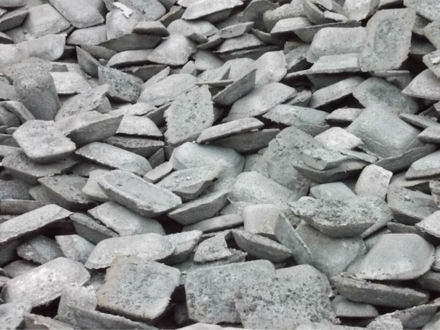
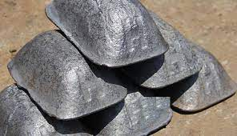
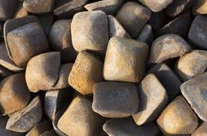
Pig Iron:
The iron ore is created by crushing it to about 50 mm cubes then placed it in calcined furnace. The impurities are knocked off. The iron is deoxidized and a part of Sulfur is removed and then limestone added. The molten melted is taken from the furnace and is cast in the form pigs.

Slide 5
Composition:
Pig iron contains 3-4% carbon, 0.5-3.5% silicon, 0.5-2.0% manganese, 0.02-0.1% Sulfur and 0.03-1.0% phosphorus.
Properties:
Pig iron is hard and brittle with fusion temperature of 1200ºC that is mean melt easily, its compressive is high but weak in tension and shear. Pig iron does not rust and cannot be riveted or welded.
Uses:
Pig iron is most suitable for making columns, base plate, etc.…...

Slide 6
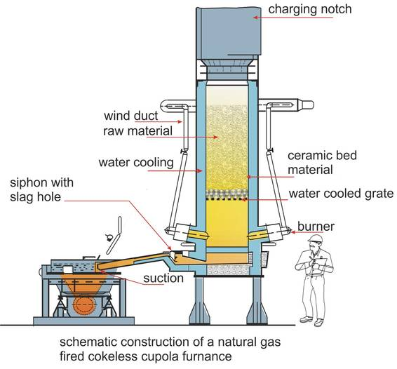
Cast Iron:
Pig iron is re-melted with limestone and coke and refined in a cupola furnace. It is then poured into molds of desired size and shape. The product is known as cast iron containing more than 1.5% of carbon.

Slide 7
Properties:
Cast iron is hard and brittle. It can neither be riveted nor welded. It is strong in compression and weak in tension and shear. It is specific gravity is 7.5. It has low melting point (1200 C°) and is affected by sea water. With proper adjustment in composition, cast iron may be rendered white by cooling rapidly or grey by cooling slowly from the molten state.
Uses:
Some of the more common uses of cast iron are making ornamental castings such as wall brackets, lamp posts, and bath room fittings such as cisterns, water pipes, sewers, manhole cover, sanitary fittings and rail chairs, carriage wheels.

Slide 8
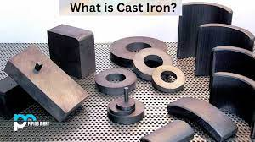
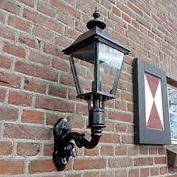
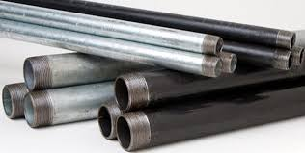
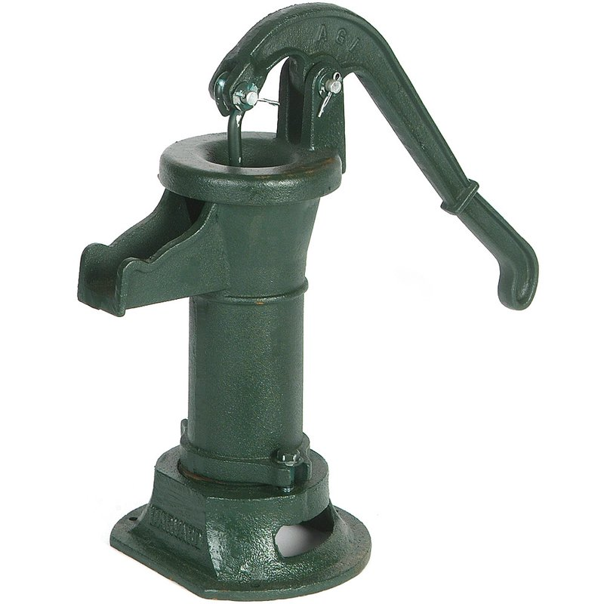
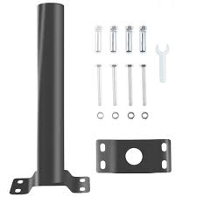
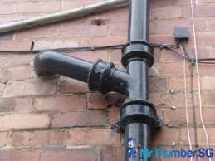

Slide 9
Wrought Iron:
Wrought iron considered to be pure iron, is produced by removing the impurities of cast iron. The total impurities are limited to 0.5% with maximum percentage of carbon as 0.15 %, silicon 0.15-0.20%, phosphorus 0.12-0.16%, Sulphur 0.02-0.03% and manganese 0.03-0.18%.
Properties:
Wrought iron is ductile, malleable, tough, and moderately elastic. The melting point of wrought iron is 1500°C. It can be forged and melted. Wrought iron effectively resists corrosion. It is tough and withstands shocks. At about 900°C wrought iron becomes so soft that its two pieces can be joined by hammering.
Uses:
Roof covering, rivets, chains, ornamental iron works such as gates, etc….

Slide 10
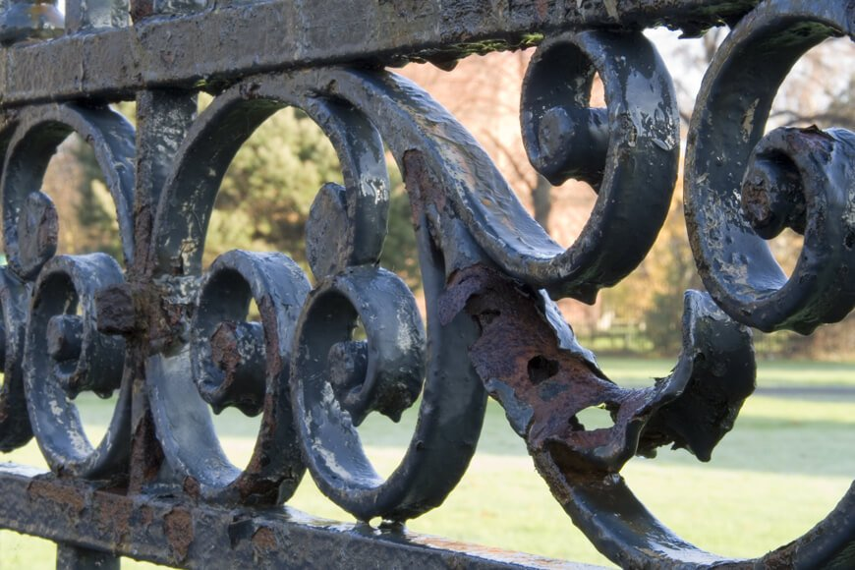
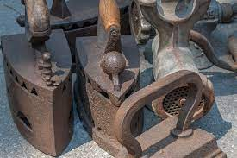
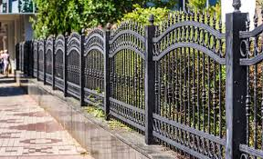

Slide 11
Steel:
Steel is the most suitable building material among metallic materials. This is due to a wide range and combination of physical and mechanical properties that steel can have. By suitability controlling the carbon content, alloying elements and heat treatment, a desired combination of hardness, ductility and strength can be obtained in steel. On the basis of carbon content, steel may be classified as under:
Type of steel | Carbon Content%
Dead mild steel | < 0.15
Mild steel | 0.15-0.30
Medium carbon steel | 0.30-0.80
High carbon steel | 0.8– 1.5
Hard steel | 1

Slide 12
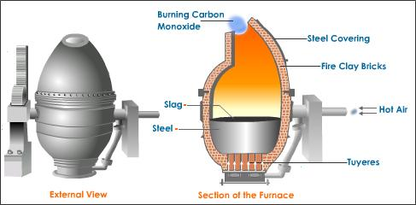
Manufacturing Method:
The most prominent present-day steel making process is the Bessemer process. It was introduced in 1856. The pig iron is first melted in Cupola furnace and sent to Bessemer converter shown in figure bellow. Blast of hot air is given to oxidize the carbon. Depending upon the requirement, adding carbon and manganese is controlled and hot air for converting process. Then the molten material is poured into molds to form ingots.

Slide 13
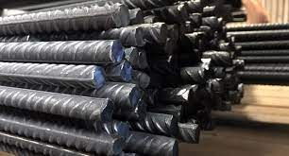
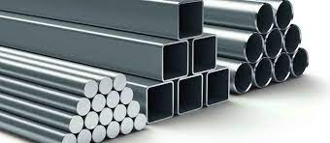
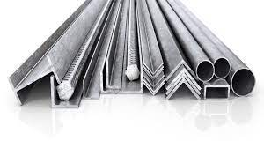
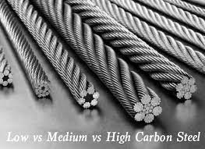
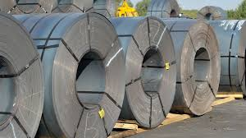

Slide 14
Properties and Uses:
Mild Steel:
Also known as low carbon or soft steel. It is ductile, malleable, tougher and more elastic than wrought iron. Mild steel can be forged and welded, difficult to temper and harden. It rusts quickly and can be permanent magnetized.
Mild steel is used in the form of rolled sections, reinforcing bars, roof covering and sheet.
High Carbon Steel:
Carbon content varies from 0.55 to 1.5%. It’s also known as hard steel. It is tougher and more elastic than mild steel. It can be forged and welded with difficulty. Its tensile strength is 1350 to 2000 N/mm².
High carbon steel is used for reinforced concrete and prestressed concrete members. It can take shocks and vibrations and used for making tools and machine parts.

Slide 15
High Tensile Steel:
The carbon content in high tensile steel is 0.6-0.8%, manganese 0.6%, silicon 0.2%, sulfur 0.05% and phosphorus 0.05%.
It is also known as high strength steel and essentially a medium carbon steel. The ultimate tensile strength is of the order of 2000 N/mm² and a min. elongation of 10% is used in prestressed concrete construction.
Properties of Steel:
The presence of carbon in steel gives high degree of hardness and strength. The addition of carbon to iron decrease the malleability and ductility of the metal, and reduce its permeability to magnetic force.

Slide 16
Steel used in construction can be classified mainly as:
1. Hot rolled sections.
Structural Steel:
Structural steel is used hot-rolled structural shapes, plates, and bars. Structural steel is used for various types of structural members such as columns, beams, bracings, frames, trusses, bridges girders …
W Shape: Wide Flange is a section similar to I shape
HP Shape: also called by wide flange shapes, the flanges and the webs have the same nominal thickness, and the depth with the width is essentially the same.
S Shape: is double symmetric shape having the inside flange surface slope of 16.7%.
M Shape: is doubly symmetric shape that cannot be classified as either W, S, or HP shapes.
Wide Flange shape is commonly used as beams and columns.
HP as bearing pile, S shapes is used as beams or girders. Composite sections can also be formed by welding different shapes to use in various structural applications.

Slide 17
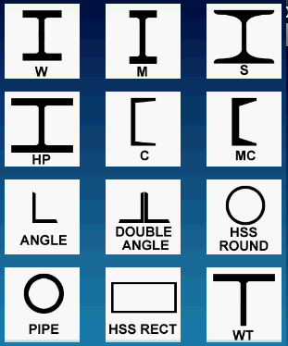

Slide 18
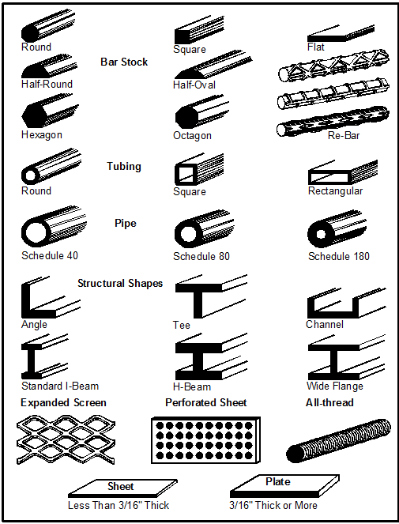

Slide 19
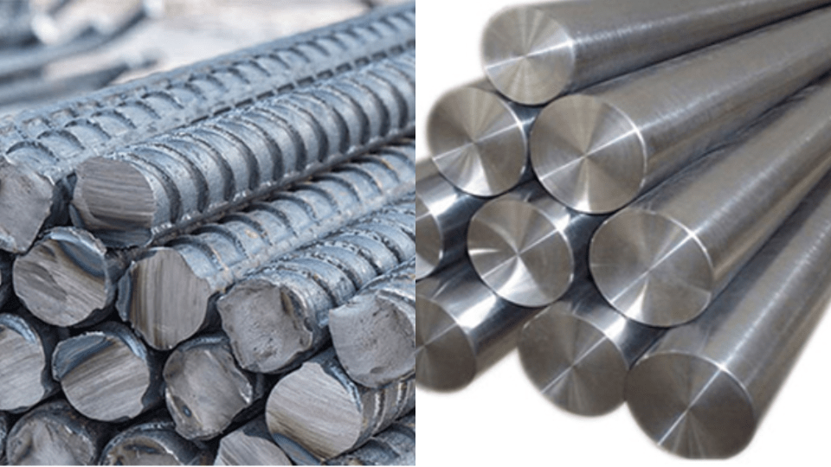
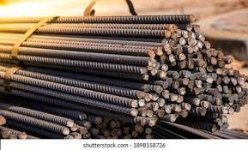
Reinforcing Steel:
Concrete has negligible tensile strength, structural concrete member subjected to tensile and flexural stresses must be reinforced either by conventional or prestressed reinforcement, depending on the design situation.
Reinforced steel (Bars) is manufactured in two forms, plain bars, and deformed bars. Plain are round without surface deformations. Deformed bars have deformations at the surface; they ensure a good bond between the bar and the concrete. The deformed surface of the bar prevents slipping, allowing the concrete and steel to work as one unit.

Slide 20
Reinforced steel is produced in the standard size; 6, 8, 10, 12, 16, 20, 25, 32 mm, .. With four grades: 40, 50, 60, and 75 with yield stresses of 276, 345, 414, and 517 MPa, respectively.
Prestressed concrete requires special prestressing wires, strands, cables, and bars. Steel for prestressed concrete must be high strength and low relaxation properties (High carbon steel and high strength alloy).
The specification allows two types of steel, stress-relieved (normal relaxation) and low-relaxation. Relaxation refers to the percent of stress reduction that occurs when a constant amount of strain is applied over an external time period, can be classified as Grade 250 and 270, with ultimate strength 1725 and 1860, respectively.

Slide 21
2. Cold formed sections.
Cold-formed steel (CFS) is the common term for products made by rolling or pressing steel into semi-finished or finished goods at relatively low temperatures (cold working). Cold-formed steel goods are created by the working of steel billet, bar, or sheet using stamping, rolling (including roll forming), or presses to deform it into a usable product.
Cold-formed steel members have been used in buildings, bridges, storage racks, grain bins, car bodies, railway coaches, highway products, transmission towers, transmission poles, drainage facilities, various types of equipment and others. These types of sections are cold-formed from steel sheet, strip, plate, or flat bar in roll forming machines, by press brake (machine press) or bending operations. The material thicknesses for such thin-walled steel members usually range from (0.373 mm) to about (6.35 mm). Steel plates and bars as thick as (25.4 mm) can also be cold-formed successfully into structural shapes.

Slide 22
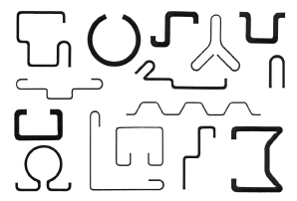
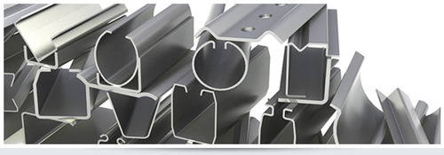
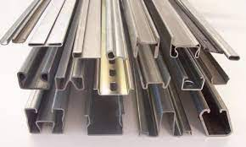
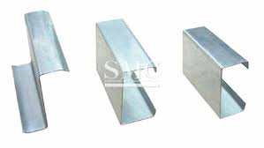

Slide 23
Mechanical Testing of Steel:
Many laboratory tests are available to evaluate the mechanical properties of steel.
Tension Test:
The tension test (ASTM E8) on steel is performed to determine yield strength, yield point, ultimate (tensile) strength, elongation, and reduction of area. Typically, the test is performed at temp. Between 10 and 35 ºC.
The test specimen can be either full sized or machined into a shape. Several cross-sectional shapes are permitted, such as round and rectangular, plate, sheet, round rod, wire, and tube specimens may be used. A 12.5mm diameter round specimen is used in many cases. The gauge length over which the elongation is measured typically is four times the diameter for most round-rod specimens.

Slide 24
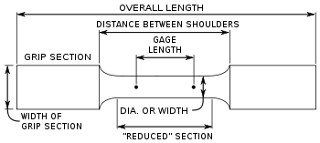
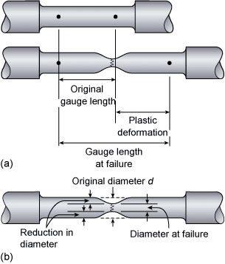
Different carbon content steel has different stress-strain relations. Increasing the carbon content in the steel increase the yield stress and reduce the ductility. Increasing the carbon content of the hot rolled bars from 0.19 to 0.90% increase the yield stress from 280 to 620 MPa. Also, this increase in carbon content decrease the fracture strain from about 0.27 m/m to 0.09m/m. note that the increase in carbon content does not change the modulus of elasticity.

Slide 25
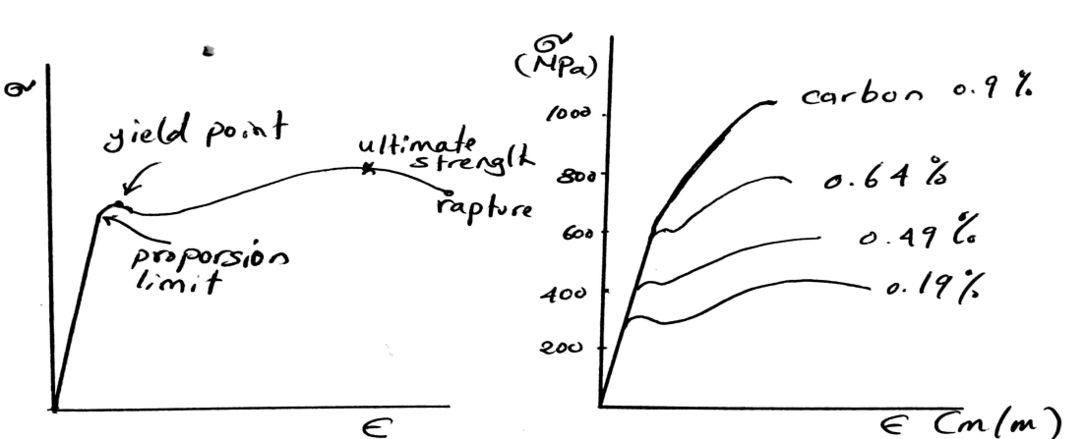
b. Torsion Test.
c. Impact Test.
d. Bending Test.
e. Hardness Test.
f. Welding Test
Welding: Many civil engineering structures, such as steel bridges, frames, and trusses required welding during construction and repair. Welding is a technique for jointing two metal pieces by applying heat to fuse the pieces together. A filler metal may be used to facilitate the process. A variety of welding methods are available, but the common types are, arc welding and gas welding.

Slide 26
Arc welding uses an between the electrode and the ground base metal to bring both the base metal and the electrode to their melting points. The resulting deposited weld metal is a cast structure.
Gas welding, an external shielding gas is used.

Slide 27
Steel Corrosion:
Corrosion is defined as the destruction of the metal by electrochemical reaction to the environment (the destruction that can be detected by rust formation). Corrosion of steel structure can cause serious problems.
Corrosion is an electrochemical process, which is a chemical reaction in which there is transfer of electrons from one chemical species to another. In case of steel, the transfer is between iron and oxygen, a process called oxidation reduction. Corrosion requires the following four elements. (without all of them corrosion will not occur):
An anode, the electrode.
A cathode, the other electrode.
Where corrosion occurs needed to form a corrosion cell.
A conductor, a metallic pathway for electrons to flow.
An electrolyte, a liquid that can support the flow of electrons.

Slide 28
Steel material contain anodes and cathodes, also an electrical conductor. Therefore, steel contains three of the four elements needed for corrosion, while moisture is usually the fourth element (electrolyte).
Contaminants deposit on the steel surface affect the corrosion reactions and the rate of corrosion. Salt, from de-icing or a marine environment, is a common contaminant that accelerates corrosion of steel bridges and reinforcing steel in concrete.

Slide 29
Corrosion Protection:
The atmosphere corrosion resistance of steel structure may be enhancing in several ways:
Corrosion coatings paints containing aluminum and zinc may be applied.
Sacrificial primers (cathode protection) contain pigments such as element zinc, for examples, steel structure such as water heaters, underground tanks and pipes, and marine equipment, can be electrically connected to another metal that is more reactive in the particular environment, such as magnesium or zinc. Such reactive metal (sacrificial anode) experiences oxidation and gives up electrons to the steel, protecting the steel from corrosion.

