Slide 1
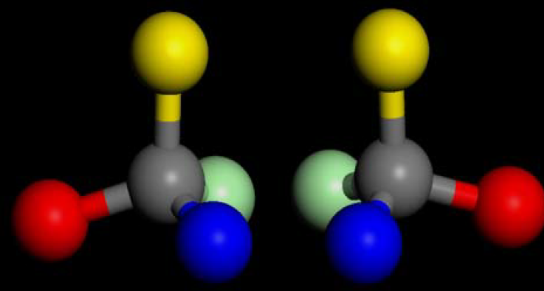
Organic Chemistry
L.Snowber M. Ahmed
Third stage
2020-2021

Slide 2
Organic Chemistry
Organic chemistry describes the structures, properties, preparation, and reactions of a vast array of molecules that we call organic compounds.
There are many different types of organic compounds, but all have carbon as their principal constituent atom. These carbon atoms form a carbon skeleton or carbon backbone that has other bonded atoms such as H, N, O, S, and the halogens (F, Cl, Br, and I).

Slide 3
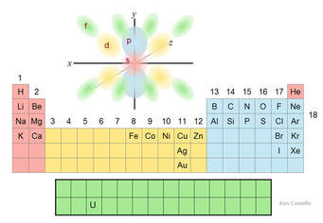

Slide 4
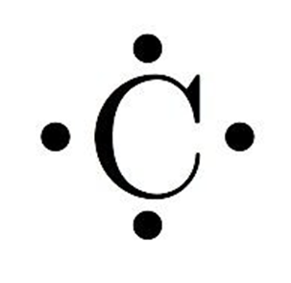
Carbon atom
Draw an electron dot diagram of carbon
Carbon is able to form 4 covalent bonds (4 valence electrons) with other carbon or other elements.

Slide 5
Characteristics of Organic Compounds
They are nonpolar compounds – they do not dissolve in polar solvents like water.
They have low melting points – due to weak intermolecular forces.
They react slower than ionic compounds – due to strong covalent bonds between atoms.

Slide 6
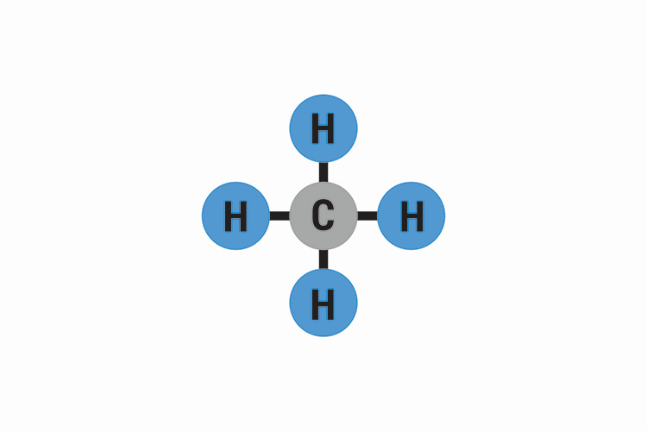
Structural Formulas
A 2D model shows bonding patterns and shapes of molecules
Carbon is found in the center
The short line – represents a pair of electrons.

Slide 7
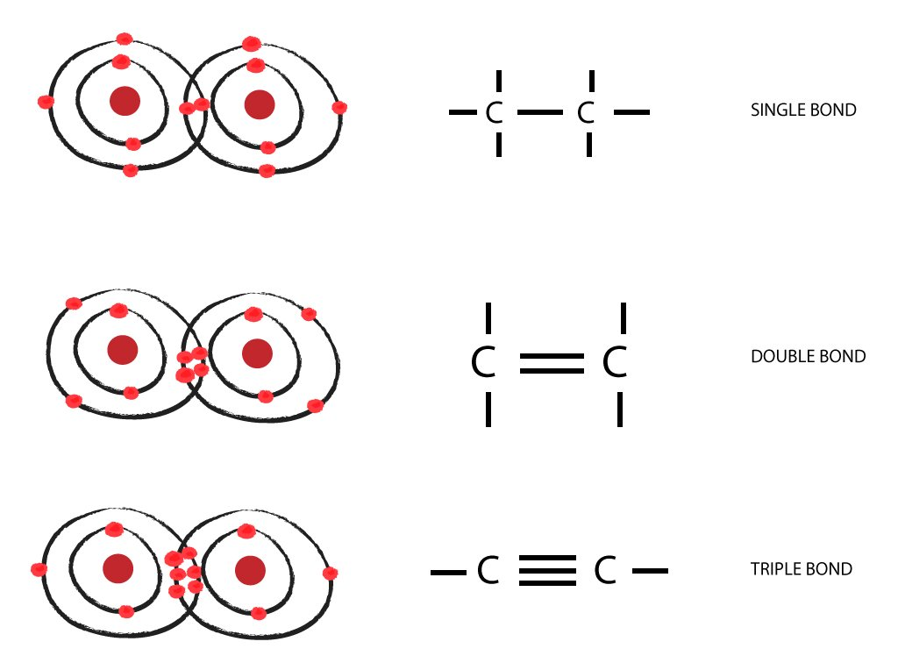
Types Of Bonds
Single Bond – single covalent bond in which they share 1 pair of electrons. (2 e-)
Double Bond – carbon atoms may share 2 pairs of electrons to form a double bond
Triple Bond – carbon atoms may share 3 pairs of electrons to form a triple bond.

Slide 8
NOMENCLATURE OF ORGANIC COMPOUNDS
Organic chemistry deals with millions of compounds. In order to clearly identify them, a systematic method of naming has been developed and is known as the IUPAC (International Union of Pure and Applied Chemistry) system of nomenclature. In this systematic nomenclature, the names are correlated with the structure .

Slide 9
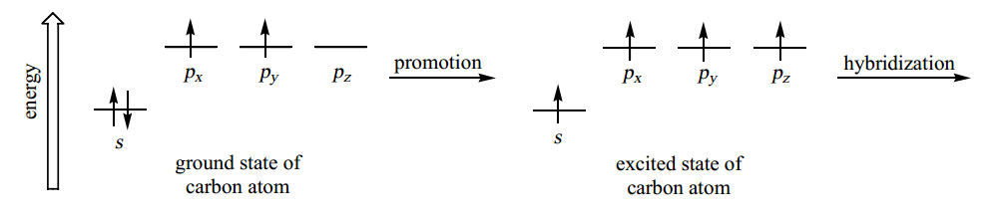
Hybridization
The tetra valence of carbon and the formation of covalent bonds by it are explained in terms of its electronic configuration and the hybridization ( mixing atomic orbitals in to new hybrid orbitals ) of s and p orbitals molecules like methane (CH₄) .

Slide 10
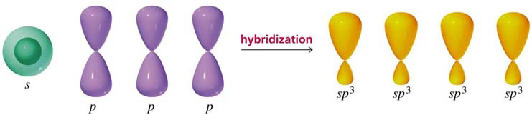
Hybridisation
After reaching the excited state, there are three possibilities for hybridization, depending on the number of electron domains
All carbon atoms start out with the same ground state and end up with the same excited state …

Slide 11
Hybridisation
This mixing of an s orbital and three p orbitals to produce four hybrid orbitals is called sp3 hybridisation. All tetrahedral carbon and nitrogen atoms in organic chemistry are sp3 hybridized.

Slide 12
Hybridisation
The types of bonds used by the carbon atom are known as sigma (δ) and pi (π) bonds. Different combinations of these bonds lead to carbon single bonds, double bond and triple bonds.
Alkanes contain only single (σ ) bonds and have the generic molecular formula: [C_{n}H_{2n+2}]
Alkenes also contain double (σ + π) bonds and have the generic molecular formula: [C_{n}H_{2n}]
Alkynes contain triple (σ + 2π) bonds and have the generic molecular formula: [C_{n}H_{2n-2}]

Slide 13
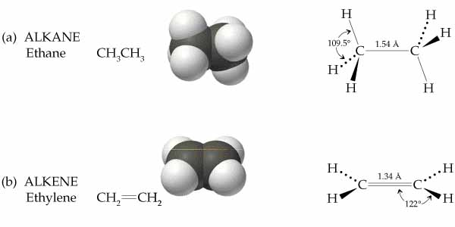
Hybridisation

Slide 14
Hybridisation
All trigonal carbons such as those found in double bonds are sp2 hybridised . The unused p orbital on each carbon overlaps to form the π part of the double bond, e.g. ethene.

Slide 15
Hybridisation
ALL linear carbons such as those found in triple bonds are sp hybridised. The unused p orbitals on each carbon overlap to form the π parts of the
triple bond, e.g. ethyne (acetylene).

Slide 16
Hybridisation
Another type of bond that carbon forms with itself is the triple bond found
in a class of compounds called alkynes. After promotion of the 2s electron to a 2p orbital, one s orbital mixes with one p orbital to give two hybrid sp orbitals.

Slide 18
Polar Covalent Bonds in Carbon
Carbon forms single, double and triple bonds with elements other than carbon.
The atoms involved in the bonding are usually oxygen, nitrogen, sulfur and the halogens. These elements are more electronegative than carbon and thus attract the electrons to themselves.
The bonds are therefore polar covalent bonds.

Slide 19
Structural and Isomerism Structural
Formulae In chemistry isomerization is the process by which one molecule is transformed into another molecule which has exactly the same atoms, but a different arrangement. (These related molecules are known as isomers ).
e.g. A-B-C → B-A-C Example one: C4H10

Slide 20
Stereoisomerism
It is also possible to arrange the atoms in molecules with the same structural formulae such that they have different spatial orientation. This is known as stereoisomerism. There are two types of stereoisomer :
Geometric
optical.

Slide 21
Geometric isomerism
It is possible for single C-C bonds to rotate freely,
however, double C=C bonds cannot.
Thus if the two carbon atoms of a C=C bond carry
different groups, it becomes possible to orientate these
groups in two ways:-
cis isomer
trans isomer
Geometric isomers have different physical and chemical
properties .

Slide 22
cis-2-butene
trans-2-butene

Slide 23
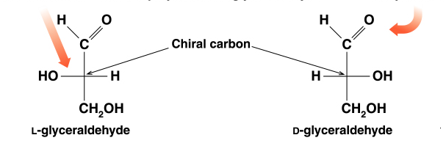
Optical isomerism
A carbon atom attached to four different groups (substituents) is termed a chiral centre. Two different mirror images are possible ,These mirror images are called enantiomers.
Enantiomers have identical physical properties, Rotation to right termed dextro or d , Rotation to left termed laevo or l

