Slide 1
Alcohols, Phenols , and Ethers
Alcohol is a compound that has a hydroxyl group bonded to a saturated,
sp³-hybridized carbon atom, ROH .
A phenol has a hydroxyl group bonded to an aromatic ring, ArOH .
Ether has an oxygen atom bonded to two organic groups, ROOR .

Slide 2
Methanol, CH₃OH, called methyl alcohol, is a common solvent, a fuel additive, produced in large quantities
Ethanol, CH₃CH₂OH, called ethyl alcohol, is a solvent, fuel, beverage
Phenol, C₆H₅OH (“phenyl alcohol”) has diverse uses - it gives its name to the general class of compounds

Slide 3
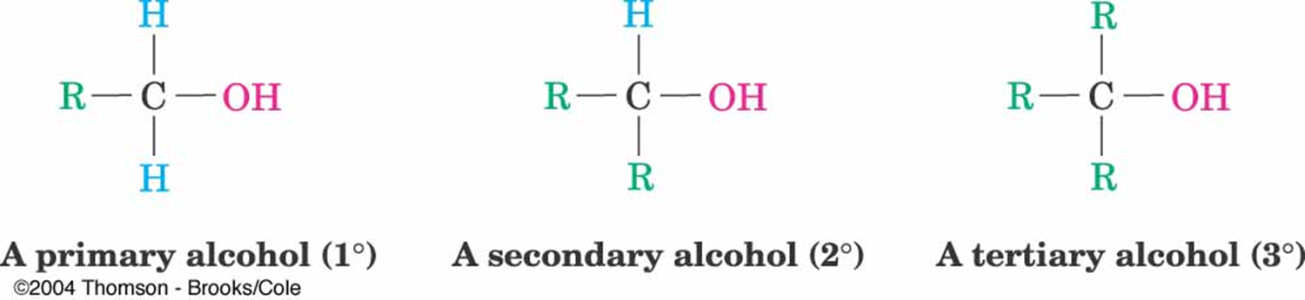
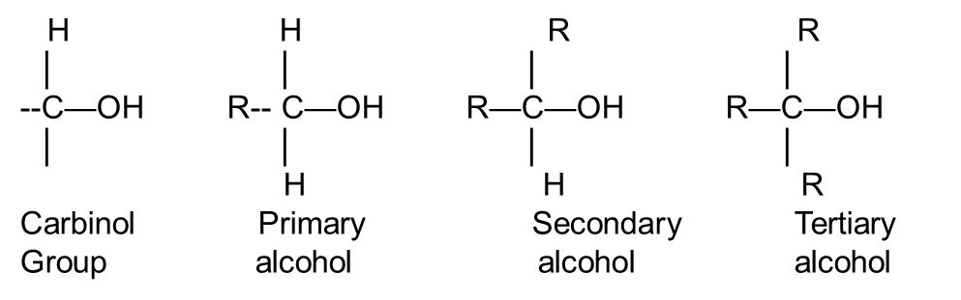
Alcohols
Alcohols are classified as primary (1°), secondary (2°), or tertiary (3°), depending on the number of carbon(Alkyle) substituents bonded to the hydroxyl-bearing carbon.
General classifications of alcohols based on substitution on C to which OH is attached

Slide 4
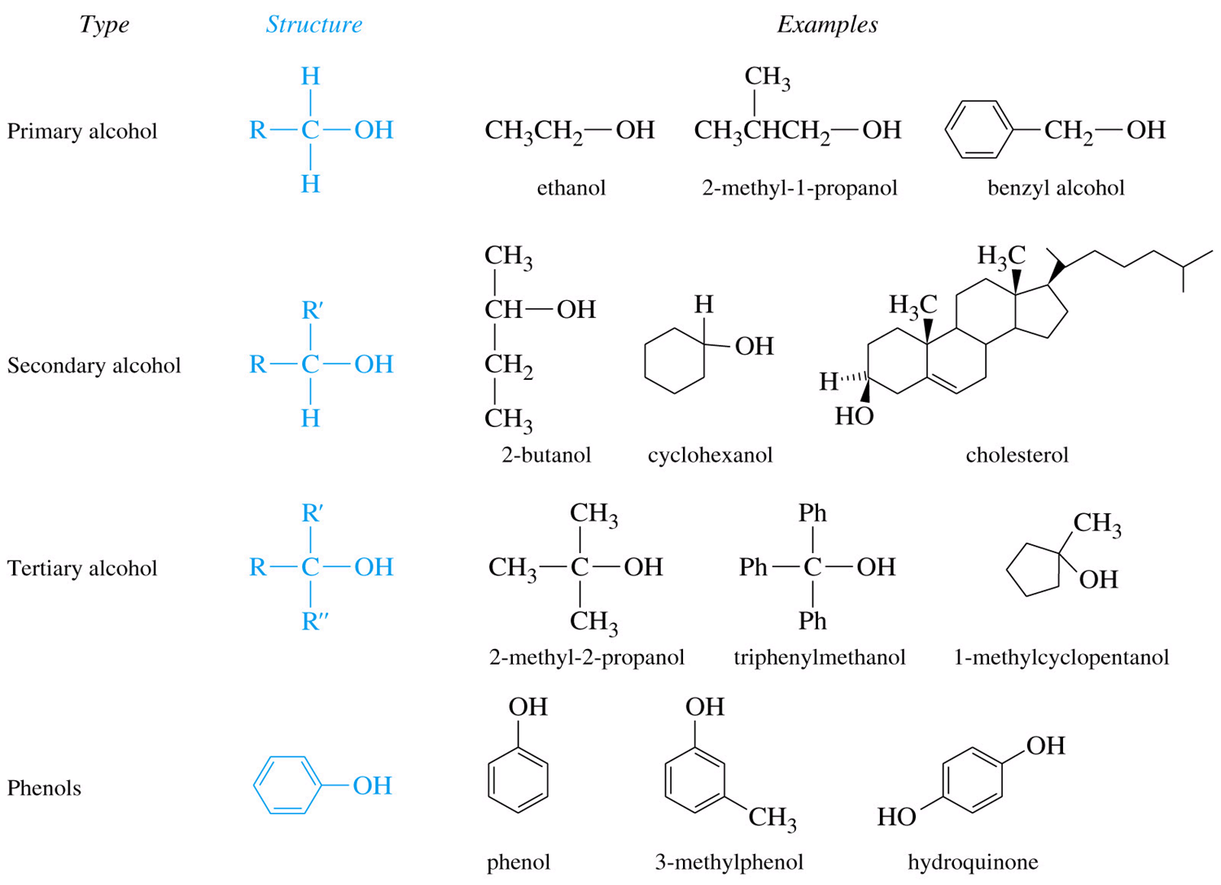

Slide 5
Phenols
The word phenol is used both as the name of a specific substance (hydroxyl benzene) and as the family name for all hydroxy-substituted aromatic compounds. Substituted phenols are named as described previously in for aromatic compounds, with -phenol used as the parent name rather than -benzene.

Slide 6
Ethers
Simple ethers that contain no other functional groups are named by identifying the two organic groups and adding the word ether.

Slide 7
Properties of Alcohols and Phenols
1-Hydrogen Bonding and Acidity
A- Alcohols, phenols, and ethers can be thought of as organic derivatives of water in which one or both of the hydrogen’s have been replaced by organic parts:
HOH becomes ROH , ArOH , or ROR′
B- Thus, all three classes of compounds have nearly the same geometry as water . The C - O -H or C - O- C
bond angles are approximately tetrahedral (109°) in methanol and 112° in dimethyl ether,
and the oxygen atoms are sp3 hybridized Also like water .

Slide 8
1-Hydrogen Bonding and Acidity
C- Alcohols and phenols have higher boiling points than
might be expected. Example :- propanol boils at 97.2 °C
phenol boils at 181.9 °C
Alcohols and phenols have unusually high boiling points because, like water, they form hydrogen bonds. The positively polarized - OH hydrogen of one molecule is attracted to a lone pair of electrons on the negatively polarized oxygen of another molecule
Ethers, because they lack hydroxyl groups, can’t form hydrogen bonds and therefore have lower boiling points

Slide 9
Properties of Alcohols and Phenols
D- Another similarity with water is that alcohols and phenols are both weakly basic and weakly acidic. As weak Lewis bases, alcohols and phenols are

Slide 10
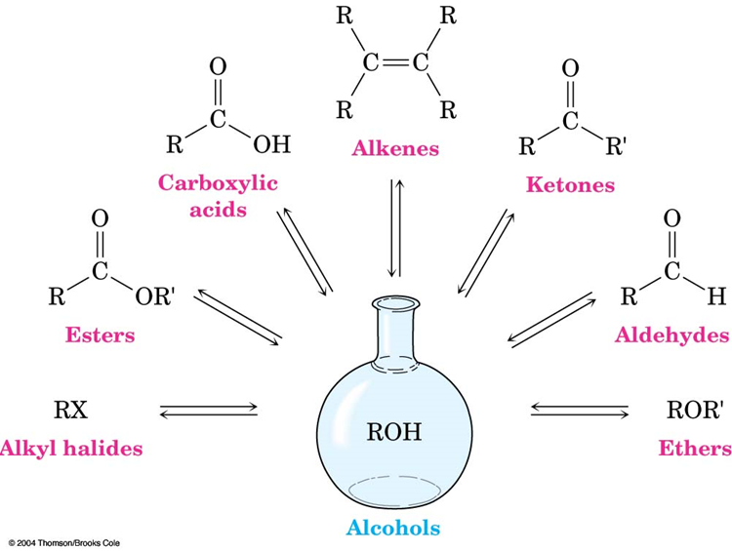
Synthesis of Alcohols
Alcohols are derived from many types of compounds
The alcohol hydroxyl can be converted to many other functional groups This makes alcohols useful in synthesis

Slide 11
Synthesis of Alcohols
Alcohols can be prepared in two major ways:
  Alkene hydration
    Ex.: CH₂=CH₂ + H₂O ----> CH₃CH₂OH
  Addition of H₂ to a carbonyl group (-C=O)
    Ex.: Aldehyde + H₂ ----> 1˚ alcohol
    Ketone + H₂ ----> 2˚ alcohol

Slide 12
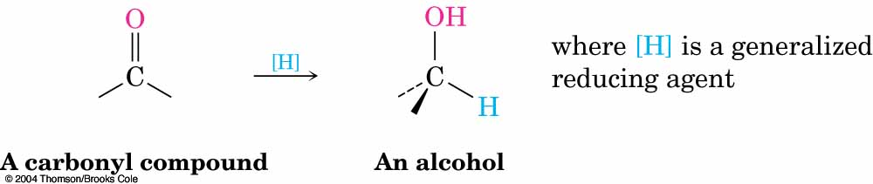
Synthesis of Alcohols
Reduction of a carbonyl compound in general gives an alcohol
Note: that organic reduction reactions add the equivalent
of H₂ to a molecule

Slide 13
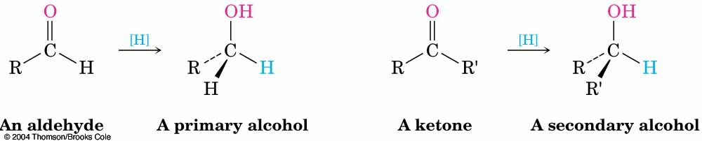
Synthesis of Alcohols
Aldehydes gives primary alcohols
Ketones gives secondary alcohols

Slide 14
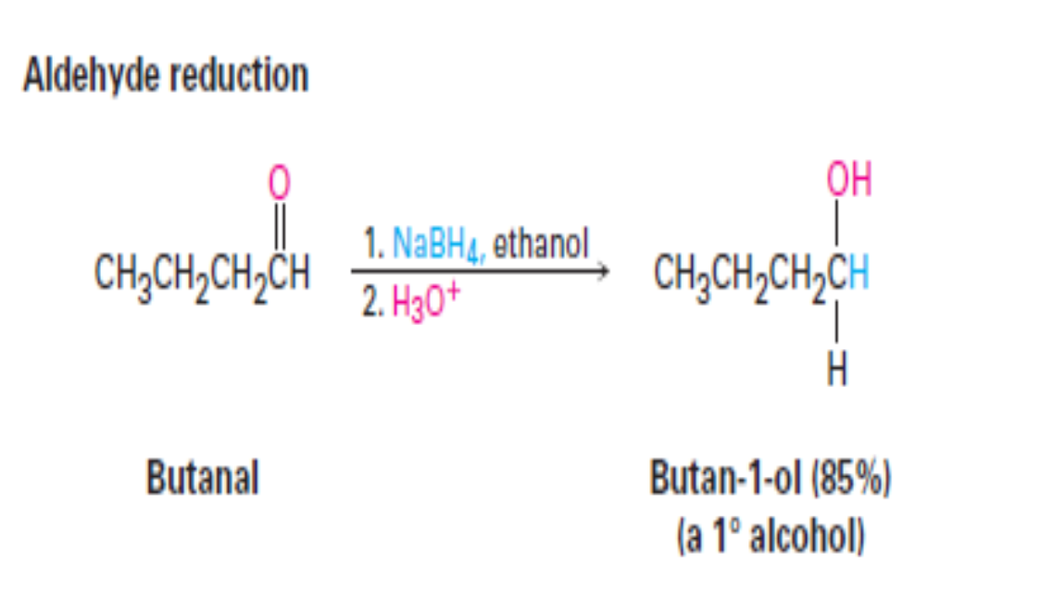
Synthesis of Alcohols

Slide 15
Reduction of Carboxylic Acids and Esters
Esters and carboxylic acids are reduced to give primary alcohols.

Slide 16
Grignard Reactions of Carbonyl Compounds
Grignard reagents (RMgX), prepared by reaction of organo halides with magnesium , react with carbonyl compounds to yield alcohols Grignard reaction involves :-
addition of a carbanion (R: ⁻ ⁺MgX).

Slide 17
Grignard Reactions of Carbonyl Compounds

Slide 18
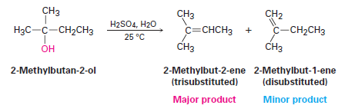
Reactions of Alcohols
1-Dehydration of Alcohols

Slide 19
Reactions of Alcohols

Slide 20
2-Oxidation of Alcohols

Slide 21
2-Oxidation of Alcohols

Slide 22
Oxidation of Phenols

