Slide 1
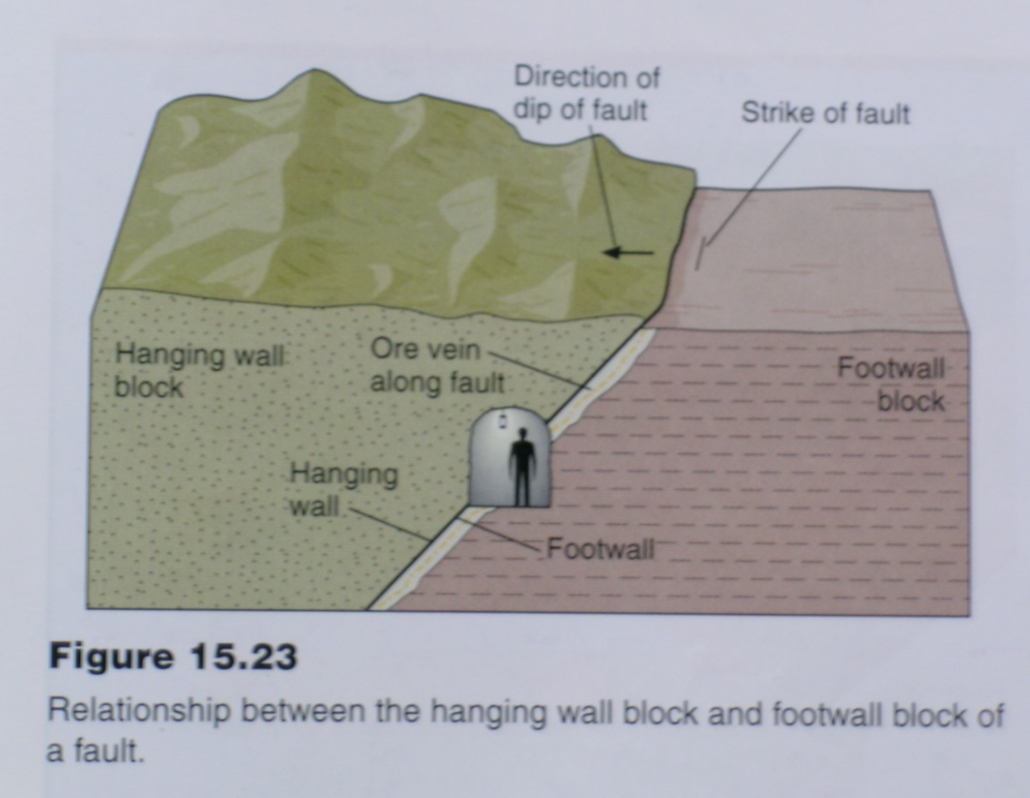
Inclined Faults
Ductile Structural geology - third year
Geometrical Projection: Finding True Dip Lab.No.8 /11/2023
Terminology:
Footwall – the underlying surface of an inclined fault plane.
Hanging Wall – the overlying surface of an incline fault plane.
Types of dip slip faults are distinguished based on the relative movement of the footwall block and the hanging wall block.

Slide 2
classification of Faults
Faults are divided into the following three categories based on the relative displacement of the fault blocks with respect to the attitude of the fault plane:
1) Dip slip fault - The hanging wall block moves (up or down) parallel to the dip of the fault plane
The net slip is pure dip-slip

Slide 3
Classification of Faults …
2) Strike slip fault - Both blocks move parallel to the strike of the fault plane
There is no hanging wall in this case!
The net slip is pure strike-slip
3) Oblique slip fault - The displacement vector is oblique to both strike and dip
The senses of both the dip slip (normal or reverse) and strike slip (left- or right-lateral) are needed for a oblique-slip fault
Left-lateral, normal, oblique-slip fault
Right-lateral, reverse, oblique-slip fault

Slide 4
Faults

Slide 5
Dip-slip Faults
Dip-slip - Motion is along the dip
High-angle ( >60º)
Intermediate angle (30º-60º)
Low-angle <30º)
Two types of dip-slip: Normal and Reverse
a) Normal fault - If the relative motion of the hanging wall block is down-dip on the fault.
Is caused by extension

Slide 6
Dip-slip Faults
b) Reverse fault, if the motion of the hanging wall block is up-dip on the fault.
Caused by contraction
e.g., faults in subduction zones
Thrust is a low-angle reverse fault
e.g. Grand Tetons; the Appalachians

Slide 7
Strike-Slip Faults - Types
a) Left-lateral (sinistral) strike slip fault
To an observer standing on one block and looking across the fault, the other block seems to have moved to the left
b) Right-lateral (dextral) strike slip fault
The block across the fault moved to the right of the observer. e.g., San Andreas fault

Slide 8
Block Diagram of Folded Rocks
Folded Rock
Note:
Plan view – geological map
Side view – geologic cross sections

Slide 9
