Slide 1
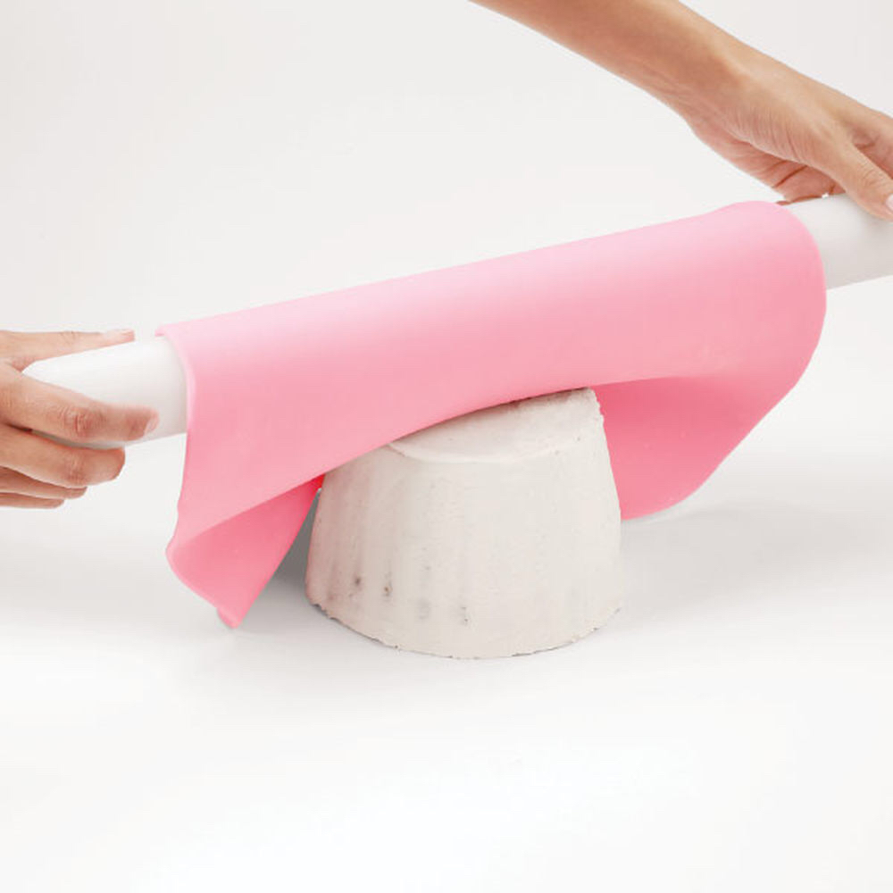
Fondants
Exprement 05
3rd Year Students
Food Technology Department
Assis. Lecturer: Srwa R. Hamza

Slide 2
Fondant (sugar paste) is the simplest of crystallized sugar confections, consisting of sugar crystals in a saturated solution of sugar and other carbohydrates. Normally there is approximately 50-60% sugar crystals present in its structure mixed into the 40-50% of syrup.
Fondants is made up of three main elements Sucrose, corn syrup and water.
Other ingredients can also be added to alter the characteristics of the fondant, including:Invert sugar, Glycerol, Sorbitol, Agar, Pectin and Gelatin.

Slide 3
Types of fondant:
There are two main types of fondant:

Slide 4
Poured fondant: is a very gelatinous, thick liquid , creamy confection used an icing or filling for cakes and other pastries. it is sugar and water cooked to the soft-ball stage, cooled slightly, and stirred until it is an opaque mass of creamy consistency. Sometimes lemon or vanilla is added to the mixture, mainly for taste. Other flavorings are used as well, as are various colorings.

Slide 5
2-Rolled fondant (Icing fondant): is commonly used to decorate cakes is made with sugar, water and corn syrup. To make a pliable dough, gelatin and/or glycerine is added.
Marshmallow fondant: is a form of rolled fondant it is made by combining melted shelf-stable marshmallows, water, powder sugar, and solid vegetable shortening.

Slide 6
Tips for working with rolled fondant:
Rolled Fondant can dry out quickly. If you need to store it for short periods of time, wrap it in plastic wrap and store it in plastic bag.
For longer storage, roll fondant into a ball, then coat with a little vegetable oil. Wrap in plastic wrap, then place the wrapped fondant in an airtight container. It can be stored for up to 2 months this way. Do not refrigerate or freeze it.
If rolled fondant is too soft or sticky to roll, knead in a little additional powdered sugar.

Slide 7
Make Rolled Fondant
Ingredients:
2 full teaspoons(package) unflavored gelatin
1/4 cup water
1/2 cup glucose syrup or corn syrup
1 tablespoon glycerin
2 tablespoons (1oz/30g) shortening or butter
1 teaspoon vanilla extract
8 cups sifted confectioners' sugar

Slide 8
Marshmallow fondant:
Ingredients:
250 gm mini marshmallows
1/4 cup water
4 cups powdered sugar
1/4 cup vegetable shortening
1 teaspoon vanilla extract
Salt

Slide 9
Instructions:
Place marshmallows and 2 tablespoons of water in a large microwave-safe bowl.
Microwave for 30 seconds on high; stir until mixed well. Continue microwaving in 30 second intervals until they are melted and smooth.
Place about 3 cups of the powdered sugar on top of the melted marshmallow mixture and gently fold it into the marshmallows.
Grease your hands and your counter-top generously with shortening. Turn marshmallow mixture onto counter and start kneading it like you would dough.
Add more confectioners' sugar as needed and re-grease your hands the counter-top as needed.

Slide 10
Thank You

