Slide 1
Academic Debate Debate
By: Mrs. Suzan Dhaher Ali Computer Dept. 2021 – 2022
Email: suzan.ali@su.edu.krd

Slide 2
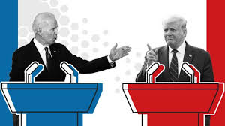
Debate
What is Debate?
Why Debate is important?
How to Get Started in Debate?

Slide 3
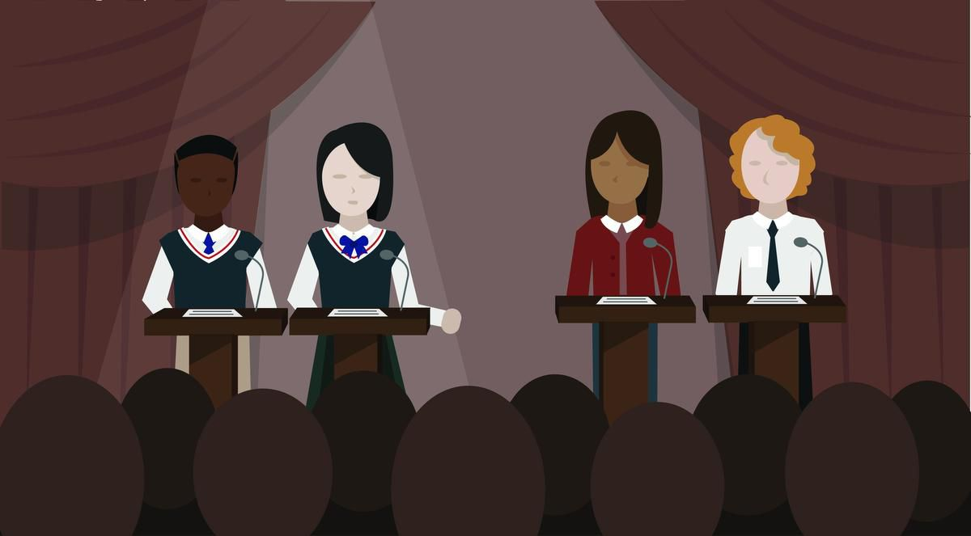
What is Debate?
A debate is a contest, like a game, where two or more speakers present their arguments intent on persuading one another.

Slide 4
Why Debate is important?
Learns to analyze; to distinguish between the vital and the unimportant.
Learns the need of proving his statements; of supporting every statement with valid evidence.
Learns to present ideas in a clear and effective manner, and in a way which wins others to his way of thinking.

Slide 5
Why Debate is important?
Learns to think under pressure, to "use his head" in a time of need, to make decisions quickly and accurately.
Debating creates opportunities
Debating improves skills
Debating leads to understanding

Slide 6
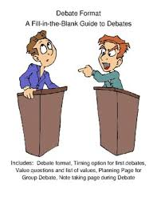
How to Get Started in Debate?
Three Tips
Read for background information about the subject.
Collect as much material as you can find.
Read and study the material discovered

Slide 7
The basics
Every debate must have a topic
2 teams ( Proposition and Opposition)
Proposition (or Affirmative) argues that the topic is true.
Opposition (or negative) argues that the topic is not true.

Slide 10
Preparing for the Debate
Each debater first needs to work as a team to prepare a case, which is essentially your group of prepared ideas about why your side of the motion is true. Teamwork is essential here because should debaters choose to work individually, the lack of a team stance will be obvious during the debate.

Slide 11
Thank you

