Slide 1
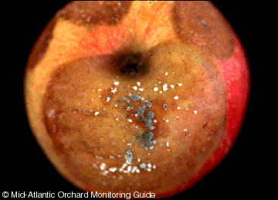
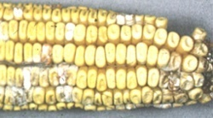
MYCOLOGY
Yeast and Molds
Notes:
Fungi, Not bacteria
Single Celled
Gram + on Gram Stain

Slide 2
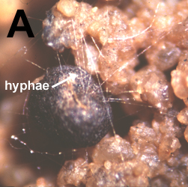
Molds
Mycology is the study
of fungi (yeast and molds)
including their genetic,
biochemical properties,
taxonomy, their use
to humans, food, and
poisoning or infection.
- A biologist who studies mycology is called a mycologist.
Notes:
Single Cell Larger than Bacteria
Molds
Multicellular fungi filamentous – Mycelium – Body of Mold
Mass of Filaments – Hyphae - Individual filaments
Produce Spores (seeds)
Dormant State of Organism
Each spore can become mycelium
Produced on end of Hyphae
NOT resistant as bacterial spores
Easy to spread through air
Can grow on low moisture foods
requires less moisture than bacteria
Problem on Grain products
Spoilage and Health Problems

Slide 3
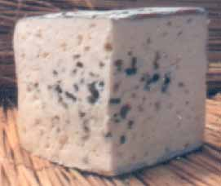
Fungus
A fungus (plural: fungi or funguses) is a member of a large group of eukaryotic organisms that includes microorganisms such as yeasts and molds
(British English: moulds).
Notes:
Problem in grains
pH of 2.0 –8.5 – spoilage in acid products
Can grow at refrigeration temperatures, but low temps slow growth
Spoilage
Can grow/spoil in lower Aw/higher NaCl content foods, but do not compete well with bacteria
Mycotoxin Production
AFLATOXINS are concinogenic
Mainly produced on grain and nut products
Feeding high moisture corn to dairy cattle can cause aflatoxins to show up in milk
Aflatoxins – Aspergillus Flavis – carcinogenic
Rye – Ergot – Claviceps purpurea – neurotoxin
Toxin effects – carcinogenic, liver damage, neurotoxins, rashes, kidney damage
Mold Allergies
Sanitation Index
Yeast and molds are less resistant to sanitizers therefore if they are present, sanitizers are not working
Foods
Blue cheese, Brie, Roquefort, Sake

Slide 4
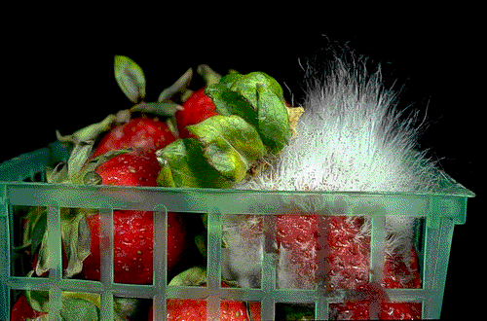
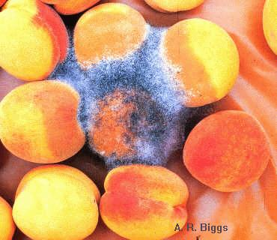
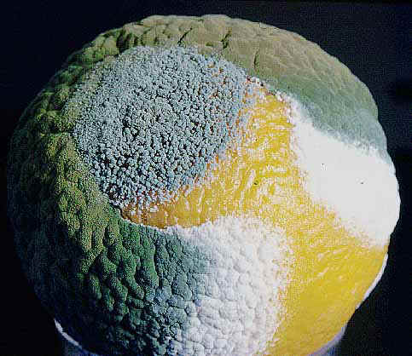
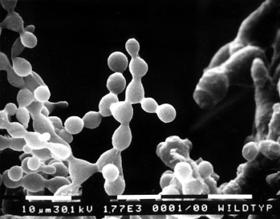
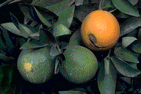
Molds
Mucor
Rhizopus
Penicillium
Geotrichum
Fusarium
Neurospora
Botrytis
Alternaria

Slide 5
These organisms are classified as a kingdom, Fungi, which is separate from plants, animals, and bacteria.

Slide 6
One major difference is that :
fungal cells have cell walls that contain chitin, unlike the cell walls of plants, which contain cellulose.

Slide 7
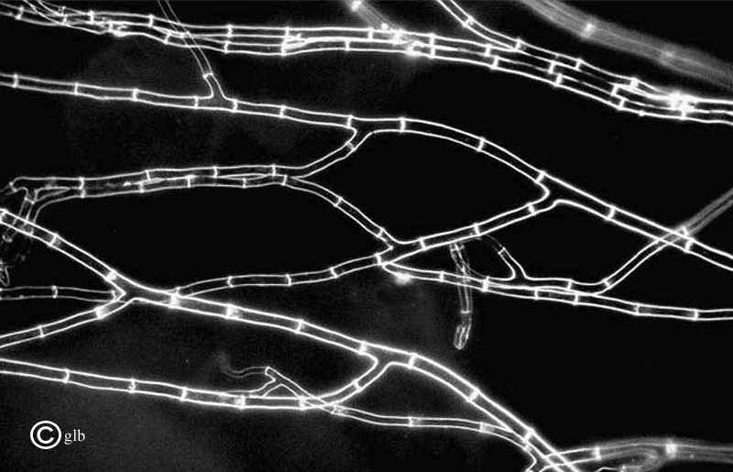
General Characteristics of Fungi
All are eukaryotic
Most are filamentous composed of individual microscopic filaments called hyphae,

Slide 8
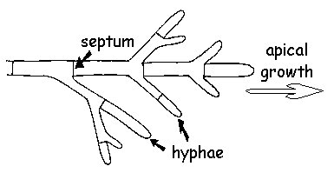
which exhibit
apical growth
and which
branch to form
a network of
hyphae
called a mycelium.

Slide 9
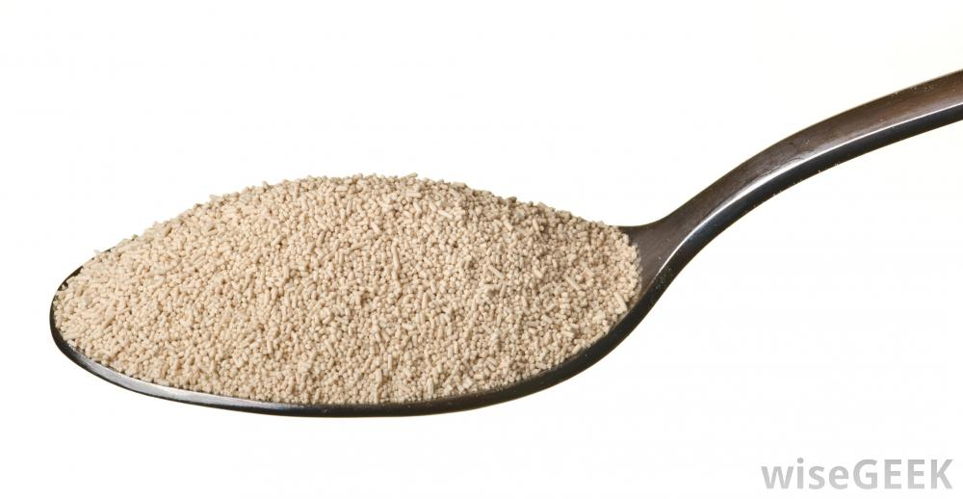
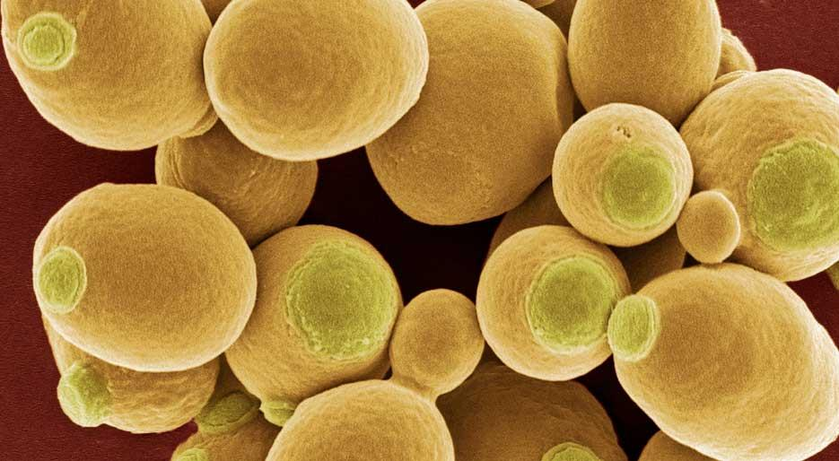
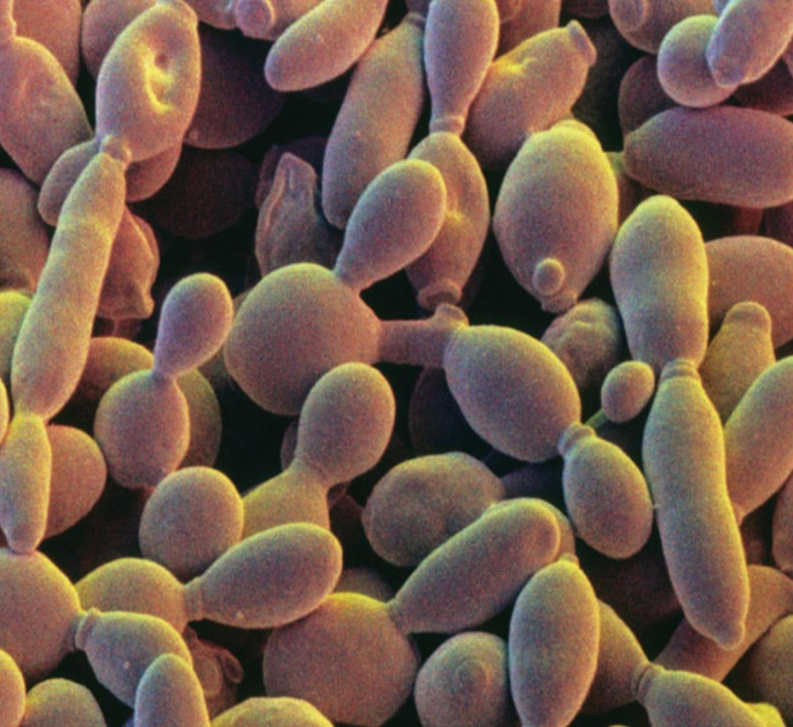
Some are
unicellular;
e.g. yeasts.

Slide 10
Protoplasm of a hypha or cell is surrounded by a rigid wall composed primarily of chitin and glucans, although the walls of some species contain cellulose.
Many reproduce both sexually and asexually.

Slide 11
Their nuclei are haploid and hyphal compartments
are often multinucleate
Although some yeasts
possess diploid nuclei.

Slide 12
All are achlorophyllous:
They lack chlorophyll
pigments and are
incapable of photosynthesis.

Slide 13
Possess range of storage compounds such as glycogen and lipids.

Slide 14
May be free-living or may form relationships with other organisms, i.e. may be free-living, parasitic or mutualistic.

Slide 15
Molds Microscopic structures
Most fungi grow as hyphae.
Hyphae are cylindrical, thread-like structures 2–10 µm in diameter and up to several centimeters in length.

Slide 16
Hyphae grow at their tips (apices); new hyphae are typically formed by emergence of new tips along existing hyphae by a process called branching, or growing hyphal tips branch (fork) giving rise to two parallel-growing hyphae.

Slide 17
The combination of apical growth and branching leads to the development of a mycelium.
Mycelium is an interconnected network of hyphae

Slide 19
Hyphae can be either septate or coenocytic:
Septate hyphae are divided into compartments separated by cross walls called septa, that are formed at right angles to the cell wall giving the hypha its shape
Each hypha compartment containing one or more nuclei;

Slide 21
Coenocytic hyphae are not compartmentalized.
Septa have pores that allow cytoplasm, organelles, and sometimes nuclei to pass through.

Slide 23
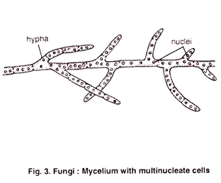
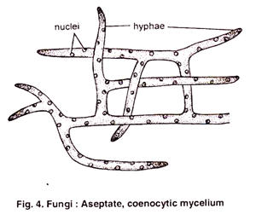

Slide 24
Macroscopic structures
Fungal mycelia can become visible to the naked eye, for example, on various surfaces such as damp walls and on spoiled food, where they are commonly called molds.

Slide 26
Mycelia grown on solid agar media in laboratory petri dishes are usually referred to as colonies. These colonies can show growth shapes and colors that can be used as diagnostic features in the identification of fungi. Fungi color is due to spores or pigmentation.

Slide 27
Mold Nutrition
Fungi secure food through the action of enzymes secreted into the surface on which they are growing;

Slide 28
the enzymes digest the food, which then is absorbed directly through the hyphal walls. Food must be in solution in order to enter the hyphae

Slide 30
Reproduction of molds
1. Asexual reproductive spores:
a.Conidiospores (conidia): Spores borne externally on an aerial hypha called a conidiophore.

Slide 31
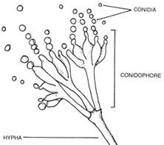

Slide 32
b. Sporangiospore:
Spores borne in a sac on an aerial hypha called a sporangiophore.
c. Arthrospore: spores produced by fragmentation of a vegetative hypha.

Slide 33
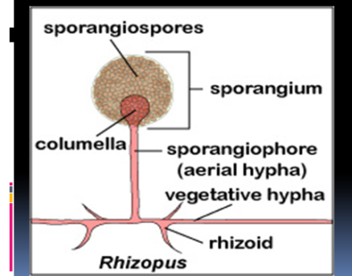

Slide 34
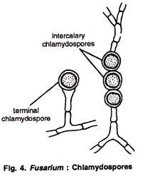
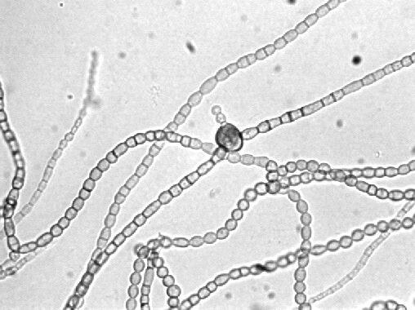
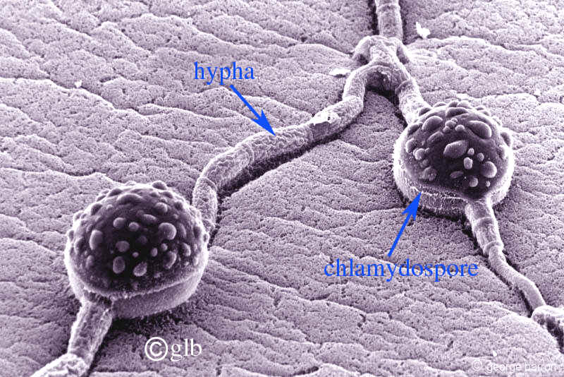
d. Chlamydospore
Is the thick-walled big resting spore
which survives in unfavourable conditions, such as dry or hot seasons

Slide 35
